Slide 1

Mobile Motosnap
Features and Functionality

Slide 2
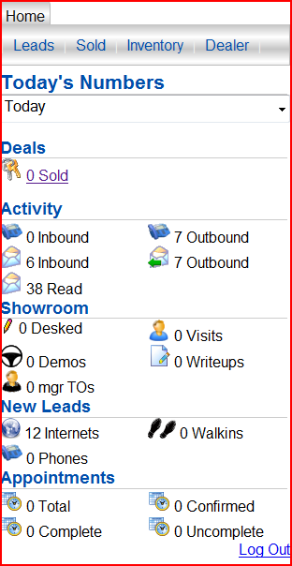
m.motosnap.com/Pages/CRM/Dashboard
Once you have entered m.motosnap.com you’ll see your home page.
This page allows you to see a daily dashboard as well as Tabs that you see above
Your dashboard will allow you to view Activity, Showroom, New Leads, and Appointments.

Slide 3
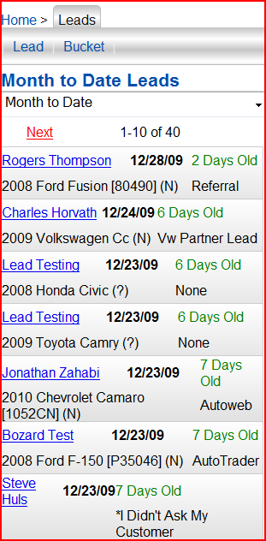
Leads
Click on the Leads tab
This allows you to view all leads up to 60 days prior.
You can click the drop down and choose Today, Yesterday, Last 7 days, MTD, and LM

Slide 4
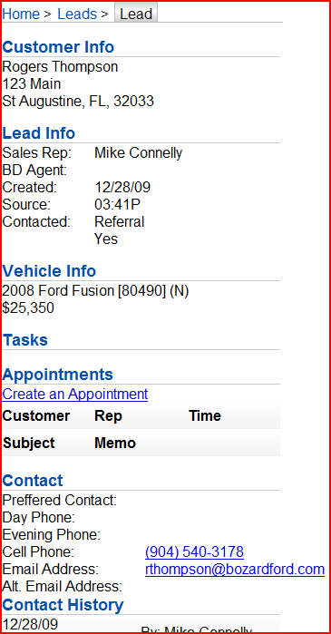
Lead Details
Click into any lead and you’ll be able to view all pertinent information about that lead.
Anything from Source, Phone and Email information, Vehicle Information, to Contact History.
From here you can email the customer and make a phone call.
You can also Create Appointments and view Tasks.

Slide 5
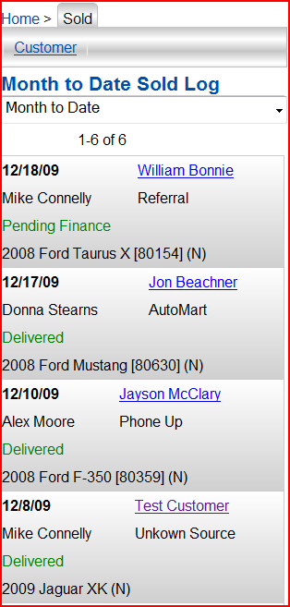
Sold
In this tab, you will be able to view all Sold customers in the same manner that you could view leads. Today, Yesterday, Last 7 days, MTD, and LM
This will show Date sold, Sold Status, Lead source and Vehicle Information.
You will also be able to click into the customer and view the same information that is available to you in the Lead view

Slide 6
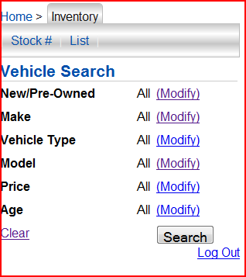
Inventory
In this tab, you will be able to search for any vehicle in the Inventory module of Motosnap.
You can refine your search based on Make, Type, Model, Price, Year, and whether it’s New, Pre-Owned, or Certified.

Slide 7
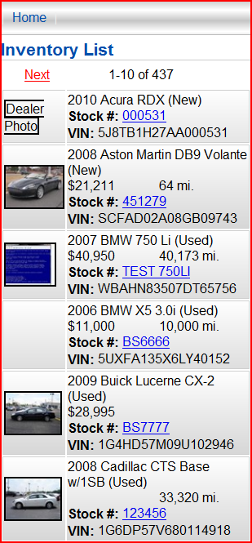
Inventory List
Once you’ve detailed your search, you will be able to view a list of vehicles that matched your search criteria.
From this list you will have access to Photos, Stock Numbers, VIN’s, and Mileage.
You can click into the vehicle stock number to obtain more information if needed.

Slide 8
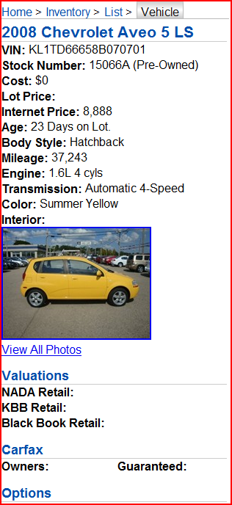
Vehicle Details
After you click on the stock number of a vehicle you will have access to all the detailed information on that vehicle.
You’ll be able to view VIN, Stock #, Cost, Internet Price, Age, Mileage, Photos, Valuations, and Options that are on that vehicle.

