Slide 1


Creating Résumé/CVs in R
library(dplyr)
rladies_global %>%
filter(city == ‘Vancouver')

Slide 2
Installation
If you haven’t already, please run the following code:
install.packages('vitae')
install.packages('tinytex’)
install.packages(‘tidyverse’) OR install.packages(‘tibble’)
Check that tinytex is properly installed:
tinytex:::is_tinytex()
Make sure it returns TRUE, if it returns FALSE please restart R, if still FALSE, run:
tinytex::install_tinytex(force=T)

Slide 3
A.
Why use R to create your Resume/CV?

Slide 4
1.
Easily Updateable
Everything is autoformatted
Vitae can be used to automatically pull from websites and databases
Very straightforward to add new information in
By using git you can track changes you’ve made easily
Hosting on Github allows you to update, download, and edit your code from virtually anywhere

Slide 5
2.
Versatile & Dynamic
All templates are freely available and it is easy to reformat your Resume/CV completely at any time.
Export to html document, pdf, etc.
htmltools and Rmarkdown integration allows for advanced customization
Can easily have inline graphs and visualizations through code chunks

Slide 6
3.
Demonstrate Competency
R is an open source coding language.
Having your scripts easily accessible helps employers determine where your skill level is at
Publicly available repository sites are great for this (e.g. Github)
Coincidentally, hosting your Resume/CV on the same account centralizes your work

Slide 7
B.
Getting Started
New -> R Markdown -> Templates -> Choose vitae template of choice

Slide 8
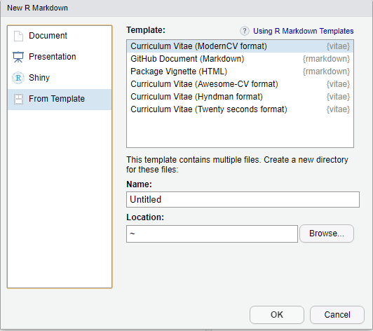

Slide 9
YAML Header
Used in this package to store common information such as name,
contact info, etc. YAML headers in R Markdown kind of act like
configuration files, and in this cased used to define our CV template
and basic information.

Slide 10
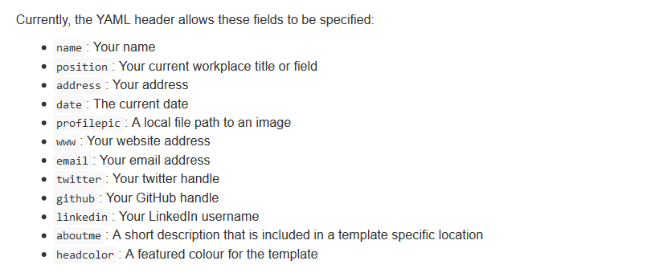

Slide 11
Templates

Slide 12
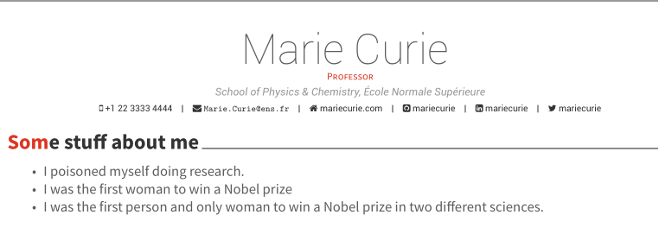
*AwesomeCV

Slide 13
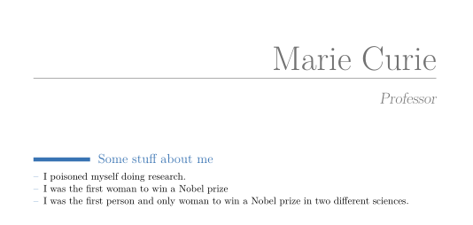
*ModernCV

Slide 14
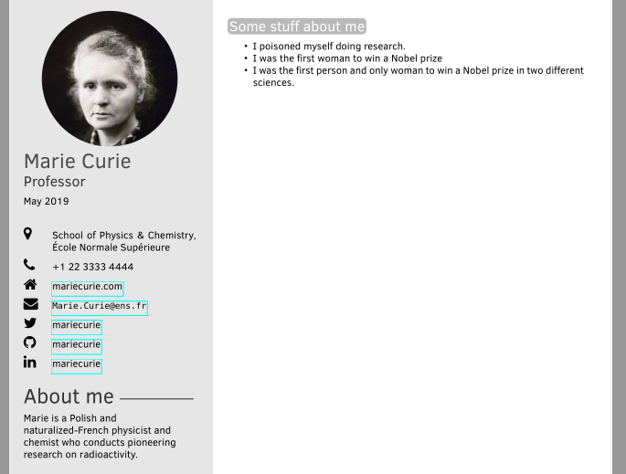
*TwentySeconds

Slide 15
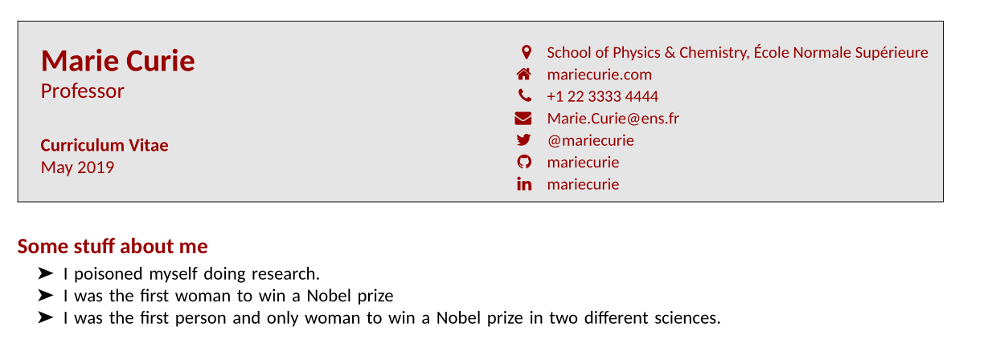
*Hyndman

Slide 16
R Markdown Cheat Sheets
https://www.rstudio.com/wp-content/uploads/2015/02/rmarkdown-cheatsheet.pdf
https://rmarkdown.rstudio.com/lesson-15.html
(see additional files)

Slide 17
Adding entries
*Standard R Markdown functions can be used to format entries in Vitae, though it comes with two functions for data structured output:
> detailed_entries()
> brief_entries()

Slide 18
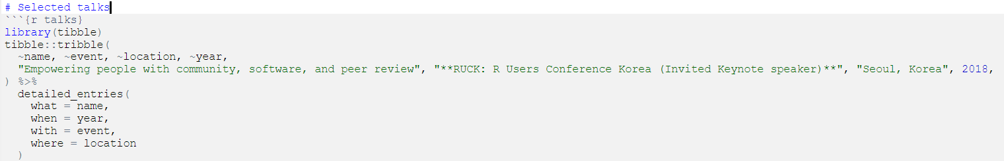
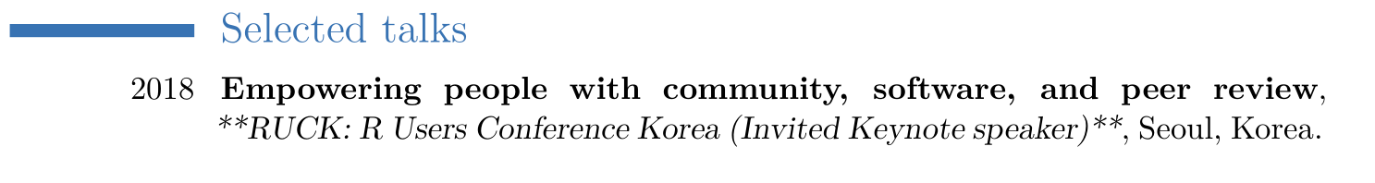
Manual Entries

Slide 19
Tibbles and Tribbles
Tibbles are type of data structuring in R used for its more refined
printing and subsetting, making datasets easier to read and understand

Slide 20
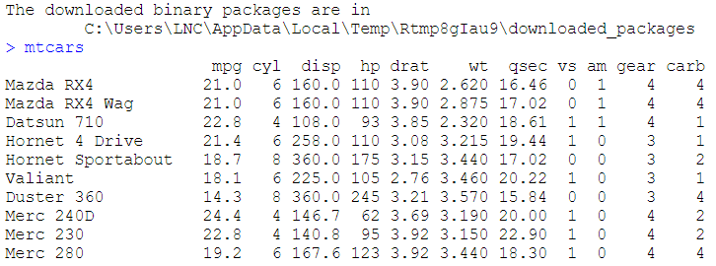
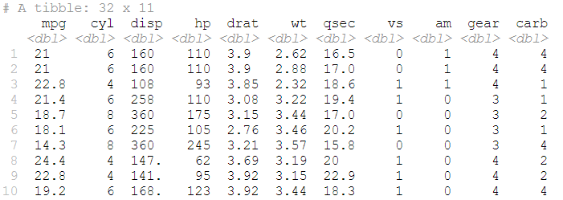

Slide 21


Tibbles -> Tribbles
Tibbles can be defined by row using the tribble() function, allowing us to manually build data structures that can be automatically typeset using vitae
Input:
Output:

Slide 22
Using tribble() to add in entries
# Education
```{r}
tribble(
~ degree, ~ uni, ~ loc, ~ dates, ~ details,
"MY DEGREE", "UNIVERSITY", "CITY, COUNTRY", "YEARS", "DETAILS",
"SECOND DEGREE", "SECOND UNIVERSITY", "CITY, COUNTRY", "YEARS", "DETAILS"
) %>%
detailed_entries(degree, dates, uni, loc, details)
```

Slide 23
# Awards & Achievements
## Awards
```{r}
tribble(
~ award, ~ from, ~ year,
"AWARD NAME", "AWARDED BY", "YEAR",
"SECOND AWARD NAME", "AWARDED BY", "YEAR"
) %>%
brief_entries(award, year, from)
```

Slide 24
Importing data
ORCID, Google Scholar, Other Dataset

Slide 25
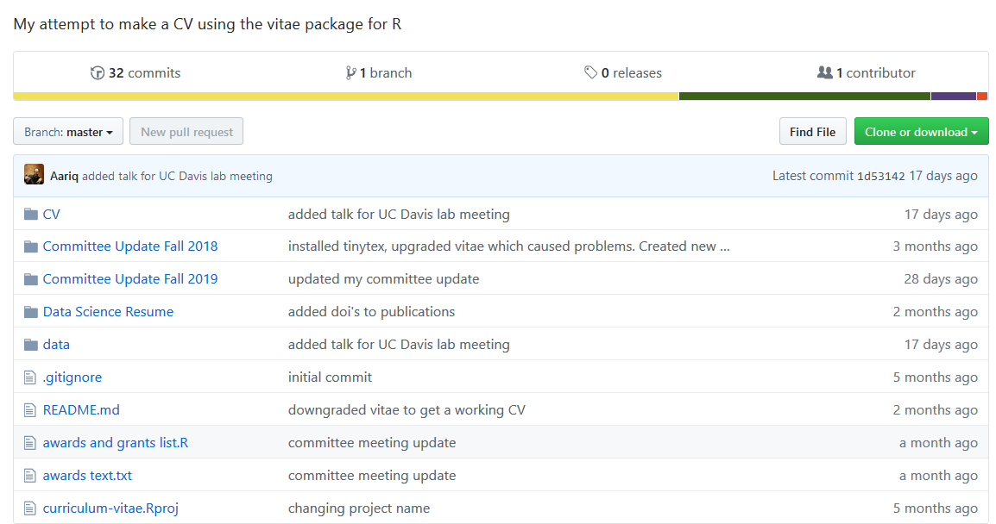
https://github.com/Aariq/curriculum-vitae

Slide 26
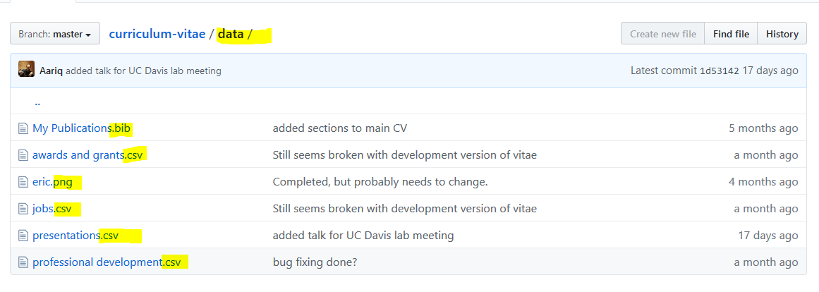

Slide 27
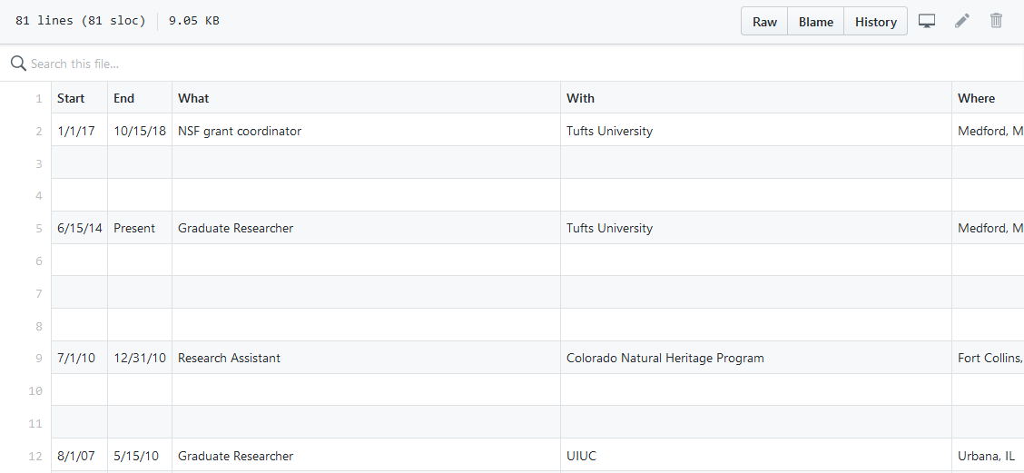

Slide 28
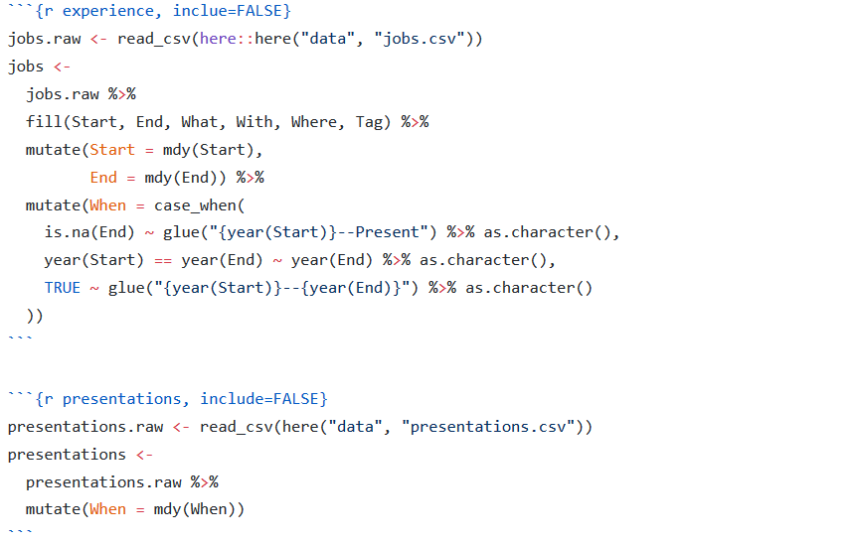

Slide 29
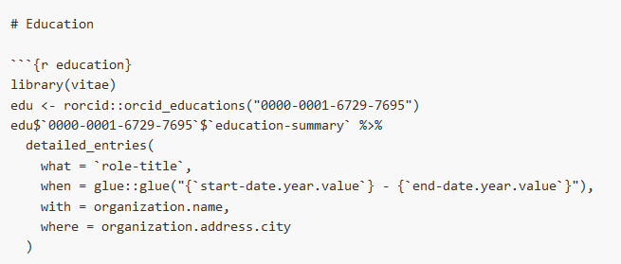
*using detailed_entries() function with rorcid package

Slide 30
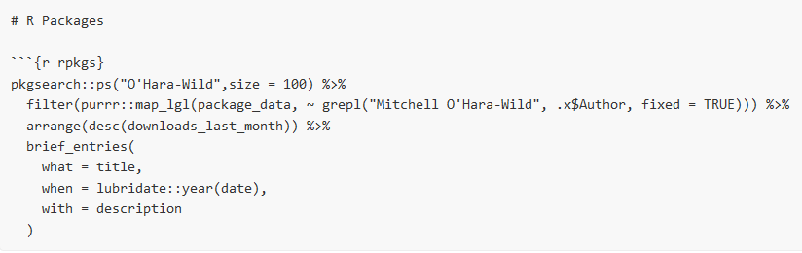
*example of brief_entries() use with pkgsearch package

Slide 31

Bibliographies
*import .bib files directly using bibliography_entries()

Slide 32
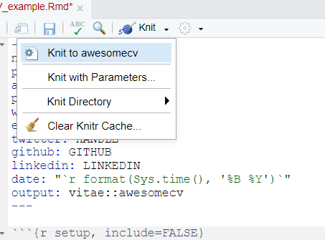
C.
Export
Knit -> Knit to ..

Slide 33
Links
RESOURCES:
https://cran.r-project.org/web/packages/vitae/index.html
https://github.com/ropenscilabs/vitae
TUTORIALS:
https://mitchelloharawild.com/vitae/
https://ropenscilabs.github.io/vitae/
https://ropensci.org/blog/2019/01/10/vitae/
https://ropenscilabs.github.io/vitae/articles/vitae.html
ADVANCED:
https://ropenscilabs.github.io/vitae/articles/extending.html

Slide 34
Community Talk

Slide 35
What makes R so special?

Slide 36
[ Drawn out monologue ]

Slide 37
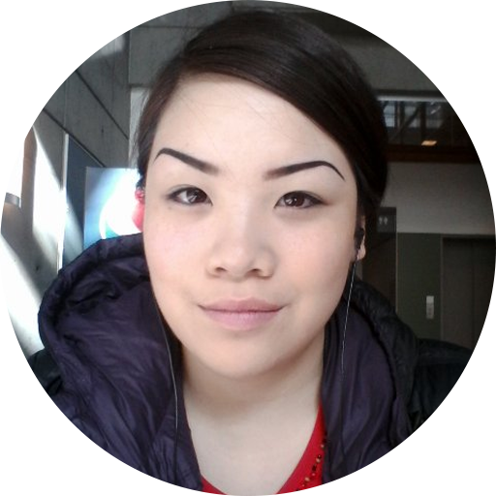
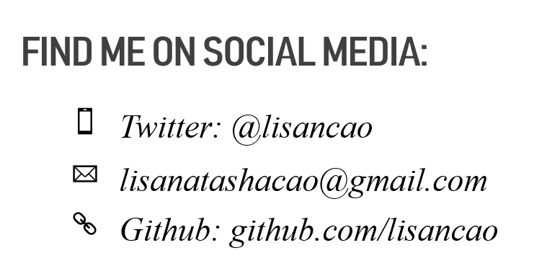
help(LisaCao, package=“Rladies”)
Research Assistant at the Circadian Rhythms and Sleep Neuroscience Lab & Behavioural Neuroendocrinology Lab, SFU Psychology Department.
Workshop facilitator with the SFU Scientific Programming Group & Rladies Co-Organizer.

