Slide 1
NETWORKING IN THE R COMMUNITY
library(dplyr)
rladies_global %>%
filter(city == ‘Vancouver')

Slide 2
1.
Getting involved
The R community is incredibly lively, and there are tons of ways to get involved both online and in person.

Slide 3
Online
Community
TidyTuesdays
Rladies Slack (https://rladies-community-slack.herokuapp.com/)
R4DS
Forums (e.g. Bioconductor, stackoverflow, rstudio forums)
R-Bloggers
*and many more. But most importantly..

Slide 4
#rstats
The R community on Twitter is HUGE
Tons of R users join the community through Twitter and use it to find new and trending packages, job postings, events, friends, and many more!
Singlehandedly one of the best communites
https://perrystephenson.me/project/mapping-r-community/

Slide 5
Local
Community
Rladies Vancouver
Vancouver R Users Group (?? – currently inactive)
Other Meetup Groups (e.g. Learn Data Science, PyLadies, etc)
Academia:
SFU Scientific Programming (Ask me!)
UBC R Study Group (Ask Jasmine!)
Data Carpentry
Field specific: Ecoscope, VanBUG, etc. MANY fall into this category
*Pretty much every major city has a practicing Rladies chapter or R Group

Slide 6
At large
Community
Hackathons
Conferences
Cascadia (Hosted in Seattle next month!)
rstudio::conf
useR!
*Many independent conferences that vary by city and are found literally all over the world, such as satRdays, R Unconference. NoRth, Riot, LatinR, etc.
https://jumpingrivers.github.io/meetingsR/events.html

Slide 7
The R Philosophy
Open source (The Linux Foundation -> R Consortium -> R Groups)
Equity, Diversity, and Inclusivity (R Community Diversity and Inclusion Working Group)
Being a genuinely nice person: ask for help and help where you can
Because of the R/Open source philosophy, you will find many more opportunities and much more accessibility (such as diversity scholarships, sponsorships, etc) than in other fields

Slide 8
General Strategies
Be accessible (both you and your work!)
Follow open sources practices and have an online presence
Contribute as much as you can on Github
- Find packages that interest you and have a small team behind them, and ask if there’s anything you can help out with
Get involved with the community at large: help organize events, stay active online, and attend as many things as you can!

Slide 9
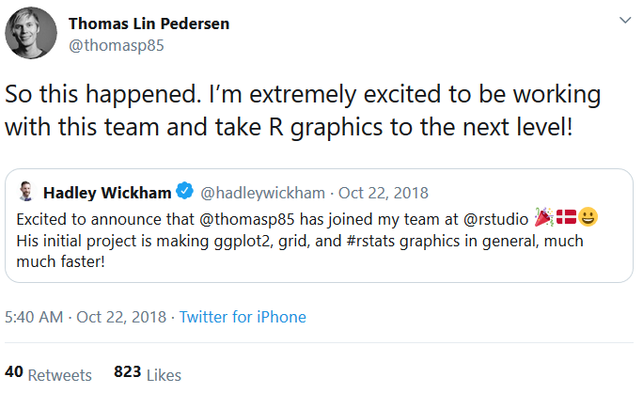
Develop packages

Slide 10

Reach Out

Slide 11
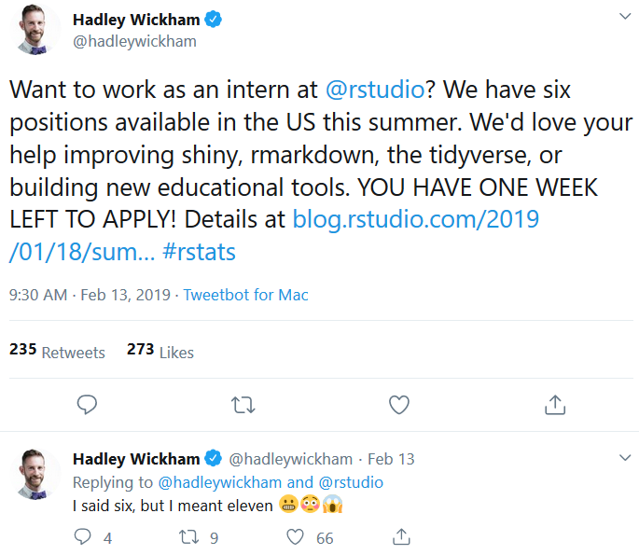
Apply!

Slide 12
DINNER AT 8:15PM
AT LA CASITA
101 West Cordova street

