Slide 1
Data Science and Big Data Analytics
Welcome to the Summer School!
Task 1. Log into your computer (personal or UCL) and find the UCL Moodle course page:
Task 2. Get to know your neighbours

Slide 2
Intro
Me (Lisa)
Bachelor in Law, Master in Computer Science, currently doing a PhD here at UCL in the CS department developing chatbots for computational argumentation and persuasion (basically chatbots that try to persuade you to change your behaviour or opinion on a certain topic). If that’s of interest to you, my publications are on my website: https://lisanka93.github.io/
Joe
has a Master in Data Science and has worked as a Data Analyst, Software Engineer and Quant Developer. His work and research includes data processing, real time big data analytics and stochastic optimisation using machine learning techniques.

Slide 3
You?
Name
Where do you study and what?
What do you want to get out of this course?

Slide 4
What is Data Science?

Slide 5
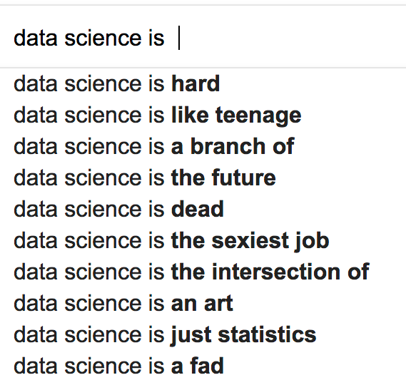

Slide 7
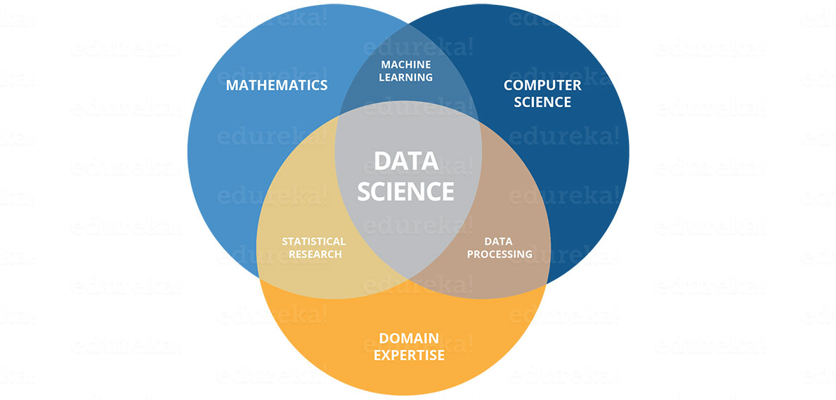

Slide 8
About this course
Provide core foundation in using R to carry out data analysis
Teach foundational statistical and machine learning methods along with approaches to optimisation, validation and performance measurement
Enable you to experience the data science workflow
Teach you how to use resources available on the internet so you can continue to learn independently and apply the skills learned in this course to new tasks (e.g. learn python, go deeper into Machine Learning etc)

Slide 9
Course does not include
Dealing with text data (natural language processing)*
Dealing with actual big data (everything that fits into a csv file and can be processed in a few seconds by your machine is not considered big data in industry)
Neural Networks/Deep learning
*will give theoretical intro if time left at the end

Slide 10
Why use R?
A free, open-source statistical analysis package and programming language.
It is extensible through add on packages with large library of available tools and libraries.
It can interface / be embedded with other computing languages and analysis packages.
Used by a large number of analytics professionals especially in R&D / academic environments.
It has a big community and all questions you will encounter have already been asked and answered online

Slide 11


...It’s free
MATLAB is what scientists use to do special scientist things.
R is what scientists use if they cant afford MATLAB

Slide 12
Textbook
Download this book from Authors website: http://www-bcf.usc.edu/~gareth/ISL/
Videos and slides: http://www.r-bloggers.com/in-depth-introduction-to-machine-learning-in-15-hours-of-expert-videos/

Slide 13
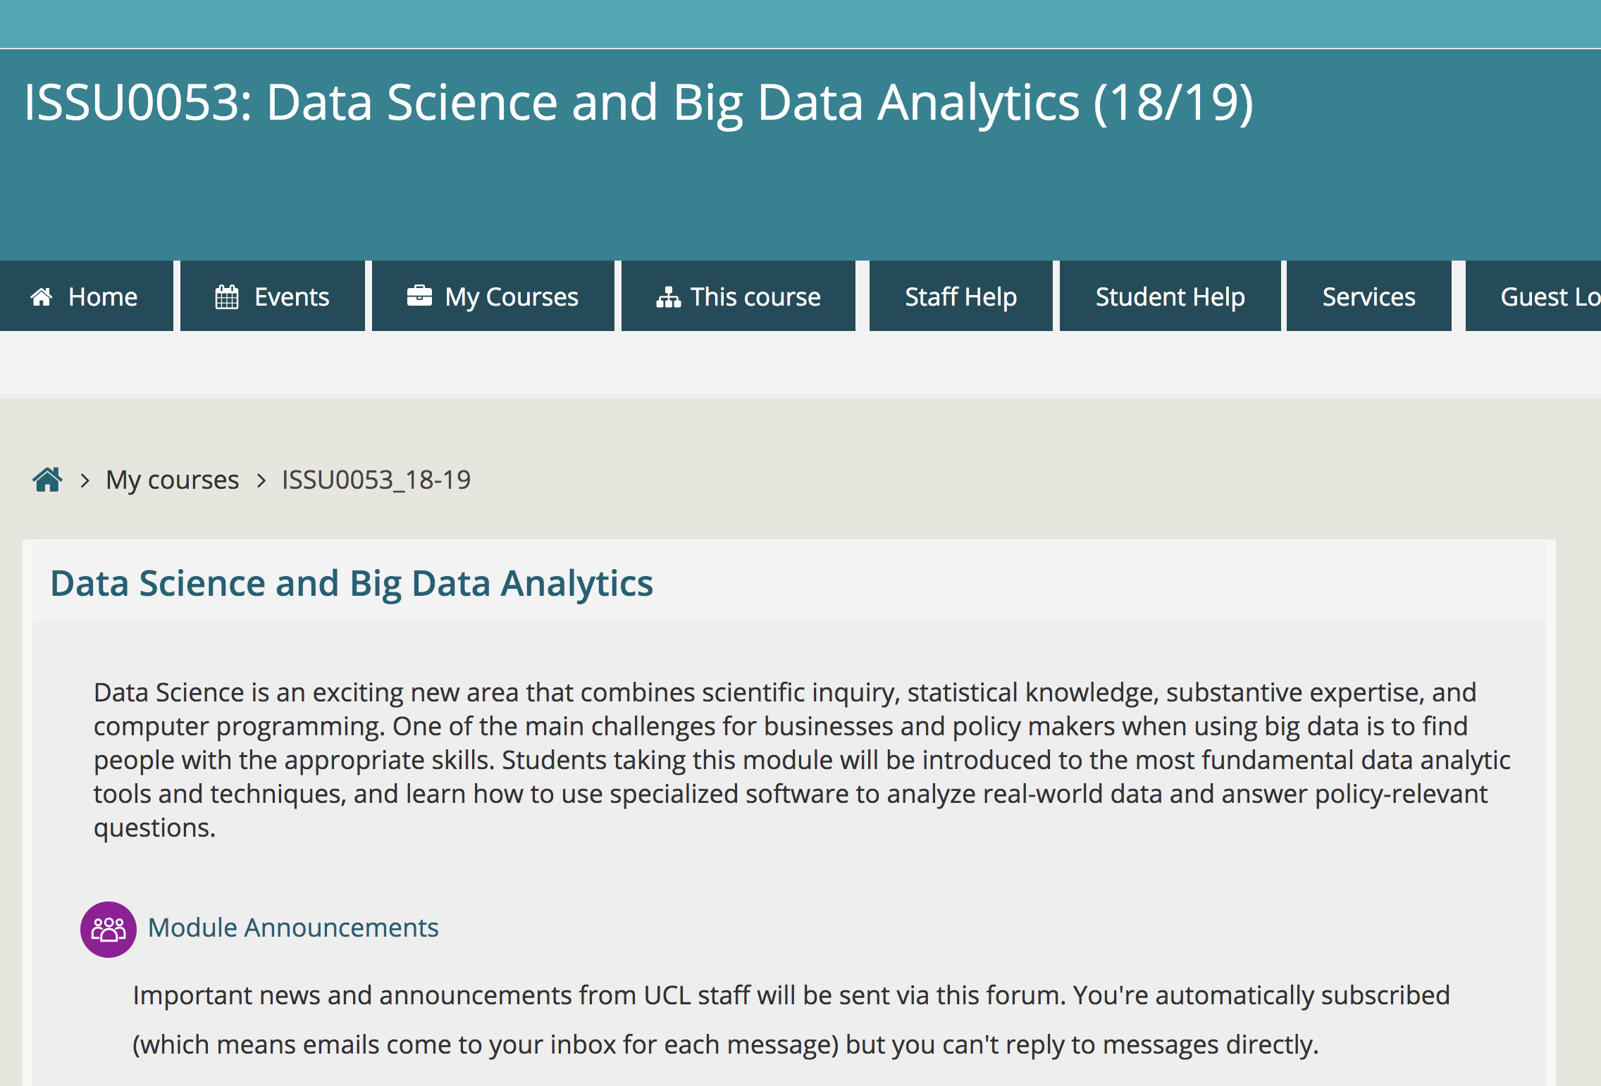
Moodle Course
I will post the dropbox link with the material for each day on the same day
I may add additional resources during/after the sessions, so check regularly

Slide 14
Getting Help
Office Hour 12:30-13:30 Friday in Week I and Week II and after each class in Week III (for report and exam related questions)
Email me at:
chalaguine.l@gmail.com
email specifically set up for this course. However, I will only reply to questions that cannot be googled

Slide 15
Syllabus
Week I:
  Intro to R and programming concepts
  Exploratory data analysis/statistical testing
Week II
  Linear Regression
  Multivariate Regression
  Logistic Regression, LDA, QDA
  K-Nearest Neighbours
Week III (not assessed in exam)
  Decision Trees, maybe SVM

Slide 16
Individual Project

Slide 17
Assessment
50% Project
(a short data analysis report demonstrating the skills you have developed. Submission deadline 1pm Wednesday 7th August.)
50% Final Examination
(Held on July 10am to 12:30pm Friday 9th August)

Slide 18
Has anyone ever used Python/Matlab/STATA/SPSS/Excel
(properly)?

Slide 19
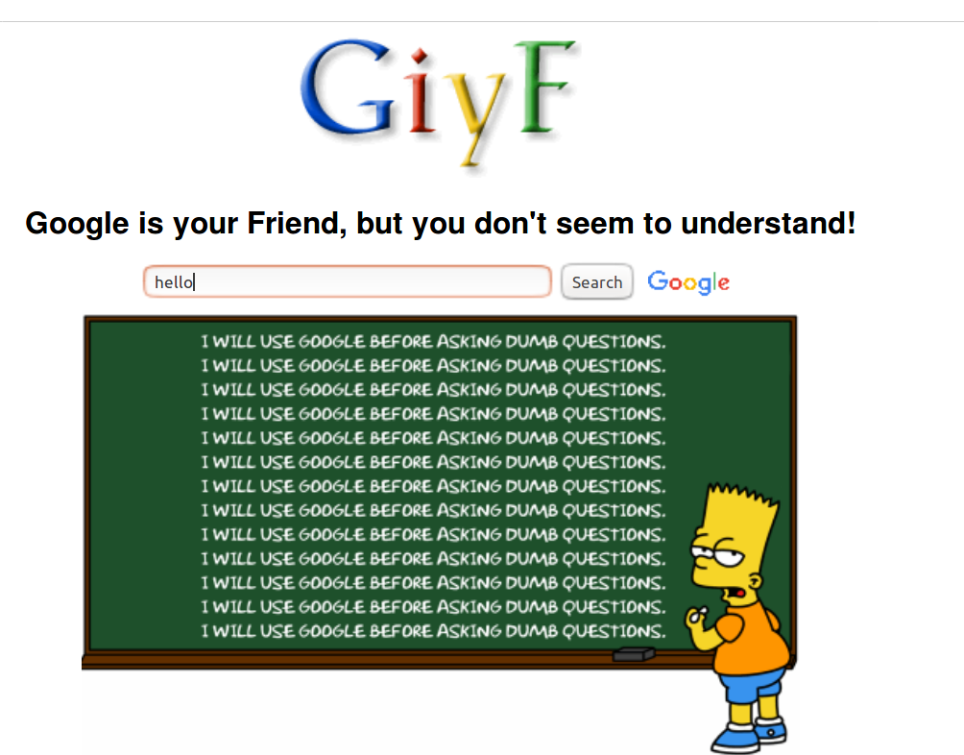
Google is your best friend
“Never memorize something that you can look up.” - Albert Einstein

Slide 20
Google is banned in China is not an excuse. Same goes for baidu or any other search engine

Slide 21
“Do experienced programmers use Google frequently?”
The resounding answer is YES, experienced (and good) programmers use Google… a lot. In fact, one might argue they use it more than the beginners. Using Google doesn’t make them bad programmers or imply that they cannot code without Google. In fact, truth is quite the opposite: Google is an essential part of their software development toolkit and they know when and how to use it.
A big reason to use Google is that it is hard to remember all those minor details and nuances especially when you are programming in multiple languages and using dozens of frameworks.
(source: https://codeahoy.com/2016/04/30/do-experienced-programmers-use-google-frequently/)

Slide 22
Don’t freak when you get an error.
READ the message
In 30% of the cases you made a typo or forgot a comma somewhere. The error message will indicate where
In 30% of the cases you used a wrong data structure. The error message will indicate what went wrong
→ If you don’t understand the error message – google it. Most likely it’s one of the 2 points above
In 30% of the cases you made some logical error previously in the code. This doesn’t necessarily result in an error message but you see that something went wrong. You need to “debug” your code (next slide)

Slide 23
Debugging
Only use code you KNOW EXACTLY what it is doing.
Ask yourself the following questions:
  What are you expecting your code to do
  What is happening instead?
  Did you make a change to your code and assume it is unrelated to the problem that you're seeing?
  Did you expect an object or variable to contain a certain value (or a certain type of value) that's different from what really happened?
Go through your code – explain it to yourself or your neighbour. When talking through your code you will find the mistake in 90% of the time
Google the error message and see what people write on stackoverflow (your second best friend after google – it’s not banned in China)

Slide 24
Asking questions correctly
Googling is a skill by itself and we will adress this in this course (learning how to phrase your question correctly so you get the answer you want)
Asking us also needs to be done correctly
Example: “this gives me an error – why?”
results <- data.frame(summary(resamples(model_set))$statistics$Accuracy)
We don’t know! You need to tell us what you did before
It’s comparable to reading a book yourself and then showing us one line in the book and asking why (even worse if variable names are meaningless)

Slide 25
Before you ask us why your code doesn’t work
Read the error message (if there is one)
Google (the error message or problem)
Ask your neighbour (if you are working on labexercises)
Go through your code and explain every line to yourself or your neighbour
If you still didn’t fix it – ask us

Slide 26
If you don’t understand something
Everyone has a different learning style. There are many tutorials and resources online to fit every need – USE THEM
I will post useful resources and examples on each topic but please feel free to find your own and go through them at your own pace

Slide 27
If you get too overwhelmed
This course if quite face paced and can be challenging at times. Everyone who has never written code before is a bit intimidated at the beginning. THAT’S OK. Tell us!
I will ask you to complete a few “surprise” tests in class which are not graded and anonymous. This will give us an idea what you are struggling with and can go over it again

Slide 28
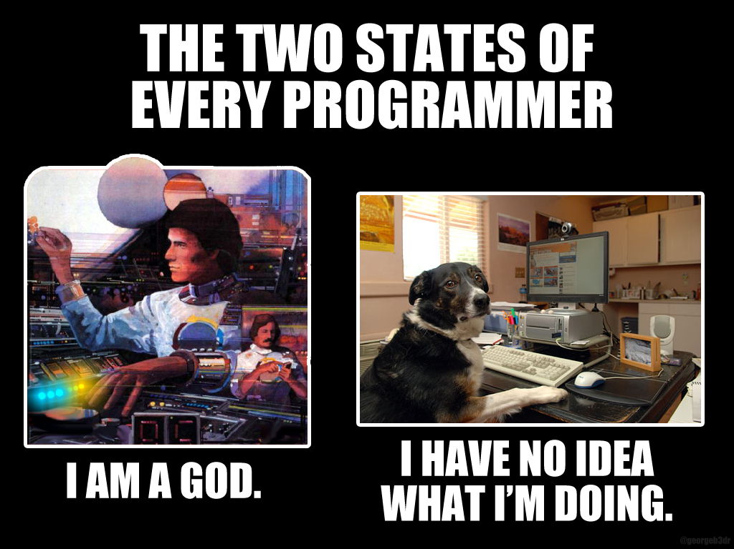

Slide 29
Last tips
COMMENT your code – so that you understand what you have been doing
SAVE your work every couple of minutes. Just get into the habit of hitting control+s after every few lines of code
For the exam: get a keyboard you are comfortable with

Slide 30
Questions?
Course
Data Science
R/Coding
UCL
London
Anything

Slide 31
Tasks for the rest of the day
Go to the dropboxfolder
Go through the “Starting our in R” and “Working with Data in R” tutorials
Do the Exercises in the .docx document
What you don’t finish in class is homework
There is a presentation in the extra_resources folder. I am not a big fan. I recommend you find an R tutorial of your preference online for extra practice

