Slide 1

Banking Risk Analytics Dashboard
Power BI-powered risk analytics for smarter lending decisions in banking & financial services

Slide 2

The Problem
Risk Gap
Need to understand risk analytics in banking & financial services
Data-Driven Lending
Use data to minimize money loss when lending to customers

Slide 3
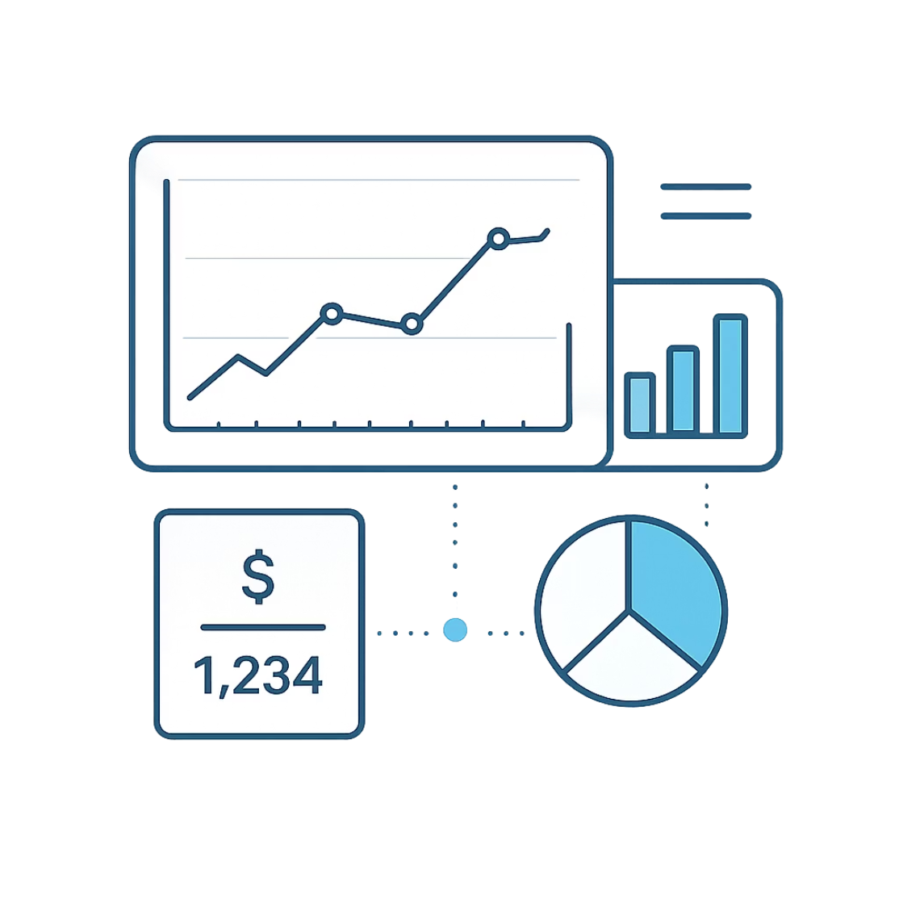

The Solution
Power BI Dashboard
Built with latest Power BI tools to evaluate applicant profiles and support loan approval decisions
Assess likelihood of loan repayment
Approve or decline based on data

Slide 4
Dataset Overview
Interlinked tables connected via primary & foreign keys
Banking Relationship
Client-Banking
Gender
Investment Advisor
Period

Slide 5
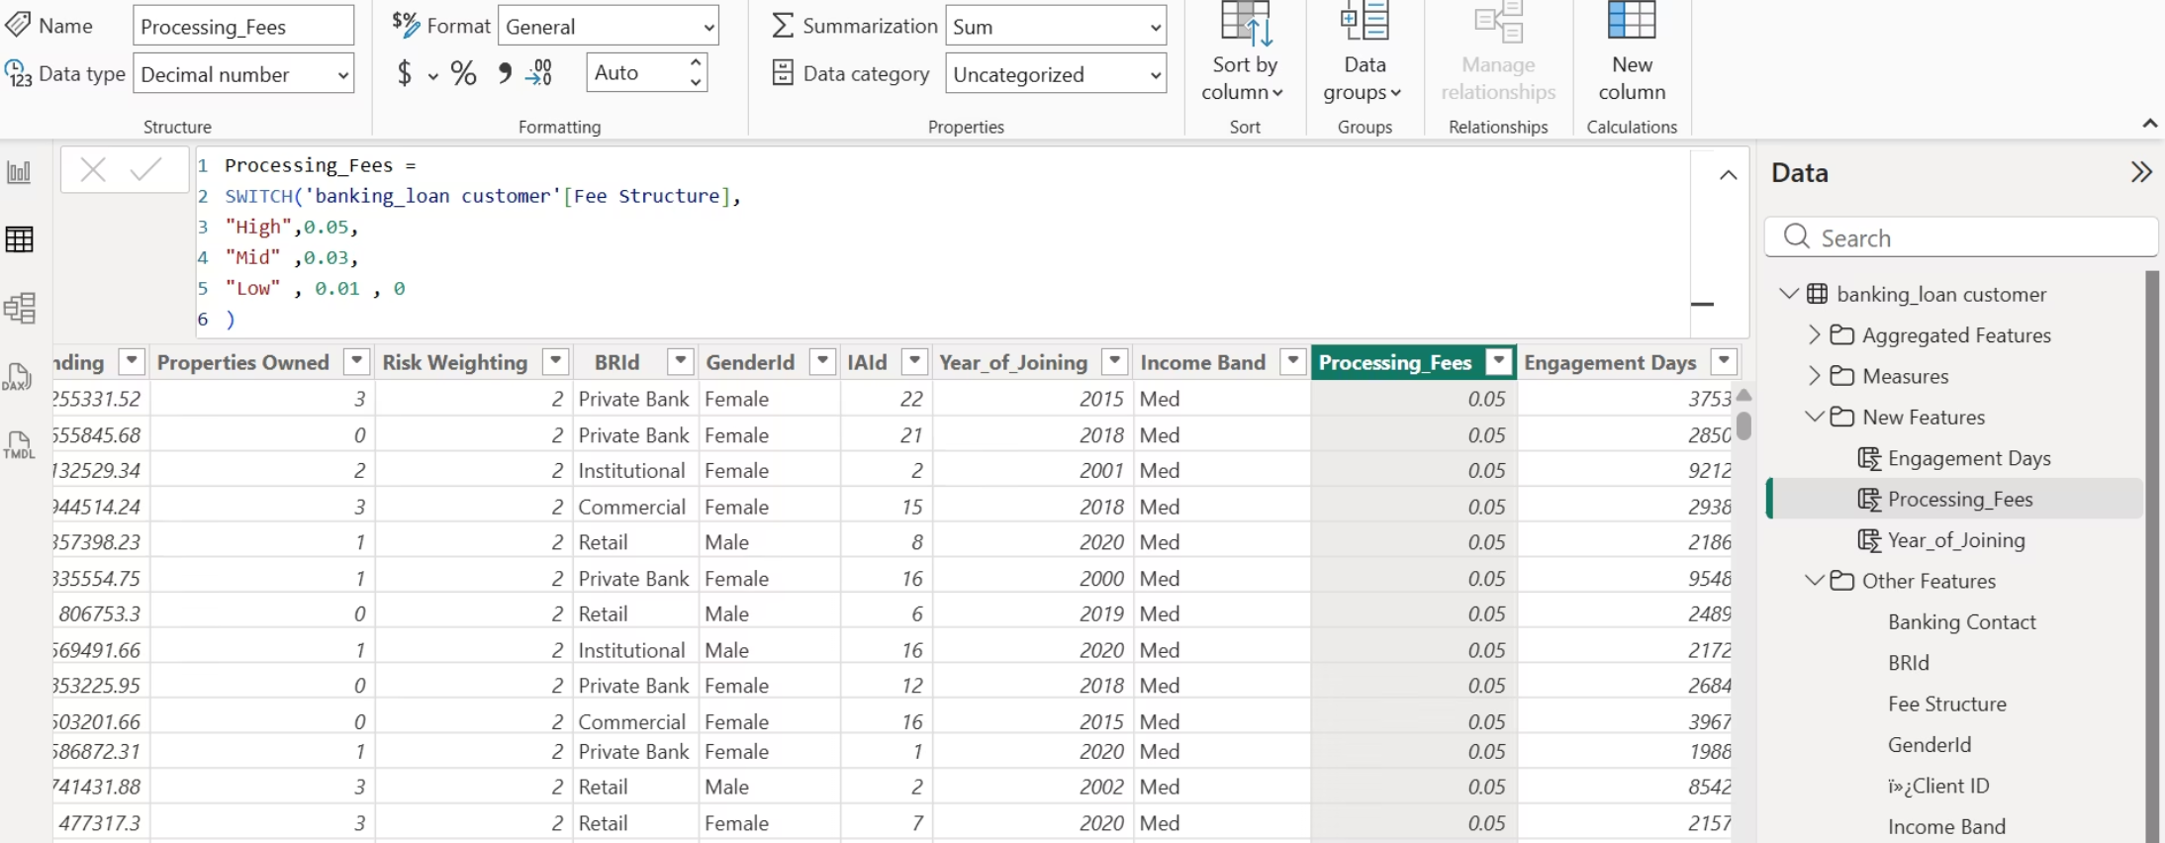
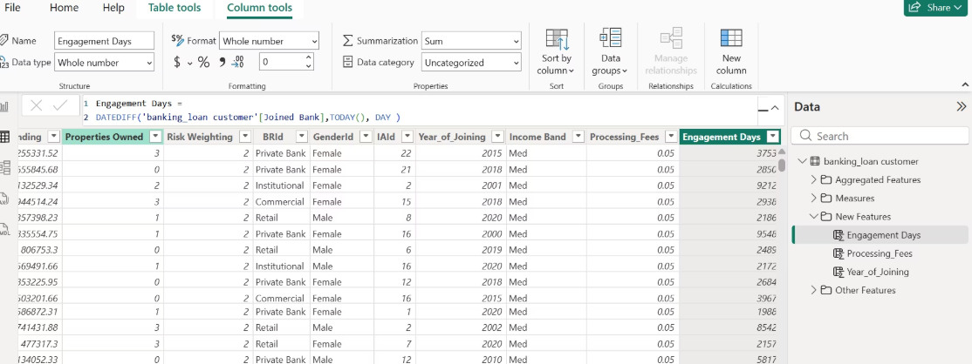
Data Cleaning
Processing Fees
Engagement Days
Derived from Fee Structure — e.g., High = 0.05
New column in Banking table — days since client joined

Slide 6
DAX Calculated Functions
SUM
1
Adds all numbers in a column
DISTINCTCOUNT
2
Counts distinct values — e.g., Total Clients
SUMX
3
Sum of expression per row — Total Fees
SWITCH
4
Maps Fee Structure to rates
DATEDIFF
5
Date interval calculation — Engagement Days

Slide 7
Key Performance Indicators
Total Loan
Total Deposit
Bank Loans + Business Lending + Credit Card Balance
Deposits + Savings + Checking + Foreign Currency
Total Clients
Total Fees
DISTINCTCOUNT of Client ID
SUMX: Total Loan × Processing Fees
Engagement
Bank Loan
SUM of Engagement Days
SUM of Bank Loans from Clients-Banking

Slide 8
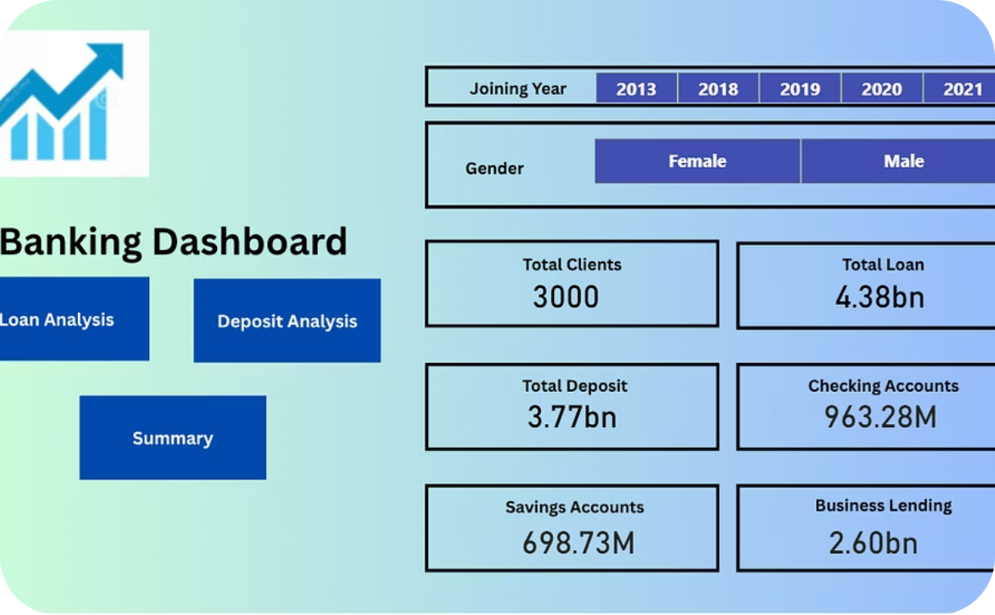
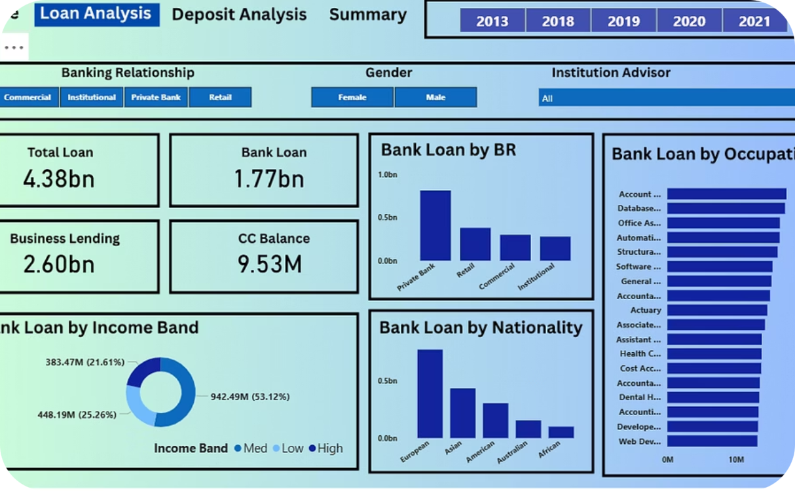
Dashboard — Home & Loan Analysis
Home Page
Loan Analysis Page

Slide 9
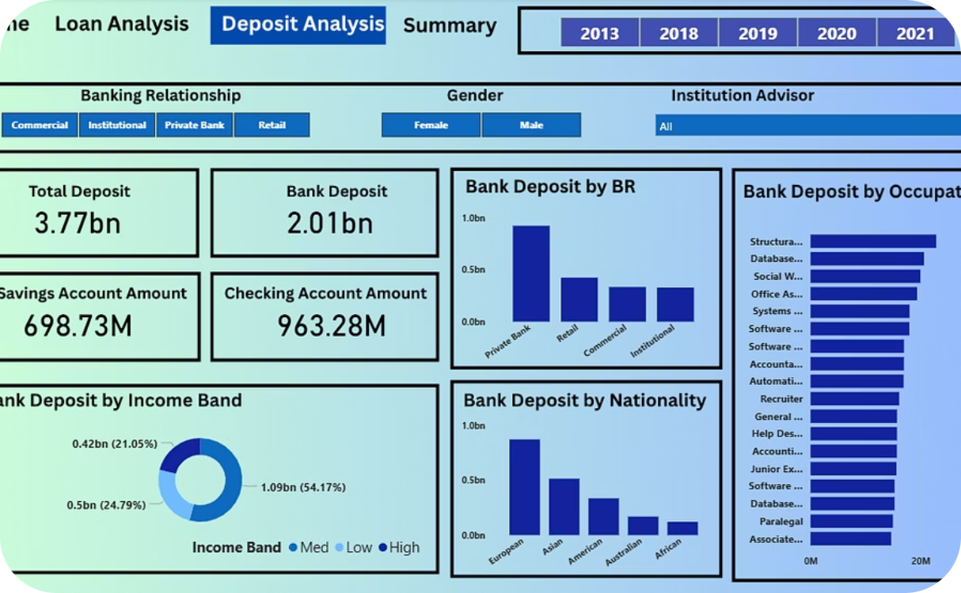
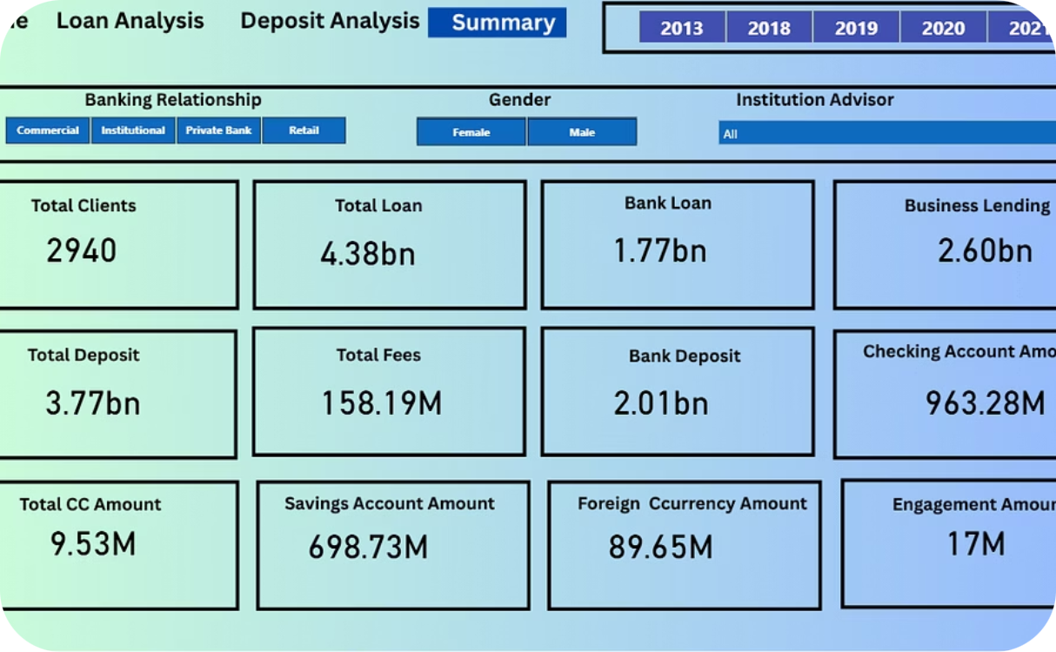
Dashboard — Deposit & Summary
Deposit Analysis Page
Summary Page

Slide 10

Conclusion
Effective Decision-Making
Power BI dashboards enable data-driven loan decisions
Client Insights
Private banks lead in clients — helps others strategize
Nationality & Account Analysis
Reveals loan patterns by nationality and account types

