Slide 1
TB DB Diagram
Lisa Over CMPINF 2110 February 24, 2021

Slide 2
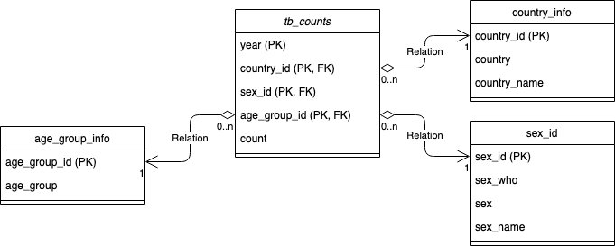
Database Schema

Slide 3
Data Dictionary: tb_values
Variable | Description
year (PK) | Year of case count
country_id (PK, FK) | Primary key and foreign key to country_info table
sex_id (PK, FK) | Primary key and foreign key to sex_info table
age_group_id (PK, FK) | Primary key and foreign key to age_group_info table
count | Tuberculosis case count

Slide 4
Data Dictionary: country_info
Variable | Description
country_id (PK) | Unique identifier; integer
country | International Organization for Standardization (ISO) 3166-1 alpha-2 country codes; character
country_name | Full name of country; character

Slide 5
Data Dictionary: sex_info
Variable | Description
sex_id (PK) | International Organization for Standardization (ISO) sex representation code; unique identifier; integer
sex_who | World Health Organization (WHO) sex representation code; character
sex | Single character representation of sex; character
sex_name | Full name of sex; character

Slide 6
Data Dictionary: age_group_info
Variable | Description
age_group_id (PK) | Unique identifier; integer
age_group | Representation of age group; character

