Slide 1
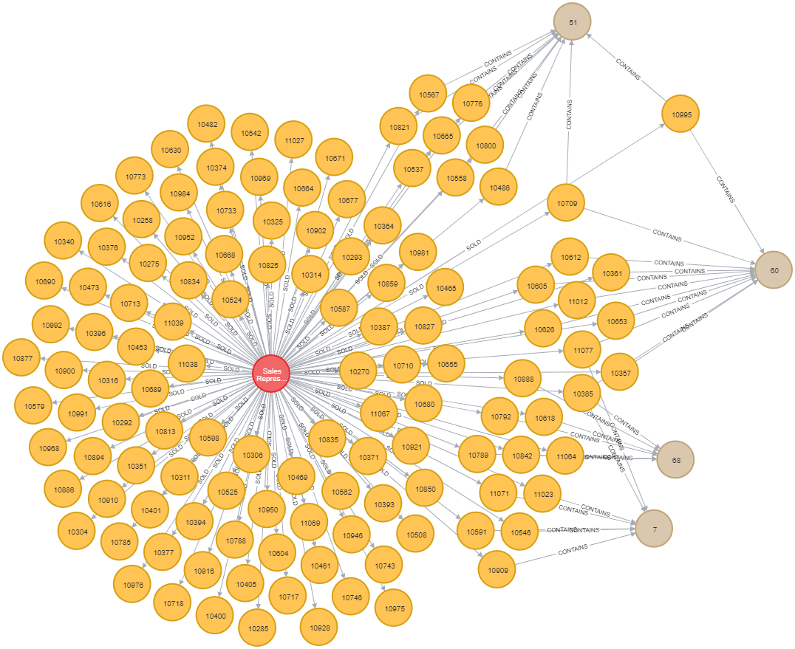
Week 11 – query example

