Slide 1
Arcs and Chords
Properties for Understanding and Use

Slide 2
Prior Knowledge
Definitions
  Minor Arc
  Central angle
  Chord
  Diameter
  Radius
Properties of central angles
  Relationship to the corresponding chords
Constructions
  Circles
  Chords
  Perpendicular lines
Measurements
  Line segments
  Angles
Methods for proving triangles congruent
  SSS
  SAS
  ASA
  AAS
  Hypotenuse Leg

Slide 3
Making Waves
Can you think of an action from your own experience that caused waves to radiate out from a central point?
Where were the effects the strongest?

Slide 4

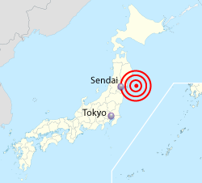
Japan Quake 2011
The epicenter of an earthquake is the point on the earth’s surface that is directly above the point where the earthquake originated.
The epicenter of the 2011 earthquake in Japan is located in the ocean east of the country.
How and why do scientists locate the epicenter of an earthquake?

Slide 5
Construct and Discuss
Use your compass and ruler to create your assigned construction.
Get into a group with students who have the same construction.
Interpret and discuss
  What can you propose about your construction?
  What does the theorem on your colored card tell you about your construction?

Slide 6
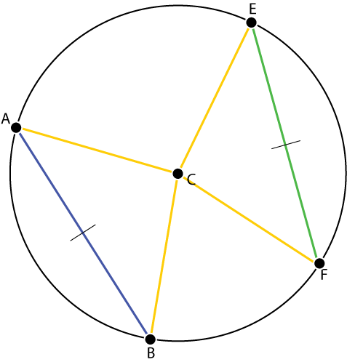
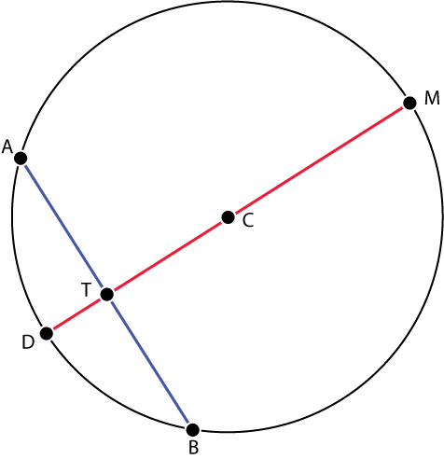

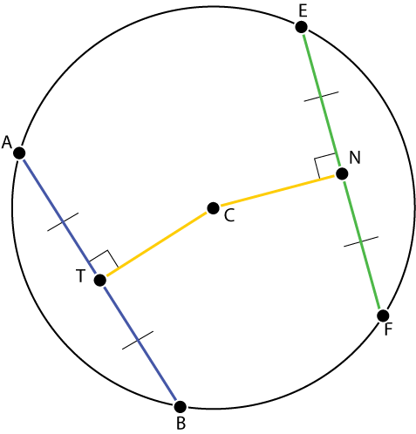
Construct and Discuss
1
2
3
4

Slide 7
Report and Demonstrate
Form groups based on your colored card. There should be four students per group.
Report and demonstrate your construction to the other three students.
Explain the theorem and how your construction is an example of a specific case.

Slide 8
Prove and Support
Theorem 10.5
  In the same circle or in congruent circles, two minor arcs are congruent if and only if their corresponding chords are congruent.
Theorem 10.6
  If diameter DM is perpendicular to the chord AB, then DM bisects the chord AB and arc AB.
Theorem 10.7
  If DM is a perpendicular bisector of chord AB, then DM is a diameter.

Slide 9
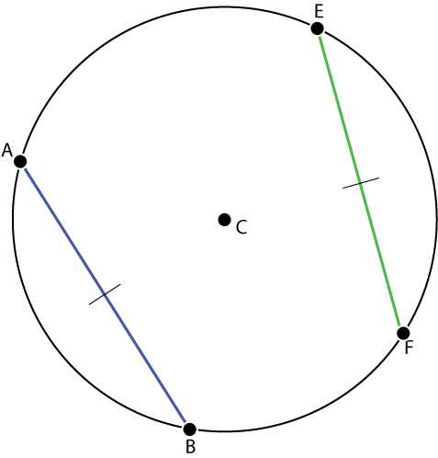
Theorem 10.5
In the same circle or in congruent circles, two minor arcs are congruent if and only if their corresponding chords are congruent.
Statement | Reason

Slide 10

Theorem 10.6
If diameter DM is perpendicular to the chord AB, then DM bisects the chord AB and arc AB.
Statement | Reason

Slide 11
Theorem 10.7
If DM is a perpendicular bisector of chord AB, then DM is a diameter.
Statement | Reason

Slide 12
Analyze, Plan, and Solve: Earthquake
Seismometers determine the distance from the device to the epicenter. But this distance does not tell the direction. The epicenter could be x miles away in any number of directions.
Seismometer Location
Distance to epicenter

Slide 13
Sendai
Seismograph Locations
Intensity wave

Slide 14
Measuring Seismic Waves
Secondary waves
Primary waves

Slide 15
Intersecting Circles
Seismometer
Location
Distance from
Epicenter
Epicenter
Epicenter range
for each location

Slide 16
References
Content idea from Larson, Roland E, Boswell, Laurie, and Stiff, Lee (1998), Geometry: An Integrated Approach, McDougal Littell, Chapter 10, p. 499-504
Japan Map from http://en.wikipedia.org/wiki/2011_T%C5%8Dhoku_earthquake_and_tsunami

