Slide 1
Coordinate Geometry
The Connection Between Algebra and Geometry

Slide 2
Unit Topics
Introduction to Coordinate Geometry
Coordinate Systems

Slide 3
Unit Preview
M
Kick-off Activity
KWL
Notebook Knowledge
  Terms to Know
  Properties of Geometric Figures

Slide 4
Terms to Know
M
Angle
Angles of Arc
Circle
Great Circle
Horizontal
Line
Line Segment
Perpendicular
Plane
Point
Ray
Rectangle
Sphere
Square
Vertical

Slide 5
Introduction to Coordinate Geometry
M
The Coordinate Plane

Slide 6
Seating Chart
M
 | A | B | C | D | Aisle | E | F
1 | Ray | Brian |  |  |  | Christine | Liz
2 |  |  | Shawn | Peg
3 | Nancy | Kristen |  |  |  | Laura | Chuck
4 |  | Prof.
 | A | B | C | D | Aisle | E | F
1 | Ray |  |  |  |  | Christine
2 | Brian |  |  | Peg |  | Liz
3 | Nancy |  |  | Shawn |  |  | Chuck
4 |  | Prof. | Peter | Kristen |  | Laura
What is the location of your seat?
Find Your New Seat

Slide 7
Terms to Know
M
Axes
Coordinate Plane
Coordinates
Graph a Point
Grid
Number Lines
Ordered Pair
Origin
Quadrants
x-axis
x-coordinate
y-axis
y-coordinate

Slide 8

M
Coordinate Plane
Quadrants
Quadrant 2
Quadrant 1
5
A
(4, 5)
________________
4
3
__-____________
2
__-____________
1
Origin
x-axis
-5
-4
-3
-2
-1
1
2
3
4
5
-1
-2
-3
-4
-5
Quadrant 3
Quadrant 4
y-axis
Axes

Slide 9
M
Representing Geometric Figures
Rays
Line Segments
5
Angles
4
3
2
1
x-axis
-5
-4
-3
-2
-1
1
2
3
4
5
-1
-2
-3
Geometric Shapes
(circles, rectangles, squares, …)
-4
-5
y-axis

Slide 10
M
Coordinate Plane
Quadrant 2
Quadrant 1
Graph a Point
(x, y)
5
A
(-3, 4)
4
(-2, -3)
3
B
C
(1, -2)
2
D
(5, 5)
1
E
(0, 0)
x-axis
-5
-4
-3
-2
-1
1
2
3
4
5
F
(-1, 5)
-1
-2
-3
-4
-5
Quadrant 3
Quadrant 4
y-axis

Slide 11
M
Coordinate Plane and Graphing Review
Name the Quadrant
Graph the Point
D
(-4, 2)
5
(-1, -5)
E
4
F
(5, -2)
3
2
A
1
C
-5
-4
-3
-2
-1
1
2
3
4
5
-1
-2
-3
-4
-5
B

Slide 12
Coordinate Systems
M
Life Connection

Slide 13

M
You are stranded in the middle of the ocean. You have a raft but no food or water. The sun is high and hot.
What would make it possible for someone to find you and rescue you?
5 lines

Slide 14
Terms to Know
M
Coordinate System
Equator
Geographic Coordinate System
Latitude
Longitude
Prime Meridian
Rectangular Coordinate System
René Descartes

Slide 15
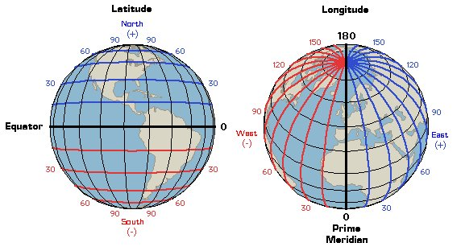
Geographic Coordinate System
M

Slide 16
References
M
Latitude and longitude image from http://berjaenglish.wikispaces.com/Parallels+and+Meridians

