Slide 1


Slide 2
What is Ansible?
It’s a provisioning system
Automates setup tasks on a server
Installing software
Altering configuration files
Executing commands

Slide 3
Scripting language
Descriptive YAML based language
Comes with a standard ‘module library’
You can create
Playbooks
Custom Modules
Tasks
Roles

Slide 4
Playbooks
A collection of Plays
A Play maps a group of hosts to a configuration

Slide 5

Module library
Over 1000 modules shipped with modules
Example, ’apt’ (Debian package manager)

Slide 6
Tasks
A call to an Ansible module
Can be defined inline within a playbook
Can also be part of an include file

Slide 7
Handlers
Handlers can be defined and triggered

Slide 8
Roles
A group of tasks and handlers that describe a ‘role’
Installing and configuring some complex bit of software
Ex: An application server, Database system etc

Slide 9
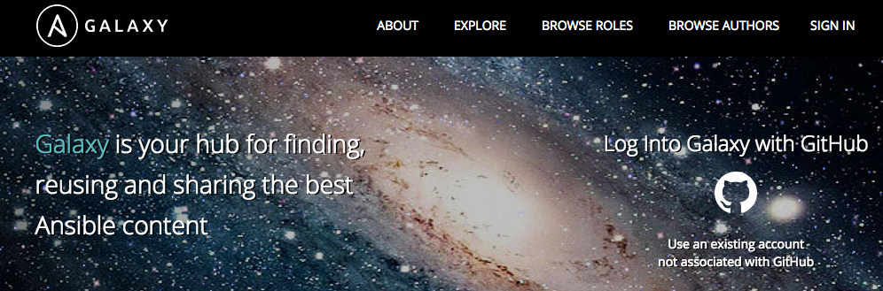
Ansible Galaxy
A large archive of community created Roles for Ansible

Slide 10
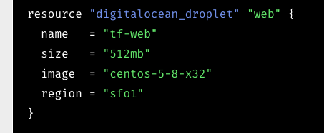
Terraform
Infrastructure management tool

