Slide 1


Slide 2
What is Ansible?
It’s a provisioning* system
Automates setup tasks on a server
Installing software
Altering configuration files
Executing commands
* Red Hat prefer to call Ansbile a “automation engine” and “automation language”

Slide 3
Scripting language
Descriptive YAML based language
Comes with a standard ‘module library’
Basic building blocks:
Playbooks
Modules
Tasks
Roles

Slide 4
Playbooks
A collection of Plays
A Play maps a group of hosts to a configuration

Slide 5
Module library
Over 1000 modules ship with Ansible
Examples: ’apt’, ‘win_unzip’, ‘shell’, ‘jira’, ‘iptables’ etc
- name: Install version ‘1.00’ of package “foo”
apt:
name: foo=1.00
state: present

Slide 6
Tasks
A call to an Ansible module
Can be defined inline within a playbook
Can also be part of an include file

Slide 7
Handlers
Handlers are triggered by ‘notifications’
Example: Restart a service
Only triggered at the end of a task block
Will only run once for multiple notifications in the same task block

Slide 8
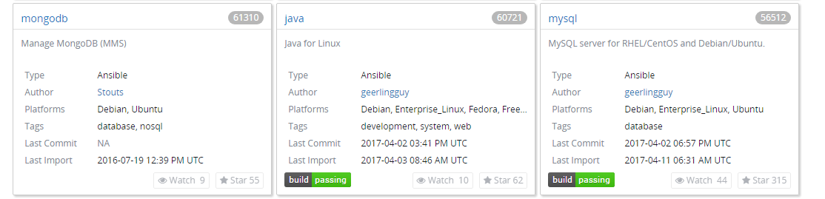
Roles
A group of tasks and handlers that describe a ‘role’
Installing and configuring some complex bit of software
Ex: An application server, Database system etc

Slide 9
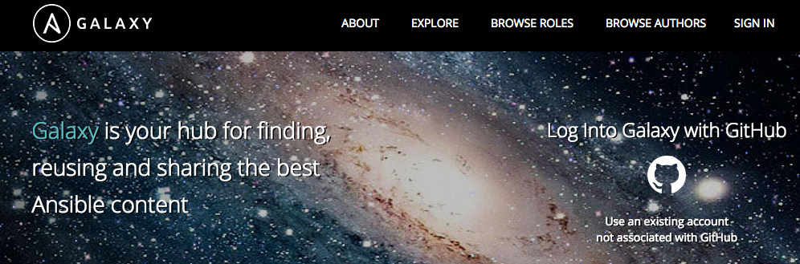
Ansible Galaxy
A large archive of community created Roles for Ansible

Slide 10
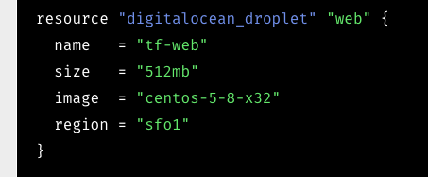
Terraform
Infrastructure management tool
Useful to separate infrastructure management from provisioning

Slide 11
Other topics
ansible-pull – syncs a server with a repository
Ansible tower – enterprise management tool
Symphony use – Hoping to use Ansible with it

