Slide 1
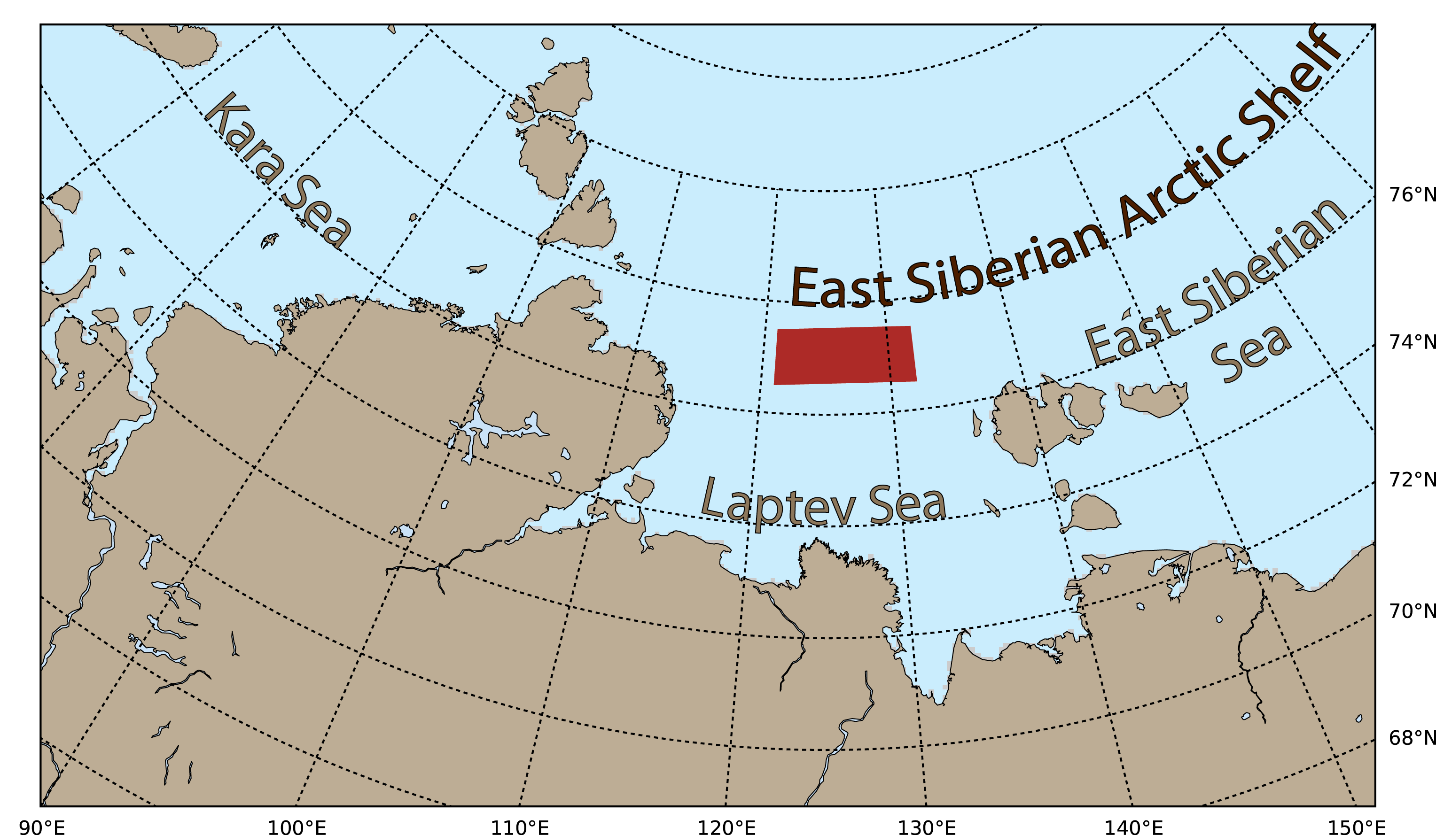
1. Area to model
Outer shelf, where permafrost thawing was suggested to be largely complete based on modelling results [Shakhova]

Slide 2
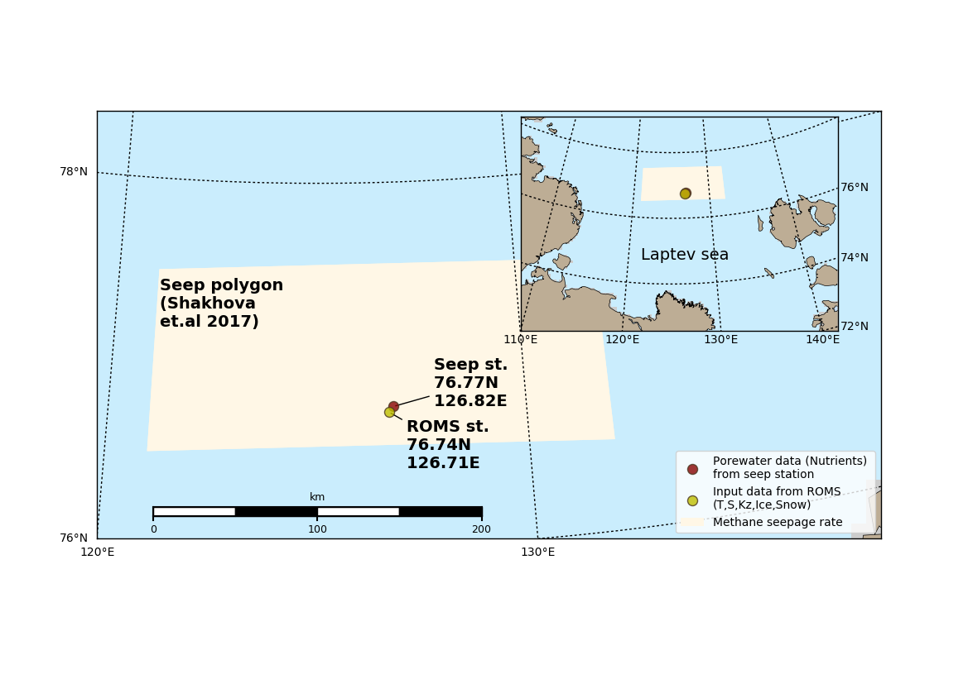
1. Area to model
ROMS node point closest to one of seep locations

Slide 3
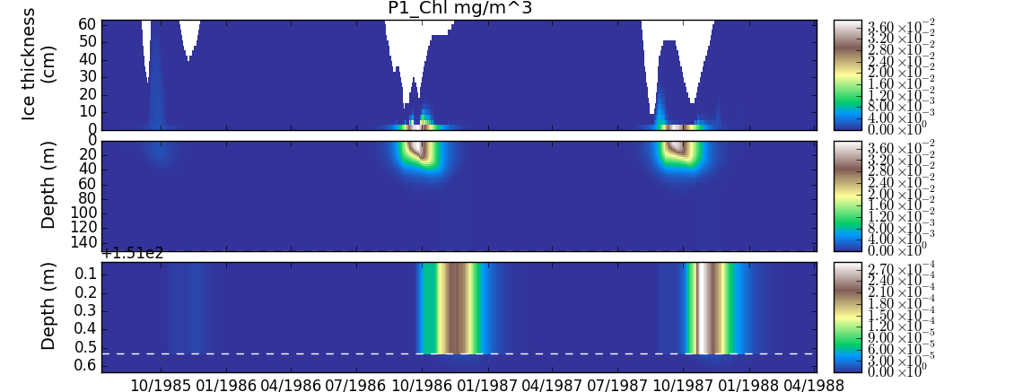
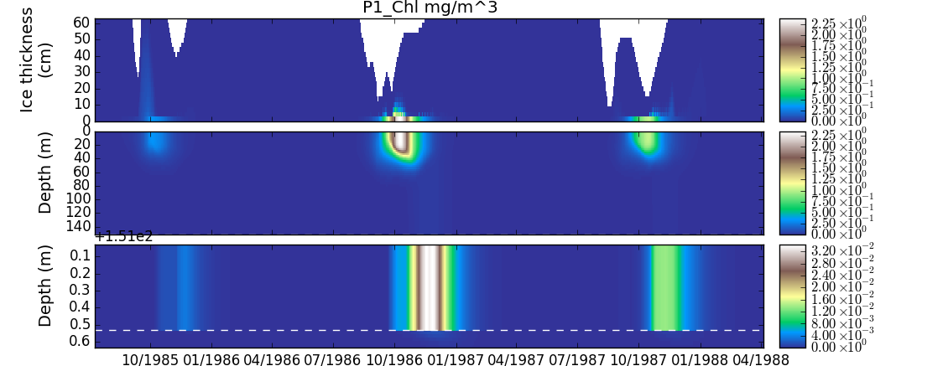
Test runs
ice+
water+
Sediment
IPBM+
ERSEM+
BROM biogeochemistry
1 Ersem test case
2 tuned parameters

Slide 4
P1: long_name: diatoms
model: ersem/primary_producer
parameters:
sum: 1.5 # 1.375 # maximum specific productivity at reference temperature (1/d)
q10: 2.5 # 2.0 #Q_10 temperature coefficient (-)
srs: 0.02 # 0.04 # specific rest respiration at reference temperature (1/d)
pu_ea: 0.1 # 0.2 # excreted fraction of primary production (-)
pu_ra: 0.1 # 0.2 # respired fraction of primary production (-)

Slide 5
Further steps
Tune biogeochemical model for chosen area (obtain boundary conditions)
Run for baseline scenario, validate
Provide numerical experiments with CH4 seepage

