Slide 1
Introduction
Lisa Over

Slide 2
Welcome to Math 125
About me
Handouts: Syllabus, research paper guidelines (discussion Wed with guest Prof)
Syllabus
Section 02, MWF 1:00-1:50
Email is the best way to reach me – lisaaover@gmail.com
Calculators – TI30
Lecture and activities
Homework
Quizzes (computation and conceptual)
Tests (computational, 1 3x5 note card)
Attendance/Participation
Read the syllabus
You are responsible even for what I do not discuss in class
Read the cell phone and academic integrity sections
Blackboard
Post slides, homework, course-related links, TI30 instructions
Introduce Course and Statistics
Course map, definition, goals, data
HW
Survey (due Mon by 4:00 PM)
Article with a graph - something that interests you (photocopy due Wed in class)

Slide 3

Today you will be able to…
Practicing Statistics
Interpret the course map
Explain the goals of statistics
Explain how statistics are used to answer questions and make decisions
Classify data
Define individuals and variables
Classify variables as categorical or quantitative
Course Map

Slide 4
Course Map
Data Gathering
Classify Data
Data Exploration
Picturing Distributions with Graphs
Scatterplots and Correlation
Probability and Distributions
Introducing Probability
Sampling Distributions
Inferences about a Population Mean
Inference
Sampling
Describing Distributions with Numbers
Experiments
Binomial Distributions
General Rules of Probability
Inferences about a Population Proportion
Confidence Intervals
Hypothesis Testing
Goals of Statistics
Regression
Normal Distributions
Practicing Statistics

Slide 5
Goals of Statistics
Statistics is the science of data.
Exploratory Data Analysis
Explore data to reveal patterns and relationships
Conclusions apply only to individuals and situations for which we have data
Statistical Inference
Goal is to answer questions posed before collecting the data
Conclusions apply to larger group of individuals or broader class of situations
Conclusions are informal
Conclusions are formal and supported by statement of confidence
Practicing Statistics
Course Map

Slide 6
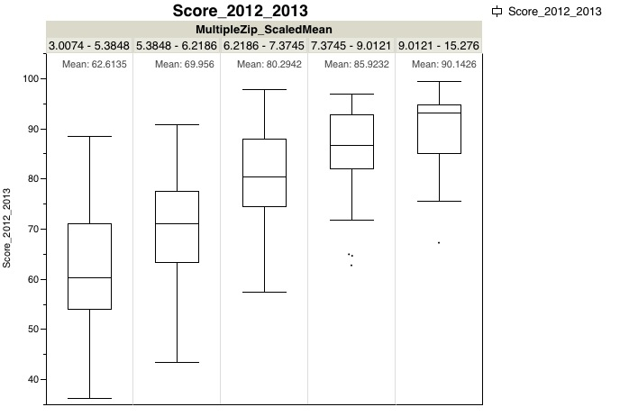
Exploratory Data Analysis
Gather Data
Practicing Statistics
Data
Explore Data
Course Map

Slide 7
Statistical Inference
Practicing Statistics
Gather Data
Ask a question about a population
(large group)
Sample
(small group)
Explore Data
Make Inferences
A probability statement about the population based on the sample.
Course Map

Slide 8
Classify Data
The first step in dealing with data is to organize your thinking about the data:
Chapter 1
Categorical Variable
Places individual into one of several groups or categories.
Individual
An object described by data
Variable
Characteristic of the individual
Quantitative Variable
Takes numerical values for which arithmetic operations make sense.
Course Map

Slide 9
Describe Yourself…
Categorical
Quantitative
Gender
Eye color
Hair color
Major
Class (Freshman, Sophomore, Junior, Senior)
Height
Age
Arm span
Time it takes you to travel to school
Miles to your permanent residence
Course Map

Slide 10
References (Graphics)
Data Gathering
http://www.shiftwave.com/information-gathering.php
Data Analysis
http://www.greenbookblog.org/2014/02/21/iiex-focus-series-technology-market-research-4-of-5-data-analysis-other-stuff/
Probability
http://msc.maths.ed.ac.uk/or/programme/core/ps
Inference
http://www.parenting-our-kids.com/word-puzzles-for-kids.html

