Slide 1

Job satisfaction and salaries among professional coders
Lisa Tegnér

Slide 2
THE DATASET
CONTRIES:
Germany
US
UK
Sweden
Switzerland
RESPONDENTS:
15 000
COLUMNS:
Country
Salary
Job satisfaction
Undergrad major
Education
…

Slide 3
Job satisfaction

Slide 4
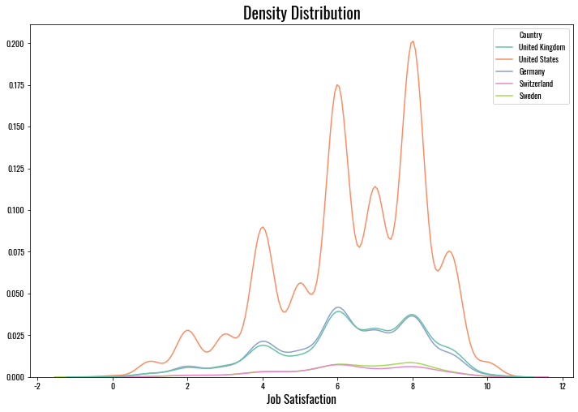

Slide 5
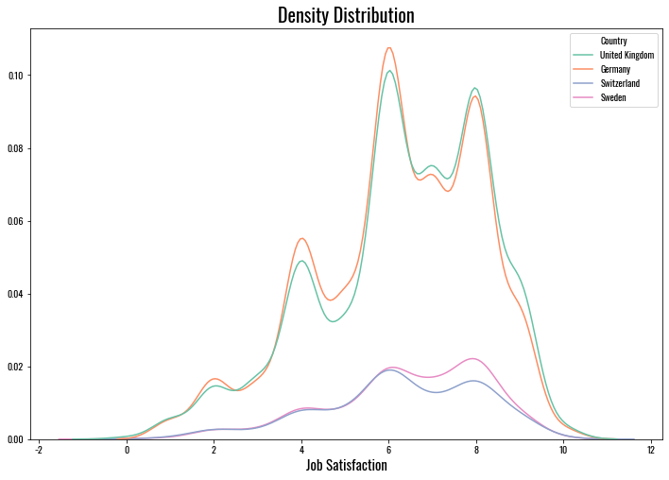

Slide 6
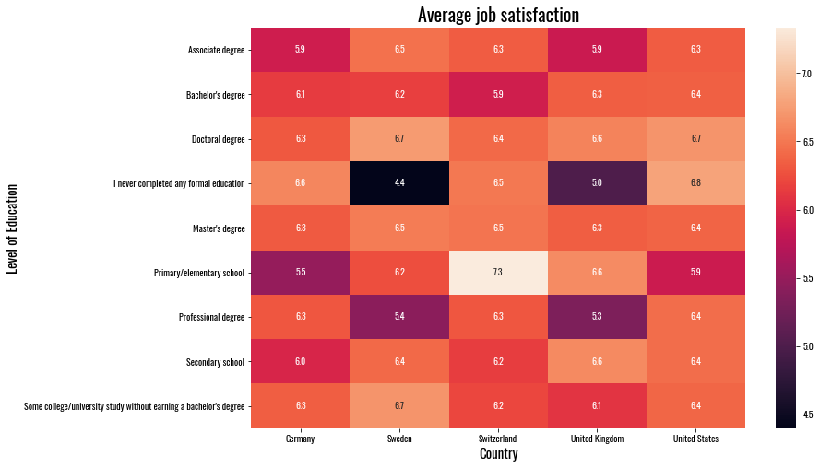

Slide 7
Salary

Slide 8
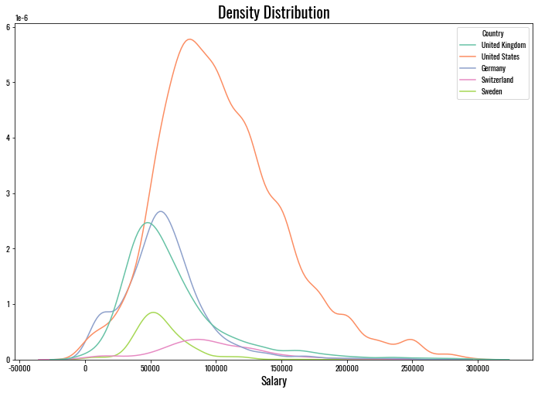

Slide 9
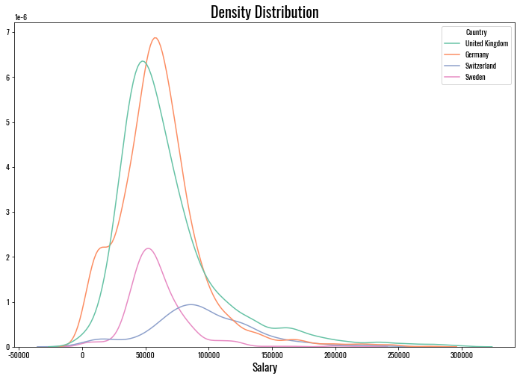

Slide 10
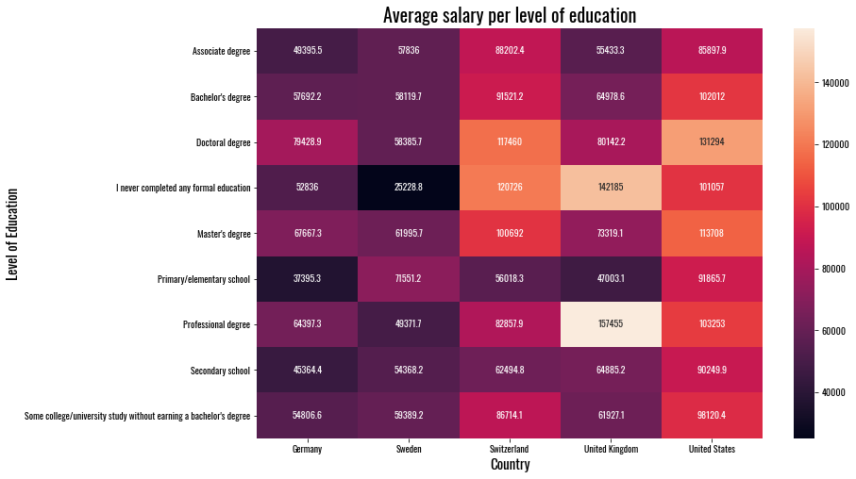

Slide 11
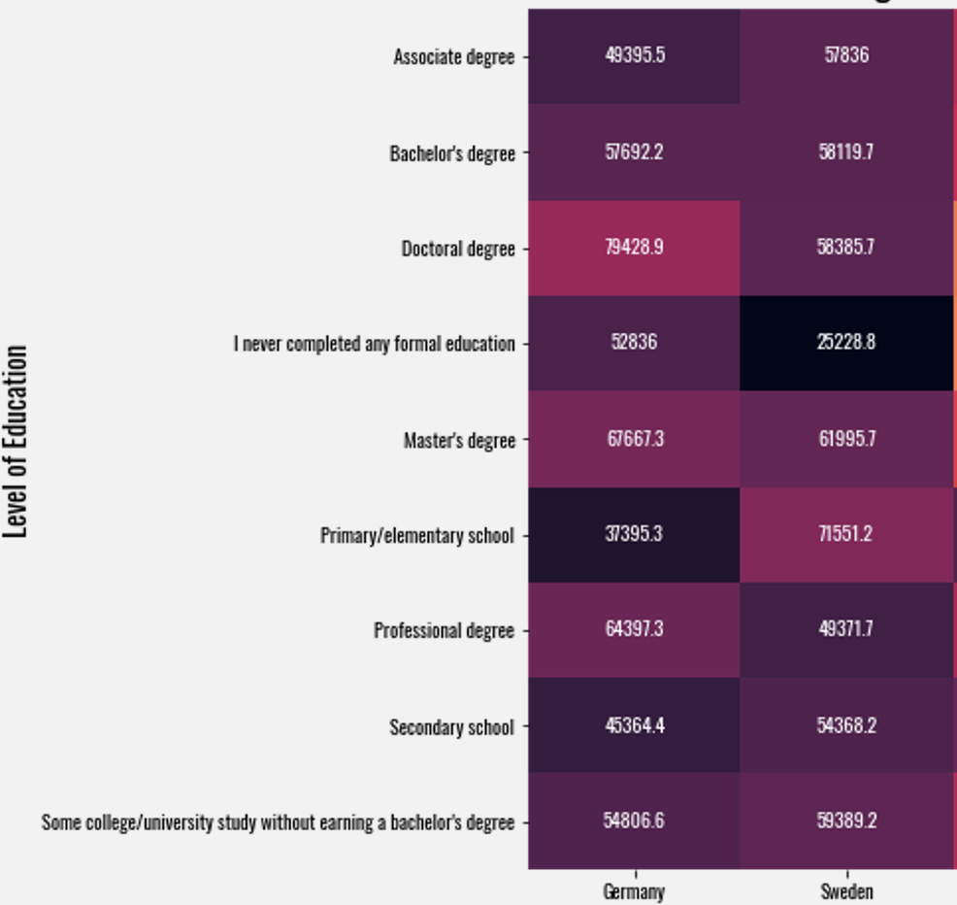
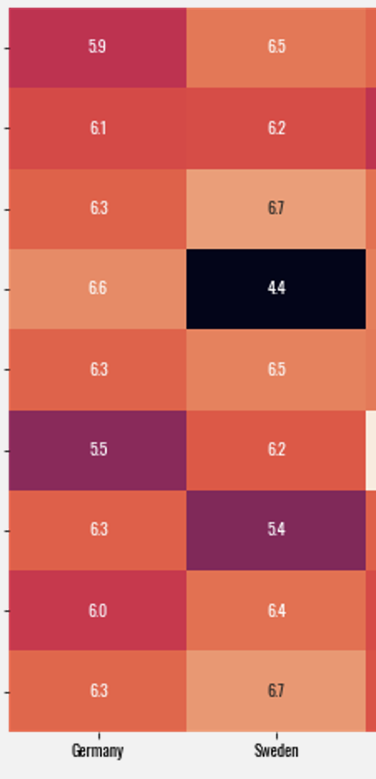
Salary
Job satisfaction

Slide 12
What is your education worth?

Slide 13
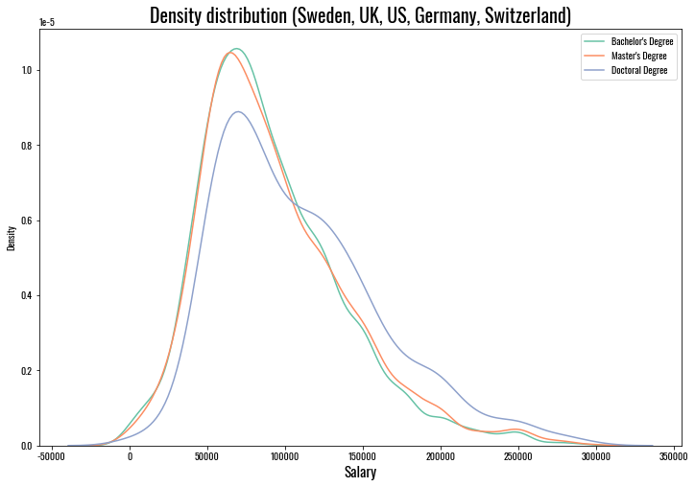

Slide 14
