Slide 1
A Blind Source Separation Technique using Second-Order Statistics
A. Belouchrani, K. Abed-Maraim, J.F. Cardoso and E. Moulines (1997)
What is Blind Source Separation?
The SOBI algorithm
Numerical analysis
Impact
Discussion
Notes:
My presentation is about a Blind Source Seperation technique using Second Order statistics, proposed by Belouchani in 1997. First, I’m gonna tell you a little bit about what Blind source separation is, and give some examples of techniques using first order statistics. Then I’ll show a problem where first order statistics fail to peform how we want them to, and explain how the SOBI algorithms applies second order statistics to solve this problem. I’ll also provide a summary of the evidence this paper provides that the SOBI algorithm works as intended. Finally, I will give a quick overview on research that followed up on this paper and give an example of an application where SOBI excels.

Slide 2
Blind Source Separation
Observe a linear mixture of source signals
Goal: separate mixture of signals without a priori information (blind)
Obtain unmixing matrix -> matrix that separates the observation into components
Used to separate sounds, overlapping images, noisy measurements
Notes:
Say you observe a signal that’s a linear mixture of some source signals. If you want to separate this mixture into source signals, you can do this by ‘blind source separation’. The goal of blind source separation is to obtain the unmixing matrix, which seperates your observations into it’s component signals. This is done ‘blindly’, meaning that you don’t have any knowledge about this the mixing matrix.
BSS is used to separate sounds, like the ‘cocktail party problem’, overlapping images and to separate the noise from measurements among other things.

Slide 3
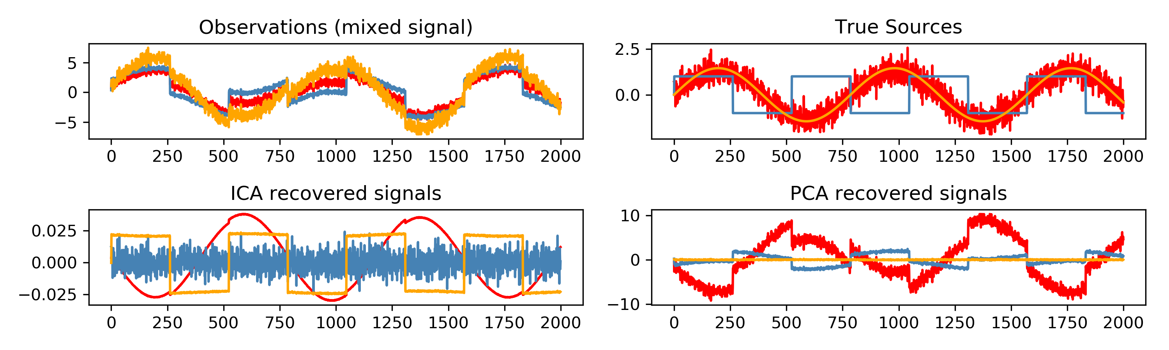
BSS using first order statistics
Independent Component Analysis
Iterative computation
Components maximize independence
Identifies independent patterns
Principal Component Analysis
Closed form computation
Components maximize explained variance
Identifies strong patterns
Notes:
Two examples of BSS using first order statistics are Independent Component Analysis and Principal component analysis, of which all of you have probably heard. While PCA computes the closed form solution that maximizes the explained variance in each component, ICA iterates over possible solutions to maximize independence between components. Usually when you talk about BSS, it’s these independent components that you are looking for.
The plots show an example of a BSS task and the components resulting from PCA and ICA. The top right shows 2 source signals: a square function, the blue line, and a sinus. I sampled the sinus twice: once with noise, the red line, and once without, which is the yellow line. The top left shows the observations by 3 sensors that record a linear mixture of these signals. ICA (bottom left) correctly identifies the separate source signals: a sinus, a square function, and some noise. Finally, PCA identified the strongest patterns. The red line shows the first component, which can be used to represent the same data with minimal loss of information.

Slide 4
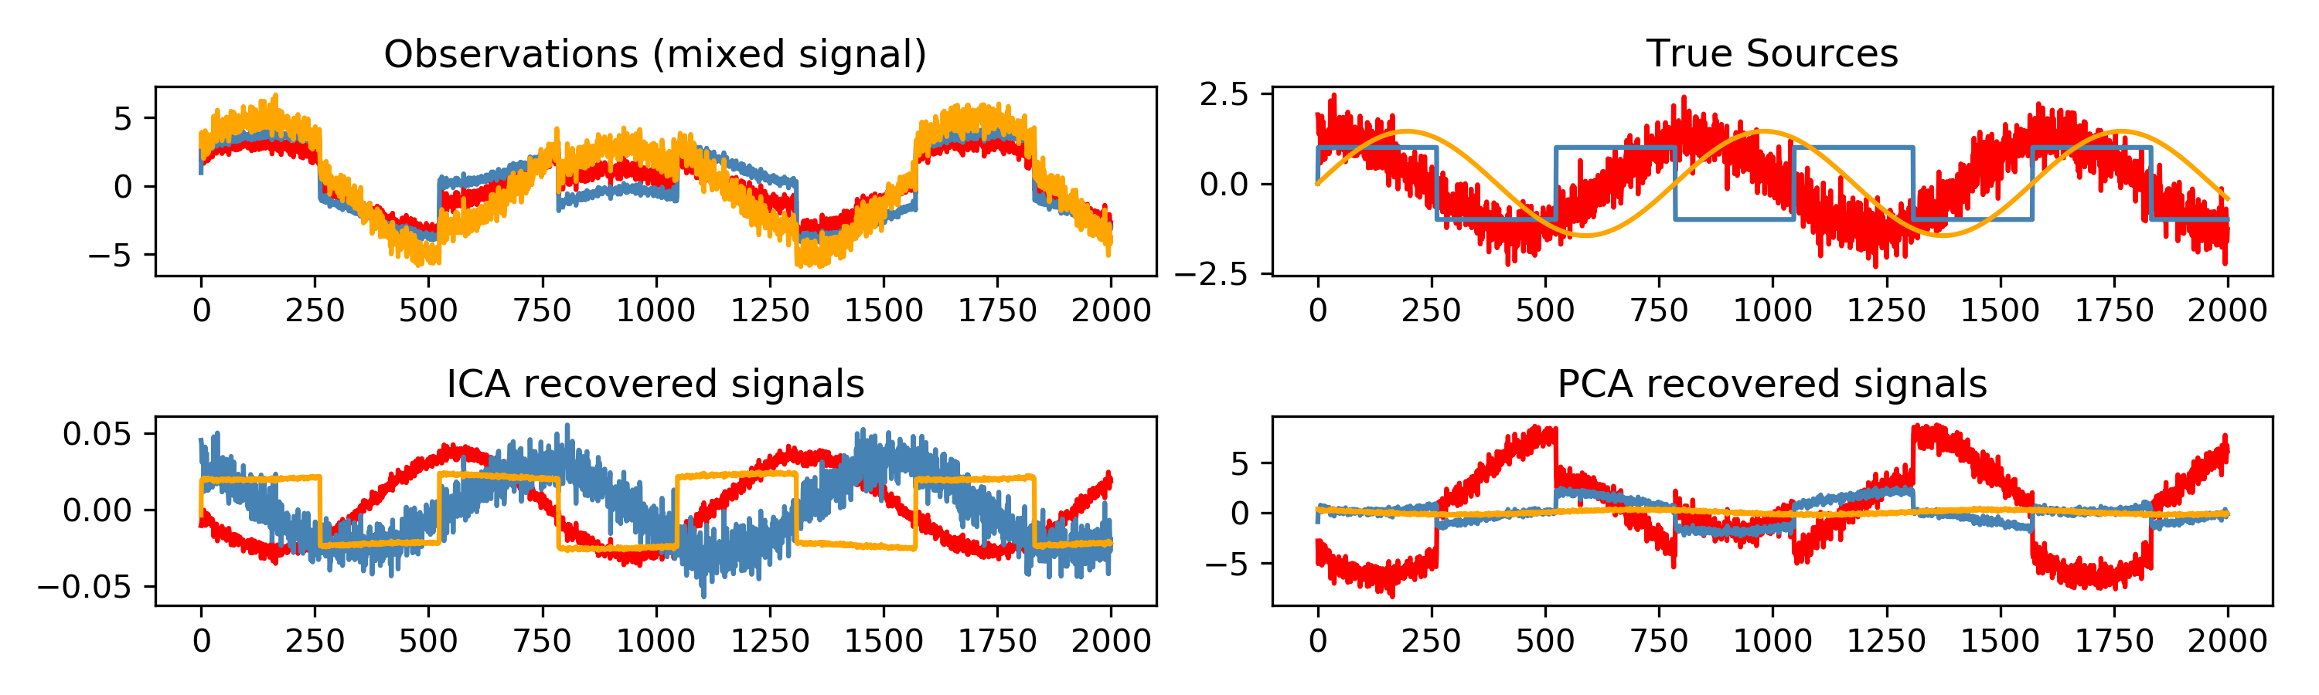
Limitations of first order statistics
Both PCA and ICA assume that the patterns are ‘time-locked’ – can’t resolve lagged correlated activity
Notes:
One limitation of using first order statistics is that it can’t be used to resolve lagged correlated activity. PCA and ICA assume that the mixture is time-locked, in the sense that the signals are not shifted during the observation.
The top right plot shows the same 2 sources as the previous slide, a sinus and a square function, except this time the samples of the sinus without noise are now also sampled at a time-delay. The top left shows the observation using the same mixing matrix, but now with the lagged samples. As you can see, ICA is now no longer able to separate the observations into two source signals and some noise, and instead finds 3 noisy uncorrelated sources.

Slide 5
Second order blind inference
Decorrelation across several time lags
How?
Whiten the data (can be done using PCA!)
Compute cross-correlation matrix at certain time lags
Compute the joint* diagonalizer** of the set of cross-correlation matrices **diagonalizer: transforms a matrix such that it contains all its information on the diagonal e.g. the eigenvalues * joint diagonalizer: jointly diagonalizes a set of matrices by minimizing the off-diagonal elements
Obtain sources using (unwhitened) joint diagonalizer as unmixing matrix
Notes:
This is where second order statistics come in. Belouchrani proposes a Second Order Blind Inference algorithm, or SOBI, that decorrelates the observations across several timelags. This is done by first whitening the data, which means that all observations are decorrelated from eachother. This results in an covariance matrix that’s equal to the identity matrix. Whitening can be done by Eigenvalue decomposition, or more generally by PCA. The second step is computing the cross-correlation matrices at a set of time lags. The entries of a cross-correlation matrix at lag t represent the correlation between one observed signal, and a second observed signal shifted by time t.
The third step is to jointly diagonalize the set of correlation matrices. This requires the joint diagonalizer, a matrix that minimizes the off-diagonal elements in the set of matrices. You probably remember the eigendecomposition from Linear Algebra. The matrix that contains the eigenvalues on its diagonal is an example such a diagonalization: it contains the same information as the original matrix, but all off-diagonal elements are zero. Such a perfect solution almost never exists for a set of matrices, but it suffices to find the joint diagonalizes that minimizes the off-diagonal error. Using the joint diagonalizer as an unmixing matrix, the original signal can be separated into independent components.

Slide 6
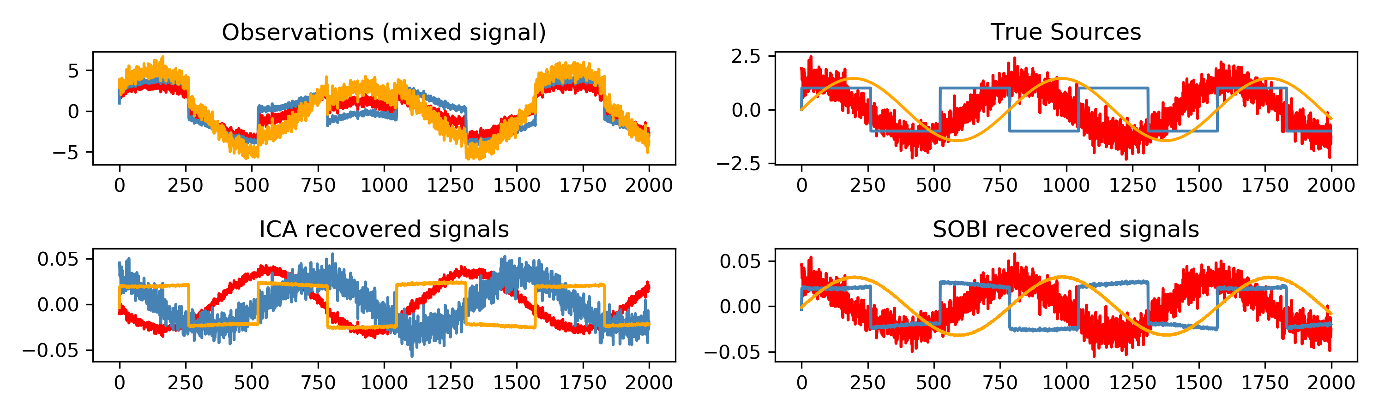
ICA vs Second order blind inference
SOBI is able to resolve lagged activity
Notes:
Back again to the same example with the lagged sinus. Using the set of lags from 1 to 300 samples (with the actual lag being 120 samples), SOBI mostly recovered the original sources, as shown on the bottom right. Note that people must be able to do something similar: while there is a timedelay between sounds picked up by the left and right ears, we are able to recognize these as one sound coming from a certain direction, as opposed to two different sounds echoing.

Slide 7
Joint diagonalization
Most important (and complex..) computation in SOBI
This paper uses Jacobi technique: a joint diagonality criterion is iteratively optimized under plane rotations
But other algorithms exist and have been proven to be more numerically stable since 1997: Fast Frobenius Algorithm, ACDC algorithm, LSB…
Depending on implementation, might be faster than using Jacobi angles
Notes:
The joint diagonalization is the most important and complicated computation in the SOBI algorithm. This paper uses an extension of the Jacobi technique, where a joint diagonality criterion is optimized under iterative plane rotations. Since 1997, other algorithms have been proven to be more numerically stable, such as the Fast Frobenius algorithm which minimizes the summed Frobenius norm, the ACDC algorithm which mimimizes a criterion with respect to the mixing matrix, and the LSB algorithm which finds the least square solution of the same criterion uses in the ACDC algorithm but with respect to the unmixing matrix.
For Fast Frobenius, a very fast implementation exists using C, and ACDC has been very efficiently implemented in MATLAB.

Slide 8

Performance evaluation – Numerical analysis
Simulation: 5 sensors pick up 2 signals coming from different directions, creating some time shifts
Measure: $Ɨ_{perf}$ measures how much interference between observations SOBI reveals -> how much did SOBI improve the separation?
Improvement is measured in dB, lower is better
Notes:
The paper provides evidence for this technique by solving the BSS problem on simulated signals. In this simulation, 5 sensors pick up 2 signals coming from different angles, resulting in some time shifts in the recording. They propose a measure of Inference to Signal, which measures how much interference between the observations is revealed by SOBI. This is not a direct measure of quality, but rather of the improvement SOBI provided to the separateness of the measurements. The improvement is measures in decibel, where a lower value is a better improvement.

Slide 9
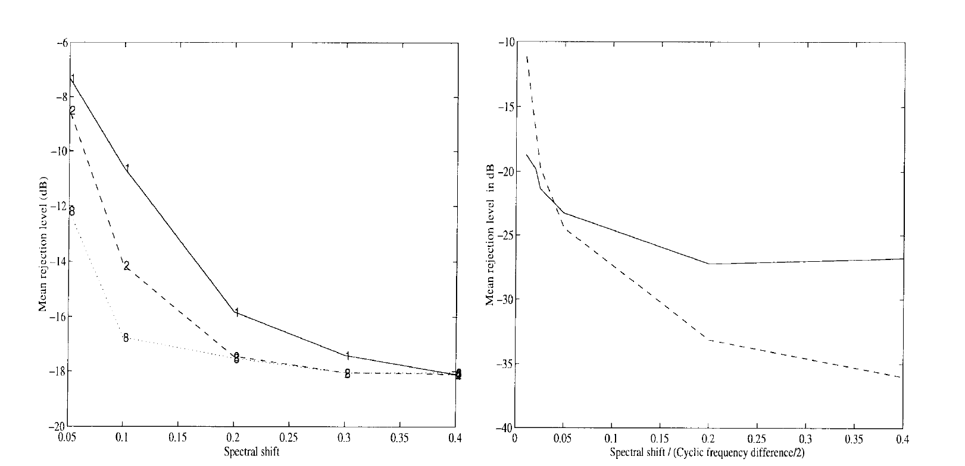
Performance evaluation – Numerical analysis
Results: SOBI improves separation most under poor circumstances*
Higher noise ratio means more relative improvement
*improvement most notable when lots of samples and correlation matrices are available
Fig1: rejection level vs spectral shift using 1, 2 and 8 covariance matrices
Fig2: rejection level vs spectral shift using
SOBI (--) and SCORE (-)
Notes:
As expected, SOBI improves the signals most when the measurement circumstances are bad, and the shift between measurements are biggest. The figure on the left shows the score versus the spectral shift, using 1,2 and 8 lags in the analysis. Improvement is biggest when this shift is largest. Compared so a similar method, SCORE, SOBI peforms better when the shift is larger, as shown on the right. The dashed line is SOBI, and the solid line is the SCORE method.

Slide 10
Many, many questions left open
What do the assumptions mean? How do they affect the results?
H1: Ergodicity -> basically, any part of the signal behaves the same way as the complete signal H2: Sources are mutually independent H3: Lags should not be too long
How long does your observation need to be for SOBI to be effective?
How do you choose the lags? And how many do you use?
Should some lags be more important than others?
(With more recent developments) Which algorithm do you use for diagonalization?
When do you stop the diagonalizing algorithm? What do you choose as maximal off-diagonal error?
How does this diagonalization error affect your results?
Can we use a priori information?
Notes:
While this paper does a good job in providing a detailed description of the algorithm, some question remain open. They propose some assumptions that the SOBI algorithm makes, but how do these affect the results? What happens if these assumptions aren’t true? In the results, they discuss that more samples result in a cleaner separation. So what is the minimum amount of samples you need? They mention the set of lags at which the observations are decorrelated, but how to you choose these lags? And how many do you need? Should the diagonalizer minimize the off-diagonal errors are shorter lags more than at longer lags? Based on more recent research, you may also wonder if the Jacobi angles are the best way to computer the diagonalizer. And while you’re minimizing the off-diagonal error, when do you stop? At which value is the error small enough? And why does the algorithm have to be blind? Is there a way to encoporate a priori information?

Slide 11
Applications in physiological signals
Tang (2000) in MEG data
Ossadtchi (2000) used SOBI to select event-related components in EEG
Belouchrani co-authored a paper himself with Gorodnistky (2001) on how SOBI can identify ocular artifacts (EOG signals) in EEG data
And then: many papers on applying SOBI to EEG data to remove blink artefacts: From the components, select the ones corresponding to artifact activity and reconstruct without these sources
Proving again and again that SOBI works better or just as good as other BSS algorithms: Delorme (2007), Joyce (2003), Romero (2008), Fitzibbon (2007)….
However, to this day, no clear consensus on which BSS method works best. At some point, the interest in SOBI dropped of a little bit, and some newer review papers don’t even mention it..
Notes:
Since then, a lot of papers have been written on the application of SOBI in physiological signals. Alice Tang started using SOBI for separating neuromagnetic responses in MEG data. Ossadtchi used SOBI so select event-related components in EEG, such as the P300 response. In 2001, Belouchrani co-authored a paper with Gorodnistky on how SOBI can be used to identify ocular artifacts, or eog signals in eeg data, and subsequently how the original signal can be reconstructed without these artifacts. In their paper, they showed that SOBI was more successful at this task than other methods used at the time. This resulted in many papers that applied SOBI to remove blink and other ocular artifacts from data. Papers that compared SOBI to other BSS algorithms showed that SOBI works better, or at least as good, as the methods most widely used. However, to this day, no clear consensus is found on which BSS method, or in general which technique works best in this task. At some point the interest in SOBI seems to drop off a little. If you look at recent review papers on ocular artifact removal, such as one from IEEE in 2012, you’ll find some of them don’t even mention SOBI as an option.

Slide 12
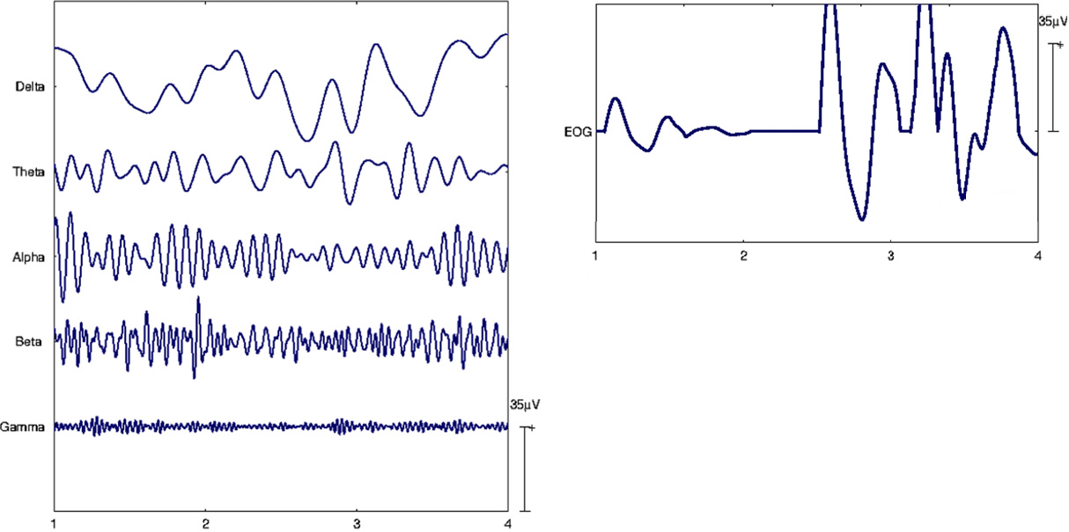
SOBI in EOG artifact removal
Belouchrani and Gorodnistky (2001) proposed using SOBI to remove EOG artifacts from EEG data
A very difficult problem, a lot of research is published on solving it
Notes:
So what is this EOG artifact problem exactly? When you measure EEG, you usually also pick up some ocular activity, the EOG. This is a very well known problem that sprouts many many papers on how to solve it. One of the reasons it’s to difficult is that EOG activity is usually of a much higher amplitude than EEG activity. The plot shows EEG activity in different bands on the left, and EOG on the right. Belouchrani and Gorodnistky propoes in their 2001 paper that SOBI can be used to remove EOG artifacts from EEG data.

Slide 13
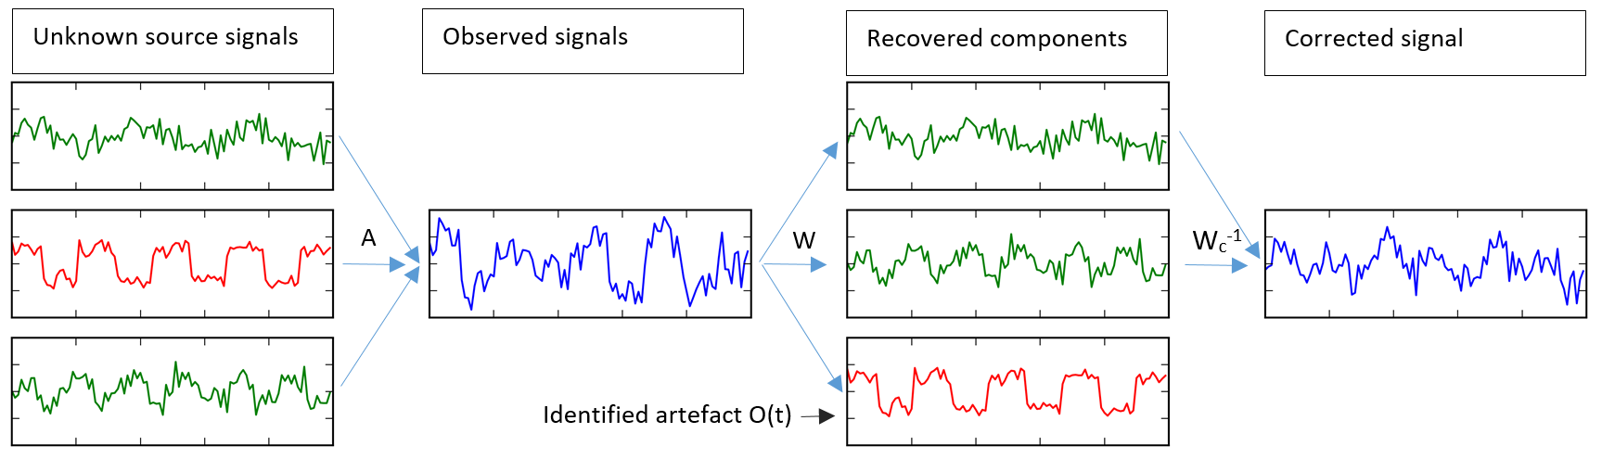
SOBI in EOG artifact removal
How do you use SOBI here?
Artefact identification can (and should) be done automatically (Joyce et al, 2004)
Why does it work? -> EOG artifacts propagate over the skull, creating lags
Notes:
So how do you use SOBI? When you separate your observed signal into independent components, you can try to identify which components correspond to EOG activity. You can then set the corresponding column of the mixing matrix to zero to obtain the corrected signal, supposedly without these artefacts (if the separation was clean). Identifying the artefacts can be done automatically, as proposed in a paper by Joyce in 2004. The reason you’d want to use SOBI as compared to ICA is that EOG artifacts propagate over the skull during EEG measurements, resulting in lagged correlated signals.

Slide 14
Answering (some) questions regarding SOBI for EEG artifact removal
How do you choose the lags? And how many do you use?
Should some lags be more important than others?
answered (partly) by Sutherland (2004) and Tang (2004): {1,2,3,4,…,10,12,14,…,25,30,35,…,100,120,…300} ms works best for certain EEG separation tasks
What do the assumptions mean? How do they affect the results?
Origuen (2015) and Sweeny (2012): BSS methods perform also when assumptions are violated
Notes:
Some papers on EOG artifact removal and using SOBI for EEG data answered a few of the questions left open by the paper: Sutherland proposed using a set of 40 lags ranging from 1 to 300 to separate EEG signals. In the same year, Tang validated that this set performed better compared to other commonly used sets. Two review papers by Origuen and Sweeny found that reportedly, even when the assumptions are violated, BSS methods generally work well.

Slide 15
(If there is time left: ) My own research at the Centre for Human Drug Research
CHDR uses EEG to assess the effect of a drug using quantitative EEG analysis
Currently, ocular artifacts are identified and removed manually
My job: implementing automated SOBI and validating parameter settings, i.e. answering these questions:
How do you choose the lags?
Which algorithm do you use for diagonalization?
When do you stop the diagonalizing algorithm? What do you choose as maximal off-diagonal error?
How does the diagonalization error affect your analysis?
Can we use a priori information?
Notes:
Now if there is some time left, I thought it’d be cool to show some of my own research in this field. I’m currently a research assistant at the Centre for Human Drug Research in Leiden. For the past 8 monhts, I’ve been working on a solution to the EOG artefact problem. CHDR uses EEG data to asses the effect of a drug by analyzing changes in the power spectrum, which reveal some information about the state of the central nervous system. In one of these measurements, subjects are asked to peform a task where a lot of blinking is required. Currently, someone manually goes over the measurements and selects epochs affected by EOG artefacts, and then completely removes the epoch. Not only is this time consuming, but removing epochs also removes information that is still relevant. We decided that SOBI was the most fitting solution given the available resources and limitations, and after implemented an automated SOBI algorithm, I’m currently working on validating the parameter settings, and answering the questions about lags, diagonalization, and available information.

Slide 16
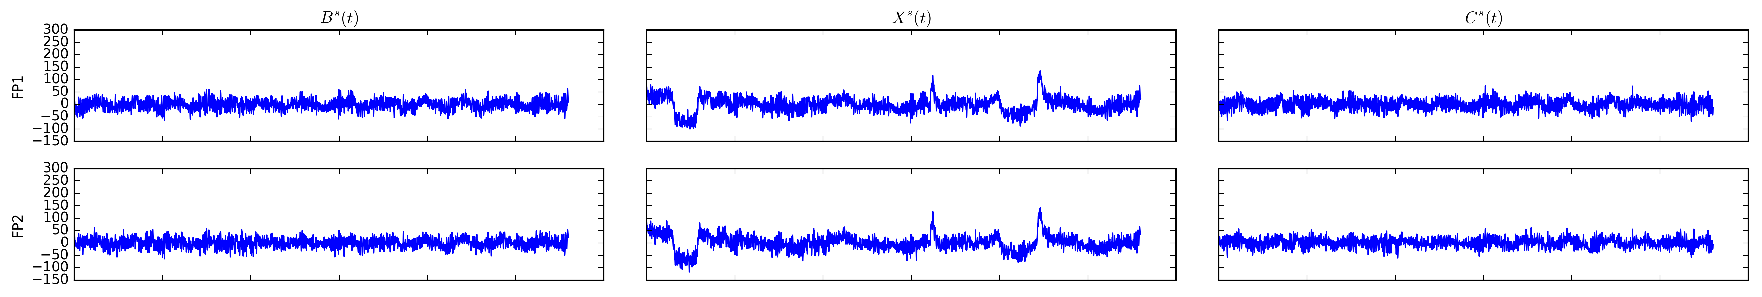
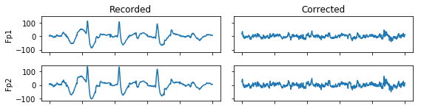
Some results
Simulated data: True signal Measured signal Corrected signal
Acquired EEG during blinking:
Notes:
These plots show some results of the current SOBI implementation with generally used settings. The top shows a simulated signal: the true signals measured at the frontal lobe, at the fp1 and fp2 electrodes placed here and here (points), at the left. Then the same signals mixed with EOG activity in the middle, and the signals corrected by SOBI on the right. The bottom shows acquired EEG during a blinking task on the left, and the resulting corrected signal on the right.

Slide 17
Some preliminary answers
How do you choose the lags?
Different lags work better for different artifacts (HEOG: {1,2} and VEOG: {1,….,100})
Which algorithm do you use for diagonalization?
Jacobi angles or LSB perform equally well, but Jacobi is faster
When do you stop the diagonalizing algorithm? What do you choose as maximal off-diagonal error?
0.01 – 0.001 works well. Anything below does not improve performance significantly
How does the diagonalization error affect your analysis?
Barely, other parameters are much more important
Can we use a priori information?
A priori information helps select lags, and the geometric information about electrode placement can improve identification of artifact components significantly
Notes:
Some of the answers we found where that while the lags proposed by Sutherland from 1 to 300 work well in general, to remove specific ocular artefacts, other sets might be more efficient. Specifically, artifacts caused by moving the eyes around (Horizontal EOG) are better separated using only short lags of 1 and 2 ms, and artefacts caused by blinking (vertical EOG) are best removed by using short to middle range lags, of 1 up to 100 ms. I also implemented all the diagonalization algorithms mentioned before in Python. After a lot of computation optimizations, using Jacobi is both the fastest and more accurate method. Varying the maximum value for the diagonalization algorithm below 0.01 barely makes a difference in the results. Other parameter settings, such as the lags, make a much bigger impact. And finally, we experimented using some a priori information. The geometric structure revealed by the unmixing matrix can help pin point which of the components originates around the eyes – seemingly, this works better than identifying the EOG artefact related components any other way.

Slide 18
Questions - computations
What is SNR? Signal to Noise Ratio
What are ARMA processes? A way to describe stationary processes
Why doesn’t using more sensors help? More sensors only helps if there are more sources to uncover
What is Givens <rotation>? A complex matrix rotation along a certain axis by a certain angle. Optimizing the diagonalization is equal to performing successive Givens rotations along angles that minimize the off-diagonal elements in a 4 element substructure…
What does the ‘off(…)’ mean in the diagonalization? The sum of off-diagonal elements, or the diagonalization error
Why does using more matrices not improve the separation <in fig1>? Those 6 matrices apparently already cover the lags
H1: Ergodicity, e.g. if you take a large enough part of a sinus, the mean = 0 and min/max values are -1/1. This stays generally the same for any part of the signal you can possibly sample
H2: Sources are mutually independent, e.g. if you have an image made up of 3 overlapping images, you can’t find 3 separate sources if one of those images is a combination of the two others
H3: sources are short range dependent, e.g. again with the images: if your image is made up of 3 images, of which the 3rd image is just the 2nd image shifted to the right, that shift can’t be ‘too big’
Notes:
A lot of the questions emailed to me were about details in the computations. While they were good and important questions, I wasn’t really sure if they’d contribute to the discussion. If there is some time left, I can talk about some of these questions. The first few are terminology – SNR means the Signal to noise ratio, or how much of a signal there is relative to the noise. An ARMA process is just a way to describe stationary processes in terms of polynomials. Using more sensors doesn’t necessarily help if all the sources and noise have already been recovered. General rule in bss: number of sources <= number of sensors. A Givens rotation is a complex matrix rotation by a certain angle. The Jacobi method optimizes the diagonalization by successive givens rotations along the complex angles that minimize the offdiagonal elements in a substructure. The off() is the sum of the off-diagonal elements in a matrix, and describes the diagonalization error.
Finally, the assumptions. The first assumption is that the sources are ergodic: Ergodicity means that any part of the signal behaves the same way as the complete signal. For example, if you take any part of a sinus, if it’s large enough, the mean =0 and the min and max values are minus one and one. This will be true for any part of the sinus you can sample. The second assumption is that the sources are mutually independent. For example, if you have an image made up of 3 overlapping images, you can’t find 3 separate sources if one of those images is a linear combination of the two others. Finally the third assumption is that the sources are short range dependent, for example again the images

Slide 19
Questions left?
Are parameter settings dependent on differences between subject?
Why does this paper have so many citations?
Why did the interest in SOBI drop off?
Are the described calculations detailed enough?
What would you have changed about this paper?

