Slide 1
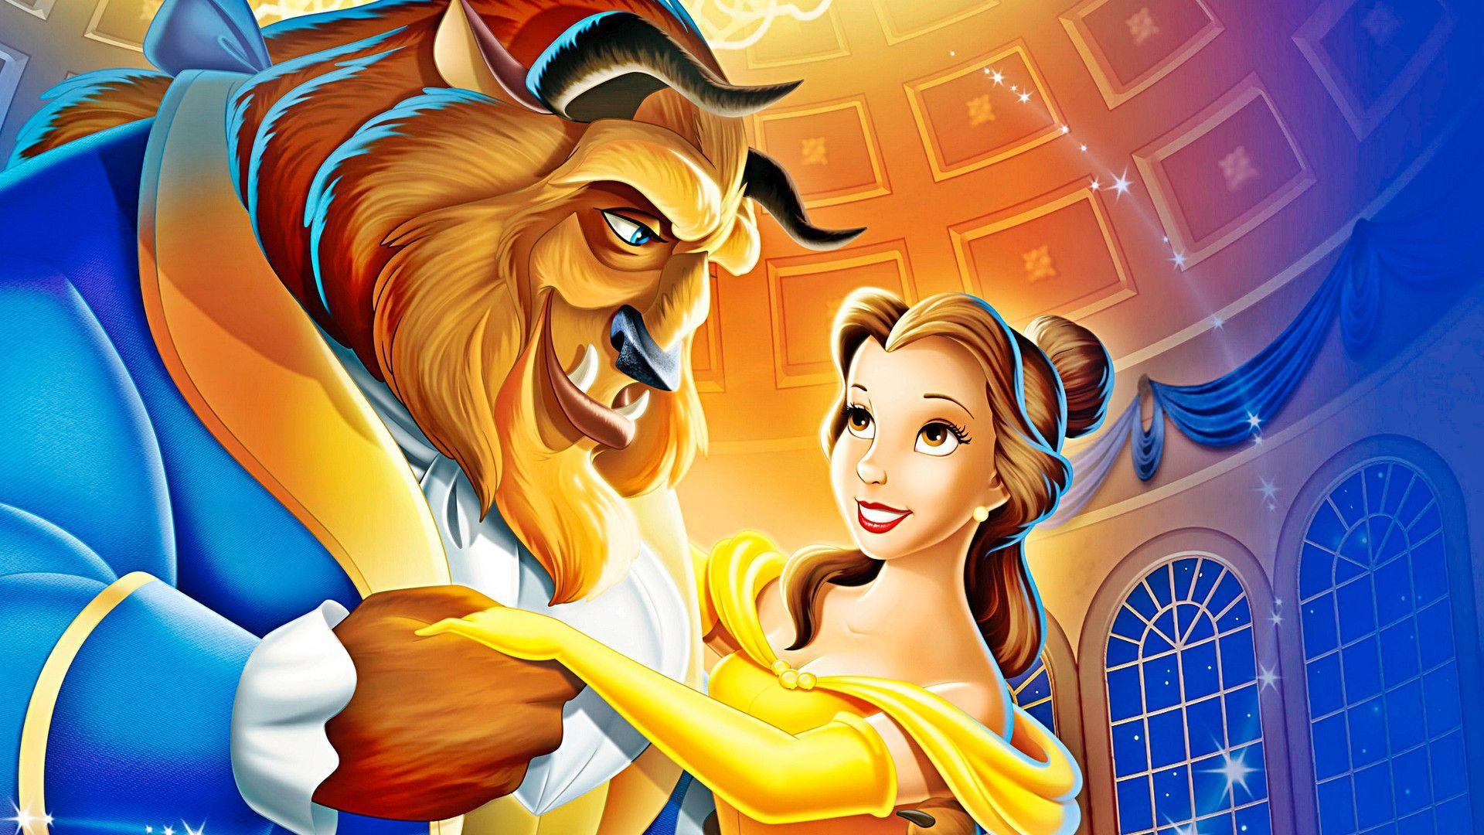
Gender Bias in Fairy Tales
By: Lisa van Gelderen, Alexia Muresan, Zoë Prins & Victor van der Sman

Slide 2
Introduction
Why have we chosen fairy tales
Why have chosen gender bias
Contemporary research about genderbias in fairy tales

Slide 3
The dataset
Where did we find the dataset.
What we can tell you about the dataset.
What have we done with the data to process it.

Slide 4
method
What methods did we apply to the data to get results
What models did we use and why

Slide 5
Results
What are the results that we got from our research
What are some interesting finds

Slide 6
Visual results

Slide 7
Conclusion
What are some conclusions that we can make from the results

Slide 8
Discussion & future work
What we could have done better
What other researchers might find interesting to work on in the future

Slide 9

Questions?

