Slide 1
MPCS53112 Advanced Data Analytics --MapReduce and Spark in text mining
QIAN WANG
THE UNIVERSITY OF CHICAGO

Slide 2
What we are going to build
A text analytics system that provides: 1. Text information retrieval system that extracts structured fields and fetch
complete customer reviews from Yelp.
2. MapReduce implementation for computing (restaurant, term) – term
frequency-inverse document frequency (tf-idf).
3. Spark implementation of clustering to extract text features based on tf-idf.
4. Classification models on predicting ratings using both structured variables
and term features.

Slide 3
How does the system work
Use rauth request to fetch restaurants’ information; Yelp responses with restaurants’ information such as name, rating, review count and url of its website in the format of JSON(rauth, requests).
Use web crawler to fetch complete reviews from the url of different restaraunsts (BeautifulSoup).
Clean reviews by removing stopwords and punctuations, and stemming (nltk, re).
Use MapReduce to output (restaurance, term) – tf-idf(mrjob); run on google cloud cluster.
Use Spark to implement K-means clustering on tf-idf matrix(pyspark.mllib); run on google cloud cluster.
Develop rating prediction models using limited structured fields and a pool of text term features(sklearn).

Slide 4
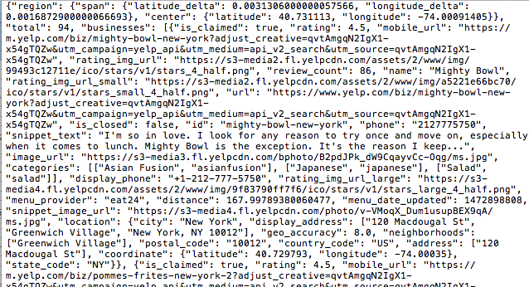
An example of a JSON response by requesting restaurants information from Yelp

Slide 5
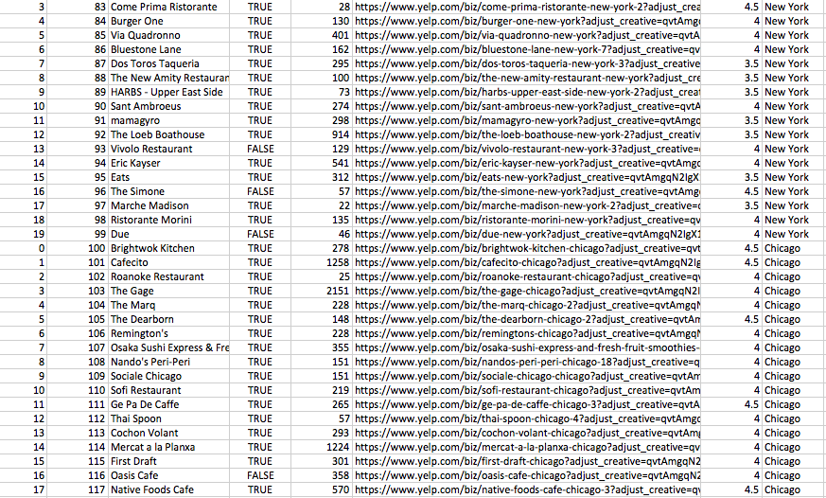
An example of a partial dataset extracted from JSON response

Slide 6
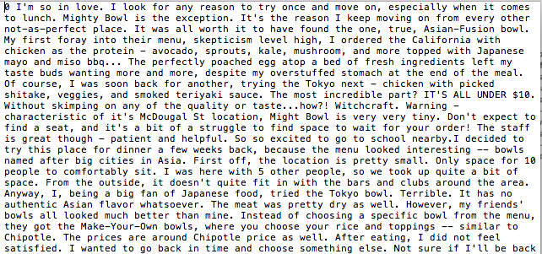
An example of fetched reviews

Slide 7
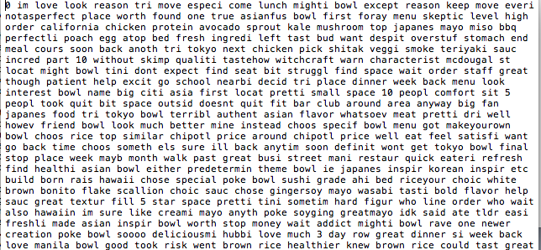
After cleaning

Slide 8
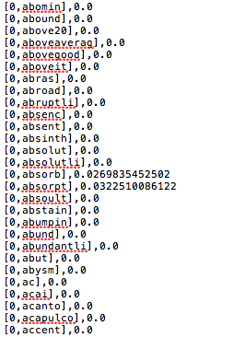
A Sklearn output of tf-idf
from sklearn.feature_extraction.text import TfidfTransformer
from sklearn.feature_extraction.text import CountVectorizer
1.Too many unshown words in package-default English corpus
2.Computation power limitation as text size increases
From Qianyu

Slide 9
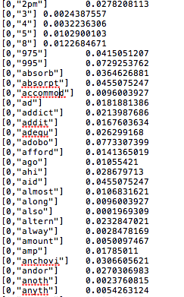

MapReduce output of tf-idf
MapReduce Algorithm:
Mapper1
yield word, (restaurant_index, word_count)
Reducer1
yield restaurant_index, (word, tf*idf)
Reducer2
yield (restaurant_index, word), normalized tf-idf

Slide 10
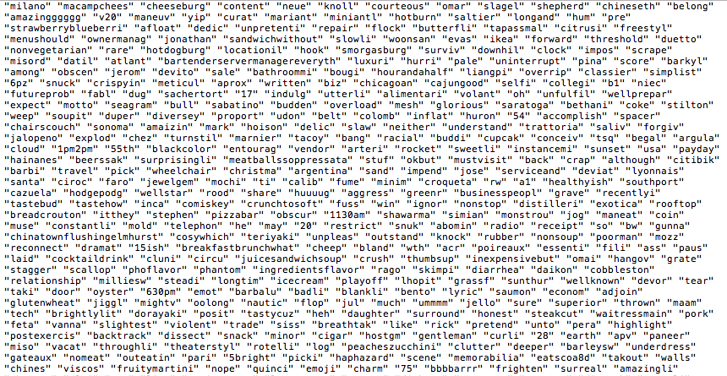
A partial corpus

Slide 11
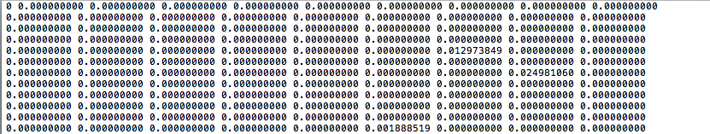
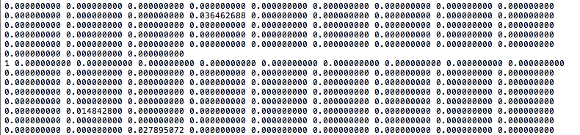
A partial tf-idf matrix (k-means input)

Slide 12
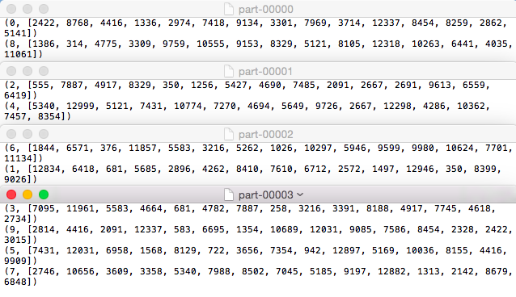
Top words(index) extracted after pyspark k-means clustering
from pyspark.mllib.clustering import Kmeans; k=10 clusters; Pick top 15 words from each cluster

Slide 13
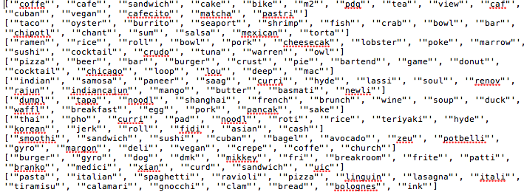
Top words(150) extracted after pyspark k-means clustering

Slide 14
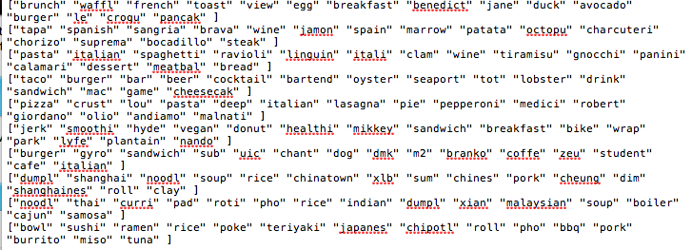
Top words(150) extracted after sklearn k-means clustering
From Qianyu

Slide 15
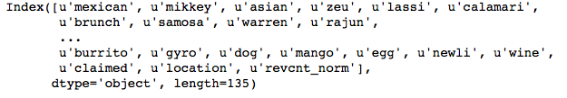
Features for classification modeling

Slide 16
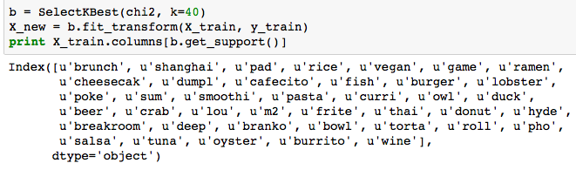
Univariate feature selection

Slide 17
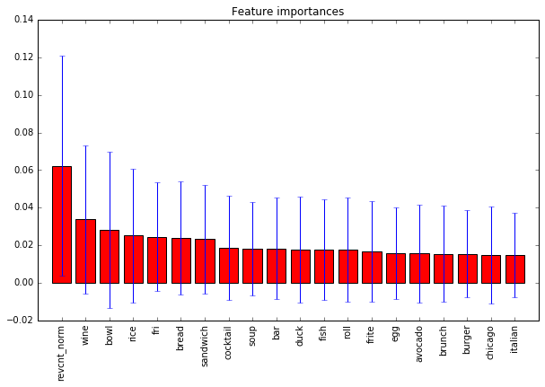
Feature importance
Top 20 features:
1. revcnt_norm (0.062245)
2. wine (0.033852)
3. bowl (0.028086)
4. rice (0.025132)
5. fri (0.024507)
6. bread (0.023955)
7. sandwich (0.023331)
8. cocktail (0.018591)
9. soup (0.018181)
10. bar (0.018163)
11. duck (0.017708)
12. fish (0.017645)
13. roll (0.017526)
14. frite (0.016667)
15. egg (0.015671)
16. avocado (0.015607)
17. brunch (0.015459)
18. burger (0.015331)
19. chicago (0.014805)
20. italian (0.014758)

Slide 18
Model cross-validation performance comparison
Model | Parameters | F1_weighted score
Random Forest Classifier | n_estimators: 10 max_depth: 100 “1” class weight: 5 | 0.66
Extra Trees Classifier | n_estimators: 10 max_depth: 90 “1” class weight: 3 | 0.66
Logistic Regression | C: 0.1 “1” class weight: 3 | 0.65

Slide 19
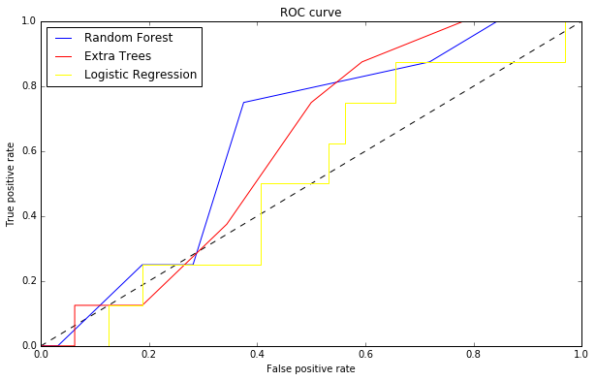
ROC for model performance on hold-out verification dataset

Slide 20
How to improve model performance
Get more data (restaurants) from more diverse locations.
Optimize k for k-means.
Try various clustering techniques.
Test on feature selections more precisely.
Test with more classification models(e.g. SVM, Naïve Bayes)
Use more techniques to deal with unbalanced class labels (e.g. undersampling, oversampling)
…
Next
PySpark implementation of classification models.
Install python libraries on google cloud platform.
Next week:
Qianyu and Han

