Slide 1

Telco Customer Churn
Lisette CRUZ

Slide 2
Descriptive Analysis of Customers that Churn
ML Library: Sklearn
Python Pandas and Python MatPlotlib
Issue: ~26% of Telco customers churn. What categorical Data can we look at based on the data set?

Slide 3
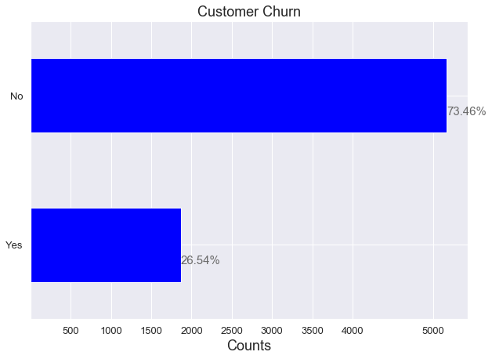
Percentages of Customer who have/have not churned

Slide 4
Binary Classification Issue
1st Step: Categorize the data into numerical vs non numerical data for smoother transition
Gender
Does the customer have a partner and or dependents?
Contract Type
Payment Method
Tenure (Numerical)
Monthly Charges(Numerical)

Slide 5
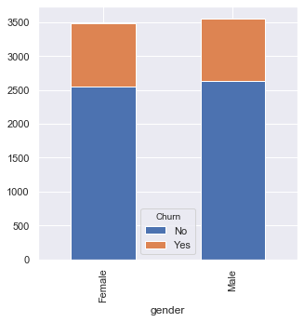
Is Gender Indicative of churn?
Gender does not appear to be indicative of churn according to the data. Males churn slightly higher but only by a percentage.

Slide 6
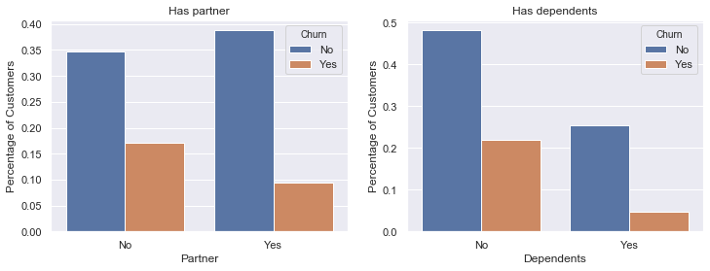

Slide 7
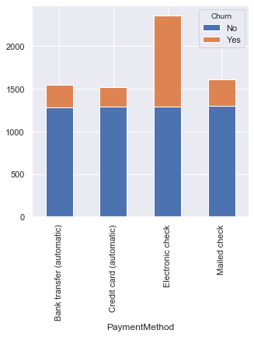
Payment Method
CUSTOMERS SET UP ON AUTO PAY WERE LESS LIKELY TO CHURN

Slide 8
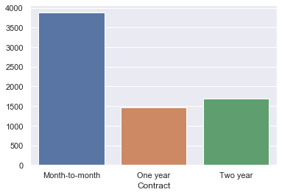
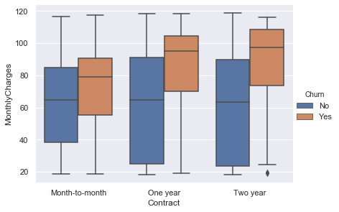
Contract Type
As expected, customers without contractual obligations were more likely to churn which could be due to early termination fees.

Slide 9
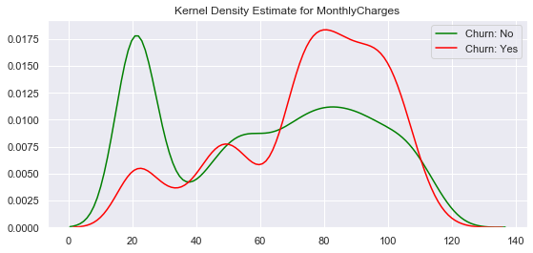
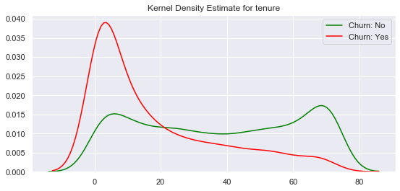
KDE
For these graphs, the shape of the distribution is being plotted.
For monthly charges, we can see that, the higher the charges, the higher probability of churn
For tenure, shorter tenure typically translates to higher churn rates

Slide 10
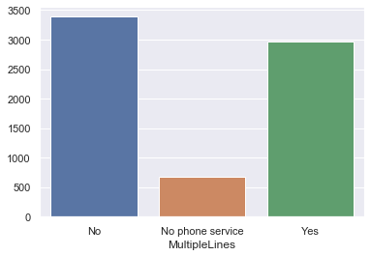
Multiple Lines

Slide 11
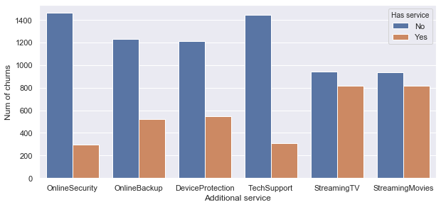
Additional Features
Customer with the first four features are more unlikely to churn

Slide 12
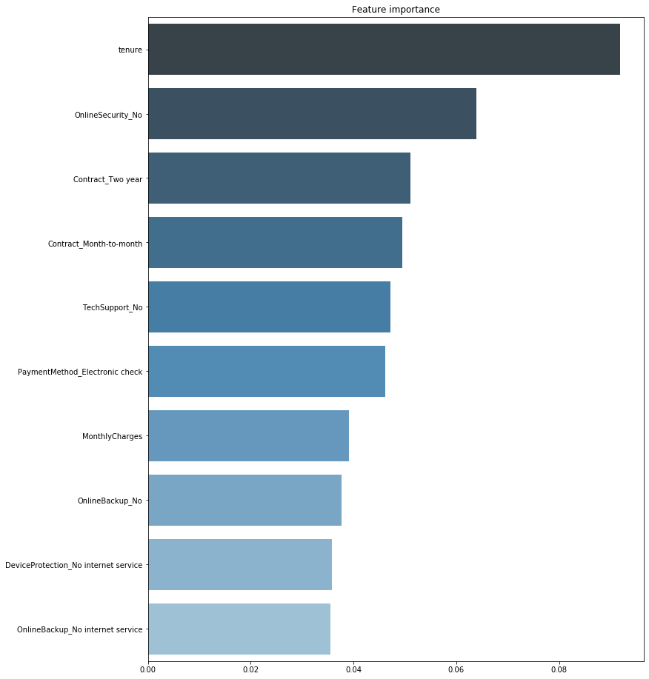
Random Forest Classifier
Most impactful features for churn
Tenure
OnlineSecurity
Contract Type
Payment Method

