Slide 1
Computing smooth surface contours with accurate topology
Pierre Bénard
Aaron Hertzmann
Michael Kass

Slide 2
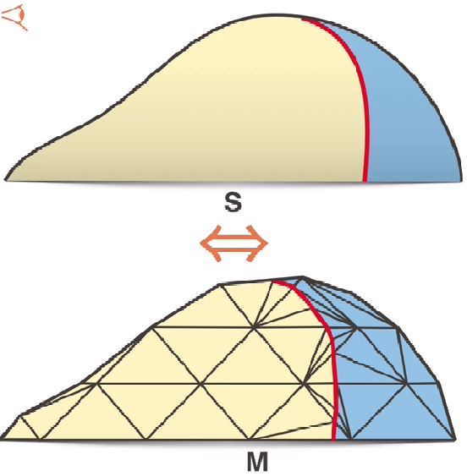
The method

Slide 3
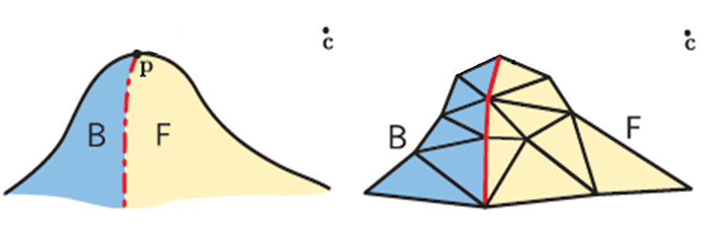
Theorem
If each triangle is contour-consistent, within every edge that is incident on F or B vertex, there are no zero crossings of g and no edges are degenerate then the orientations of the mesh faces form a partition of the surface into front-facing and back-facing regions that is isotopic to the orientation S.

Slide 4
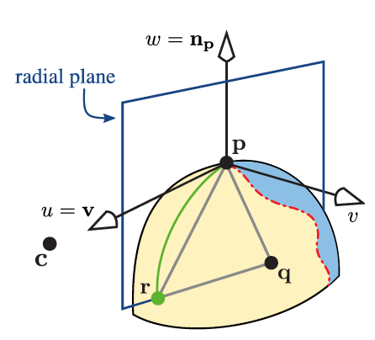
Radial triangles
A radial triangle is a triangle with one vertex p on the contour, and another vertex r on the radial plane of p.

Slide 5
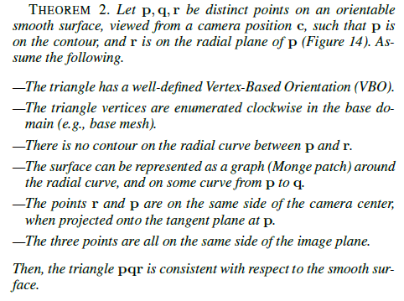

Slide 6
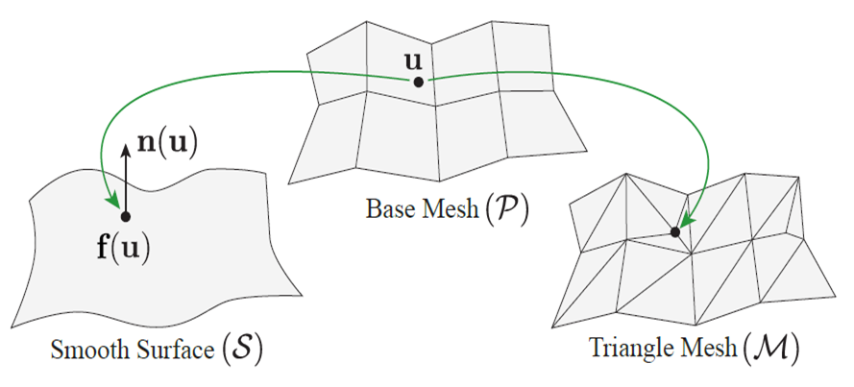
Orientation

Slide 7
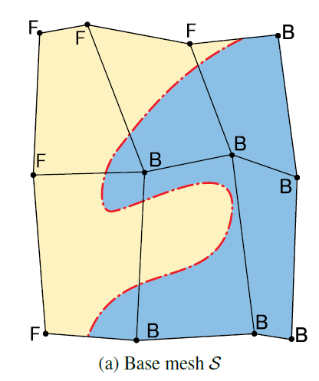
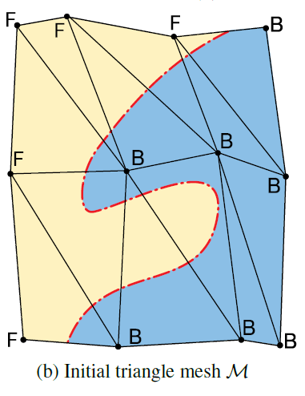
Initialization

Slide 8
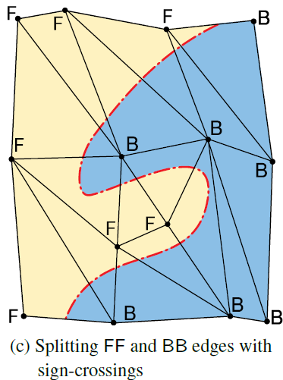
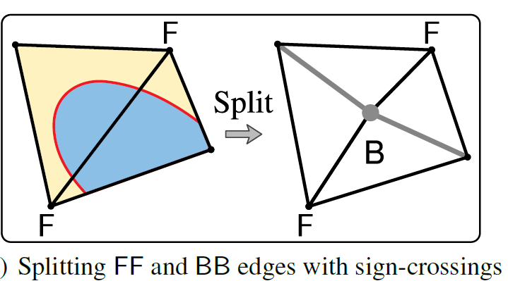
Initialization

Slide 9
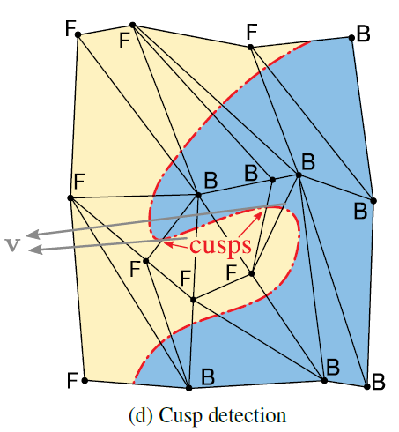
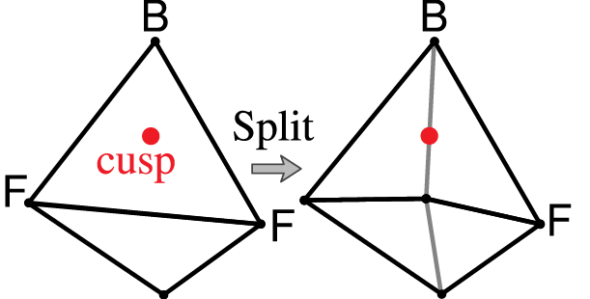
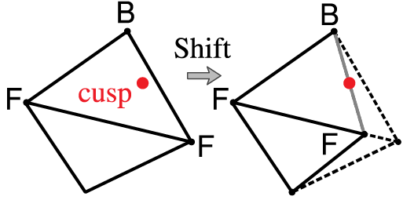
Contour insertion: Cusp detection

Slide 10
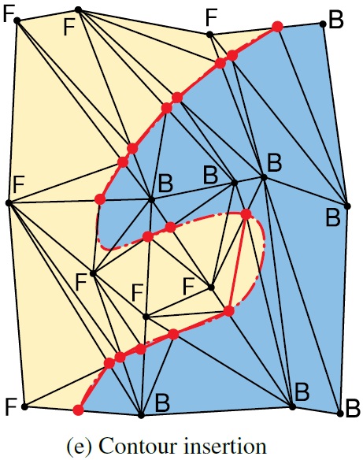
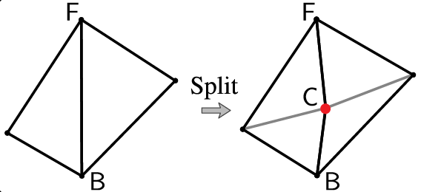
Contour insertion

Slide 11
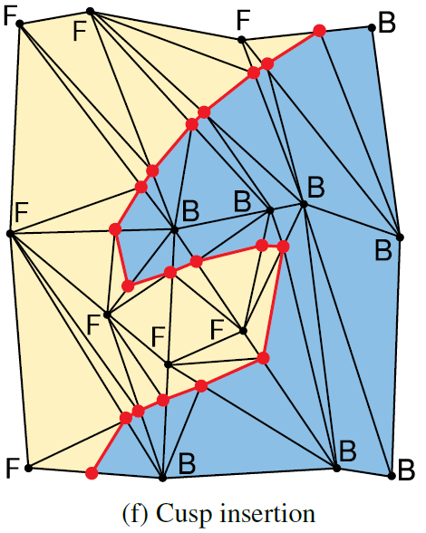
Contour insertion: Cusp insertion

Slide 12
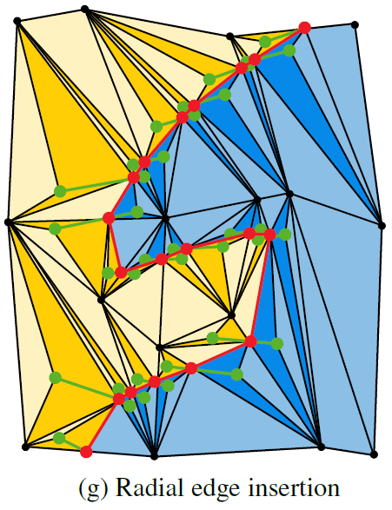
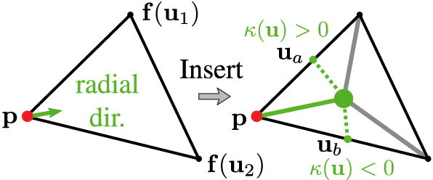
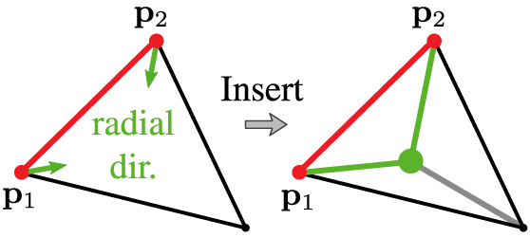
Radialization Radial edge insertion

Slide 13
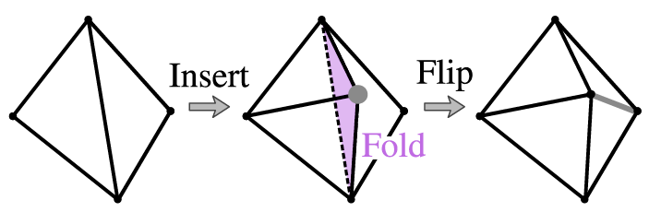
Prevention of folds

Slide 14
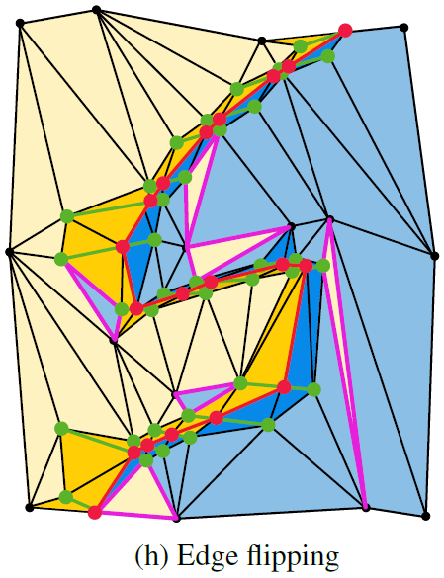
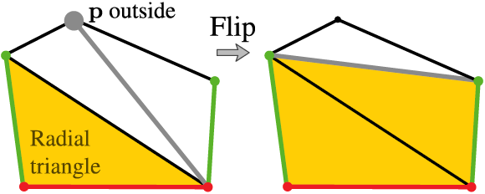
Radialization Edge flipping

Slide 15
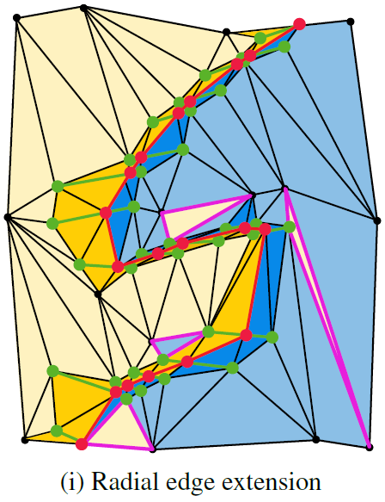
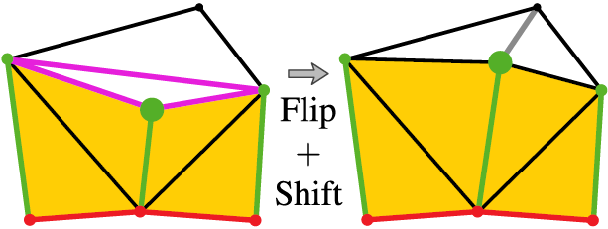
Optimization Radial edge extension

Slide 16
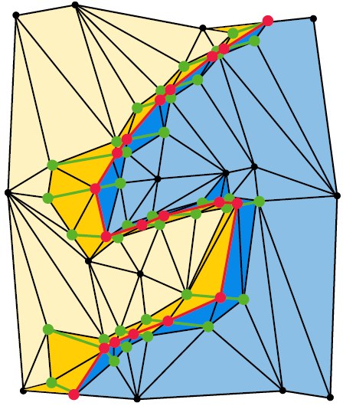
Other local optimizations
Edge fippling
Vertex wiggling
Vertex wiggling in the
normal direction

Slide 17
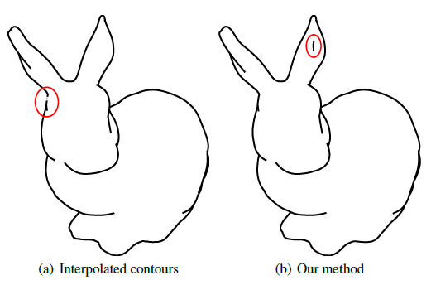
Resultados

Slide 18
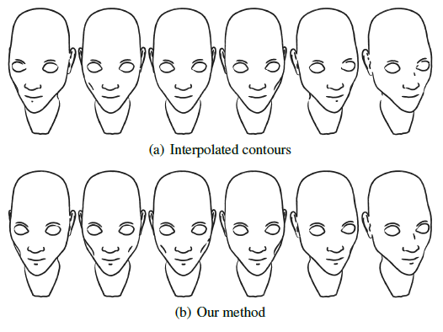
Resultados

