Slide 1
Referral-Based Hiring Model
Network Fair Process
Group #1
Trust and Referrals as Network Effects
(Friend-of-Friend Advantage)
To Better Understand Decisions in Hiring

Slide 2
The Hiring Challenge with Referrals
You receive TWO referrals for each candidate
But you don't trust all referrers equally
Key insight: Trust matters more than referral quality!
Example:
  Referral 1: 'Excellent' (from stranger)
  Referral 2: 'Very Bad' (from trusted colleague)
  → You use Referral 2 because you trust that source!

Slide 3
What We're Modeling
R1, R2
Referrals
G (Network)
= Selected R
T1, T2
Trust
F (Fit)
Hidden
N (Papers)
Observed
Goal: Compute Pr(F = good | G, N)

Slide 4
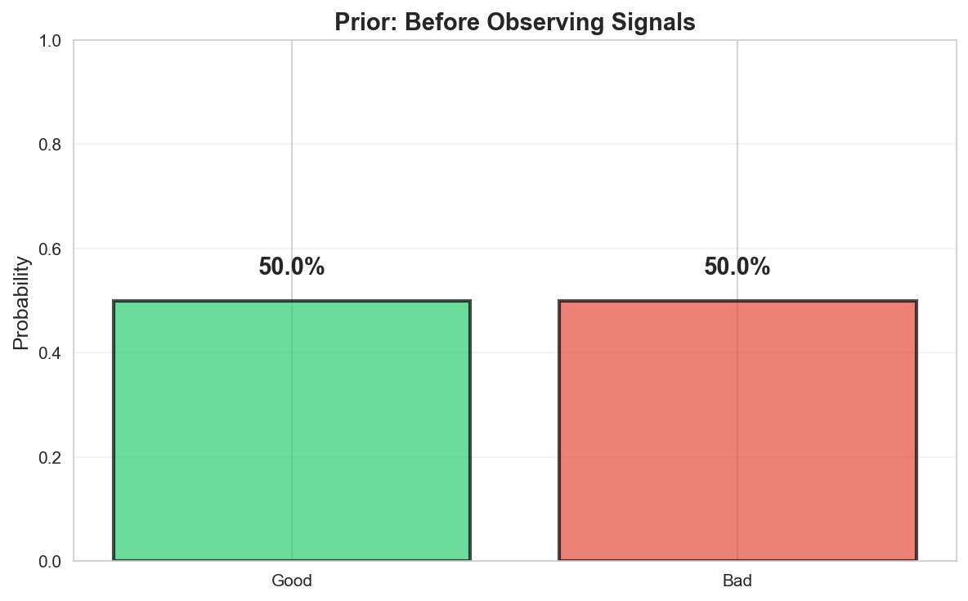
Step 1: Start with Prior Belief
Before seeing any signals, we have an initial belief:
Pr(F = good) = p = 0.5
This means: 50% of candidates are good (on average)

Slide 5
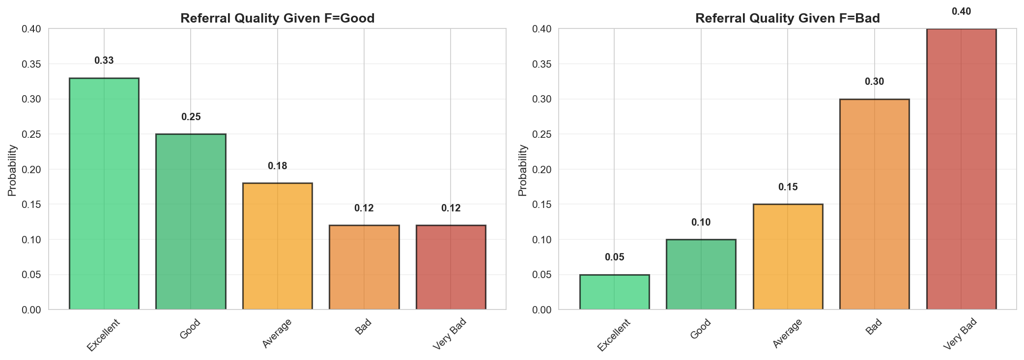
Step 2: Referral Quality Signal
Referrals come in 5 quality levels:
Excellent → Good → Average → Bad → Very Bad
Quality depends on candidate's true fit:
Good candidates: More likely to get excellent/good referrals
Bad candidates: More likely to get bad/very bad referrals

Slide 6
Step 3: Trust-Based Referral Selection
Decision Rule:
Trust only R1 → Use R1 (regardless of R2)
Trust only R2 → Use R2 (regardless of R1)
Trust both → Use WORST referral (conservative!)
Trust neither → Use WORST referral

Slide 7
Step 4:
Network Effect = Selected Referral
Network effect IS the referral quality!
  G = Selected Referral Quality
  No mapping needed - they are the same!
    If selected referral is 'Excellent' → G = Excellent
    If selected referral is 'Very Bad' → G = Very Bad

Slide 8
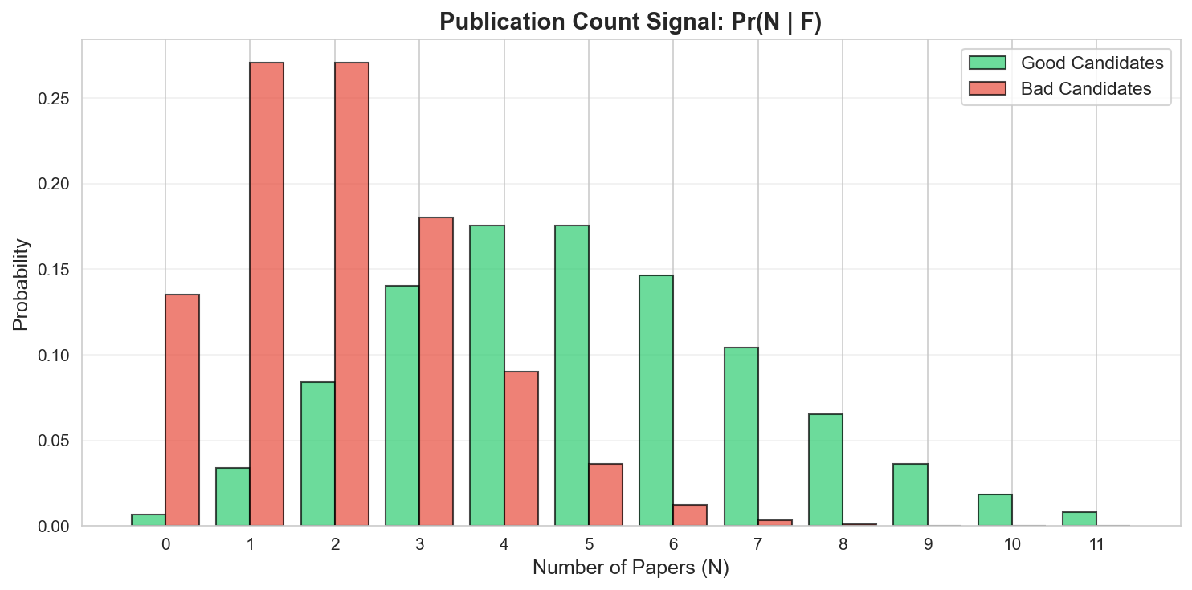
Step 5: Publication Count Signal
Publication count follows Poisson distribution:
Good candidates: Average 5 papers (λ_good = 5.0)
Bad candidates: Average 2 papers (λ_bad = 2.0)

Slide 9
Step 6: Combine Signals with Bayes' Theorem
Bayes' Theorem combines prior and signals:
Updated Belief = Prior × Likelihood / Evidence
Pr(F = good | G, N) = Pr(good) × Pr(G, N | good)
  ──────────────────────────────────
  Pr(G, N)

Slide 10
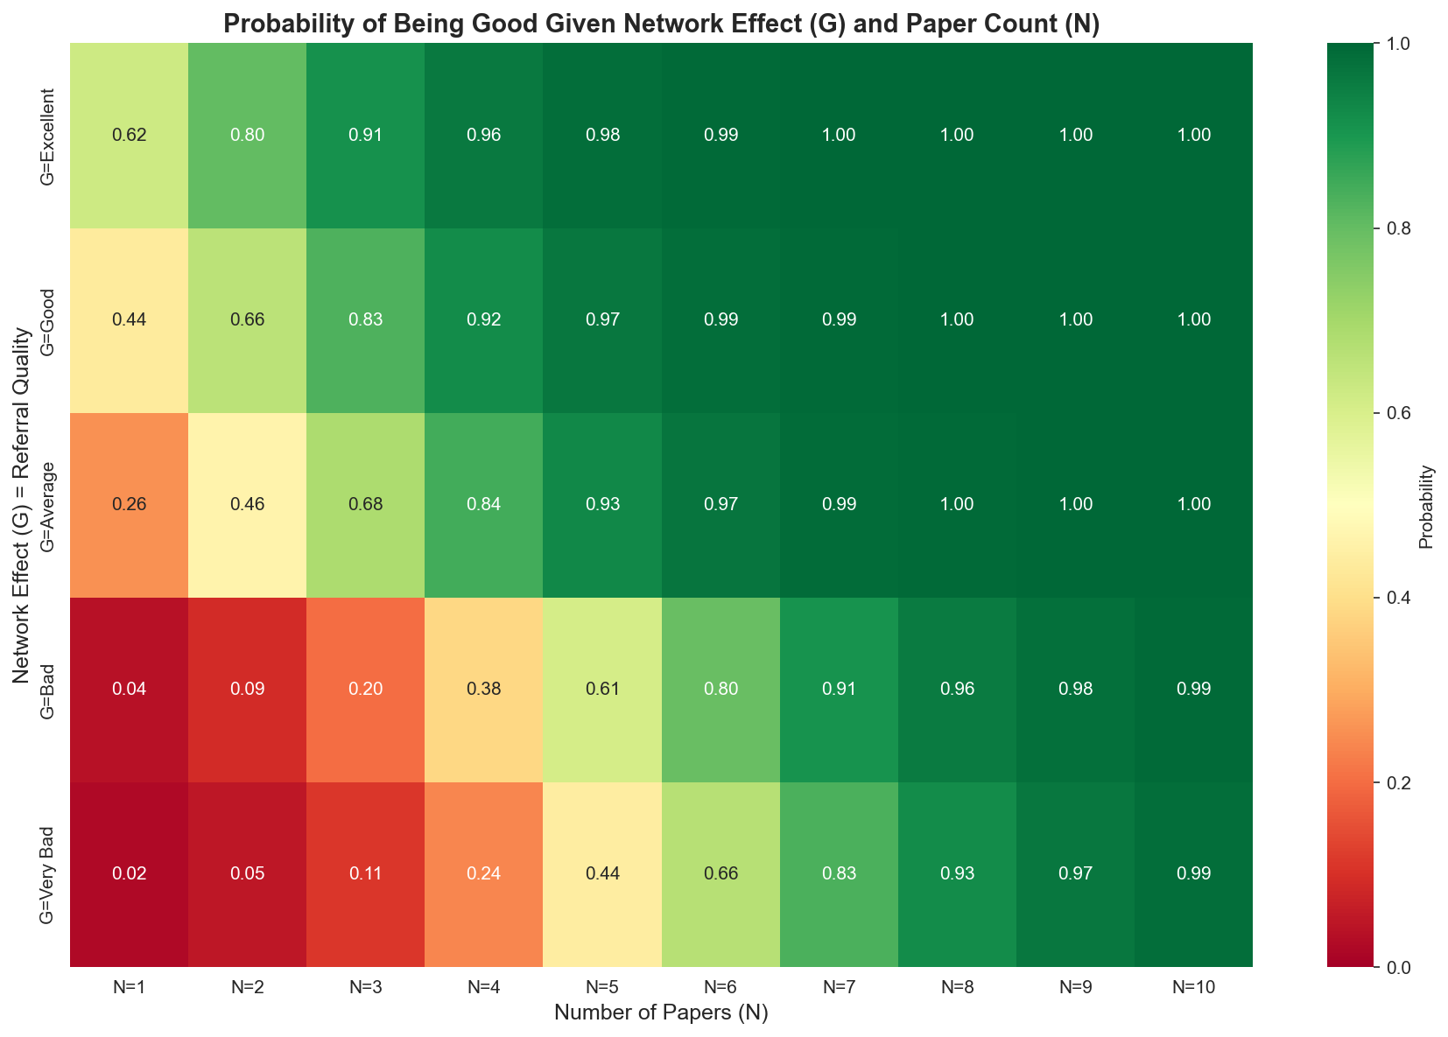
The Result: Probability Matrix
For each combination of signals, we compute the probability of being a “good” candidate:
Rows: Network effect G (5 levels: excellent → very bad)
Columns: Number of papers N (1-10)
Values: Pr(F = good | G, N)

Slide 11
Interpretation
6 papers are worth 1 referral

Slide 12
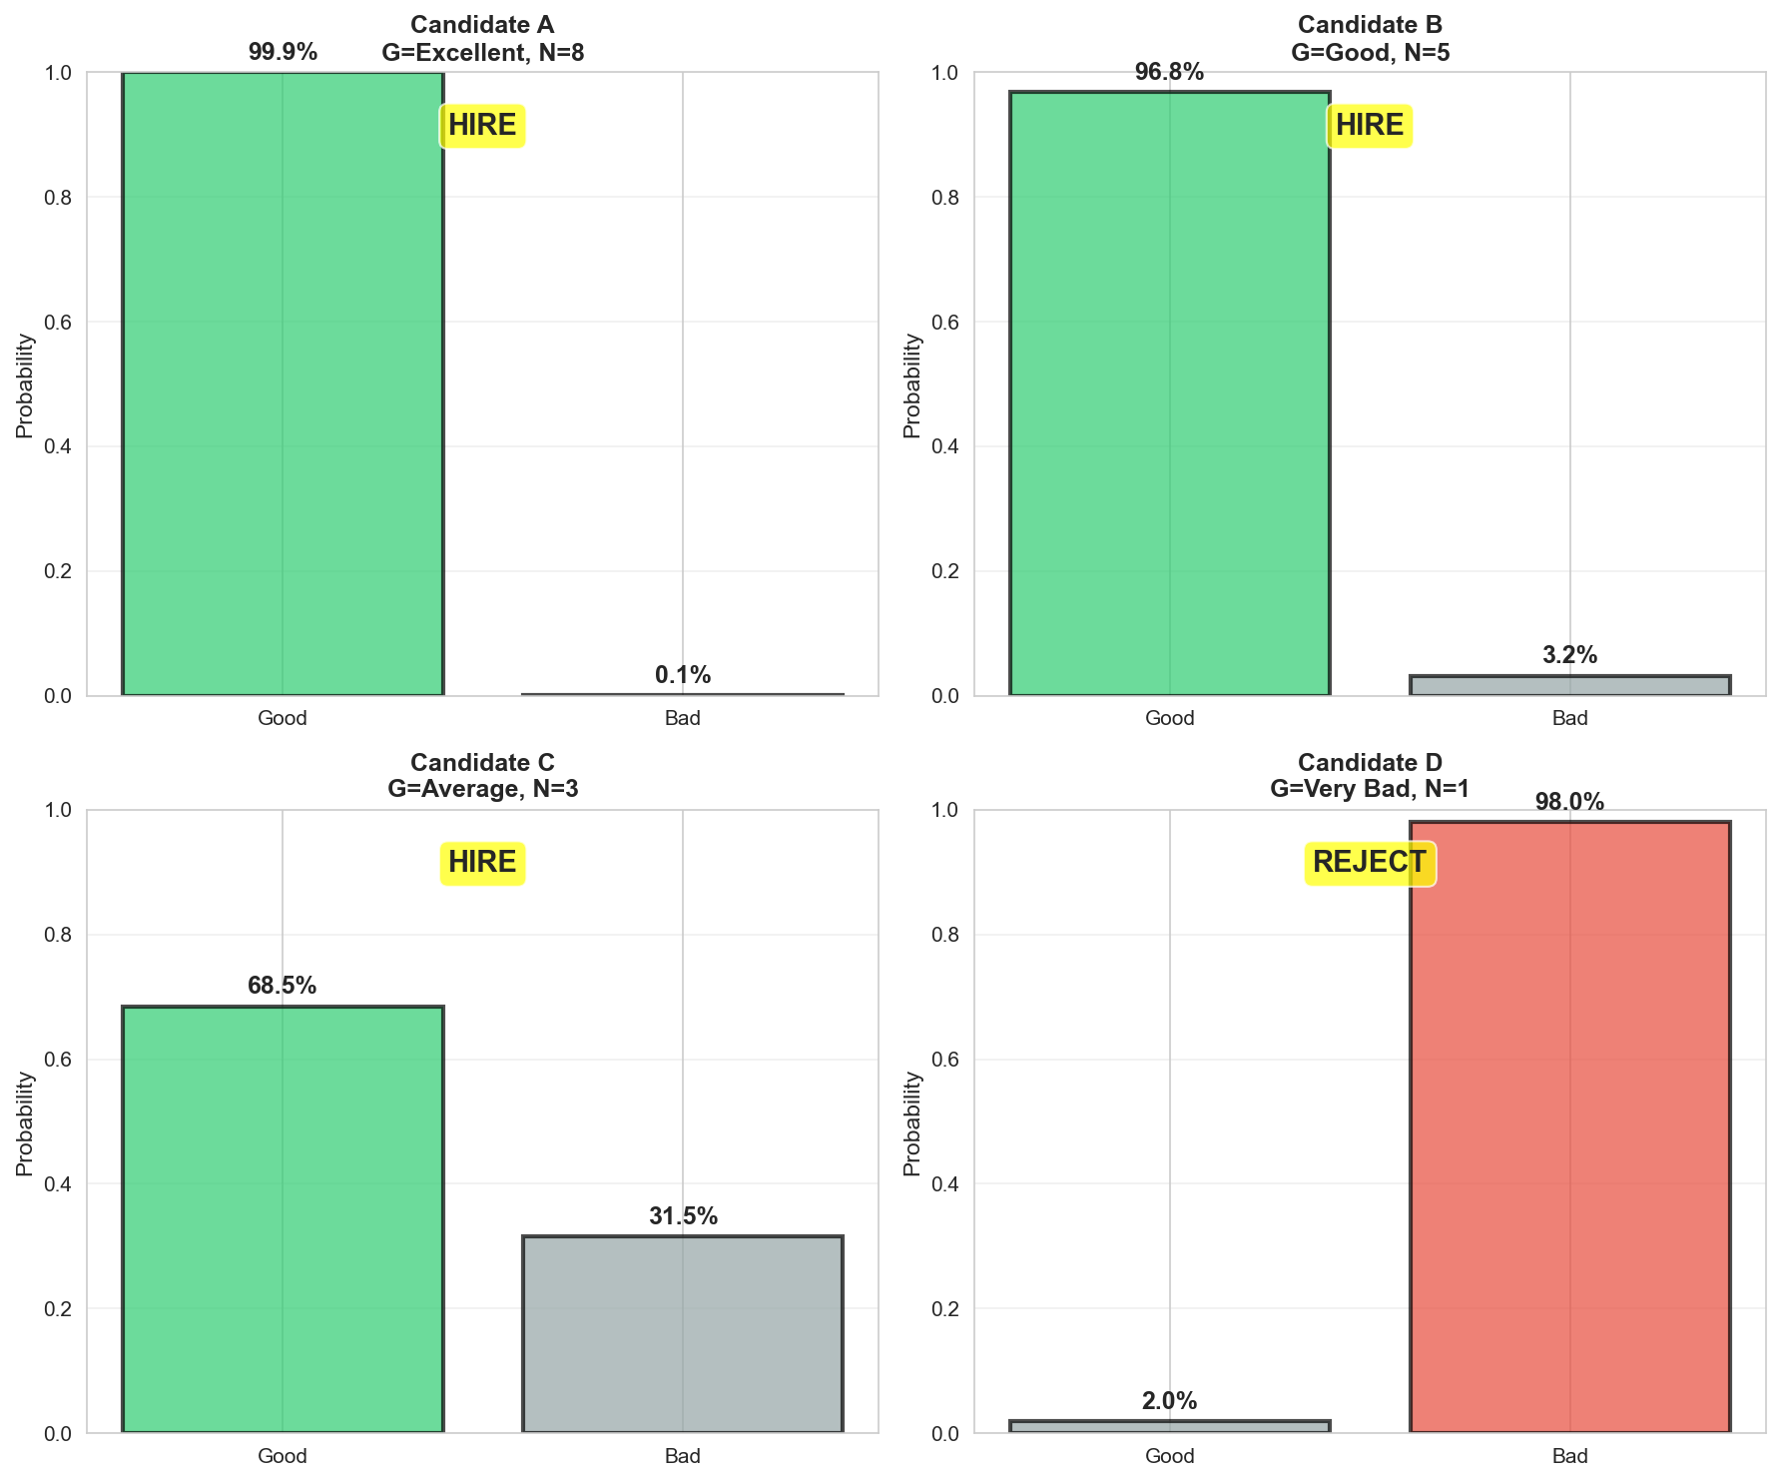
Real Examples: Four Candidates

Slide 13
Key Insights
Trust overrides quality:
  Trusted referral is used even if untrusted is better
Conservative when both trusted:
  When both referrers trusted, use the WORST referral
Network effect = Referral quality:
  No separate mapping - they are the same!
Excellent referral + many papers = Strong signal
Very bad referral + few papers = Weak signal

Slide 14
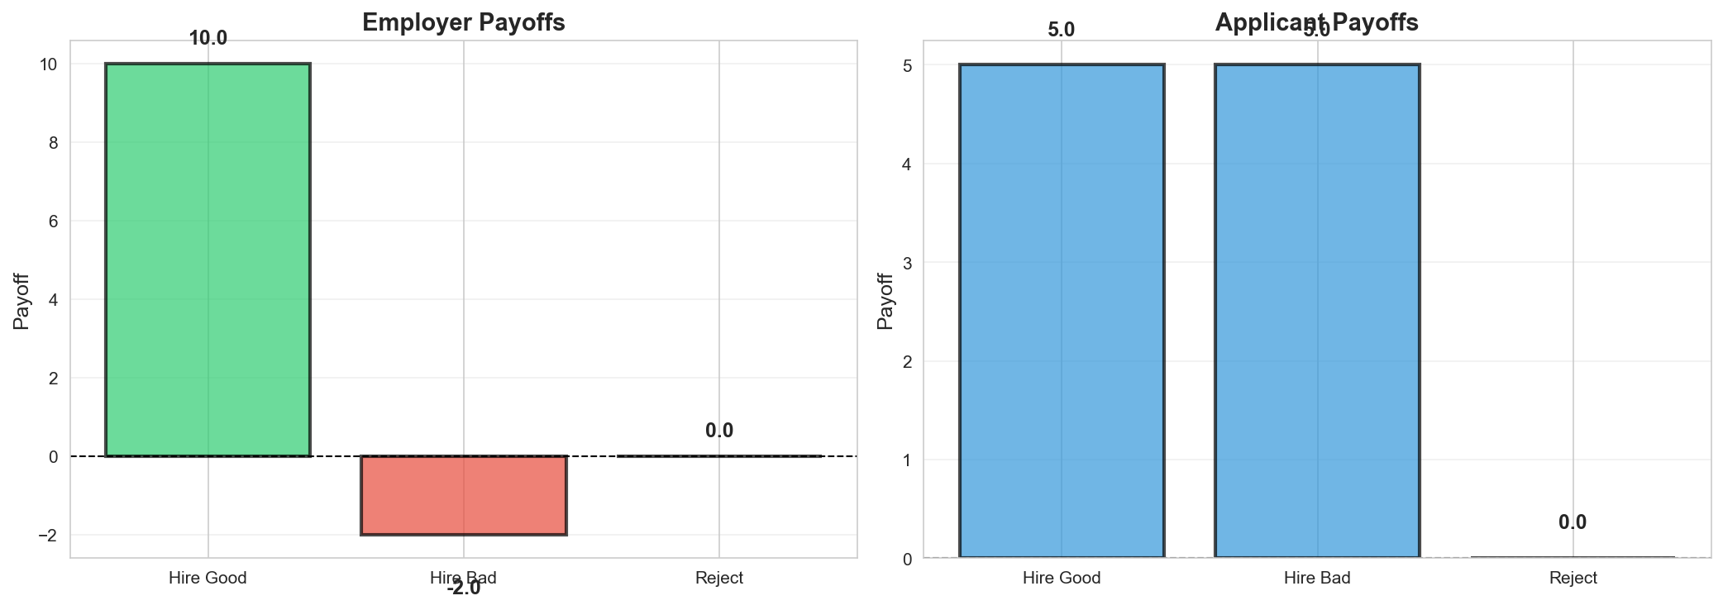
Beyond Probabilities: Payoffs
Hiring decisions involve costs and benefits:
B = Payoff from hiring a GOOD candidate (e.g., 10)
b = Payoff from hiring a BAD candidate (e.g., -2)
w = Applicant payoff if hired (e.g., 5)
Key insight: Bad hires can have negative payoffs!

Slide 15
Expected Payoff Calculation
Expected Payoff = Weighted average of possible outcomes:
E[Payoff] = B × Pr(Good) + b × Pr(Bad)
Or equivalently:
E[Payoff] = b + (B - b) × Pr(Good)
Example:
If Pr(Good) = 0.6, B = 10, b = -2
E[Payoff] = -2 + (10 - (-2)) × 0.6 = 5.2

Slide 16
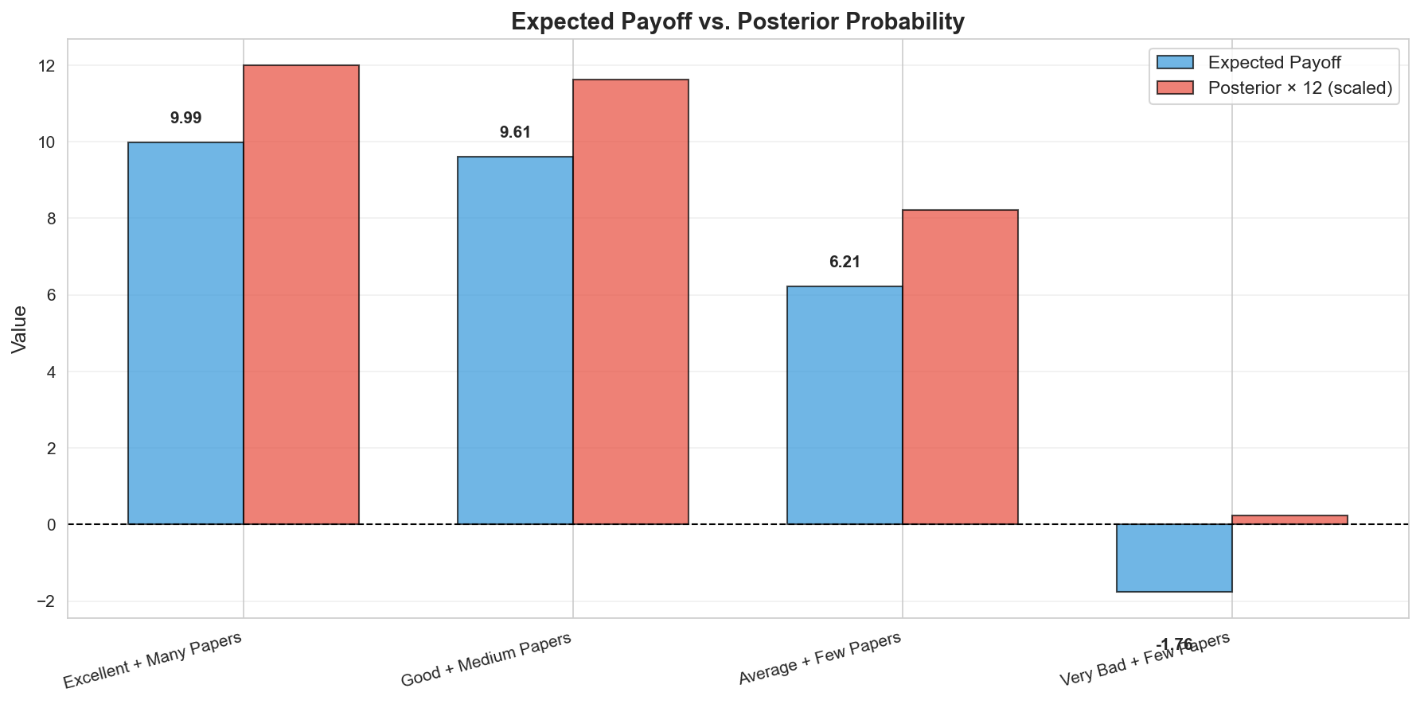
Expected Payoff: Real Examples

Slide 17
Two Decision Approaches
Approach 1: Probability-Based
IF Pr(F = good | G, N) > 0.5 → HIRE
ELSE → REJECT
✓ Simple and intuitive
✗ Assumes symmetric costs
Approach 2: Payoff-Based
IF E[Payoff] > 0 → HIRE
ELSE → REJECT
✓ Accounts for different costs/benefits
✓ More realistic for actual decisions
✓ Handles negative payoffs from bad hires

Slide 18
When Do Decisions Differ?
Example: Candidate with Pr(Good) = 0.55
Probability-based: HIRE (55% > 50%)
Payoff-based (B=10, b=-2):
E[Payoff] = -2 + 12 × 0.55 = 4.6 > 0 → HIRE
Payoff-based (B=10, b=-10):
E[Payoff] = -10 + 20 × 0.55 = 1 > 0 → HIRE
Payoff-based (B=10, b=-30):
E[Payoff] = -30 + 40 × 0.55 = -8 < 0 → REJECT
Key insight: High cost of bad hires makes us more conservative!

Slide 19
Summary
Start with prior belief about candidate quality
Observe two referrals (R1, R2) and trust (T1, T2)
Select referral based on trust (trust overrides quality!)
Network effect G = selected referral quality
Use Bayes' theorem to get Pr(F = good | G, N)
Compute expected payoff: E[Payoff] = B × Pr(Good) + b × Pr(Bad)
Make hiring decision based on probability

Slide 20
Thank You!
Questions?

