Slide 1
Chaperon-Based Hiring Model
Network Fair Process
Group #1
Using Chaperon Effect and Publication Count
To Better Understand Decisions
in Hiring

Slide 2
The Hiring Challenge
You need to hire the best candidates
But you can't directly observe their true quality
You only see signals:
  Network effect (G): Did they work with top researchers?
  Publication count (N): How many papers did they publish?
Solution: Bayesian inference to combine signals!

Slide 3
What We're Modeling
F (Fit)
Hidden
G (Network)
Observed
N (Papers)
Observed
Goal: Compute Pr(F = good | G, N)

Slide 4
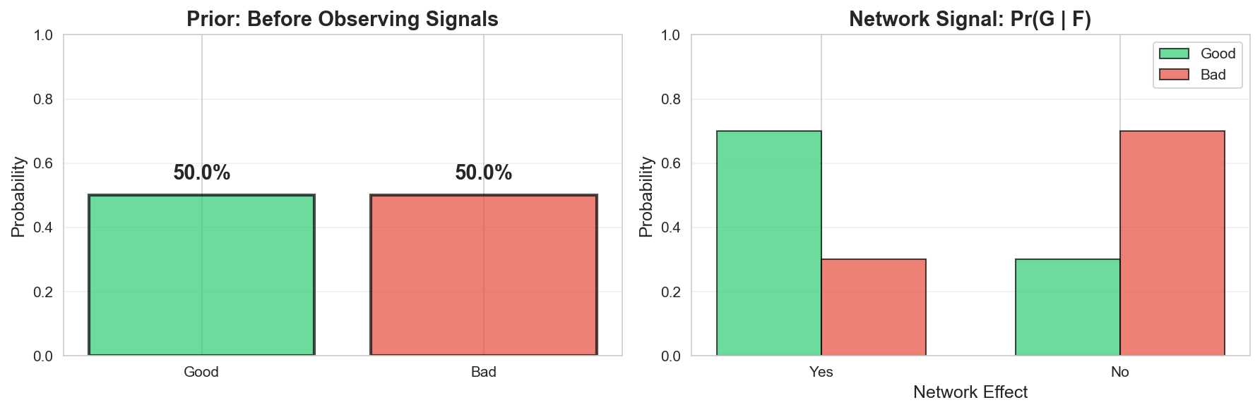
Step 1: Start with Prior Belief
Before seeing any signals, we have an initial belief:
Pr(F = good) = p = 0.5
  This means: 50% of candidates are good (on average)
Pr(F = bad) = 1 – Pr(F = good)

Slide 5
Step 2: Network Effect Signal
Network effect tells us about candidate quality (follows a Bernoulli distribution):
• Good candidates: 70% have network (q_good = 0.7)
• Bad candidates: 30% have network (q_bad = 0.3)
Network effect is a stronger signal for good candidates! q_good > q_bad

Slide 6
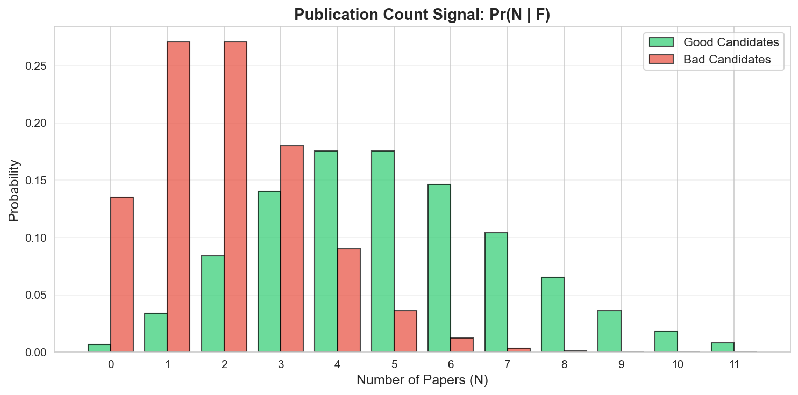
Step 3: Publication Count Signal
Publication count follows Poisson distribution:
• Good candidates: Average 5 papers (λ_good = 5.0)
• Bad candidates: Average 2 papers (λ_bad = 2.0)

Slide 7
Step 4: Combine Signals with Bayes' Theorem
Bayes' Theorem combines prior and signals:
Updated Belief = Prior × Likelihood / Evidence
Pr(F = good | G, N) = Pr(good) × Pr(G, N | good)
  ─────────────────────────
  Pr(G, N)
We assume that G and N are independent
  Pr(G, N | good) = Pr(G|good) Pr(N|good)

Slide 8
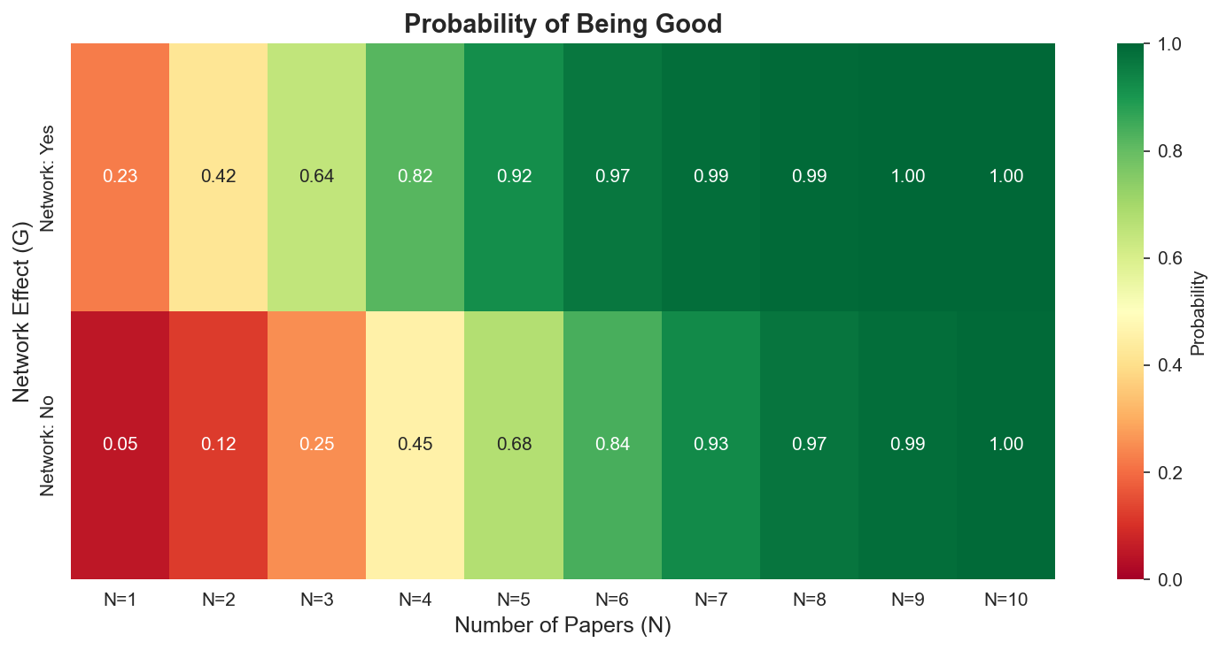
The Result: Probability Matrix
For each combination of signals, we compute the probability of being a “good” candidate:
Rows: Chaperon effect (Yes/No)
Columns: Number of papers (1-10)
Values: Pr(F = good | G, N)

Slide 9
Interpretation
5 papers are worth 3 chaperoned

Slide 10
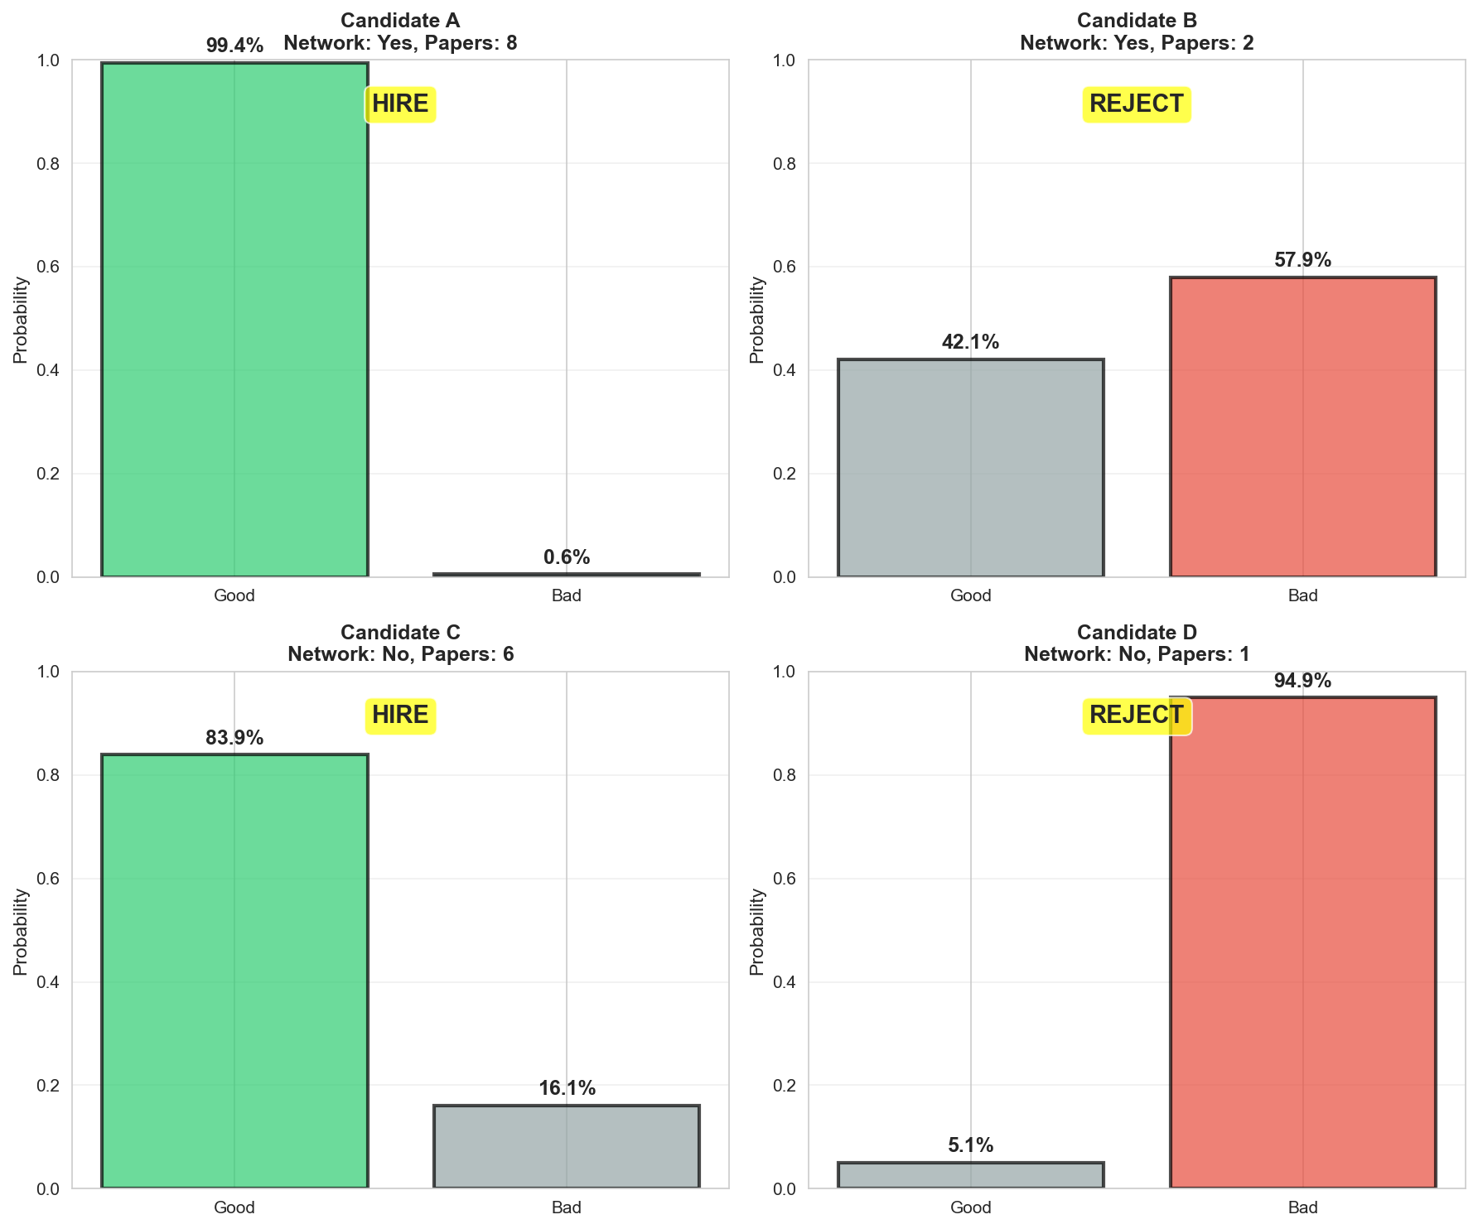
Real Examples: Four Candidates

Slide 11
Key Insights
Network effect is powerful:
  Candidates with network + few papers can still be good
Many papers help, but network matters more:
  No network + many papers = moderate probability
Weakest signal: No network + few papers
Strongest signal: Network + many papers

Slide 12
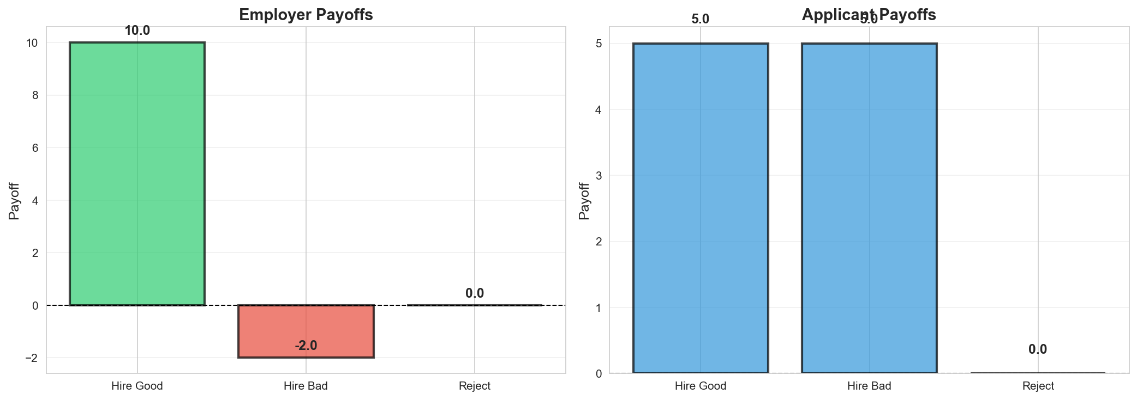
Beyond Probabilities: Payoffs
Hiring decisions involve costs and benefits:
B = Payoff from hiring a GOOD candidate (e.g., 10)
b = Payoff from hiring a BAD candidate (e.g., -2)
w = Applicant payoff if hired (e.g., 5)

Slide 13
Expected Payoff Calculation
Expected Payoff = Weighted average of possible outcomes:
  E[Payoff] = B × Pr(Good) + b × Pr(Bad)
Or equivalently:
E[Payoff] = b + (B - b) × Pr(Good)
Example:
If Pr(Good) = 0.6, B = 10, b = 2
E[Payoff] = 2 + (10 - 2) × 0.6 = 6.8

Slide 14
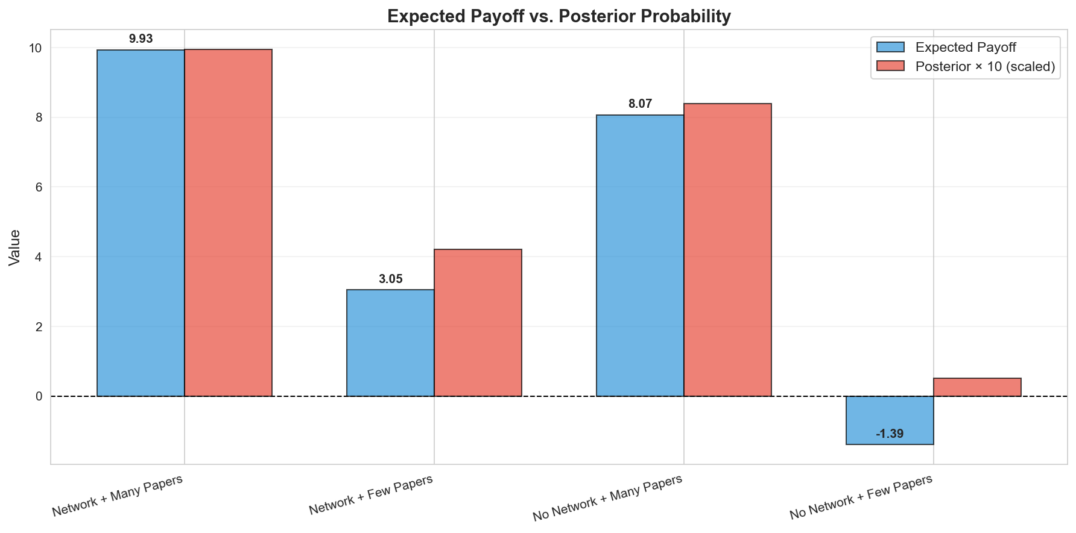
Expected Payoff: Real Examples

Slide 15
Two Decision Approaches
Approach 1: Probability-Based
IF Pr(F = good | G, N) > 0.5 → HIRE
ELSE → REJECT
✓ Simple and intuitive
✗ Assumes symmetric costs
Approach 2: Payoff-Based
IF E[Payoff] > 0 → HIRE
ELSE → REJECT
✓ Accounts for different costs/benefits
✓ More realistic for actual decisions

Slide 16
When Do Decisions Differ?
Example: Candidate with Pr(Good) = 0.55
  Probability-based: HIRE (55% > 50%)
  Payoff-based (B=10, b=2):
  E[Payoff] = 2 + 8 × 0.55 = 6.4 > 0 → HIRE
  Payoff-based (B=10, b=-10):
  E[Payoff] = -10 + 20 × 0.55 = 1 > 0 → HIRE
  Payoff-based (B=10, b=-30):
  E[Payoff] = -30 + 40 × 0.55 = -8 < 0 → REJECT
Key insight: High cost of bad hires makes us more conservative!

Slide 17
Summary
Start with prior belief about candidate quality
Observe signals: Network effect (G) and Papers (N)
Use Bayes' theorem to update beliefs
Get posterior probability: Pr(F = good | G, N)
Compute expected payoff: E[Payoff] = B × Pr(Good) + b × Pr(Bad)
Make hiring decision based on probability (probability-based or payoff-based)

Slide 18
Thank You!
Questions?

