Slide 1
Identification of the most suitable neighborhood in Munich, Germany, for a new state-funded food delivery service
Applied Data Science Capstone Project

Slide 2
The city of Munich needs to make a data-backed decision
As part of a Covid-19 recovery plan the city of Munich can deploy state funds for boosting the local economy
Insights are needed to plan major investment in a non-profit food delivery service
A pilot phase will start in the neighborhood(s) with highest potential
Highest potential is defined as the right combination of demand and supply indicators:
Demand = potential customers assumed as workers, aged 25 to 55
Supply = potential sellers

Slide 3
Sources
Demographic Data:
Population density
Employment data
Unemployment data
Geo-Spatial Data:
Foursquare Developers API
Coordinates for each postal code
Postal codes list

Slide 4
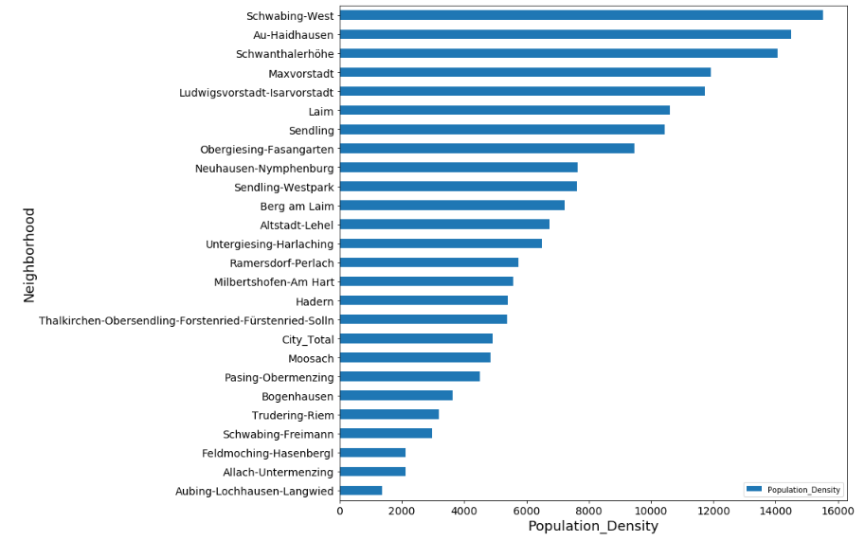
The neighborhood of Schwabing-West is the most populated = high potential demand

Slide 5
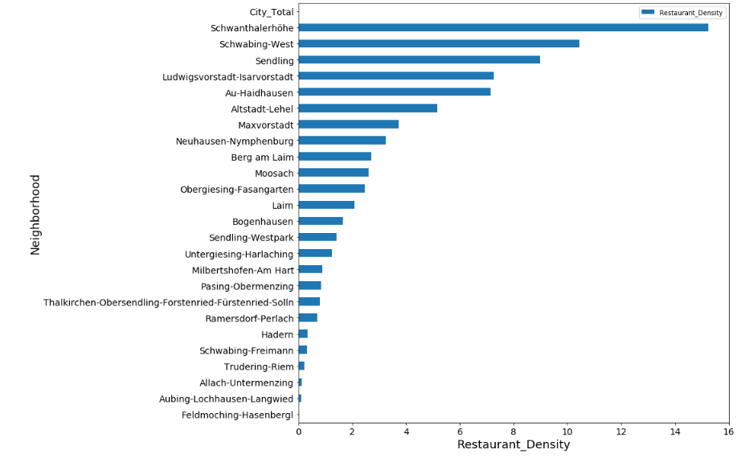
It is also the second highest for concentration of restaurants = high potential supply

Slide 6

Its net employment rate and population to restaurant ratio confirm its suitability
Other high potential neighborhoods identified in the analysis are:

