Slide 1
Digital Geometry Processing and Simulation
Jinlan Xu
Spring, 2020

Slide 2
What is a mesh ?
A mesh is a discretization of space into small simplicial or non-simplicial elements.
  Simplicial Complex: Triangle and tetrahedra
  Non-simplicial complex: Quadrilateral, polygon hexahedra, polyhedra.
Meshes are used in:
  Solving partial differential equations.
  Computer animation and simulations.

Slide 3
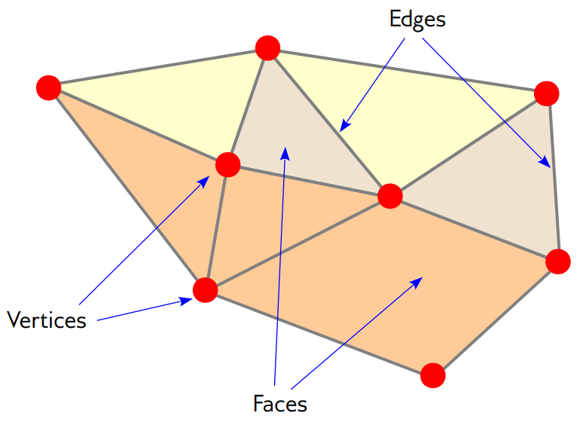
Elements of a mesh

Slide 4
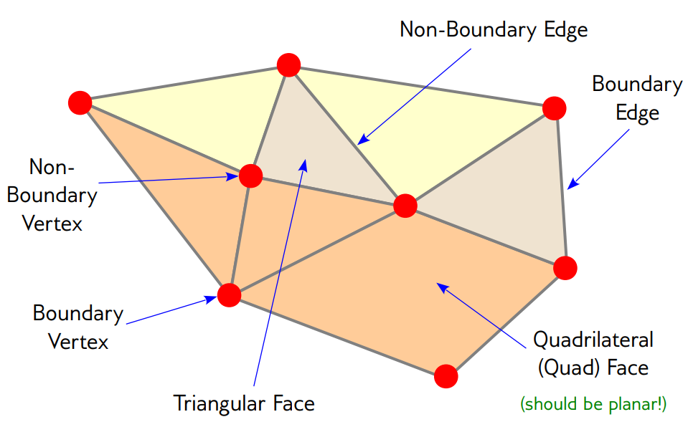
Elements of a mesh

Slide 5
Provable and Automatic
Simplicial meshing
Well-developed theory(especially Delaunay) and robust general purpose software.
All these can generate millions of high quality elements/min in any complex geometry.
Software | Elements | Developer
Triangle | Triangle | Jonathan Shewchuk
Tetgen | Tetrahedra | Hang Si
Quadmesh | Tetrahedra | Tamal Dey
Jaal | Quadrilateral | Tim Tautges

Slide 6
Meshes
Triangle mesh, Tetrahedron, Quadrilateral mesh, Hexahedral mesh
Data Structure
  halfedge

Slide 7
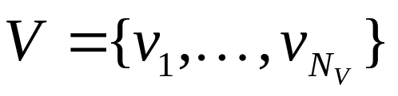
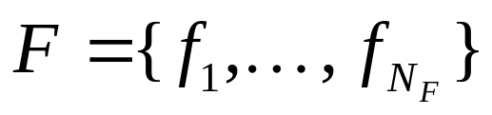
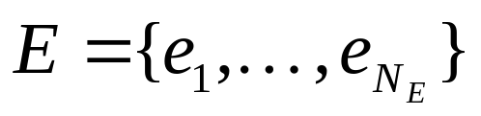
Triangle Mesh
A collection of triangles
  without any particular mathematical structure
Each triangle: a segment of piecewise linear surface representation
Geometric component
  Discrete vertices:
Topological component
  Faces:
  Edges:

Slide 8
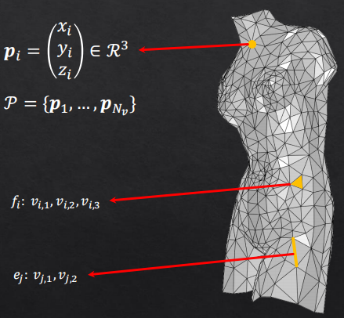
Triangle Mesh
A collection of triangles
  without any particular mathematical structure
Each triangle: a segment of piecewise linear surface representation
Geometric component
  Discrete vertices:
Topological component
  Faces:
  Edges:

Slide 9
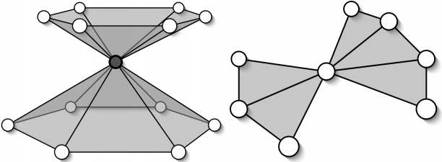
Non-manifold
Non-manifold vertex is generated by pinching two surface sheets together at that vertex such that the vertex is incident to more then one fan of triangles.

Slide 10
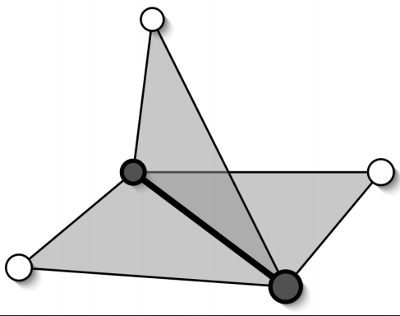
Non-manifold
Non-manifold edge has more than two incident triangles.

Slide 11
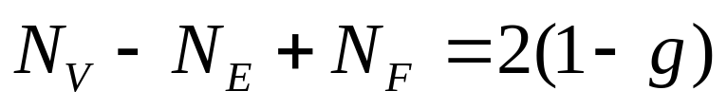
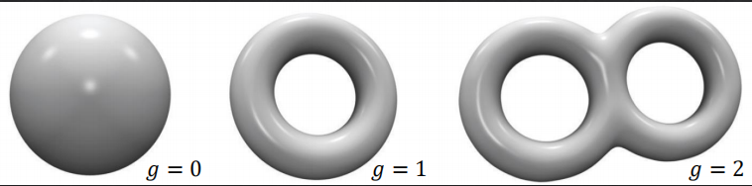
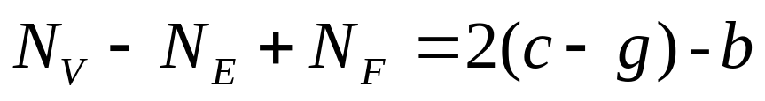
Euler fomula
  The number of vertices N_{V}, edges N_{E}, and faces N_{F} in a closed mesh.
  The number of connected components c , boundaries b in a open mesh.

Slide 12
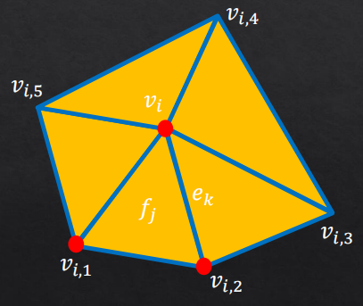
Mesh Data Structure
Geometry queries
  What are the vertices of face #k?
  Are vertices #i and #j adjacent?
  Which faces are adjacent face #k?
Geometry operations
  Remove/add a vertex/face
  Vertex split, edge collapse

Slide 13
Storing Mesh Data (1)
Storage of generic meshes
  Hard to implement efficiently
Assume
  Triangular
  Orientable
  Manifold

Slide 14
Storing Mesh Data (2)
How “good” is a data structure?
  Space complexity
  Time
    Time to construct - preprocessing
    Time to answer a query
    Time to perform an operation (update the data structure)
  Trade-off between time and space
  Redundancy

Slide 15
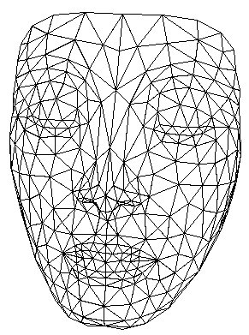
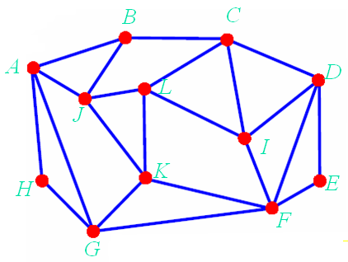
Define a Mesh (1)
Geometry
  Vertex coordinates
Connectivity
  How do vertices connected?

Slide 16
Define a Mesh (2)
List of Edge
Vertex-Edge
Vertex-Face
Combined

Slide 17
3D Mesh Surface
Surface & material properties
  Material color
  Ambient, hightlight coefficients
  Texture coordinates
  BRDF, BTF
Rendering properties
  Lighting
  Normals
  Rendering modes

Slide 18
General Used Mesh Files
General used mesh files
  Wavefront OBJ (*.obj)
  3D Max (*.max, *.3ds)
  VRML(*.vrl)
  Inventor (*.iv)
  PLY (*.ply, *.ply2)
  OFF(*.off)
  User-defined(*.m, *.liu)
Storage
  Text – (Recommended)
  Binary

Slide 19
List of Faces
List of vertices
  Position coordinates
List of faces
  Triplets of pointers to face vertices (c1,c2,c3)
Queries:
  What are the vertices of face #3?
    Answered in O(1) - checking third triplet
  Are vertices i and j adjacent?
    A pass over all faces is necessary – NOT GOOD

Slide 20
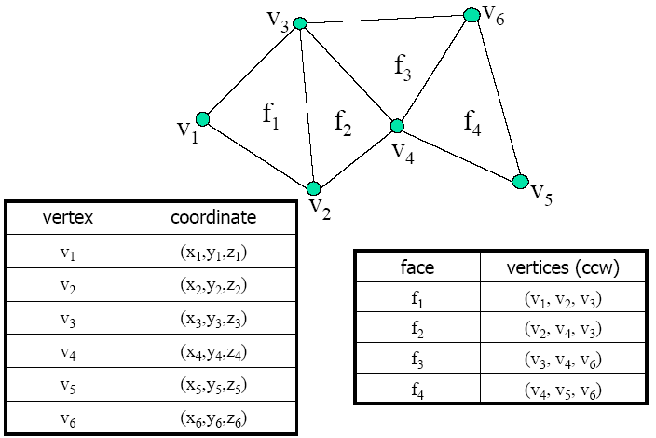
List of Faces – Example

Slide 21
List of Faces – Analysis
Pros:
  Convenient and efficient (memory wise)
  Can represent non-manifold meshes
Cons:
  Too simple - not enough information on relations between vertices & faces

Slide 22
Adjacency Matrix – Definition
View mesh as connected graph
Given n vertices build n*n matrix of adjacency information
  Entry (i,j) is TRUE value if vertices i and j are adjacent
Geometric info
  list of vertex coordinates
Add faces
  list of triplets of vertex indices (v1,v2,v3)

Slide 23
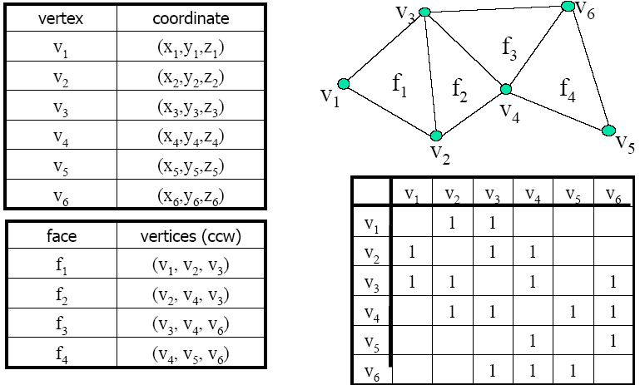
Adjacency Matrix – Example

Slide 24
Adjacency Matrix – Queries
What are the vertices of face #3?
  O(1) – checking third triplet of faces
Are vertices i and j adjacent?
  O(1) - checking adjacency matrix at location (i,j).
Which faces are adjacent to vertex j?
  Full pass on all faces is necessary

Slide 25
Adjacency Matrix – Analysis
Pros:
  Information on vertices adjacency
  Stores non-manifold meshes
Cons:
  Connects faces to their vertices, BUT NO connection between vertex and its face

Slide 26
Half-Edge Data Structure
Record for each face, edge and vertex:
  Geometric information
  Topological information
  Attribute information
Doubly-Connected Edge List(DCEL)

Slide 27
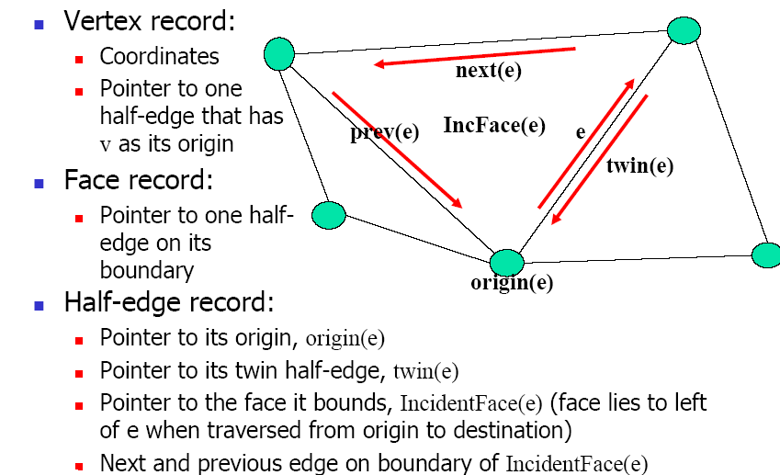
Half-edge Data structure

Slide 28
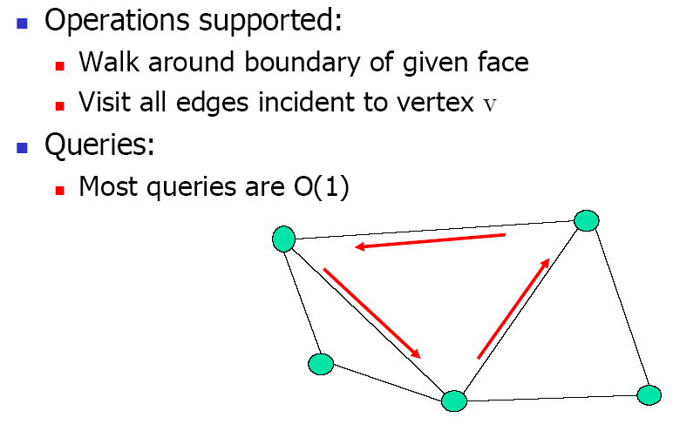
Half-edge Data structure

Slide 29
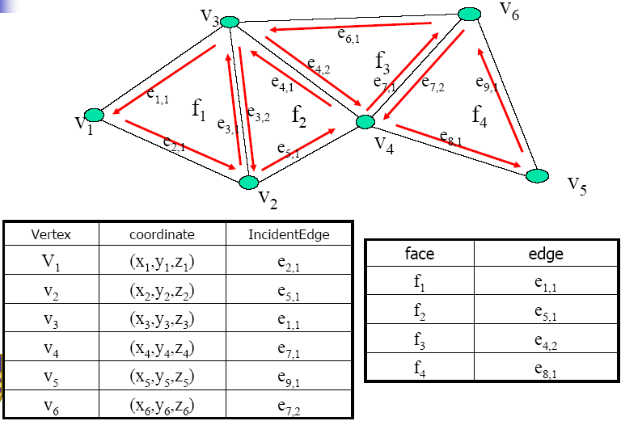
Half-edge – Example

Slide 30
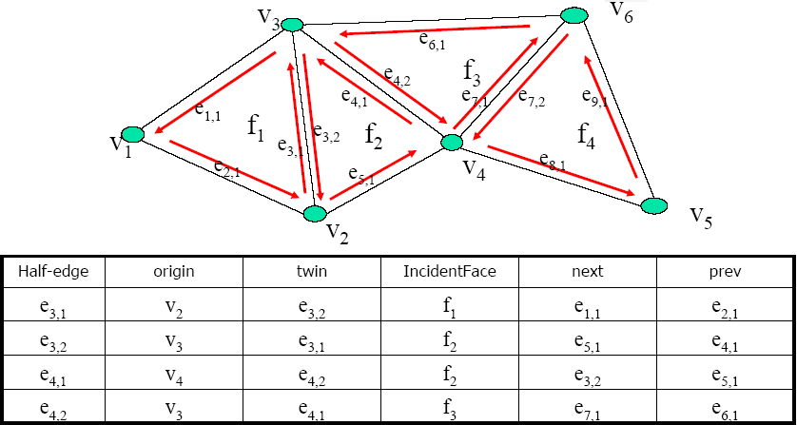
Half-edge – Example

Slide 31
Half-edge – Analysis
Pros
  All queries in O(1) time
  All operations are O(1) (usually)
Cons
  Represents only manifold meshes

Slide 32
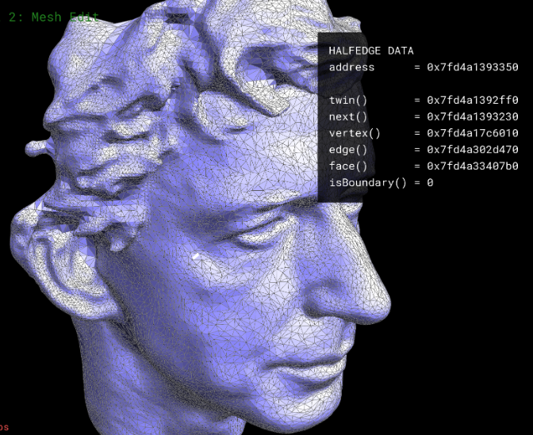
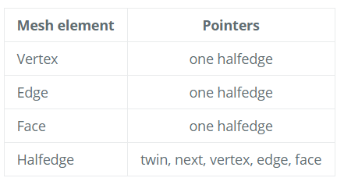
Half-edge based mesh representation
Store a triangular mesh.

Slide 33
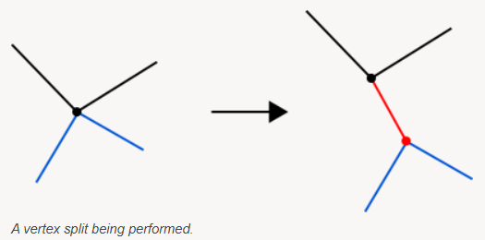
Half-edge based mesh representation
Vertex split.

Slide 34
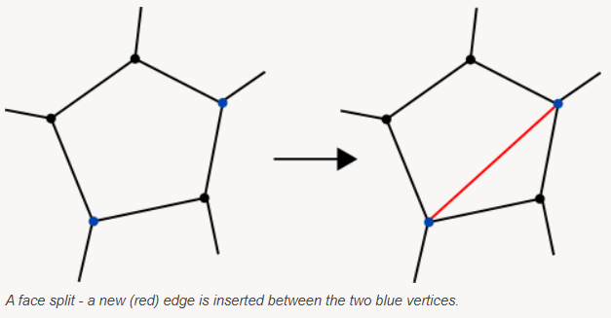
Half-edge based mesh representation
Face split.

Slide 35
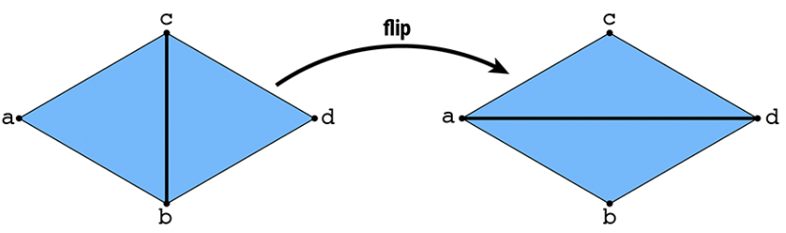
Half-edge based mesh representation
Flip the selected edge.

Slide 36
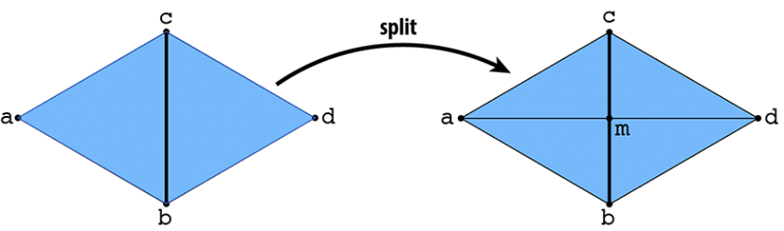
Half-edge based mesh representation
Split the selected edge.

Slide 37
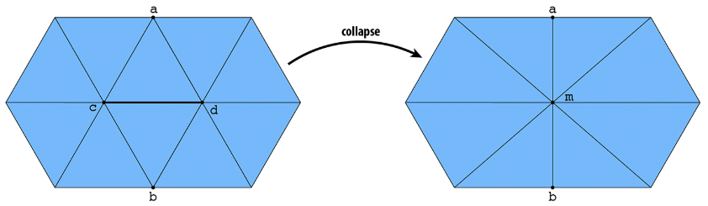
Half-edge based mesh representation
Collapse the selected edge.

Slide 38
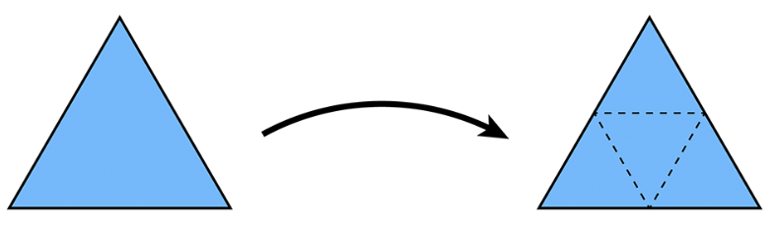
Half-edge based mesh representation
Subdivision.

Slide 39

Questions?

