Slide 1
Digital Geometry Processing and Simulation
Jinlan Xu
Spring, 2020

Slide 2
Discrete Differential Geometry on Meshes

Slide 3
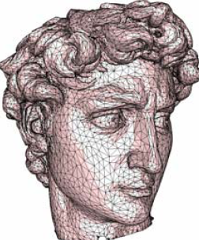
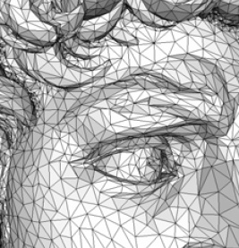
Smoothness of a triangular mesh?

Slide 4
However, meshes are only C⁰
Meshes are piecewise linear surfaces
  Infinitely continuous on triangles
  C⁰ at edges and vertices

Slide 5
Discrete Differential Geometry
How to apply the traditional differential geometry on discrete mesh surfaces?
  Normal estimation
  Curvature estimation
  Principal curvature directions
  …

Slide 6
Estimation of Differential Measures
Approximate the (unknown) underlying surface
  Continuous approximation
    Approximate the surface & compute continuous differential measures (normal, curvature)
  Discrete approximation
    Approximate differential measures for mesh

Slide 7
Continuous Approximation

Slide 8
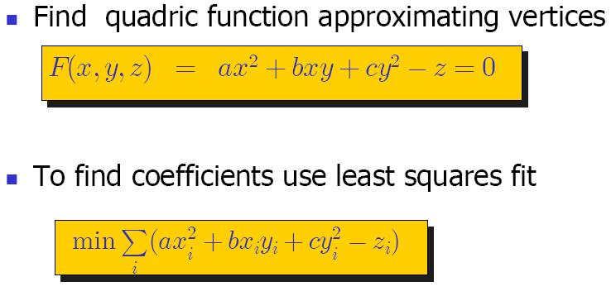
Quadratic Approximation

Slide 9
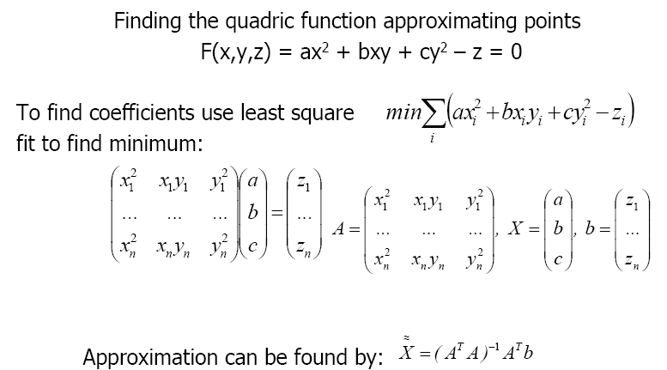
Quadratic Approximation

Slide 10
Other approximation
Cubic approximation
  J. Goldfeather and V. Interrante. A novel cubic-order algorithm for approximating principal direction vectors. ACM Transactions on Graphics 23, 1 (2004), 45–63.
Implicit surface approximation
  Yutaka Ohtake et al. Multi-level partition of unity implicits. Siggraph 2003.
Many others…

Slide 11
Discrete Approximation

Slide 12


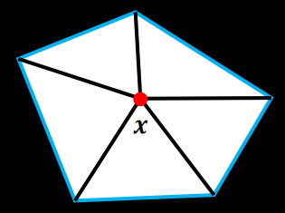
Local Averaging Region
General idea: spatial averages over a local neighborhood of a point .
: a mesh vertex
: n-ring neighborhoods of mesh vertex or local geodesic balls.
Size of affects the
stability and accuracy.

Slide 13
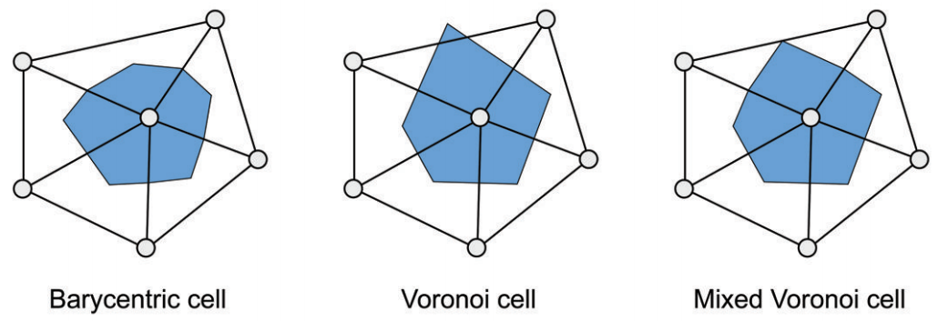
Local Averaging Region
triangle barycenters
edge midpoints
triangle barycenters
triangle circumcenter
circumcenter for obtuse triangles
edge midpoints

Slide 14

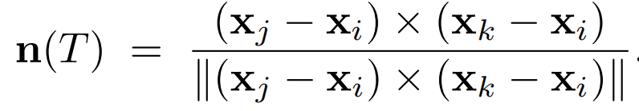
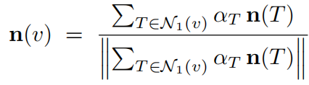
Normal Estimation
Normal vectors on faces
  For individual triangle
Normal estimation on vertices
  Average face normals of 1-ring neighborhood
    Weighted: face areas, angles at vertex

Slide 15
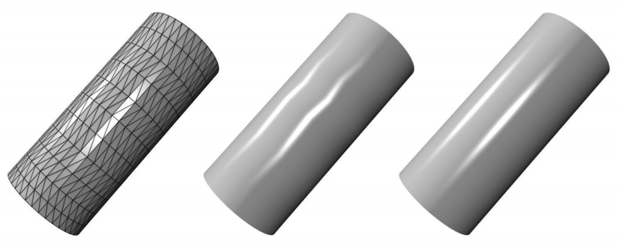



Normal Estimation

Slide 16
Implementation thinking
How to compute the area of local average region?
How to compute the normal on triangles or vertices?

Slide 17
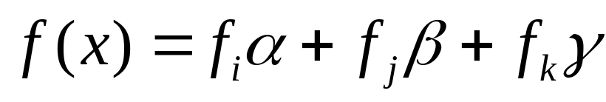
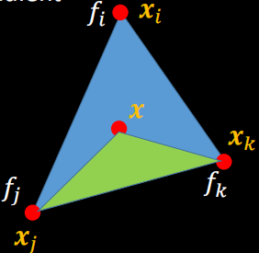
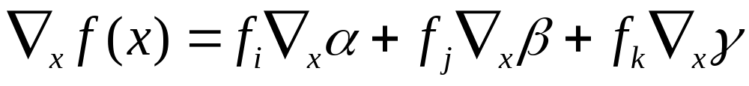
Gradients
Given the function value on vertices, compute the gradient on each triangle.
A piecewise linear function
Gradient:

Slide 18
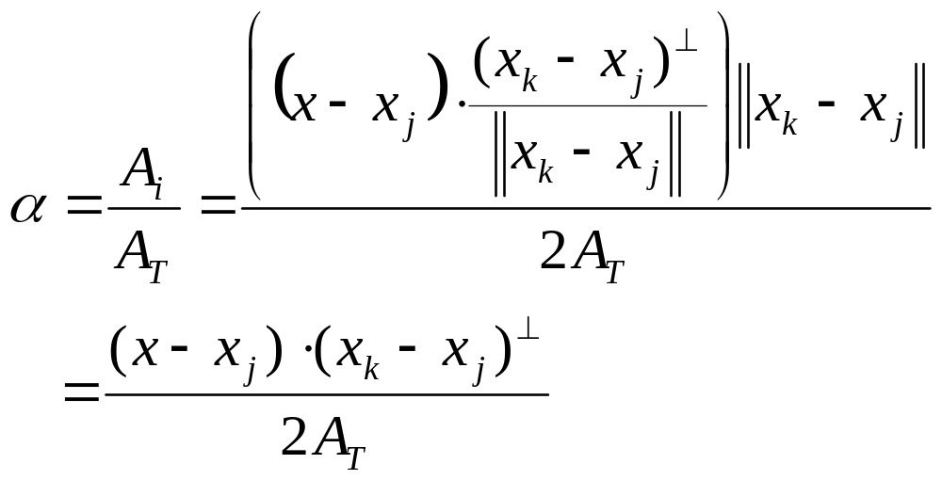
Gradients
Because

Slide 19
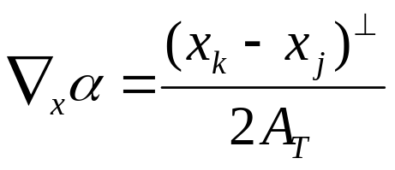
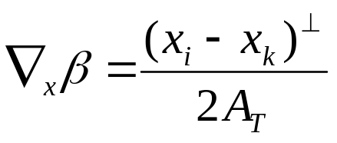
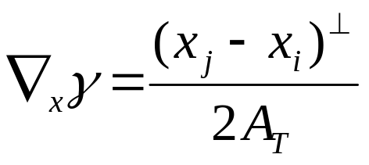
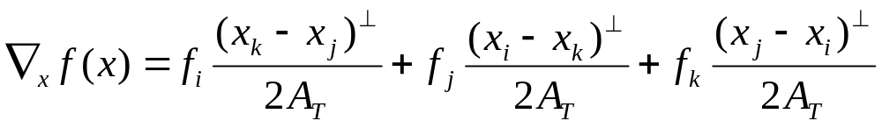
Gradients
Then

Slide 20
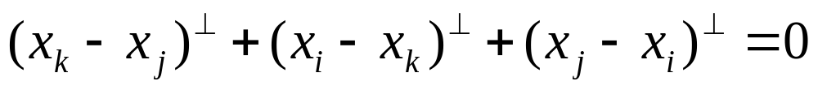
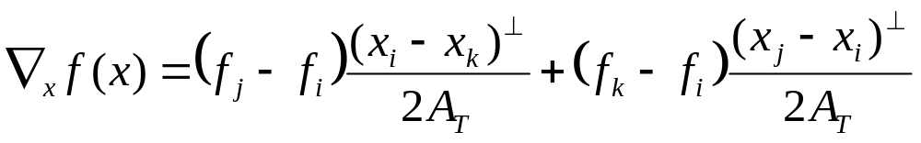
Gradients
Because

Slide 21
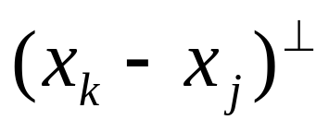
Gradients
Constant on each facet.
Different in different facets
No definition on vertices.
If the signal is on the positions of vertices, what does the gradient mean?
How to compute in 3D?

Slide 22
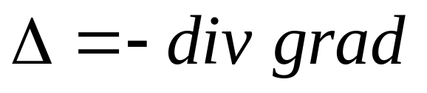
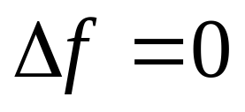

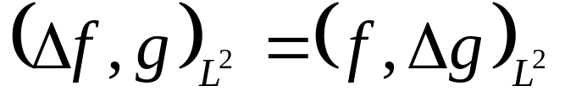
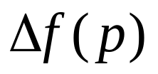
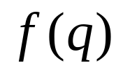

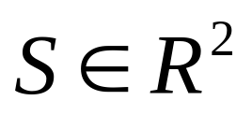
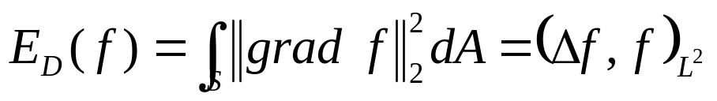
Laplace-Beltrami Operator
On smooth surface S, .
  (NULL) where is constant.
  (SYM)
  (LOC) is independent of for any pair .
  (LIN) where and is linear.
  (MAX) Maximum principle: harmonic functions have no local maxima at interior points.
  (PSD) Dirichlet energy is non-negative.

Slide 23
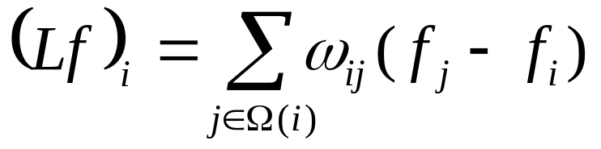
Discrete Laplace-Beltrami Operator
Applications on triangular surface mesh
  mesh filtering, parameterization, pose transfer, segmentation, reconstruction, remeshing, compression, simulation, and interpolation
Constant gradient on facet --> zero laplace value on facet.
Exists on the vertex
A discrete Laplace operator on vertex-based functions:

Slide 24
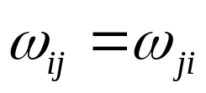
Desired Properties for Discrete Laplace Beltrami Operator
Require a discrete Laplacian having properties corresponding to (some subset of) the properties of the continuous Laplace operator:
  NULL
    whenever is constant.
  SYM
    Condition:
    Real symmetric matrices exhibit real eigenvalues and orthogonal eigenvectors.

Slide 25
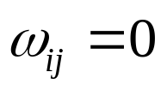
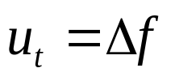
Desired Properties for Discrete Laplace Beltrami Operator
Require a discrete Laplacian having properties corresponding to (some subset of) the properties of the continuous Laplace operator:
  LOC
    Condition: weights are associated to mesh edges,
    if vertex i and j do not share an edge.
    Smooth Laplacians govern diffusion processes via
    .

Slide 26
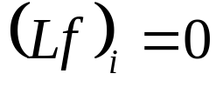
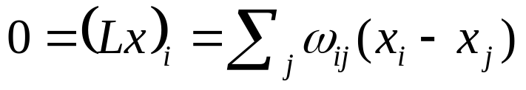
Desired Properties for Discrete Laplace Beltrami Operator
Require a discrete Laplacian having properties corresponding to (some subset of) the properties of the continuous Laplace operator:
  LIN
    for all interior vertices when the positions of vertices are in the plane.
    Condition: .
    Applications: de-noising, parameterizations, plate bending energies.

Slide 27
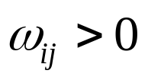

Desired Properties for Discrete Laplace Beltrami Operator
Require a discrete Laplacian having properties corresponding to (some subset of) the properties of the continuous Laplace operator:
  POS
    Condition: whenever
    A sufficient condition for a discrete maximum principle.
    In diffusion problems, this property assures that flow travels from regions of higher to regions of lower potential.
    Establishes a connection to barycentric coordinates.

Slide 28

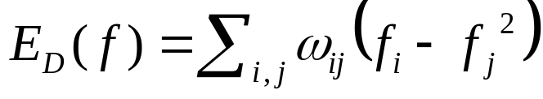
Desired Properties for Discrete Laplace Beltrami Operator
Require a discrete Laplacian having properties corresponding to (some subset of) the properties of the continuous Laplace operator:
  PSD
    Condition: is symmetric positive semi-definite.
    Discrete Dirichlet energy
    SYMMETRY + POSITIVE WEIGHTS → POSITIVE SEMI-DEFINITENESS
    POSITIVE SEMI-DEFINITENESS ↛ POSITIVE WEIGHTS

Slide 29
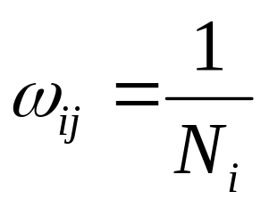
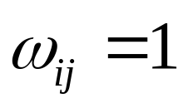
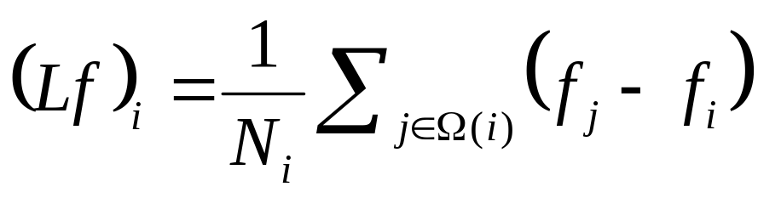
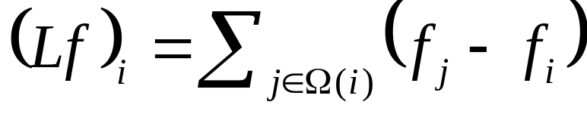
Uniform Laplacian
or
or
Violate property of LINEAR PRECISION
The definition only depends on the connectivity of the mesh.
The uniform Laplacian does not adapt at all to the spatial distribution of vertices.

Slide 30
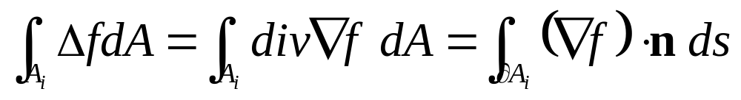
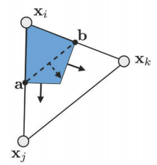
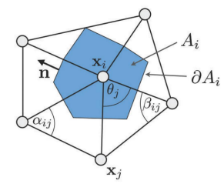
Cotangent Formula
mixed finite element/finite volume method
  Assume it constant on each vertex

Slide 31
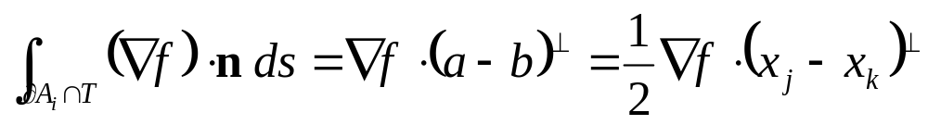
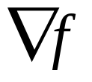
Cotangent Formula
We split this integral by considering the integration separately for each triangle T.
is constant within each triangle.

Slide 32
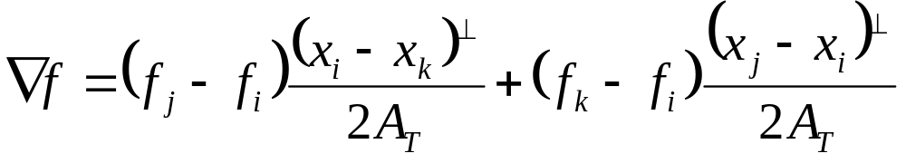
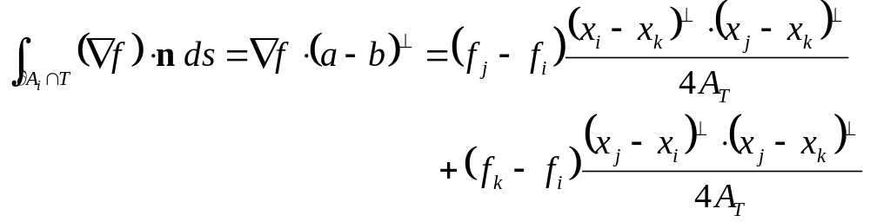
Cotangent Formula

Slide 33
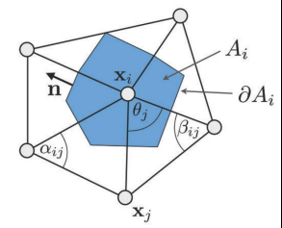
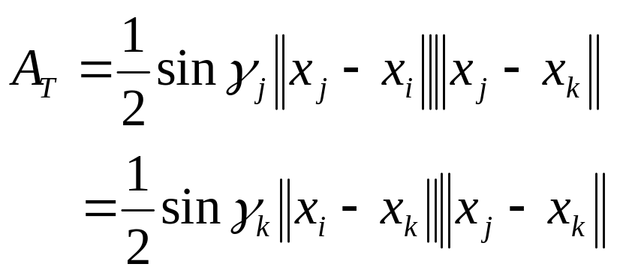
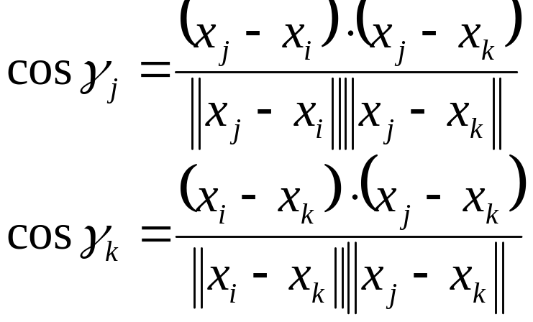
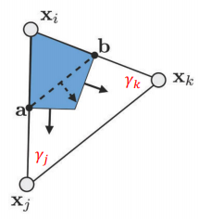
Cotangent Formula

Slide 34


Cotangent Formula

Slide 35





Cotangent Formula
Discrete average of the Laplace-Beltrami operator of a function 𝑓at vertex is given as
  most widely used discretization
  become negative if
  Violate the property of POSITIVE WEIGHTS.

Slide 36


Discrete Curvature
When applied to the coordinate function 𝒙, the Laplace-Beltrami operator provides a discrete approximation of the mean curvature normal.
absolute discrete mean curvature at vertex

Slide 37



Discrete Curvature
A discrete operator for Gaussian curvature

Slide 38

mean curvature
Gaussian curvature

Slide 39
Implementation thinking
How to compute the cotangent formula?
How to compute the discrete Gaussian curvature?

Slide 40
More…
MEYER M., DESBRUN M., SCHRÖDER P., BARR A.: Discrete differential-geometry operators for triangulated 2-manifolds. In Visualization and Mathematics III, Hege H.-C., Polthier K., (Eds.). Springer, 2003, pp. 35–58. (PDF)

Slide 41


Applications
Feature detection
Shape recognition
Mesh segmentation
Any feature-aware applications
  Preserving salient features in processing
Challenges:
  What are features on surfaces?

Slide 42

Questions?

