Slide 1
BevoTag: Finding Lost Items Anywhere on the UT Campus
Oral Design Review · Team SP11
Ethan Chua, Abhirit Das, Esteban Martinez, Li Shi, Andrew Yin
Faculty Mentor: Dr. Haris Vikalo · Technical TA: Mugdha Jadhao
[Date]
Notes:
Introduce the team and the project in one sentence: BevoTag is a small tag that finds a laptop, bag, or piece of lab equipment anywhere on campus, including inside buildings where today's trackers fail. Say that the talk covers the design choices we have made so far and the results of our five risk reduction deliverables, and that we want feedback on the open questions at the end.

Slide 2
Where Is the Laptop You Left in EER Last Night?
An AirTag updates only when a passing iPhone hears it. An empty lab at night has no passing phones [1].
GPS barely works indoors. Between tall buildings, one test measured position errors over 9 m [2].
Campus already has the infrastructure: UT IT lists 300 Wi-Fi access points in EER alone [12].
BevoTag uses those campus Wi-Fi signals and its own motion sensor to find the item, indoors and on any floor.
Sources: [1] Apple, AirTag; [2] Yoder and Humphreys, NAVIGATION, 2023; [12] UT IT access point list, 2026.
Notes:
Open with the scenario, not the technology. Someone leaves a laptop in an EER lab and realizes it at home. An AirTag updates only when a passing iPhone hears it, and at night an empty lab has none. GPS is the other common answer, but satellite signals barely reach indoors, and even between tall buildings one test of a precise receiver without inertial aiding measured errors over 9 m. The point to land: campus already has the infrastructure we need. UT IT's list shows 300 access points in EER alone, and BevoTag uses those signals instead of new hardware or other people's phones.

Slide 3
Problem Statement
BevoTag is a low-cost tag that locates misplaced items anywhere on the UT campus, including inside buildings and on any floor, without new infrastructure or passing phones.
Target | Value
Identifies the room that contains the item | More than 90% of trials
Median position error | Under 5 m
Location update while the item moves | At least every 10 s
Battery life on one charge | At least 24 h
Source: BevoTag Project Definition, Oct. 2026.
Notes:
Read the one-sentence problem statement, then the four targets in the table. These four numbers are how we will judge every design choice in the rest of the talk. Room identification is the hardest one: published Wi-Fi fingerprinting already reaches 1 to 5 m, so the 5 m median error is a ceiling, but picking the right room as conditions change is where existing systems fall short.

Slide 4
What We Will Cover
Design objectives: requirements, standards, and what we design vs. buy
Alternatives we considered and the criteria we used to choose
System block diagram and progress against our original plan
Five risk reduction deliverables:
  Omnidirectional antenna · ESP32 firmware · Survey collector · 3D building model · EER data collection
Residual risks for EE 464 and our plan to address them
Team contributions and our assessment of the project
Notes:
Give the roadmap in one breath. We start with the problem and the targets, then the requirements and standards, then the alternatives we considered and how we chose. After the block diagram and our progress against plan, we present the five risk reduction deliverables: the omnidirectional antenna, the ESP32 firmware, the survey collector, the 3D building model, and the EER data collection. We close with the residual risks, each member's contributions, and our assessment.

Slide 5
Requirements and Key Specifications
Need: find an item indoors, on any floor, with no new infrastructure and no passing phones.
Parameter | Target | Parameter | Target
Room identification | > 90% of trials | Time to first fix | < 30 s
Floor identification | > 95% of indoor trials | Battery life | ≥ 24 h per charge
Median position error | < 5 m | Tag size | ≤ 80 × 50 × 25 mm
Update interval while moving | ≤ 10 s | Tag mass | ≤ 100 g
End-to-end latency | < 5 s | Parts cost | ≤ $50 per tag
Operating conditions: surveyed EER floors and plazas first; at least three access points above −80 dBm; 0 to 40 °C; walking speed up to 5 m/s.
Source: BevoTag Project Definition, Oct. 2026 (Performance and Operating Environment Specifications).
Notes:
Explain how the product meets the need: it works indoors on every floor, it needs no beacons installed in rooms, and it does not depend on a passerby's phone. Then walk the table briefly. The first four rows are accuracy and timeliness; the last four are battery, size, mass, and cost, which constrain the tag hardware. All values come from the Project Definition; we will confirm them with Dr. Vikalo before detailed design.

Slide 6
Standards and Constraints
Standard or policy | Effect on BevoTag
IEEE 802.11 [11] | Defines the training fields that CSI is measured from; the tag needs a CSI-capable Wi-Fi chip
FCC 47 C.F.R. Part 15 [13] | Use a pre-certified radio module and label the product "Contains FCC ID"
IEC 62133-2 [14] | Certified lithium cell plus a protection circuit for overcharge, short circuit, and heat
UT Acceptable Use Policy [15] | Tag acts only as an ordinary client on utexas-iot; never probes or congests the network
Privacy commitment (Project Definition) | Keep only access point measurements; discard frames from people's devices
Sources: [11] IEEE Std 802.11-2020; [13] 47 C.F.R. Part 15; [14] IEC 62133-2:2017+A1:2021; [15] UT Austin, Acceptable Use Policy, 2019.
Notes:
Each standard changes a concrete design decision. 802.11 defines the training fields that CSI is measured from, so the tag needs a Wi-Fi chip that exposes CSI. FCC Part 15 pushes us to a radio module that is already certified. IEC 62133-2 covers lithium battery safety, so we choose a certified cell and add a protection circuit. UT's acceptable use policy forbids probing or disrupting the network, so the tag only listens or joins utexas-iot as an ordinary client, and it never stores another person's device address.

Slide 7
What We Design vs. What We Buy
We design | We buy or reuse
ESP32 firmware: RSSI and CSI capture | ESP32 development board
Survey collector web app | IMU and GPS modules
3D building model and signal map | Linx 2.4 GHz omnidirectional antenna
Position estimation and sensor fusion | Certified rechargeable battery
Location server and user app (EE 464) | Three.js 3D library, UT floor-plan PDFs
Tag circuit board and enclosure (EE 464) | 300 EER and 103 ECJ campus access points
Notes:
Left column is our design content: the firmware, both parts of the web app, the position estimation and fusion, and next semester the server, user app, and tag circuit board. Right column is off-the-shelf: the ESP32 board, the IMU and GPS modules we bought for the logger, the Linx omnidirectional antenna, a certified battery, and the campus access points themselves, which we use but do not control.

Slide 8
Alternatives Considered: The Product Concept
Criterion | GPS watch / bike computer | Urban positioning system | Campus item tag (BevoTag)
Source | 9/20 brainstorm | 9/1 project proposal | 9/20 brainstorm; 10/15 Project Definition
Survey effort | Low: street level | High: whole urban area | High: room level, a few buildings
Optimized for | User experience | Sub-meter accuracy | Small size, low power, low cost
Unmet user need | Weak: mature products exist | Broad, hard to define a user | Strong: trackers fail indoors
Testable in 2 semesters | Yes | No: scope too large | Yes: EER, ECJ, ASE
Decision | Rejected | Narrowed into BevoTag | Chosen
Sources: team brainstorming notes (9/20/2026); ECE 364D Student-Proposed Project Form (9/1/2026).
Notes:
We did not start with BevoTag. In our September 20 brainstorm we compared a GPS watch or bike computer with a campus item tag, and our September 1 proposal described a general urban positioning system. Walk the criteria row by row. The watch needs little survey work but mainly competes on user experience with mature products. The urban system matched our skills but was too broad to test in two semesters. The campus tag needs the most survey effort, but it answers a clear need that current trackers miss and we can test it in buildings we use every day. [Team: confirm the deciding reason in your own words.]

Slide 9
Alternatives Considered: Technical Choices
Decision | Options compared | Criteria | Current choice
Position signal | GNSS, BLE crowdsourcing, BLE beacons, UWB, Wi-Fi RSSI, Wi-Fi CSI | Works indoors; no new infrastructure; cost | Wi-Fi RSSI baseline; CSI under test [4], [5]
Fusion filter | Extended Kalman filter vs. particle filter | Uses floor plans; compute cost | Compare both on logged EER walks [7], [8]
Where the position is computed | On the tag vs. on the server | Battery life; tag memory | Decide after measuring power
Fingerprint matching | k-nearest neighbors vs. neural network | Accuracy; amount of survey data needed | k-NN baseline built; neural network later
Antenna | ESP32 onboard antenna vs. external omnidirectional | RSSI change with heading | Omnidirectional (risk reduction 1)
Sources: [4] Bahl and Padmanabhan, INFOCOM, 2000; [5] Wang et al., IEEE Trans. Veh. Technol., 2017; [7] Evennou and Marx, 2006; [8] Welch and Bishop, 2004.
Notes:
Each row is a design decision, the options we compared, the criteria, and where we stand. For the signal, GNSS fails indoors, BLE crowdsourcing needs passing phones, and beacons or UWB need new hardware in every room, so Wi-Fi wins on infrastructure. RSSI is the baseline; CSI stays only if it improves room identification, since DeepFi reported 30 to 39 percent lower error on more capable hardware. For fusion, the EKF is light enough for the tag but cannot use walls; a particle filter can, but would likely run on the server. We will compare both on logged EER walks.

Slide 10
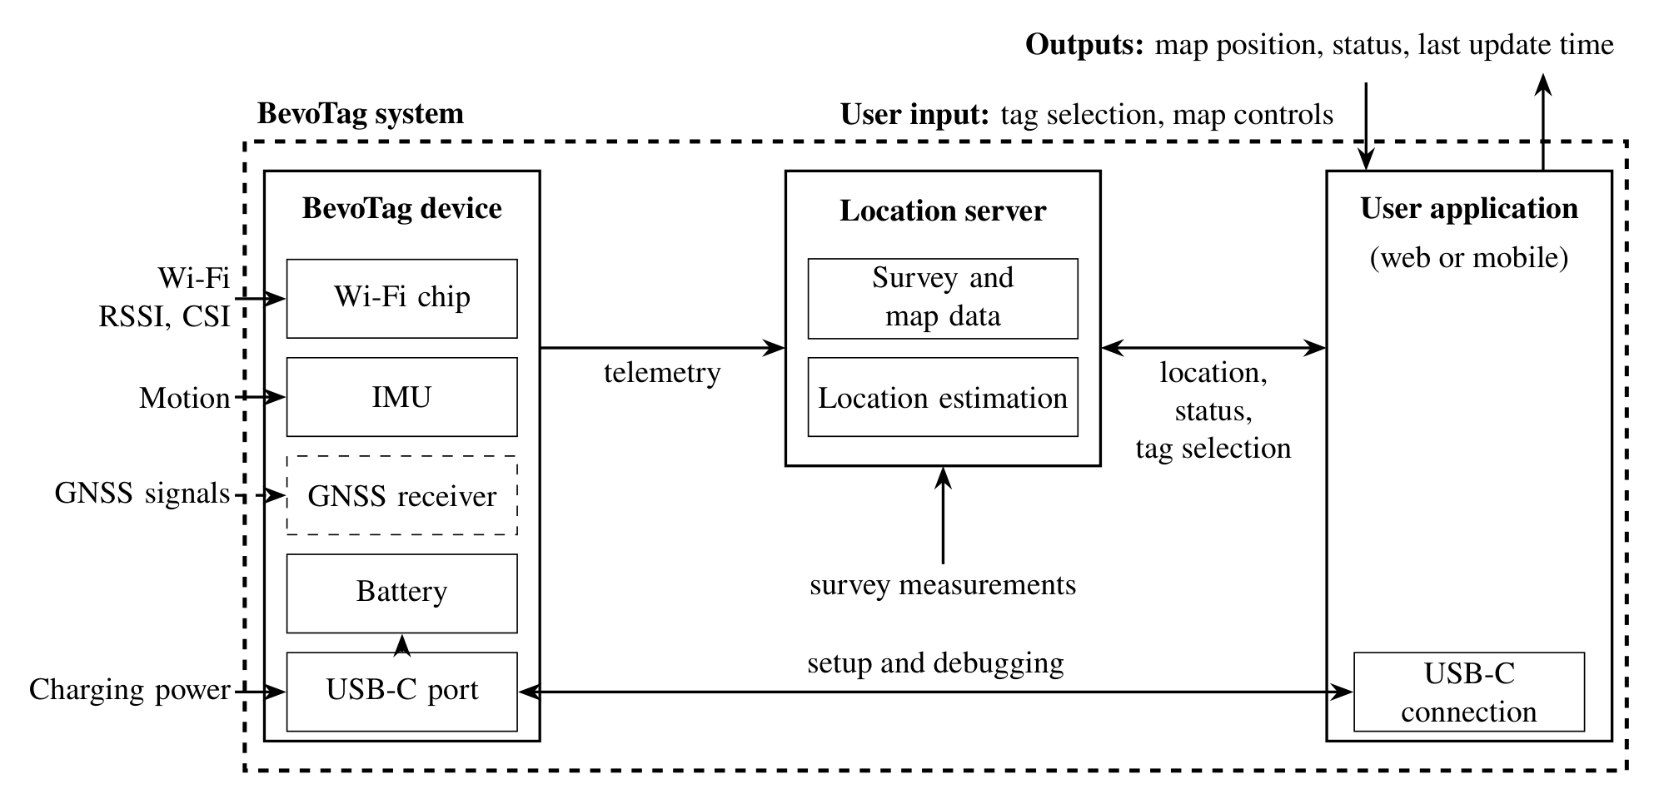
System Block Diagram
Source: BevoTag Project Definition, Oct. 2026, Fig. 2. Dashed items are optional.
Notes:
Walk left to right. Inputs enter the BevoTag device: Wi-Fi RSSI and CSI from campus access points, motion from the IMU, optional GNSS outdoors, and USB-C charging. The tag sends telemetry over campus Wi-Fi to the location server, which holds the building survey and map and estimates the position. The user application shows the position, status, and last update time, and connects over USB-C for setup and debugging. Point out that this semester we built the measurement side and the survey and map data; the server and user app are EE 464 work.

Slide 11
Original Plan vs. Where We Are Now
Item | Planned | Status
Logger hardware: ESP32, IMU, GPS | Week 3 | Done: acquired week 3
Logger web app (survey collector) | Week 3 | Done: week 3, refined through week 7
CSI capture in the ESP32 firmware | Week 4 | Done: first CSI capture 10/11
Access point list and floor plans from UT IT | Week 3 | Received week 4
Omnidirectional antenna | Week 4 (ordered) | Done: first capture 11/8
3D building model in the web app | Week 5 | Done: EER, ECJ, ASE by 10/21
Multi-floor EER survey, 5,000 samples per location | Weeks 6 to 7 | Behind: 2 indoor spots, 2 plaza points
Fingerprint matching model | Week 7 | Partial: k-NN baseline only
IMU and GPS fusion | EE 364D | Not started: no IMU or GPS data yet
Sources: BevoTag Project Definition; team status reports, weeks 1 to 7 (Sept. 25 to Nov. 6, 2026).
Notes:
The plan in the Project Definition was to build a data logger first, then survey EER and test the matching method. The logger, firmware, collector, and 3D model are done, and the omnidirectional antenna arrived and was tested on November 8. Behind plan: the survey covers two spots on EER level 2 and two outdoor points, short of the multi-floor survey with 5,000 samples per location in our week 6 report. We have no IMU or GPS data yet, so fusion has not started, and system design of the tag starts now.

Slide 12
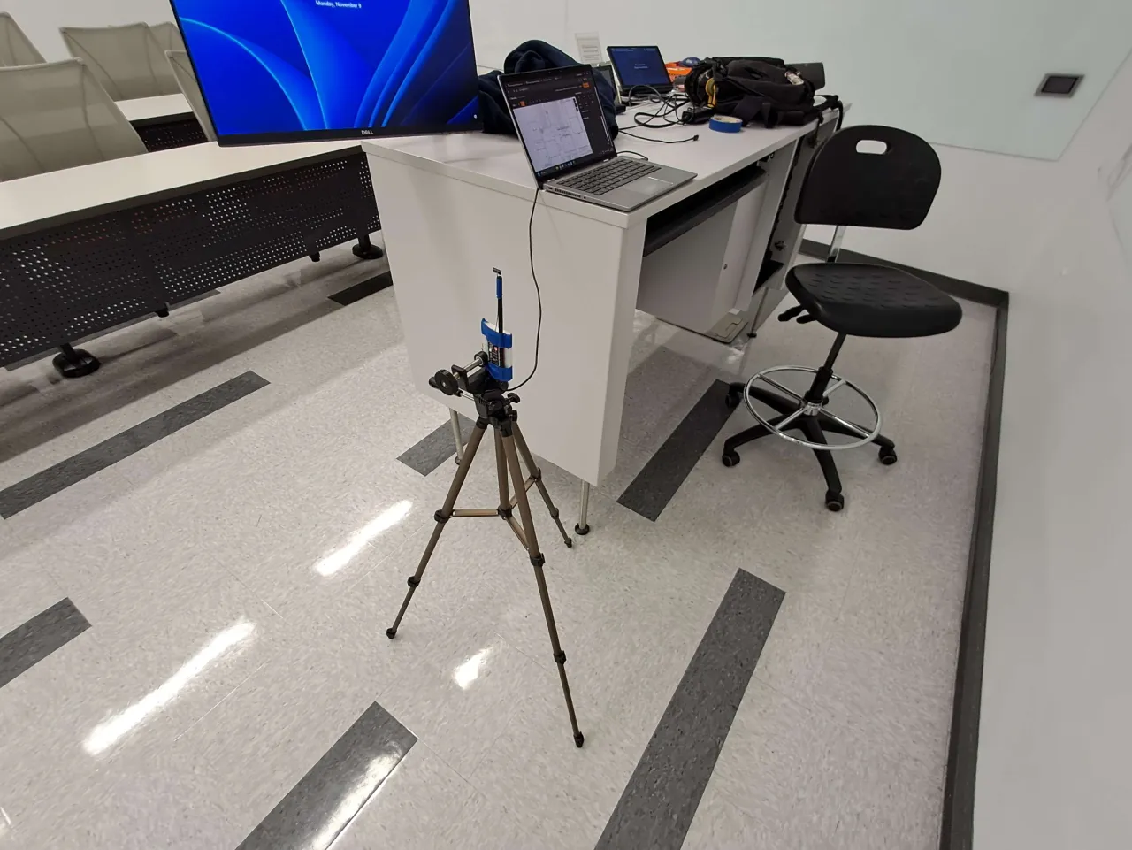
Capture Setup
ESP32 on a tripod at fixed height and heading, USB to a laptop running our collector (115200 baud)
Operator marks the spot on the floor plan and starts the CSV log
Firmware runs a 3-minute RSSI phase (about 85 scans), then a 5-minute CSI phase
Spots: EER 2.813 south corridor and 2.701 staircase corner, each facing north and east
Outdoor: two points on the plaza by PMA (10/11)
Each session needs two people
Notes:
Describe the photo. The ESP32 sits on a tripod at a fixed height and heading, which is what Dr. Vikalo asked for so that the fingerprints are not corrupted by orientation. A USB cable runs to the laptop running our survey collector. The operator clicks the spot on the floor plan and starts the log. The firmware then runs a 3-minute RSSI phase, about 85 scans, followed by a 5-minute CSI phase. We captured the 2.813 south corridor and the 2.701 staircase corner, each facing north and east, plus two points on the plaza by PMA. Every capture needs two people: one with the device, one running the logger.

Slide 13
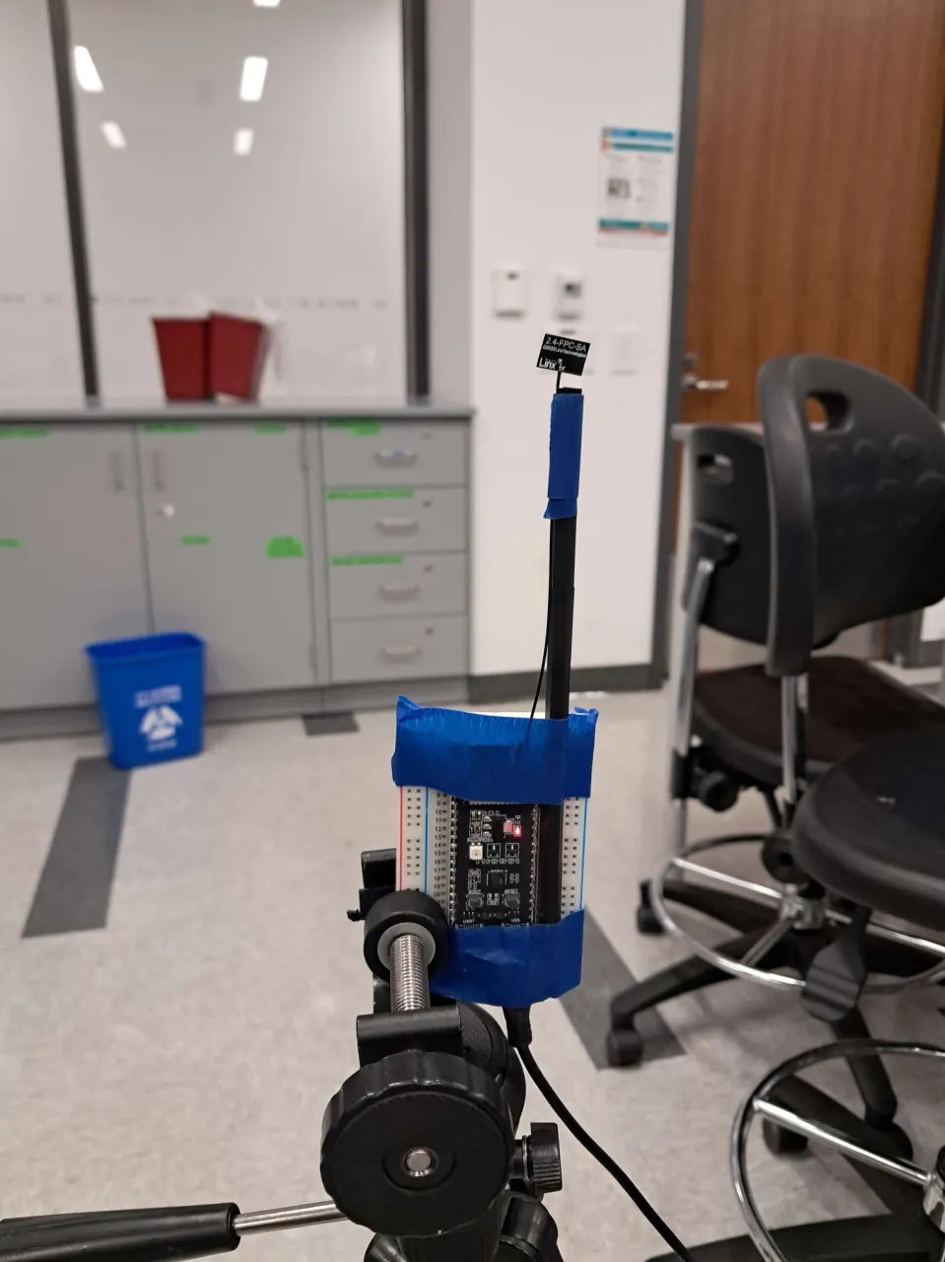
Risk Reduction 1: Omnidirectional Antenna
Goal: readings changed when the board turned (10/11 notes)
What we did: bought a Linx 2.4 GHz omnidirectional antenna; repeated the 2.813 capture facing north and east
Result: typical change 3 → 2 dB; largest 10 → 5 dB
Decision: survey only with the omnidirectional antenna on the tripod
Data: 2.813 south corridor, one scan per heading per antenna (11/8: median over 81 scan pairs). Photo: ESP32 with Linx antenna.
Notes:
Goal: our first capture on October 11 showed that turning the board changed the readings, which would corrupt fingerprints. We bought a Linx 2.4 GHz flexible antenna and mounted it vertically, shown in the photo, and repeated the 2.813 corridor capture facing north and then east. The chart compares one scan in each direction for both antennas. The typical per-AP change dropped from 3 to 2 dB, and the largest change from 10 to 5 dB. Fewer access points appear in only one direction, 10 vs. 7. Decision: every survey uses the omnidirectional antenna on the tripod. The 10/11 setup was the same board without the external antenna, using the antenna trace printed on the ESP32 module.

Slide 14
Risk Reduction 2: ESP32 Firmware
Goal: confirm the ESP32 records CSI from campus access points, not only RSSI
What we did: Arduino firmware with an RSSI phase and a CSI phase; each result sent as a JSON line over USB
Result: 7–12 CSI frames/s from campus APs indoors; 52 usable subcarriers per frame; pattern differs between spots
Decision: keep CSI under test; discard frames from people's devices before storing
Data: 10/11 and 11/8 captures. Campus AP = vendor prefix in UT IT's AP list [12]. Amplitude averaged over 101 and 104 frames; unused subcarriers omitted.
Notes:
Goal: show that the ESP32 can record CSI from campus access points, not only RSSI, since the literature left that in doubt for a single-antenna chip. The firmware runs an RSSI scan phase and a CSI phase and sends every result to the laptop as one JSON line. Top chart: CSI frames per second for each capture, split by sender. Campus access points gave 7 to 12 frames per second indoors and 15 to 18 on the plaza. Gray is phones and laptops with randomized addresses, 2.3 to 7.2 per second, which our privacy commitment says the firmware must discard. Bottom chart: the same access point, in room 2.501, has a different CSI amplitude pattern at the two spots, which is what makes CSI useful as a fingerprint.

Slide 15
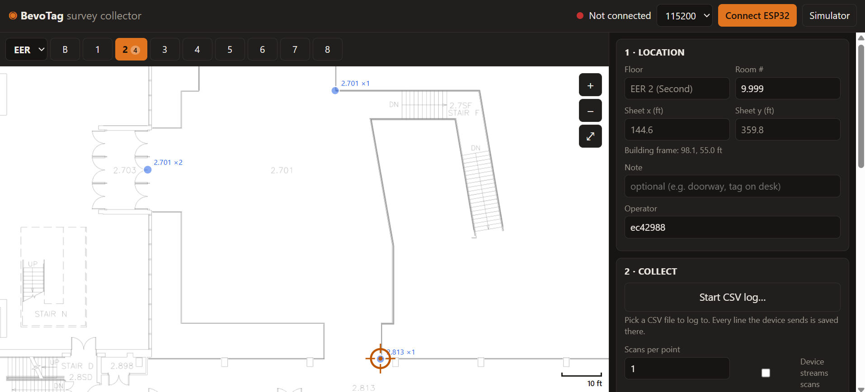
Risk Reduction 3: Web App Survey Collector
Goal: tie every measurement to a building, floor, room, and x/y position
What we did: browser app over Web Serial: click your spot on the floor plan, then log every device line raw to CSV
Result: all 10 capture files (about 55,000 CSI frames, 350 RSSI scans) recorded with it; floor plans registered in feet
Decision: keep raw logging so the firmware can add IMU data without app changes
Screenshot: BevoTag survey collector during the 10/11 EER level 2 capture.
Notes:
Goal: every measurement has to carry its true location, or it is useless for fingerprinting. The collector runs in Chrome and talks to the ESP32 over Web Serial. The operator picks the building and floor, clicks the spot on the registered floor plan, types the room, and starts the CSV log. Every line the device sends is saved raw with the location, time, and operator, so new firmware data, such as IMU readings next semester, needs no app changes. Result: all ten capture files in our dataset, about 55,000 CSI frames and 350 RSSI scans, were recorded with this tool. The screenshot is from the October 11 capture on EER level 2.

Slide 16
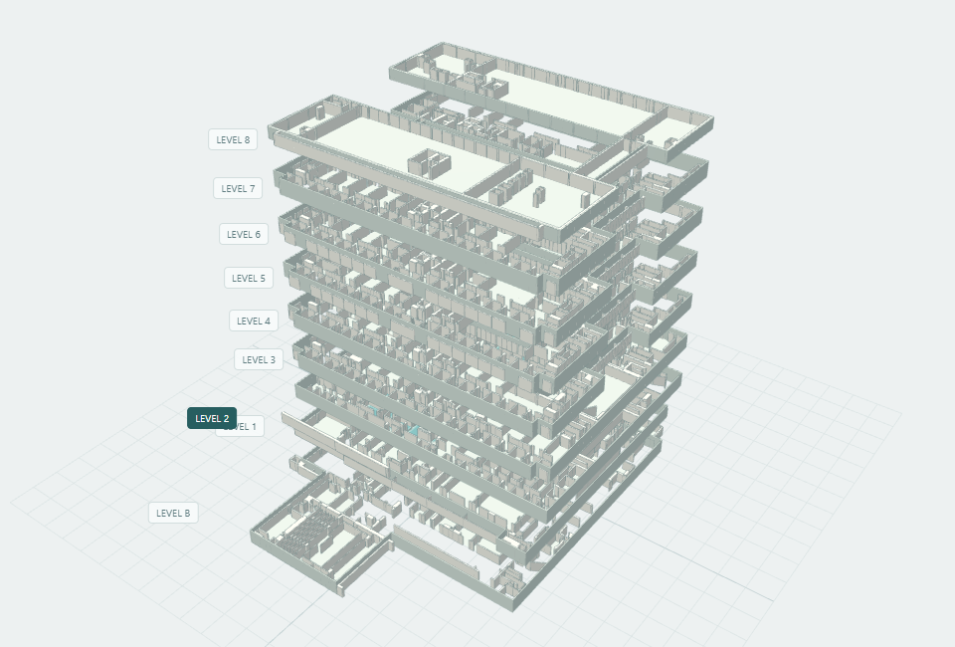
Risk Reduction 4: Web App 3D Model and Signal Map
Goal: a 3D campus map for the user app and for checking survey coverage by floor
What we did: rebuilt walls and rooms from UT floor-plan PDFs; Three.js workspace with CSV import and heatmaps
Result: EER 9 levels, ECJ 15, ASE 7 (3,403 wall and room polygons); k-NN position estimate; IFC/OBJ export
Limits: floor heights unverified; accuracy not yet measured
Screenshot: BevoTag Signal Studio, EER exploded view with the 11/8 captures imported.
Notes:
Goal: the user app needs a 3D campus map, and we need to see survey coverage floor by floor. We reconstructed walls and rooms from UT's floor-plan PDFs and built a Three.js workspace on top of the collector. It covers EER with 9 levels, ECJ with 15, and ASE with 7, about 3,400 wall and room polygons, and it imports our CSV captures and shows signal heatmaps on the floor where they were taken. It also has a k-nearest-neighbor fingerprint estimate and exports IFC and OBJ files. Be clear about the limits: floor heights in EER are schematic, and position accuracy has not been measured yet.

Slide 17
Risk Reduction 5: Data Collection
Goal: learn how RSSI behaves at a fixed spot before scaling up the survey
What we did: 2 spots on EER level 2 × 2 headings (11/8); 2 plaza points (10/11)
Result: RSSI standard deviation 0.6–1.1 dB over 3 minutes; about 30 APs heard indoors vs. over 100 on the plaza
Decision: average several scans per spot; survey 4 headings at 3 times of day
Data: 11/8 RSSI phase (omnidirectional antenna) and 10/11 captures. σ = standard deviation.
Notes:
Goal: learn how RSSI behaves at a fixed spot before we scale up the survey. The top chart is the 3-minute RSSI phase at the 2.813 corridor spot with the omnidirectional antenna: 81 scans, five strongest radios. Each line is nearly flat; standard deviations are 0.6 to 1.1 dB. That means averaging a few scans gives a stable fingerprint at one spot. The bottom chart shows how many access points the ESP32 hears per scan: about 30 indoors and over 100 on the open plaza, so outdoor spots have far more signals to match against. Dr. Vikalo's advice to collect data early is why we have these results now.

Slide 18
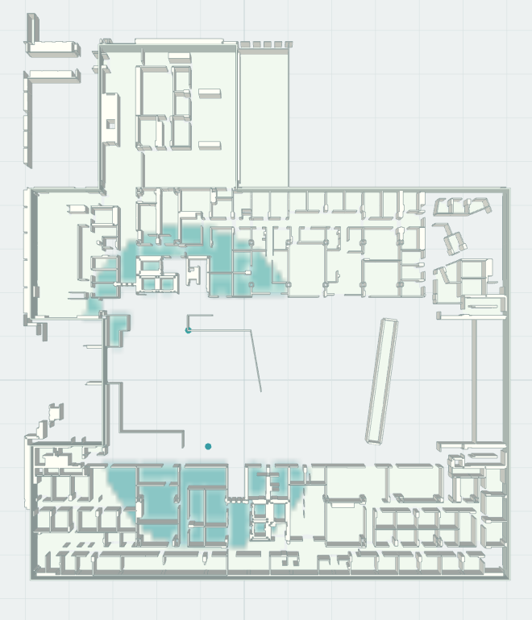
The AP List Alone Does Not Identify the Floor
2.701 staircase
2.813 corridor
8 of the 10 strongest are installed on floors 0, 1, and 3. The strongest is in 3.854.
Likely cause: both spots are in EER's open central area, where APs on other floors have a clear path.
No floor classifier has been run yet; this is not a measured accuracy.
Data: 11/8 RSSI phase, 2.813 corridor facing north; installed rooms from UT IT's AP list [12]. Image: BevoTag Signal Studio, EER level 2.
Notes:
This is the most important result of the data collection. The left image is EER level 2 from our 3D model, with the two survey spots as dots; both sit in EER's open central area. The chart ranks the ten strongest UT access points heard at the corridor spot, using UT IT's list to find the room each one is installed in. Only 2 of the ten are on floor 2; the strongest is in room 3.854, on floor 3. So the list of routers the ESP32 hears does not tell us which floor it is on. Our explanation is the open area: access points on other floors have a clear path to the tag. We have not run a floor classifier yet, so this is not a measured accuracy; it is why floor identification is our top residual risk.

Slide 19
Residual Risks for EE 464
Risk | Why it matters | Plan in EE 464
Floor identification in open areas | APs on other floors are heard as strongly as those on the tag's floor; target is > 95% correct floor | Match full RSSI and CSI patterns, not the AP list; use the IMU to detect stairs and elevators; survey spots away from open areas
Room-level accuracy is unmeasured | No held-out test yet; target is > 90% correct room | Survey EER level 2 facing 4 headings at 3 times of day; test only on spots held out of the survey
Also tracked: CSI capture rate and power on the final tag against the 24 h battery target; IMU fusion (no IMU data yet).
Notes:
We see two residual risks that matter most. First, floor identification: in open areas like EER's atrium, access points on other floors are heard as strongly as those on the tag's floor, which threatens the 95 percent floor target. We will use the full RSSI and CSI pattern across many access points rather than the list alone, use the IMU to detect floor changes on stairs and elevators, and survey spots away from the open area for comparison. Second, room accuracy has not been measured at all. We will survey EER level 2 facing four directions at three times of day and test only on spots held out of the survey. Power, CSI rate on the final tag, and IMU fusion are tracked too but come after these two.

Slide 20
Team Contributions in EE 364D
Member | Role | Contributions so far
Ethan Chua | Project Lead | Coordinated UT IT access point request; ordered the omnidirectional antenna; planned and ran EER captures
Esteban Martinez | Hardware and firmware | Selected and acquired logger hardware; ESP32 CSI capture; organized CSI data and metadata
Li Shi | Hardware and firmware | Logger firmware and serial data format; survey collector and 3D building model
Andrew Yin | Software; Documentation Lead | Logger web app and reliability testing; mapped survey points onto the 3D model; Project Definition
Abhirit Das | Software | Logger web app interface and serial link; CSI logging and live plots; 3D model integration
[DRAFT: team to confirm]
Notes:
[DRAFT: team to confirm.] Each member summarizes their own row in a sentence. Rows are drafted from the weekly status reports and the repository history; edit before the talk.

Slide 21
Conclusion
Purpose: present our design alternatives, how we chose, and where BevoTag stands
Main points: Wi-Fi RSSI baseline with CSI under test; omnidirectional antenna halves the largest heading effect (10 → 5 dB); the AP list alone does not identify the floor
Time and resources: about 1 week waiting for UT IT's AP list; 2 people per capture; survey covers EER level 2 only; no IMU or GPS data yet
Assessment: the measurement chain works end to end; floor and room accuracy are the open questions for EE 464
Notes:
Restate the purpose: this review presented the alternatives we considered, how we chose, and where BevoTag stands. Main points: Wi-Fi RSSI is the baseline with CSI under test; the omnidirectional antenna halved the largest heading effect; the ESP32 records CSI from campus access points; and the access point list alone does not identify the floor in open areas. Time and resources: we waited about a week for UT IT's access point list, every capture needs two people, and the survey covers EER level 2 only. Our assessment: the measurement chain works end to end, and floor and room accuracy are the questions EE 464 must answer.

Slide 22
Questions?
BevoTag · Team SP11
Notes:
About 5 minutes. Questions we could ask the audience if time allows: how much survey data is enough for fingerprinting, and whether CSI amplitude and RSSI carry different information.

Slide 23
References
[1] Apple Inc. (2026). AirTag [Online]. Available: https://www.apple.com/airtag/
[2] J. E. Yoder and T. E. Humphreys, "Low-cost inertial aiding for deep-urban tightly coupled multi-antenna precise GNSS," NAVIGATION, vol. 70, no. 1, Mar. 2023.
[3] A. S. Yaro et al., "A survey of the performance-limiting factors of a 2-dimensional RSS fingerprinting-based indoor wireless localization system," Sensors, vol. 23, no. 5, 2023.
[4] P. Bahl and V. N. Padmanabhan, "RADAR: An in-building RF-based user location and tracking system," in Proc. IEEE INFOCOM, 2000, pp. 775–784.
[5] X. Wang et al., "CSI-based fingerprinting for indoor localization: A deep learning approach," IEEE Trans. Veh. Technol., vol. 66, pp. 763–776, 2017.
[6] S. M. Hernandez and E. Bulut, "Lightweight and standalone IoT based WiFi sensing for active repositioning and mobility," in Proc. IEEE WoWMoM, 2020, pp. 277–286.
[7] F. Evennou and F. Marx, "Advanced integration of WiFi and inertial navigation systems for indoor mobile positioning," EURASIP J. Appl. Signal Process., 2006.
[8] G. Welch and G. Bishop, "An introduction to the Kalman filter," Univ. North Carolina, Tech. Rep. TR 95-041, 2004.
[9] D. Lymberopoulos et al., "Microsoft indoor localization competition: Experiences and lessons learned," GetMobile, vol. 18, no. 4, 2014.
[10] Espressif Systems. (2026). ESP-IDF Programming Guide: Wi-Fi Vendor Features [Online].
[11] IEEE Standard 802.11-2020, Wireless LAN MAC and PHY Specifications, Feb. 2021.
[12] UT Austin Information Technology Services, access point list and floor plans for EER and ECJ, provided to the team, Oct. 2026.
[13] Radio Frequency Devices, 47 C.F.R. Part 15, 2025.
[14] IEC 62133-2:2017 with Amendment 1:2021, Safety requirements for portable sealed secondary lithium cells and batteries.
[15] UT Austin Information Security Office. (2019). Acceptable Use Policy for University Students [Online]. Available: https://security.utexas.edu/policies/aup
Notes:
Not presented; for the submitted file.

