Slide 1
数字逻辑
复习

Slide 2
1: 数制
2: 布尔代数
基础知识（全部掌握）

Slide 3
Introduction to Number System
Digital systems represented information in a discrete form, and Number systems provide the means of quantifying information for processing by digital system.
  Positional Number Systems
  Number system conversion
  Binary Codes
  Arithmetic

Slide 4
Number Systems – General
“base” r (radix r)
r digits
N = A_{n-1} ×r ^{n-1} + A_{n-2} × r ^{n-2} +… + A₁ × r + A₀ +
A₋₁ × r ⁻¹ + A₋₂ × r ⁻² +… + A_{-m} × r ^{-m}
Most
Significant
Bit (MSB)
Least
Significant
Bit (LSB)

Slide 5
Number Systems (cont.)
Most common number systems for computers:
  Binary (r = 2)
  Octal (r = 8)
  Hexadecimal (r = 16)

Slide 6
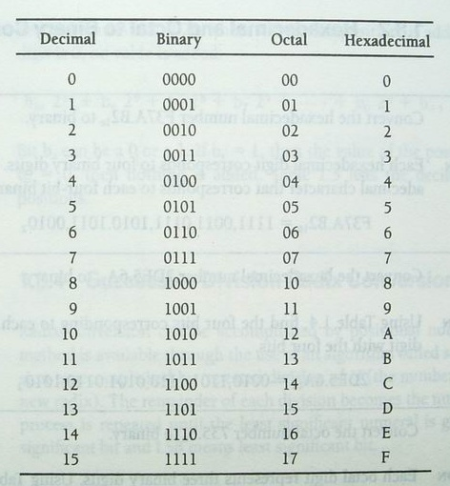
Number System Conversion
Decimal，binary,octal,and hexadecimal number

Slide 7
Number System Conversion
hexadecimal and octal to Binary Conversion
Binary to decimal Conversion
decimal to Binary Conversion
  Successive Division Radix Conversion
Decimal to Binary Conversion
  Fractional Radix Conversion, Successive Multiplication

Slide 8
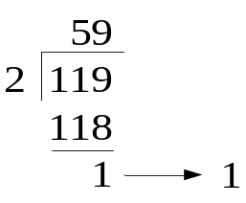
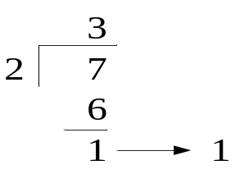

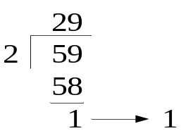
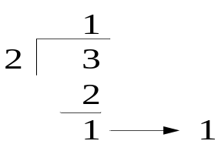
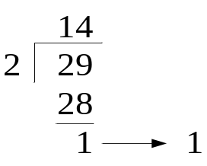
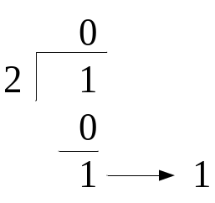
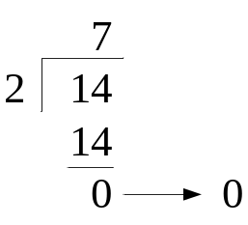
Number System Conversion
decimal to Binary Conversion
  Successive Division Radix Conversion
E.g. Convert 119₁₀ to binary
（LSB）
Solution
119₁₀=1110111₂
（MSB）

Slide 9
Number System Conversion
Decimal to Binary Conversion
  Fractional Radix Conversion, Successive Multiplication
E.g. Convert .75₁₀ to binary
Solution
Multiply .75 by 2 (.75)2=1.5 1(MSB)
Multiply .75 by 2 (.5)2=1.0 1
Multiply .75 by 2 (0)2=0.0 0(LSB)
.75₁₀=.110=(1)2⁻¹+(1)2⁻²

Slide 10
Binary Codes
Signed Number Binary
Radix Complement Number Systems
Diminished Radix Complement Number systems
Binary Arithmetic Using Complement Codes
Notes:
2进制带符号数规定使用最高位表示符号而其他较低位表示数量，我们要关注3种带符号的2进制编码：带符号数量码，以2为基的补码，以1为基的补码（原码、补码、反码）

Slide 11
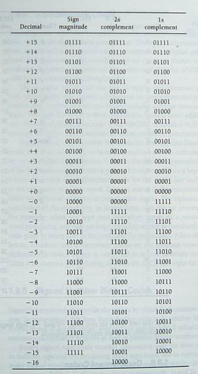
1.3.3 Binary Codes
Signed Number Binary
Sign magnitude and complement
Binary signed magnitude number convention uses the most significant bit position to indicate sign and the remaining lesser significant bits to represent magnitude
Sign magnitude
2s complement
1s complement
Notes:
2进制带符号数规定使用最高位表示符号而其他较低位表示数量，我们要关注3种带符号的2进制编码：带符号数量码，以2为基的补码，以1为基的补码（原码、补码、反码）

Slide 12
Signed Number Representation
Signed Magnitude Method
  N = (s,a_{n-1} ... a₀.a₋₁ ... a_{-m})_{rsm},
  where s = 0 if N is positive and s = r -1 otherwise.
  E.g. N = -(15)₁₀
  In binary: N = -(15)₁₀ = -(1111)₂ = (1, 1111)_{2sm}
  In decimal: N = -(15)₁₀ = (9, 15)_{10sm}
Complementary Number Systems
  Radix complements (r's complements)
  [N]_{r} = r^{n} - (N)_{r}
  where n is the number of digits in (N)_{r}.
  Diminished radix complements (r-1’s complements)
[N]_{r-1} = r^{n} - (N) _{r} - 1
Notes:
带符号数的表示，约定数码序列中的最高位为符号位，符号位为0表示正数，当为负数的时候符号位为r-1，其余有效数值部分则用绝对值表示。
带符号数原码性质：
1、对于2进制，数值0在原码表示中可以有两种形式，可称为+0或-0，以整数为例它们的代码分别为00…00,与10…00，但含义相同。
2符号位不是数值的一部分，它们是人为约定”0正1负”，所以符号位在运算过程中需要单独处理，不能当作数值的一部分直接参与运算。
原码中用绝对值表示数值比较直观，但对于应用得更多的加减运算，原码加减不太方便
为了克服原码加减的缺点，让符号为业作为数值的一部分参与运算，简化加减运算方法，化“减”为“加“，计算机广泛采用补码表示作为运算基础。补码表示方法为：如果数为正，则整数的补码与原码表示形式相同；如果数为负，则将负数原码除符号位外其余各位取反，末位再加1。这是以有模运算为前提的。
众所周知，时钟以12为计数循环，即以12为模，13点钟在舍去模12后，即为1点钟。从0点出发反时针拨一格即-1点钟，也可以看成是从0点出发顺时针拨11格，即11点，换句话说，在模12前提下，-1可以映射为+11。
计算机的运算部件与寄存器都有一定字长限制，因此它的运算也是一种有模运算。例如一定位数的计数器，在计满后会产生溢出，又从头开始计数，产生溢出的量就是计数器的模，相当于时钟的12。
补码的定义：
确定模以后，我们将某数X对该模的补数称为其补码。定义为：[X]补=M+X。若x〉0，则模M作为正常的溢出量可以舍去，同时钟一例一样，13点舍去12成1点，因而正数的补码就是它本身，形式上与原码相同。若x<0，则X补=M-|X|，因而负数的补码等于模M减去该数的绝对值，如同时钟一例中，-1的补码是12-1=11一样。
2.由真值、原码转换成补码
根据补码定义可以直接求得补码，但是比较原码与补码在形式上的差异，可以找到更简便的实用转换规律，由原码求补码。这里给出两种方法
1、正数的补码表示与正数的原码表示相同，有负数原码表示转换为负数补码表示时，符号位不变，将尾数各位先变反，然后末位加一
例： X原=0.1010 X补=0.1010
X原=1.1010 变反 1.1010
末位加1 1
X补 1.0110
2、正数的补码表示与正数的原码表示相同，由负数原码表示转换为负数补码表示时，符号位不变，尾数自低位向高位，第一个1及其以前的各位0保持不变，以后各位按位变反
例： X原=1.1010
X补=1.0110
*****补码的性质******
1、在补码表示中，最高位表示数的正负，在形式上与原码相同，即0正1负。但补码的符号位是数值的一部分，由补码定义式计算而得
2、在补码表示中，数0只有一种表示，即00000…..
3、负数补码的表示范围比原码稍宽。
******补码的加法*****
计算机基本采用补码加减法，因为它比较简单。补码加减是指：操作数用补码表示，连同符号位一道运算，结果也用补码表示，依据的基本关系是：
（X+Y）补=X补+Y补
（X-Y）补=X补+（-Y）补
******补码加减法运算规则*******
1、参加运算的操作数用补码表示，符号位作为数的一部分直接参与运算，所得即为补码表示的运算结果
2、若操作码为加，则两数直接相加
3、若操作码为减，则将减数变补后再与被减数相加
9+3=12 （-9）+（-1）=-12
01001 10111 （-9补码）
+ 00011 + 11101 （-3补码）
01100 1 10100 （-12补码）
9-3=6 9-（-3）=12
01001 01001
+ 11101 + 00011
1 00110 01100
3-9=-6
00011
+ 10111
11010

Slide 13
Binary Arithmetic Using Complement Codes
Subtract
Operation
Add
X>Y
X<Y
X=Y
(+X)+(+Y)
(+X)+(-Y)
(-X)+(+Y)
(-X)+(-Y)
(+X)-(+Y)
(+X)-(-Y)
(-X)-(+Y)
(-X)-(-Y)
+(X+Y)
-(X+Y)
+(X+Y)
-(X+Y)
+(X-Y)
-(X-Y)
+(X-Y)
-(X-Y)
-(X-Y)
+(X-Y)
-(X-Y)
+(X-Y)
+(X-Y)
+(X-Y)
+(X-Y)
+(X-Y)
Addition and subtraction of signed numbers

Slide 14
布尔开关代数
1.Three Primitive Logic Function
------ AND、OR、 NOT
Derived logic functions
------NAND 、NOR、EX-OR、EX-NOR
2. Switching Algebra Properties
3. Switching Algebra---Theorems
4. Reduction Of Switching Equations Using Boolean Algebra
Notes:
布尔代数是一种数学系统。它在一组变量（a,b,c…….）上定义了一系列逻辑操作（AND、OR、NOT）。用上述格式描述的表达式。称为布尔方程或开关方程

Slide 15
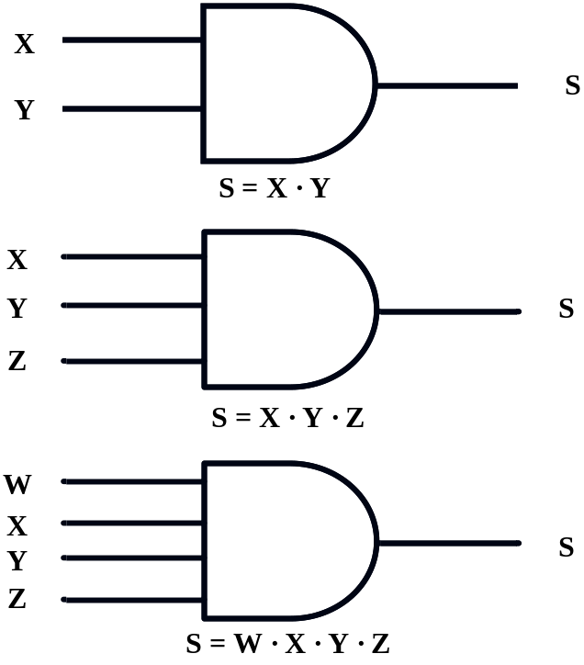
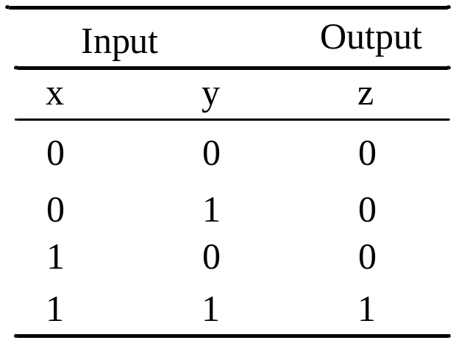
Three Primitive Logic Function
--------AND
Operator Symbols: “()”, “ * ”, “ ·”,no space
S=x y s=x*y s=(x) (y)
Two input and truth table
Distinctive shape symbols for AND gate
S
Notes:
真值表是用完全归纳的方式给出的表，它反映输入输出的逻辑关系。

Slide 16
IEEE Logic Symbols
X
&
Z
X
+
Z
X
>1
Z
Y
Y
Y
Z=XY
Z=X+Y
X׳
X׳
X
X

Slide 17
IEEE Logic Symbols
X
&
Z
X
+
Z
Y
Y
Z=XY
Z=X+Y
X
=1
Z
X
⊕
Z
X
=1
Z
Y
Y
Y
Z=X ⊕ Y
Z=X☉ Y

Slide 18
Switching Algebra Properties
1、Commutative(交换) Properties :
X+Y=Y+X X·Y=Y·X
2、Associative(结合) Properties:
(X+Y)+Z=X+(Y+Z)
(X·Y) ·Z=X·(Y·Z)
3、Distributive(分配) Properties:
X+(Y·Z)=(X+Y) ·(X+Z)
X·(Y+Z)=X·Y+X·Z
4、Identity (0-1律) Properties:
X+0=X X·1=X
X+1=1 X·0=0
5、Complement (互补) Properties:
X+X=1 X·X=0

Slide 19
Switching Algebra---Theorems
Binary Variables and Constants：
0+0=0 1+0=1
0+1=1 1+1=1
0·0=0 1·0=0
0·1=0 1·1=1
2、Idempotency Property (幂等性): X+X=X X·X=X
3、Absorption Property(吸收): X+X·Y=X X·(X+Y)=X
X+X ·Y=X+Y X·(X+Y)=X·Y
4、DeMorgan Properties(反演，狄*摩根): X+Y=X ·Y
X·Y=X+Y
5、Adjacency Properties: X·Y+X·Y=X
(X+Y) ·(X+Y)=X

Slide 20
组合电路

Slide 21
DEFINITION OF COMBINATIONAL LOGIC
Logic circuits without feedback from output to the input, constructed from a functionally complete gate set, are said to be combinational.
·
Combinational Logic Functions
·
Inputs
·
·
Outputs
·
·

Slide 22
Deriving Switching Equations
Definitions
  Product term: literals connected by •
  Sum term: literals connected by +
  Minterm: a product term in which all the variables appear exactly once, either complemented or uncomplemented
  Maxterm: a sum term in which all the variables appear exactly once, either complemented or uncomplemented

Slide 23
Canonical(规范) Forms
Any Boolean function F( ) can be expressed as a unique sum of minterms and a unique product of maxterms (under a fixed variable ordering).
every function F() has two canonical forms:
  Canonical Sum-Of-Products (sum of minterms)
  Canonical Product-Of-Sums (product of maxterms)

Slide 24
Convert switching equations to canonical form
Convert switching equation to SOP
Eg： f₁(a,b,c) = ∑ m(1,2,4,6),
Convert switching equation to POS
Eg： f₁(a,b,c) = ∏ M(0,3,5,7),

Slide 25
GENERATION OF SWITCHING EQUATIONS FROM TRUTH TABLES
Canonical Sum-Of-Products:
The minterms included are those m_{j} such that F( ) = 1 in row j of the truth table for F( ).
Canonical Product-Of-Sums:
The maxterms included are those M_{j} such that F( ) = 0 in row j of the truth table for F( ).

Slide 26
Karnaugh Maps
Why Karnaugh maps？
to simplify boolean equations
Karnaugh maps (K-maps) are graphical representations of boolean functions.
One map cell corresponds to a row in the truth table.
one map cell corresponds to a minterm or a maxterm in the boolean expression

Slide 27
Karnaugh Maps
AB
A
00
01
11
10
B
0
1
C
0
m₀
m₂
0
m₀
m₂
m₆
m₄
1
m₁
m₃
1
m₁
m₃
m₇
m₅
AB
CD
00
01
11
10
Logic adjacency : Any two adjacent cells in the map differ by ONLY one.
Example:
m₀ (=x₁’x₂’) is adjacent to m₁ (=x₁’x₂) and m₂ (=x₁x₂’) but NOT m₃ (=x₁x₂)
00
m₀
m₄
m₁₂
m₈
01
m₁
m₅
m₁₃
m₉
11
m₃
m₇
m₁₅
m₁₁
10
m₂
m₆
m₁₄
m₁₀
Notes:
把真值表中的最小项重新排列成矩阵形式，并且使矩阵的横方向和纵方向的逻辑变量的取值按格雷码的顺序排列
相邻是指两个最小项只有一个变量互补，其他变量都相同

Slide 28
Simplification using K-map
2、3、4 varibles

Slide 29
Analysis of Combinational Logic
Deriving Switching Equations
Simplifying the switching equations
Giving truth table
Logic function conclussion

Slide 30
Combinational Circuit Design
Determine the required number of inputs and outputs and assign variables to them.
Derive the truth table that defines the required relationship between inputs and outputs.
Obtain and simplify the Boolean function (K-maps, algebraic manipulation, CAD tools, …). Consider any design constraints (area, delay, power, available libraries, etc).
Draw the logic diagram.
Verify the correctness of the design.

Slide 31
Combinational Logic Design –
Design Procedure, Encoders/Decoders

Slide 32
Decoders
A combinational circuit that converts binary information from n coded inputs to a maximum 2^{n} coded outputs
→ n-to- 2^{n} decoder
n-to-m decoder, m ≤ 2^{n}
Examples: BCD-to-7-segment decoder, where n=4 and m=10

Slide 33
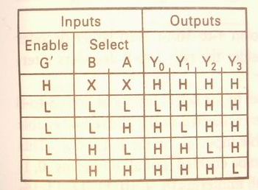
2 to 4 Decoders
Y₀=(G’B’A’)’=G+B+A
Y₁=(G’B’A)’=G+B+A’
Y₂=(G’BA’)’=G+B’+A
Y₃=(G’BA)’=G+B’+A’

Slide 34
3-to-8 Decoder
Three inputs, A₀, A₁, A₂, are decoded into eight outputs, Y₀ through Y₇
Each output Y_{i} represents one of the minterms of the 3 input variables.
Y_{i} = 1 when the binary number A₂A₁A₀ = i
Shorthand: Y_{i} = m_{i}
The output variables are mutually exclusive; exactly one output has the value 1 at any time, and the other seven are 0.

Slide 35
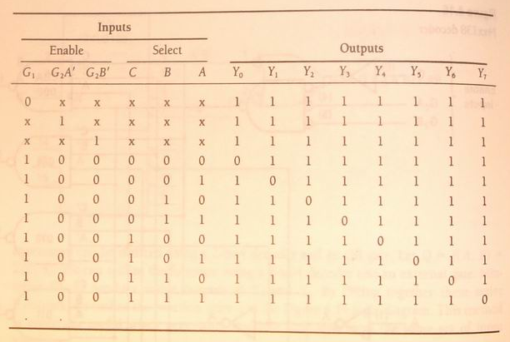
3 to 8 Decoders (cont.)

Slide 36
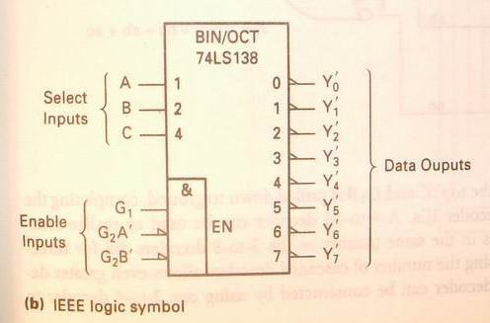
Implementing Boolean functions using decoders
Y₀’=(C’B’A’)’=m₀’
Y₁’=(C’B’A)’=m₁’
Y₂’=(C’BA’)’=m₂’
Y₃’=(C’BA)’=m₃’
Y₄’=(CB’A’)’=m₄’
Y₅’=(CB’A)’=m₅’
Y₆’=(CBA’)’=m₆’
Y₇’=(CBA)’=m₇’
Notes:
一个N变量的二进制姨妈的输出包含了n个变量的所有最小项，例如，3线/8线译码器的8个输出包含了3个变量的最小项，如图所示，当使能端有效时，译码器处于译码状态，各输出端表达式为：{}
因此，应用n变量译码器实现逻辑函数时，可以首先将逻辑函数变换成最小项之和的标准形式，并在译码器输出端连接适当的与非门作输出级，就能获得任何形式的输入变量不大于n的组合逻辑函数

Slide 37
Encoders
An encoder is a digital circuit that performs the inverse operation of a decoder. An encoder has 2^{n} input lines and n output lines.
The output lines generate the binary equivalent of the input line whose value is 1.

Slide 38
Combinational Logic Design –
Multiplexers

Slide 39
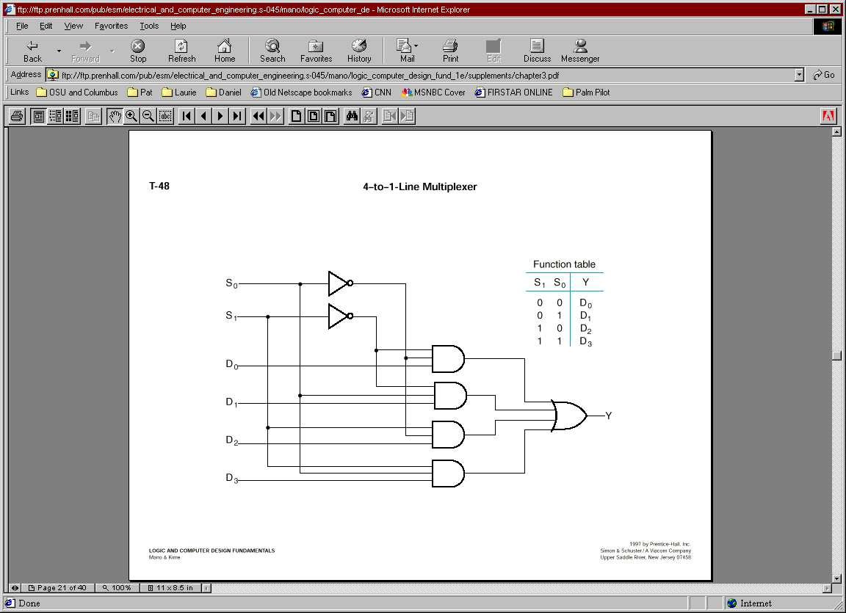
4-to-1 MUX
B
A
A
B
Y
Y=A’B’D₀+A’BD₁+AB’D₂+ABD₃
=∑m_{i}D_{i}
0
0
D₀
2^{n}-1
0
1
D₁
i=0
1
0
D₂
1
1
D₃

Slide 40
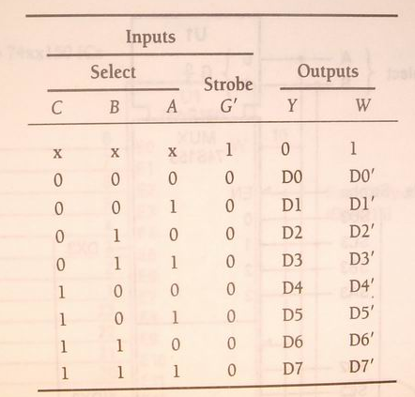
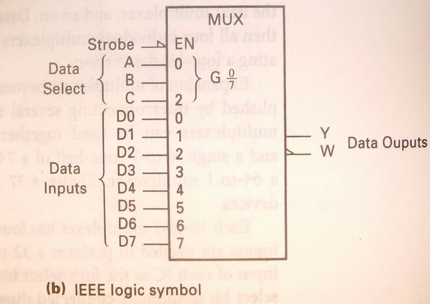
8-to-1 MUX
Y= C’B’A’D₀+ C’B’AD₁+ C’BA’D₂+C’BAD₃+ CB’A’D₄+ CB’AD₅+ CBA’D₆+ CBAD₇
=∑m_{i}D_{i}
i=2^{n}-1
i=0

Slide 41
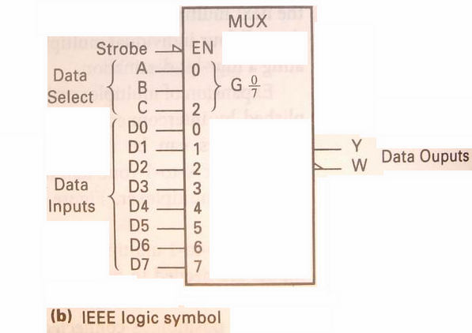
Implementing Boolean functions with Multiplexers
E.g. Using an 8-to-1 multiplexer to realize the Boolean function F=f(x,y,z)=∑(1,2,4,5,7)
Y= C’B’A’D₀+ C’B’AD₁+ C’BA’D₂+C’BAD₃+ CB’A’D₄+ CB’AD₅+ CBA’D₆+ CBAD₇
=∑m_{i}D_{i}
i=2^{n}-1
i=0
F=f(x,y,z)=∑(1,2,4,5,7)
=x’y’z+x’yz’+xy’z’+xy’z+xyz
C=x,B=y,A=z
D₀=D₃=D₆=0
D₁= D₂= D₄= D₅= D₇=1

Slide 42
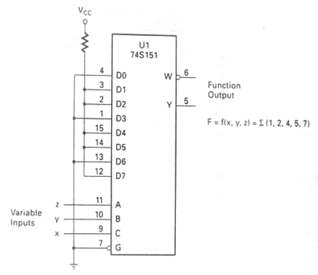
Implementing Boolean functions with Multiplexers
C=x,B=y,A=z
D₀=D₃=D₆=0
D₁= D₂= D₄= D₅= D₇=1

Slide 43
Using an 4-to-1 multiplexer to realize the Boolean function F=f(x,y,z)=∑(1,2,4,5,7)
F=f(x,y,z)=∑(1,2,4,5,7)=x’y’z+x’yz’+xy’z’+xy’z+xyz
XY
Z
00
01
11
10
Z
Z’
1
Z
Y
Y’
Y
1
X
X’
1
X
D₀
D₁
4-1
MUX
0
1
1
D₂
F
D₃
B
A
1
1
1
1
D₀=Z
D₁=Z’
D₂=1
D₃=Z
D₀=X
D₁=X’
D₂=1
D₃=X
D₀=Y
D₁=Y’
D₂=Y’
D₃=1
X
Z
Z
Y
X
Y
F=X’Y’D₀+X’YD₁+XY’D₂+XYD₃

Slide 44
MUX as a Universal Gate
We can construct OR, AND, and NOT gates using 2-to-1 MUXs. Thus, 2-to-1 MUX is a universal gate.
NOT
AND
OR
1
1
0
1
X₁
1
Z
Z
Z
MUX
MUX
MUX
X₀
0
1
0
0
0
X₁
X
X₀
z = x₁+ x₁’x₀
= x₁x₀’ + x₁x₀ + x₁’x₀ = x₁ + x₀
z = 0x + 1x’ = x’
z = x₁x₀ + 0x₀’ = x₁x₀

Slide 45
Binary Addition
  Half Adder
  Full Adder
  Ripple Carry Adder(并行加法器)
  Carry Look ahead Adder(超前进位加法器)
Decimal Addition
Binary Comparators

Slide 46
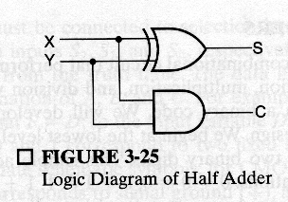
Half Adder (cont.)
S₀ = A₀B₀’+A₀’B₀ = A₀⊕ B₀
C₁ = A₀B₀
Block Diagram
Logic Diagram
A₀
B₀
A₀
1 bit
half adder
S₀
C₁
B₀
C₁
S₀

Slide 47
Full Adder
Full adder (for higher-order bit addition)
Combinational circuit that performs the additions of 3 bits (two bits and a carry-in bit)
A_{i}
B_{i}
1 bit
full adder
C_{i+1}
C_{i}
S_{i}

Slide 48
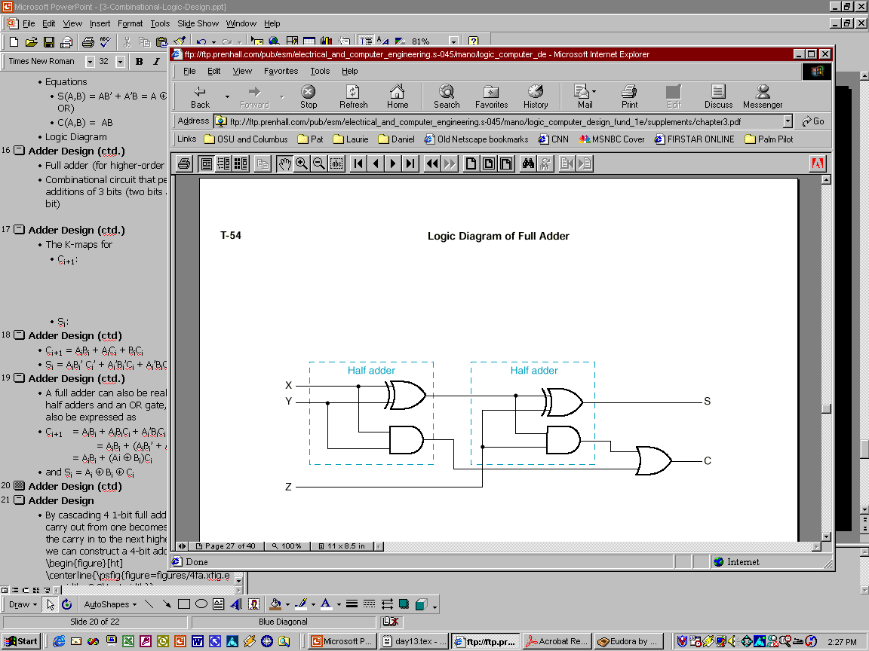
Full Adder using 2 Half Adders
A full adder can also be realized with two half adders and an OR gate, since C_{i+1} can also be expressed as:
C_{i+1} = A_{i}B_{i} + A_{i}B_{i}’C_{i} + A_{i}’B_{i}C_{i}
= A_{i}B_{i} + (A_{i}B_{i}’ + A_{i}’B_{i})C_{i}
= A_{i}B_{i} + (Ai ⊕ B_{i})C_{i}
and S_{i} = A_{i} ⊕ B_{i} ⊕ C_{i}
A_{i}
B_{i}
S_{i}
C_{i+1}
C_{i}

Slide 49
Binary Comparators
Binary Comparators 逻辑图

Slide 50
时序逻辑
Sequential Circuits:
Latches & Flip-Flops

Slide 51
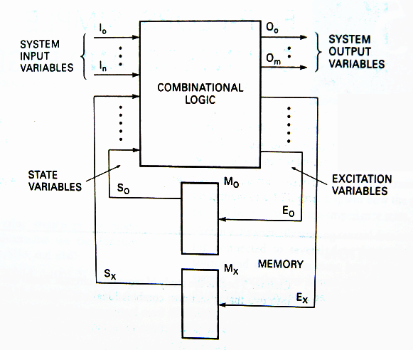
Sequential Circuit Models
Notes:
Combinational Logic:
Output depends only on current input
Able to perform useful operations (add/subtract/multiply/…)
Require cascading of many structures
Costly and inflexible
Sequential Logic:
Output depends not only on current input but also on past input values
Store information between operations (no need for cascading)
Need some type of memory to remember the past input values
Sequential Logic circuits remember past inputs and past circuit state.
Outputs from the system are
“fed back” as new inputs (usually with delay).
The storage elements are circuits that are capable of storing binary information: memory.
There are two types of sequential circuits:
Synchronous (latch mode) sequential circuit: the behavior can be defined from knowledge of its signal at discrete instants of time. This type of circuits achieves synchronization by using a timing signal called the clock.
Asynchronous (fundamental mode) sequential circuit: the behavior is dependent on the order of input signal changes over continuous time, and output can change at any time (clockless).

Slide 52
Alternatives in FF choice
Type of FF
  SR
  D
  JK
  T
Type of triggering
  Untriggered (asynchronous)
  Level-triggered (C=1)
  Edge-triggered (rising or falling edge of C)
D Q
D Q
CLK
CLK
positive
edge-triggered
flip-flop
negative
edge-triggered
flip-flop
D Q
G
CLK
transparent
(level-sensitive)
latch

Slide 53
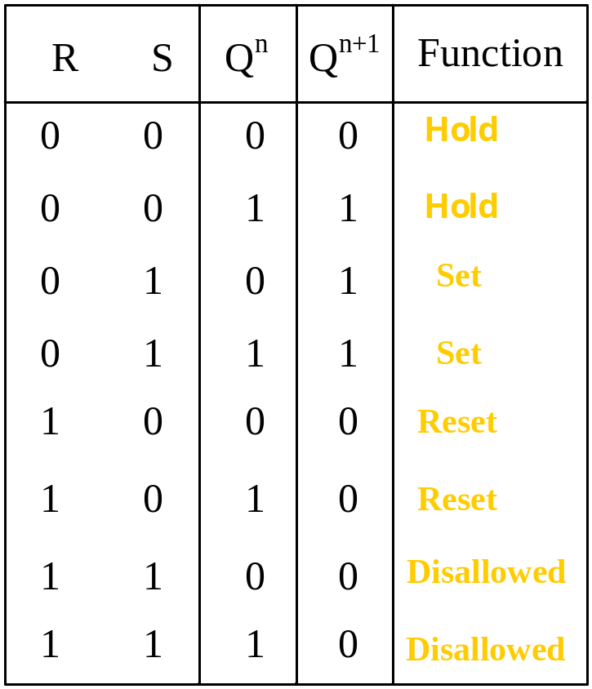
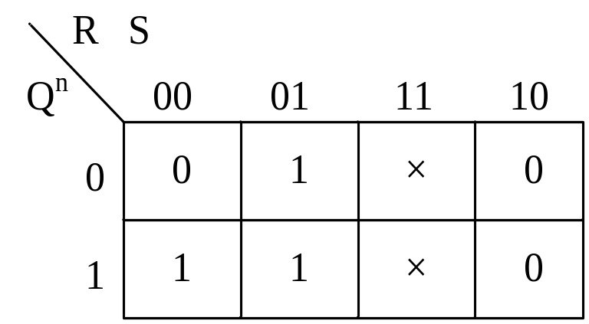
SR latch (NOR version)
Characteristic Equation
Q^{n+1}=S+R’Q^{n}
SR=0

Slide 54
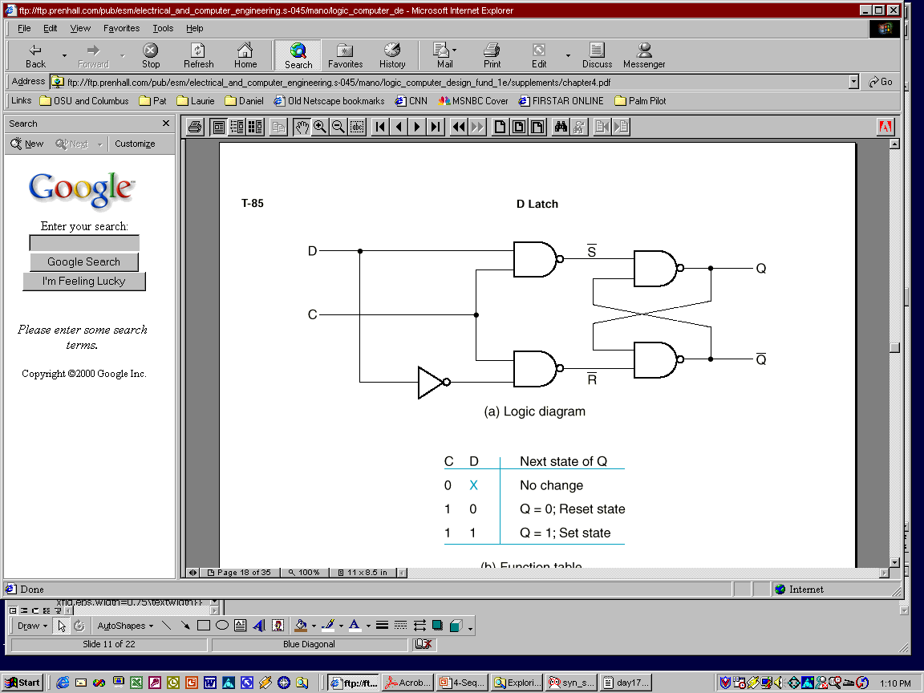
D Latch
One way to eliminate the undesirable indeterminate state in the RS flip flop is to ensure that inputs S and R are never 1 simultaneously. This is done in the D latch:
Characteristic Equation
Q^{n+1}=S+R’Q^{n}=D+D’’Q^{n}=D

Slide 55
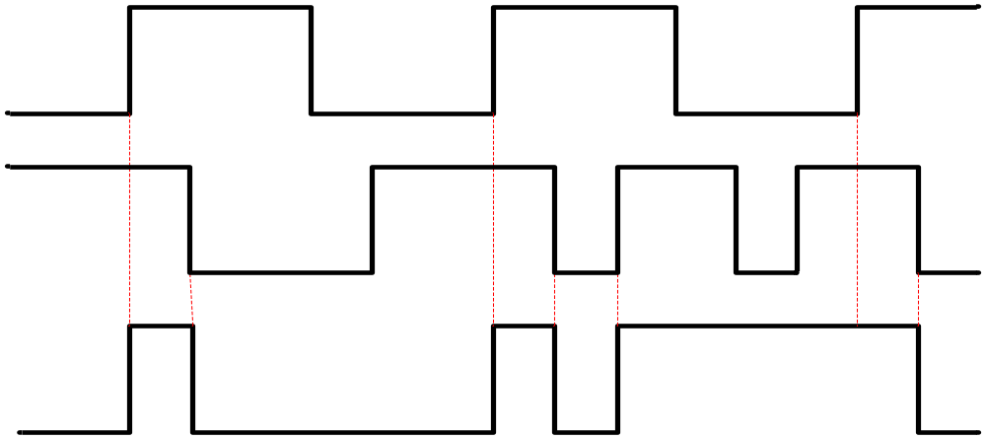
D Latch
CP
D
Q

Slide 56
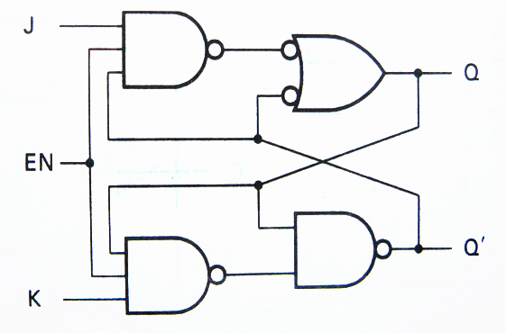
JK Latch
When EN=1
R’=(KQ^{n})’ S’=(JQ^{n}’)’
So : Q^{n+1}=S+R’Q^{n}=JQ^{n}’+(KQ^{n)’} Q^{n}
= JQ^{n}’+K’ Q^{n}
Q^{n+1}=JQ^{n}’+K’Q^{n}
S’+R’=(JQ^{n}’)’+(KQ^{n})’
=J’+Q^{n}+K’+Q^{n}’
=1

Slide 57
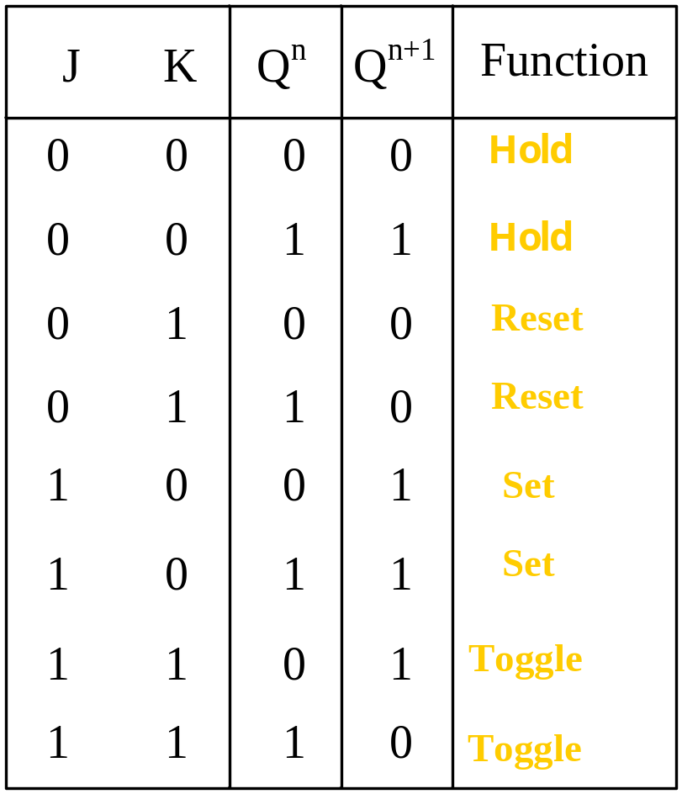
JK Latch

Slide 58
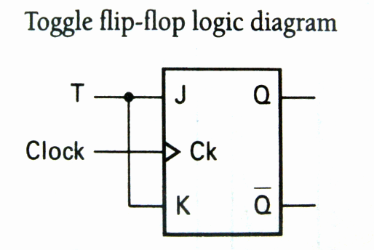
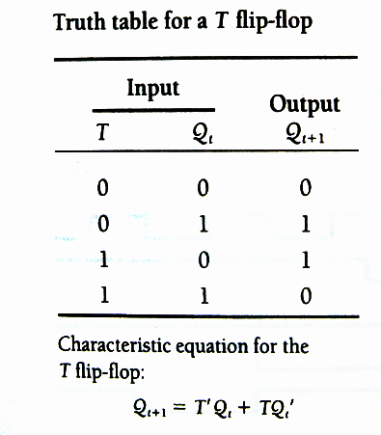
T Latch
Q^{n+1}=JQ^{n}’+K’Q^{n}
=TQ^{n}’+T’Q^{n}

Slide 59
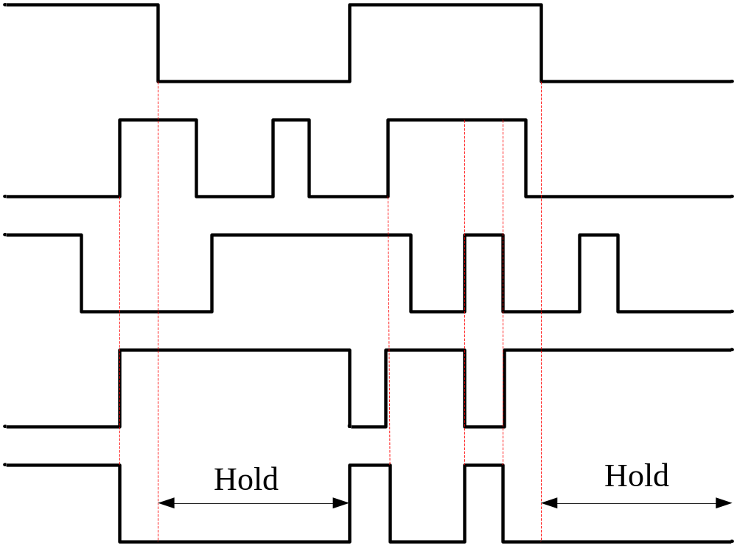
JK Latch
CP
J
K
Q
Q’

Slide 60
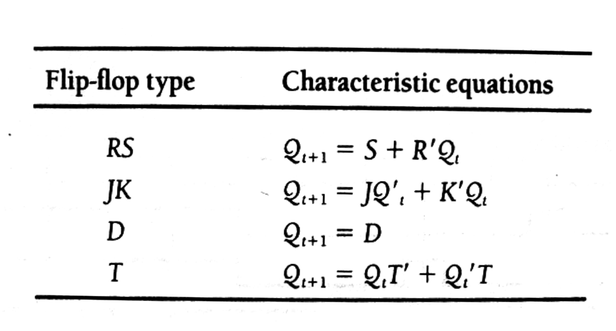
Characteristic equations compare

Slide 61
Simple counters
Devide by 2,4,8 Counters

Slide 62
Mealy Vs Moore machines
Mealy model:
  Both outputs and next state depend both on primary inputs AND present state.
Moore model:
  Only next state depends directly on primary inputs AND present state. Outputs depend only on present state.

Slide 63
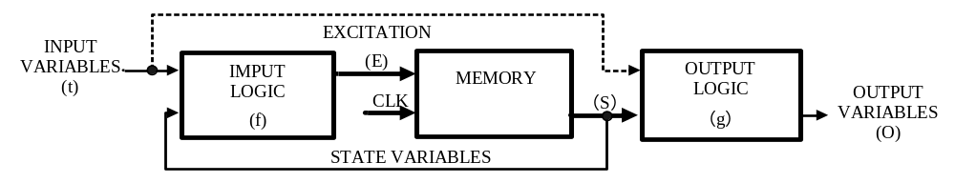
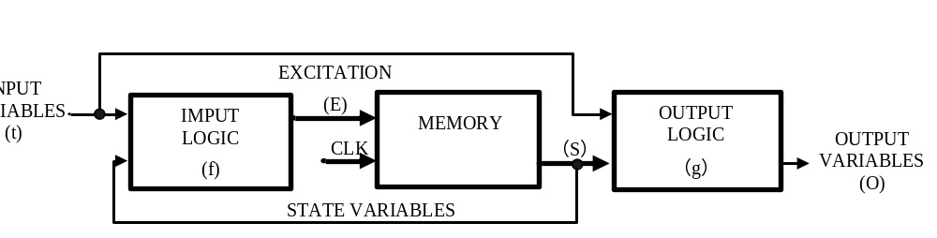
Mealy Vs Moore machines
Moore sequential circuit model
Mealy sequential circuit model

Slide 64
State Diagram
Graphical representation of a state table.
Graph node with label s denotes state s
Graph edge with label X denotes transition between two states when input X is applied
S
X

Slide 65
State Diagram of Mealy model
0/0
1/0
I/O
00
01
S1
S2
0/1
Reads as:
When at state s1 and apply
input I, we get output O
and proceed to state s2.
0/1
0/1
1/0
10
1/0
11
1/0

Slide 66
State Diagram of Moore model
I
00,11
S1/O1
S2/O2
01,10
0/0
1/1
Reads as:
When at state s1 with output
O1 and apply input I,
we proceed to state s2 with
Output O2.
01,10
00,11

Slide 67
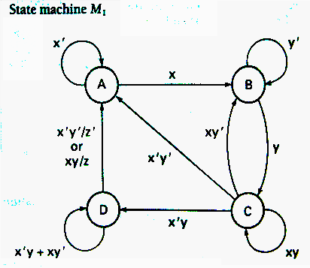
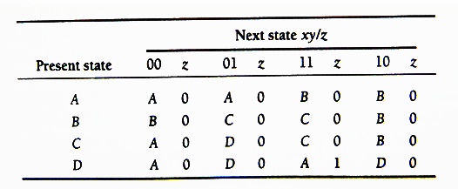
State Table
Enumerates the relationship between inputs, outputs, and states of the sequential circuit.
State Table

Slide 68
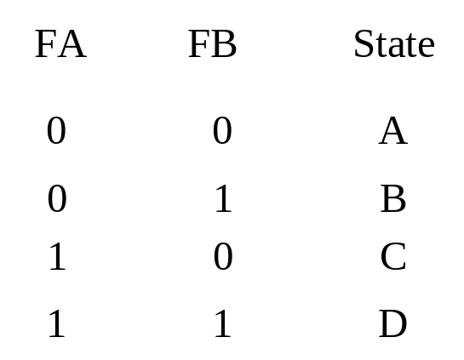
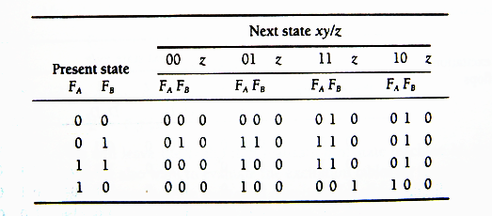
Transition Table
Each state is assigned a unique code.
Transition Table for state machine M₁

Slide 69
Excitation Table and Equations
D flip-flop used to realize circuit
T flip-flop used to realize circuit
S-R flip-flop used to realize circuit
J-K flip-flop used to realize circuit

Slide 70
Synchronous Sequential Circuit Analysis
Analysis Pinciples
  1. Determine the system variables: input, state, and output.
  2. Determine the flip-flop type. Write the characteristic equations.
  3. write the excitation equations.
  4. write the next state equations.
  5. Write the output variable equations.
  6. Construct a transition table.
  7. Assign symbols to the states and construct a table or state diagram.
  8. When possible, construct a timing diagram.
  9. Functionality analysis

Slide 71
Construction of State Diagrams
(掌握分析方法)
Up-Down Decade Counter (P263)
Sequence Detectors

Slide 72
Registers and Counters
（了解）
A n-bit register is a set of n flip-flops that is capable of storing n bits of binary information.
With added combinational gates, the register can perform data-processing tasks.
A counter is a register that goes through a predetermined sequence of states upon the application of clock pulses.

