Slide 1
Compiler Principles
College of Computer
Sichuan University
luoyining@scu.edu.cn

Slide 2
第四章 语法分析—自上而下分析

Slide 3
要进行语法分析，必须对语言的语法结构进行描述。
采用正则表达式和有穷自动机描述和识别语言的单词符号；
采用上下文无关文法描述语法规则。

Slide 4
Contents
►
4.1 语法分析器的功能
4.2 自上而下分析面临的问题
4.3 LL(1)分析法
4.4 递归下降分析程序构造
4.5 预测分析程序

Slide 5
语法分析的任务是分析一个文法的句子结构。
语法分析器的功能：按照文法的产生式(语言的语法规则)，识别输入符号串是否为一个句子(合式程序)。

Slide 6
Token
语法
分析树
源程序
词法
分析器
语法
分析器
编译程序
后续部分
符号表

Slide 7
main( )
main( int argc, char * argv[] )
{
…
source = fopen(pgm,"r");
…
listing = stdout; /* send listing to screen */
…
#if NO_PARSE
while (getToken()!=ENDFILE);
#else
syntaxTree = parse();
…
}

Slide 8
语法分析方法
自上而下/自顶向下分析法(Top-down)
从文法的开始符号出发，根据文法规则正向推导出给定句子的分析方法；
从根节点开始，往下构造分析树，直到创建每个叶节点的分析方法。
自下而上/自底向上分析法(Bottom-up)
从给定的输入串开始，根据文法规则逐步进行归约，直至归约到文法开始符号的分析方法；
从分析树的叶节点开始，步步向上归约，直至创建根结点的分析方法。

Slide 9
Contents
4.1 语法分析器的功能
4.2 自上而下分析面临的问题
4.3 LL(1)分析法
4.4 递归下降分析程序构造
4.5 预测分析程序
►

Slide 10
两种自上而下分析方法
带回溯（Backtracking）的方法
不带回溯的方法（预测分析）

Slide 11
带回溯的方法
这种分析过程本质上是一种穷举试探过程，是反复使用不同产生式谋求匹配输入串的过程。
试探发生回溯。
非确定的自顶向下分析法
S → aAb
A → de | d
adb
S
a
A
b
d
d
e

Slide 12
存在的问题
1. 回溯问题
分析过程中，当某个非终结符有多个产生式候选时，如果用某一个候选匹配成功，这种匹配可能是暂时的。出错时，不得不“回溯”。
2. 文法左递归问题
一个文法是含有左递归的，如果存在非终结符P
P ⇒⁺ Pα
含有左递归的文法将使自上而下分析陷入无限循环。

Slide 13
不带回溯的方法
attempts to predict the next construction in the input string using one or more look-ahead tokens.
确定的自顶向下分析法
Backtracking parsers are more powerful than predictive parsers but much slower, unsuitable for practical compilers.

Slide 14
Contents
4.1 语法分析器的功能
4.2 自上而下分析面临的问题
4.3 LL(1)分析法
4.4 递归下降分析程序构造
4.5 预测分析程序
►

Slide 15
4.4.1 递归下降分析的基本方法
4.4.2 消除左递归和消除回溯

Slide 16
exp → exp addop term | term
addop → + | -
term → term mulop factor | factor
mulop → *
factor → (exp) | number

Slide 17
Basic Method
The idea of Recursive-Descent Parsing
Viewing the grammar rule for a non-terminal A as a definition for a procedure to recognize an A.
The right-hand side of the grammar for A specifies the structure of the code for this procedure.
The sequence of terminals and nonterminals in a choice correspond to matches of input and calls to other procedures,
while choices correspond to alternatives (case or if statements) within the code.
factor → (exp) | number

Slide 18
Basic Method
Example A recursive-descent procedure that
recognizes a factor
factor → (exp) | number
procedure factor
begin
case token of
( :
match( ( );
exp;
match( ));
number :
match(number);
else error;
end case;
end factor ;
The token keeps the current next token in the input (one symbol of look-ahead).
The match procedure matches the current next token with its parameters, advances the input if it succeeds, and declares error if it does not.
procedure match(expectedToken);
begin
if token = expectedToken then
getToken;
else
error;
end if;
end match;

Slide 19
递归下降分析
遇到非终结符就调用，遇到终结符就匹配。
对应某个非终结符的典型过程的伪代码如下：
void A()
{
选择一个A产生式 A→X₁X₂…X_{k} ;
for ( i=1 to k)
{
if ( X_{i}是一个非终结符 )
调用过程X_{i}();
else if ( X_{i}是一个终结符 )
match();
else error;
}
}
通用的递归下降分析方法可能需要回溯。
— Alfred V. Aho, 《Compilers: Principles, Techniques, and Tools》

Slide 20
exp → exp addop term | term
addop → + | -
term → term mulop factor | factor
mulop → *
factor → (exp) | number
Left recursion
An immediate infinite recursive loop
Choice
Both exp and term (or term and factor) can begin with the same tokens (a number or left parenthesis).
确定的自顶向下分析法对语言的文法有一定的限制条件，那就是要求描述语言的文法是无左递归的和无回溯的。

Slide 21
构造确定的自上而下分析算法
消除左递归
消除回溯

Slide 22
4.4.1 递归下降分析的基本方法
4.4.2 消除左递归和消除回溯

Slide 23
Using EBNF
Extended Backus–Naur form，扩展的巴科斯范式
BNF notation is extended to include special notations for repetitive and optional constructs.

Slide 24
Repetition
Repetition is expressed by recursion in grammar rules.
A → A α | β (left recursive)
EBNF opts to use curly brackets {. . .} to express repetition
A → β {α}

Slide 25
Repetition
BNF
exp → exp addop term | term
EBNF
exp → term {addop term}
addop → + | -
procedure exp;
begin
term;
while token = + or token = - do
match(token);
term;
end while;
end exp;

Slide 26
Repetition
BNF
term → term mulop factor | factor
EBNF
term → factor {mulop factor}
mulop → *
procedure term;
begin
factor;
while token = * do
match(token);
factor;
end while;
end term;

Slide 27
Choice
Optional construct in EBNF are indicated by surrounding them with square brackets [...].
The grammar rule
if-stmt → if (exp) statement
| if (exp) statement else statement
would be written as follows in EBNF:
if-stmt → if (exp) statement [ else statement ]

Slide 28
Choice
if-stmt → if (exp) statement [else statement ]
procedure ifstmt;
begin
match( if );
match( ( );
exp;
match( ) );
statement;
if token = else then
match (else);
statement;
end if;
end ifstmt;
It is natural to write a parser that matches each else token as soon as it is encountered in the input.
This corresponds precisely to the most closely nested disambiguating rule.
（最近嵌套原则）

Slide 29
Using EBNF
In fact, EBNF notation is designed to mirror closely the actual code of a recursive-descent parser,
EBNF表示法是为更紧密地映射递归下降分析程序的真实代码而设计的。
so a grammar should always be translated into EBNF if recursive-descent is to be used.

Slide 30
Examples
exp → exp addop term | term
addop → + | -
term → term mulop factor | factor
mulop → *
factor → (exp) | number
exp → term { addop term }
addop → + | -
term → factor { mulop factor }
mulop → *
factor → (exp) | number
E→T | E+T
T→F | T*F
F→i | (E)
E→T{+T}
T→F{*F}
F→i | (E)

Slide 31
Syntax Diagrams（语法图）
Graphical representations for visually representing EBNF rules are called syntax diagrams.

Slide 32
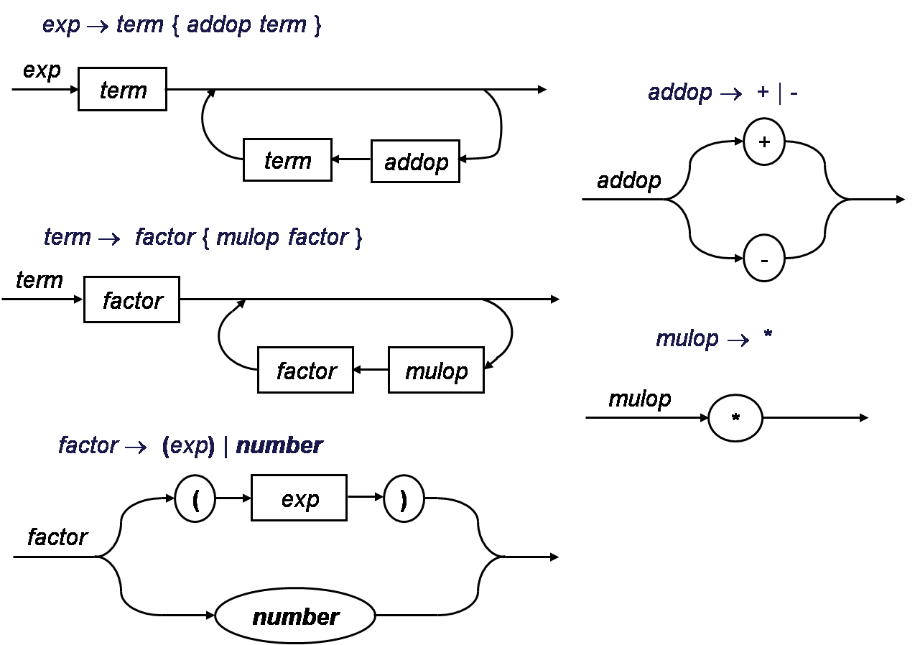
Examples

Slide 33
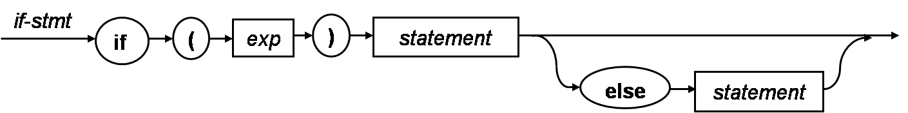
Examples
if-stmt → if (exp) statement [ else statement ]

Slide 34
Examples
E
T
E→T{+T}
T→F{*F}
F→i | (E)
T
+
T
F
F
*
F
i
(
E
)

Slide 35
A working simple calculator
Suppose to write a recursive-descent calculator for the simple integer arithmetic of the grammar.
Assume that the parsing procedures are functions that return an integer result.
exp → term { addop term }
addop → + | -
term → factor { mulop factor }
mulop → *
factor → (exp) | number

Slide 36
A working simple calculator
exp → term { addop term }
function exp: integer;
var temp: integer;
begin
temp:=term;
while token=+ or token = - do
case token of
+ : match(+);
temp:=temp+term;
- : match(-);
temp:=temp-term;
end case;
end while;
return temp;
end exp;
procedure exp;
begin
term;
while token = + or token = - do
match(token);
term;
end while;
end exp;
The code ensure that the operations are left associative by performing the operations as we cycle through the loop.

Slide 37
A working simple calculator in C code(1)
/* Simple integer arithmetic calculator according to the EBNF:
<exp> → <term> { <addop> <term> }
<addop> → + | -
<term> → <factor> { <mulop> <factor> }
<mulop> → *
<factor> → ( <exp> ) | Number
Inputs a line of text from stdin.
Outputs “error” or the result.
*/

Slide 38
A working simple calculator in C code(2)
#include <stdio.h>
#include <stdlib.h>
char token; /* global token variable */
/*function prototype for recursive calls*/
int exp(void);
int term(void);
int factor(void);
void error(void)
{
fprintf(stderr, “error\n”);
exit(1);
}

Slide 39
A working simple calculator in C code(3)
void match(char expectedToken)
{
if (token==expectedToken) token=getchar();
else error();
}
main()
{
int result;
token=getchar(); /*load token with first character for lookahead*/
result=exp();
if (token==’\n’) /*check for end of line*/
printf(“Result = %d\n”, result);
else error(); /*extraneous chars on line*/
return 0;
}

Slide 40
A working simple calculator in C code(4)
int exp(void)
{
int temp=term();
while ( (token==‘+’) || (token==‘-’) )
switch (token)
{
case ‘+’: match (‘+’);
temp+=term();
break;
case ‘-’: match (‘-’);
temp-=term();
break;
}
return temp;
}
<exp> → <term> { <addop> <term> }

Slide 41
A working simple calculator in C code(5)
int term(void)
{
int temp=factor();
while (token==‘*’)
{
match(‘*’);
temp*=factor();
}
return temp;
}
int factor(void)
{
int temp;
if (token==‘(’)
{
match (‘(’);
temp = exp();
match(‘)’);
}
else
if (isdigit(token))
{
ungetc(token,stdin);
scanf(“%d”,&temp);
token = getchar();
}
else error();
return temp;
}
<term> → <factor> { <mulop> <factor> }
<factor> → ( <exp> ) | Number

Slide 42
A working simple calculator
We have used above ideas to create a working simple calculator.
Instead of writing a full scanner, we have opted to use calls to getchar and scanf in place of a getToken procedure.

Slide 43
Right Associativity
exp → term addop exp | term
addop → + | -
term → factor mulop term | factor
mulop → *
factor → (exp) | number
A → α A | β (right recursive)
A → {α} β
exp → term addop exp | term
exp → { term addop } term
exp → term [ addop exp ]

Slide 44
Contents
4.1 语法分析器的功能
4.2 自上而下分析面临的问题
4.3 LL(1)分析法
4.4 递归下降分析程序构造
4.5 预测分析程序
►

