Slide 1
Generating Adversarial Examples with Adversarial Networks

Slide 2
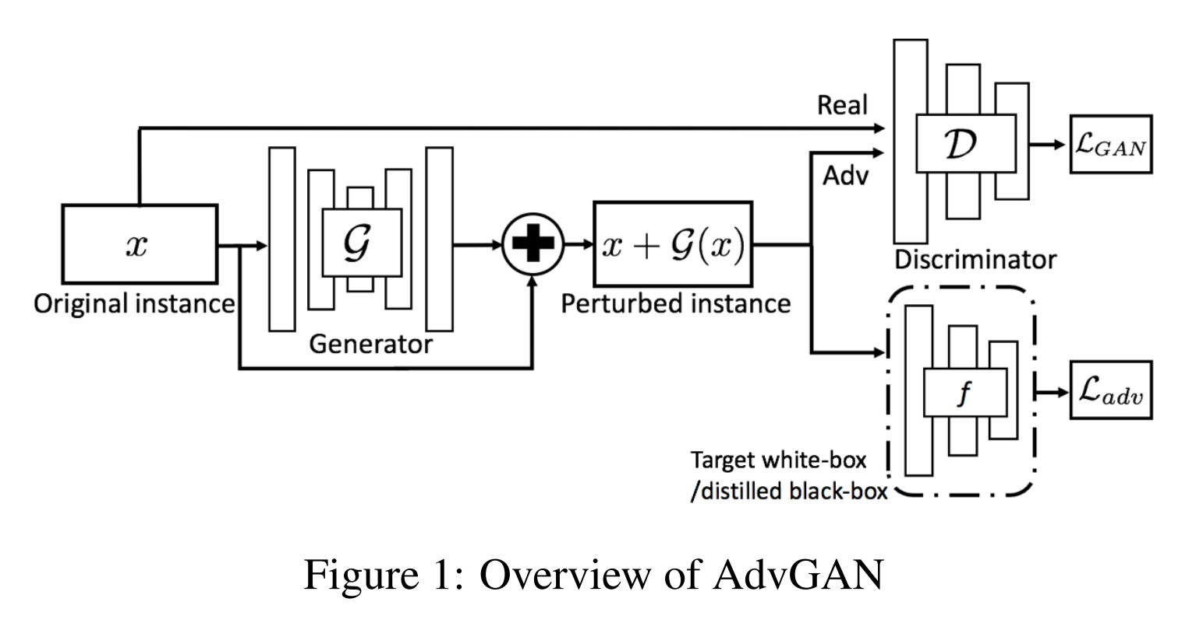

Slide 3



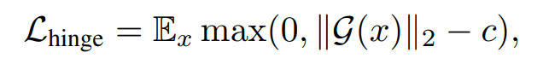

Slide 4

Adv损失

Slide 5
Hinge损失

Slide 6
训练结果
Target net 测试集上 0.993900
Advgan
Target net 在x+g(x)上 0.006000
epoch 20:
loss_D:0.001, loss_G_fake: 0.986, loss_adv: 0.906,
epoch 40:
loss_D: 0.001, loss_G_fake: 0.994, loss_adv: 0.436,
epoch 60:
loss_D: 0.000, loss_G_fake: 0.999, loss_adv: 0.139,

