Slide 1
題目: 浴室++

Slide 2



Scenario
Here comes a person. Then, he (she) turns the light.
If the elder crushes, the alarm rows.

Slide 3
Design
Evaluate whether or not a person comes with the assistance of infrared detector.
As detector gets the datum, turn on the light.
Set two pressure detectors to get the data.
If two pressure detectors are invoked, the alarm starts ringing.
BATHROOM++
HUMAN DETECT
CRUSH DECTECT
INFRARED DETECTOR
LED
PRESSURE DETECTOR
ALARM

Slide 4
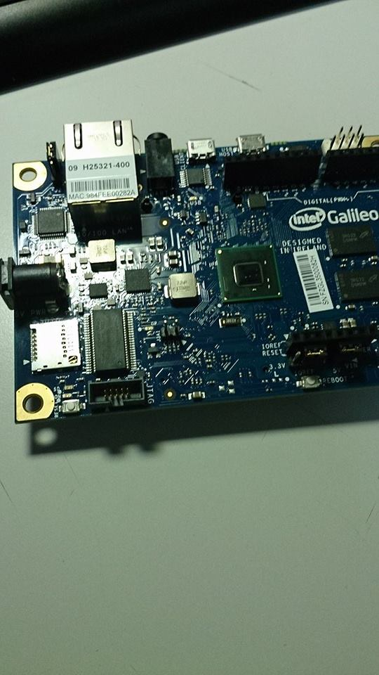
Why Galileo?
High efficiency.
More functional
Novel and fancy

Slide 5
Galileo Operations
do nothing
others
11
alarm
twopressure
[1:0]
No
sensor
state
Yes
do nothing
turn on/off
Temperature
Detector
(infrared)
Turn the data back.
Crush
Detector
Galileo
Turn the data back.
Send signal to control.
Send signal to control.
Evaluate
Control
LED
Alarm

Slide 6
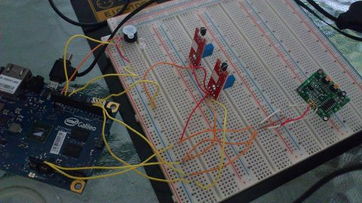
Demonstration
When our hand approaches the infrared detector, the LED will be turn on.
When two pressure detectors are invoked simultaneously, the alarm rings.
Infrared
Detector
Pressure
Detector
Galileo

Slide 7
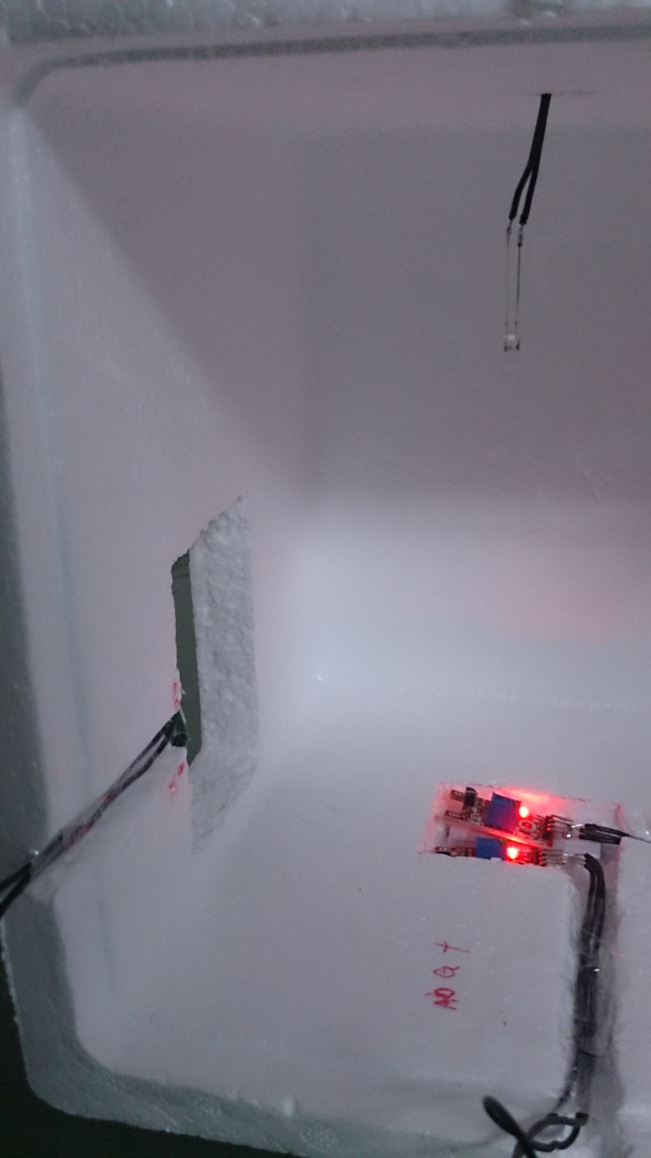
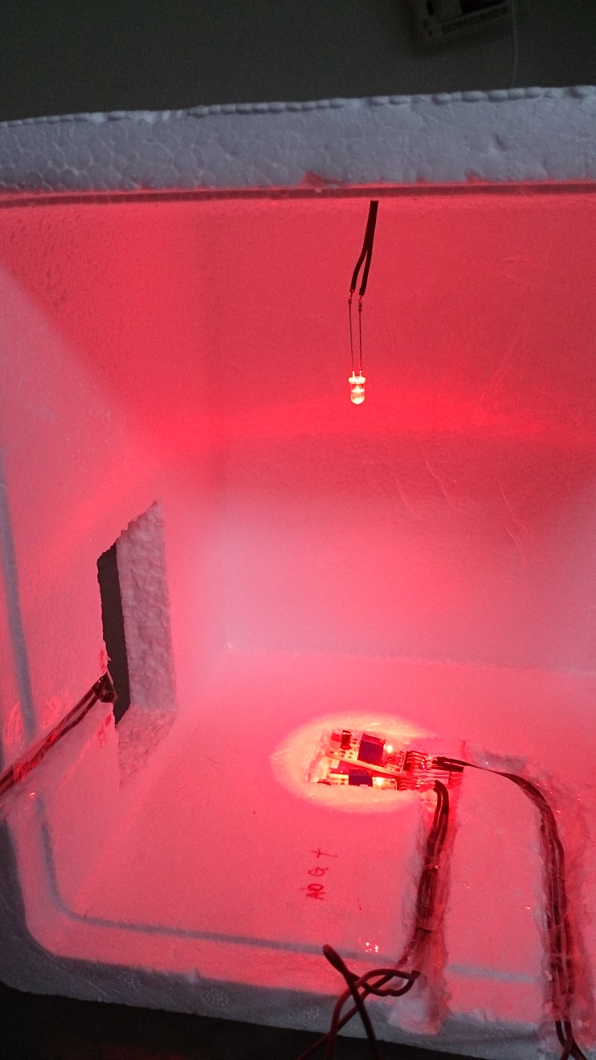
Demo Pictures

Slide 8
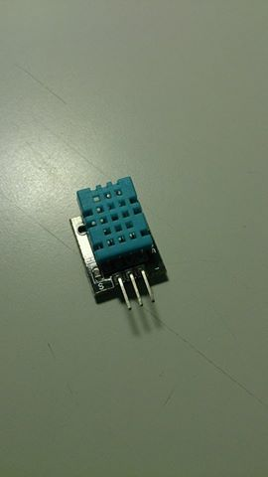
Idea
Provide more convenience in the bathroom.
The expansibility:
More powerful, functional, and human designs.
The systematization of every kinds of rooms in the house or buildings.
Bath++
Kitchen++
Study++
Bedroom++
Dining room++
…

