Slide 1
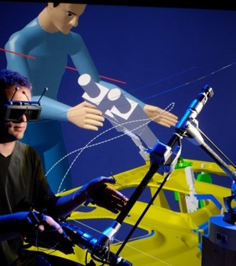
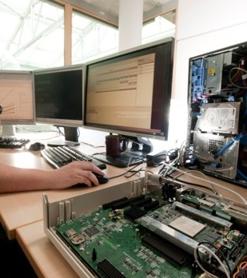
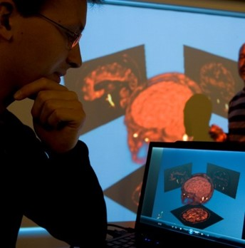

SETI B2 – Model-Based Software Engineering Case study of ADAS

Slide 2
Minimum Content
Requirement, use-case, and interaction models
Please keep it short…
Message and service models
Only your components
Component models
Only your components
System model
Code generation experience
Not a description of the code, just show you understood the structure of the generated code w.r.t. specifications in the models
Skill models
Behavior tree models
HARA
One online talk per team. You only join during your time slot.
Maximum of 30 minutes talk + 15 minutes questions.
Slides must be sent to shuai.li@cea.fr before March 1st 23:59 (UTC+1).
Date: March 2nd, 2021.
Time: To be communicated to each team soon™.
60% common score for all teams + 40% individual team score.

Slide 3
Additional Instructions and Advises
The minimum content is a checklist and not a plan for your talk. You are free to follow it as a plan or adjust it for your own talk. You can add new content if you want.
Diagrams can be inserted in slides as screenshots or exported PNG from Papyrus. Diagrams must be well drawn and understandable.
Good examples: Rectilinear edges, no overwhelming labels, aligned nodes, no superposition.
Teams handle the time of each part of their presentation as they wish but no part should be excessively longer than the others.
Bad example: Requirements part takes 15 minutes.
Better to do a short presentation that’s interesting than a long presentation that’s boring.
Bad examples: See bad examples in next slide.
Every team member should participate in the talk.

Slide 4
Additional Instructions and Advises
Prioritize explaining your thought process and the abstract “big picture” instead of doing a syntactical description of your models.
Bad examples:
There is requirement called Requirement 1 with id REQ01 and text […]
There is a message called Msg1. It has 3 attributes called attr1, attr2, and attr3.
In the system model, we have Instance 1 with Port 1 connected to Instance 2 with Port 2.
We clicked on the button ‘Generate ROS code’ and it generated code for us after we clicked on several other menus.
There is one fallback node, connected to one sequence node and one action node.
In the Hazard Event cell, it is written ‘The event that causes the hazard is […]’. In the Frequency cell it is written ‘2’.
Good examples:
We modeled a behavior to make the vehicle stop upon detection of several objects, like obstacles, pedestrians, and lack of road. We had some difficulty modeling the AI behavior with a BT because in Papyrus there’s not decorator node. Our solution was to […]. The whole approach of modeling a behavior as a tree is new to us and unnatural.
We had some integration issues during system modeling because we didn’t expect the same interfaces provided by the other teams. As domain experts, we would have preferred […].
The ISO standard didn’t help us identify hazards with a go-to method. Instead, this is how we identified our hazards […]. Also, we found a quantification of risks by numbers too restricting, which limited our creativity in risk assessment.

Slide 5
Thank you for your attention

