Slide 1
Plan for the Day
Goals
Students will develop ways of thinking that make use of R's computing power to solve problems. (CT.1, CT.2)
Students will develop their skills in programming with statistical software. (Prog.4, Prog.5, Prog.6)
Students will develop their skills in creating reproducible code and data analyses. (Repro.1, Repro.2, Repro.5, Repro.6)
Needs: signal cups, notes, a Quarto document to experiment in
Steps
Cross-referencing in Quarto
Alt Text and Quarto
Adding Citations

Slide 2
Cross-Referencing in Quarto
Stat 184

Slide 3
Cross-Referencing
While reading a textbook, journal article, or report, have you come across phrases like any of the following?
As seen in Table 2,...
...(Figure 1)...
Figure 5a demonstrates...
...(see Listing 6).
Equation 7 shows...
These are all examples of cross-references.
A cross-reference is a short phrase that connects narrative text to another element in the document such as a table, figure, (code) listing, or equation.
Quarto provides a way to not only automatically number each of these elements, but also create automatically updating cross-references in your narrative text.

Slide 4
Creating Cross-References
To create a cross-reference, there are two key things that you must do:
Uniquely name each element, incorporating a reserved prefix.
For tables, figures and code listings, you'll use the label code chunk option. Ex:
#| label: tbl-diamondSummary
#| label: fig-priceHistogram
#| label: lst-scrapeRanks
Note: these are 3 examples that would go with 3 distinct and separate code chunks.
For display equations, you'll add the label in a set of curly braces after the closing double dollar signs.
$$y = x^3$$ {#eq-cubic}
Notice that each label starts with a special prefix that is separated from the name by a dash. The most common reserved prefixes include
fig for Figures
tbl for Tables
lst for List(ing)s
eq for Equations
thm for Theorems
def for Definitions
sec for Sections

Slide 5
Creating Cross-References
To create a cross-reference, there are two key things that you must do:
You must then use reference tags in your narrative text.
In your narrative text where you want to create a cross-reference, you'll need to put a reference tag by typing the @ followed by the element's label. For example, @fig-priceHistogram or @tbl-diamondSummary.
These reference tags will get converted to the appropriate label (Figure, Table, etc.), number, AND be hyperlinked.
To build a cross-reference to a sub-element such as Figure 5b, you'll do all of the preceding steps. When you make your reference tag, you'll add a number suffix for the desired sub-element.
For example, @fig-boxplots-2 would create a reference to the second plot in a set of multiple plots (i.e., Figure #b). Note: faceting does not count as a set of sub-figures for cross-referencing.

Slide 6
Practice Cross-Referencing
```{r}
#| label: priceHistogram
#| fig-cap: "Histogram of Diamond Prices"
#| fig-pos: "H"
#| fig-width: 5
#| fig-alt: "insert alt text here"
# Make a histogram of diamond price ----
library(ggplot2)
data(diamonds)
ggplot(
data = diamonds,
mapping = aes(x = price)
) + geom_histogram() +
theme_bw()
```
In our last class you practiced creating a code chunk for a plot using the code to the left.
Use this code and create a cross-reference in your narrative text.
Are there any issues with this code for cross-referencing? If so, identify the issue(s) and how to fix them.

Slide 7
Alt-Text and Quarto
Unit 4

Slide 8
Adding Alt Text in Quarto
We need to define Alt Text for all images we use in our Quarto documents. This includes plots/graphs that we create in R (or any other scripting language) as well as images that we insert from files.
In both cases, we will be making use of the option fig-alt.
For plots/graphs we create via code, the fig-alt option is a code chunk option we can specify in two possible ways.
First, we can directly define the value of the Alt Text.
#| label: fig-priceHistogram
#| fig-cap: "Histogram of Diamond Prices"
#| fig-alt: "A positively skewed histogram of diamond prices going from 0 U S D to over 17500 U S D."
NOTE: the fig-cap and the fig-alt options are BOTH specified and are NOT identical.

Slide 9
Adding Alt Text in Quarto
The second way we can set Alt Text for a plot/graph we make via code depends on three things:
We made the plot/graph via the {ggplot2} package.
There is only one (1) such plot/graph in the code chunk we're working in.
We specified the Alt Text in the alt argument of the labs function of {ggplot2}.
If we meet all three of the above criteria, then we can use the following command:
#| fig-alt: !expr get_alt_text(get_last_plot())
The functions get_alt_text and get_last_plot are part of {ggplot2} are do exactly what their names imply. Keep in mind that get_last_plot will only grab the most recently rendered {ggplot2} plot.

Slide 10
Alt Text for Inserted Images
When you are inserting an image from a file into your Quarto document, we will use the fig-alt label in a little bit different of a way.
First, you need to make sure that you know where your image file is.
We recommend that you add this file to an images sub-directory for your current R Project directory that you're working in.
Second, you need to insert this image into your Quarto file.
![A green cup](images/cupGreen.png){#fig-greenCup fig-alt="Green cup flipped upside down." height=100pt}
Note:
The text in the square brackets is your figure caption.
The relative file path to the image file appears in parentheses.
Your figure label appears first in the curly braces starting with #.
We use an equals sign instead of a colon to set the alt text.

Slide 11
Alt Text Reminders
Remember,
All images need alt text.
Alt Text should be descriptive and concise (~140 characters max).
You do not need to describe every single thing; focus only on the most important element(s).
You may use ASU's Image Accessibility tool to help you come up with Alt Text for any image file.
Make sure that you proof-read and fix any text this tool or any other tool generates for you.

Slide 12
Adding Citations
Unit 4

Slide 13
Referencing Others Work
A standard part of science is reviewing the work of others that might pertain to our current project.
We want to be sure that we acknowledge the insight that we gain from others as well as anything that we might use from them in our work.
This includes
Ideas and findings,
Data,
Code,
Methodology,
Images,
and the list goes on.
Practicing Open Science and being a good/ethical Statistician/Data Scientist includes giving credit to others when appropriate.

Slide 14
Why Given Credit?
Practicing Open Science and being a good/ethical Statistician/Data Scientist includes giving credit to others when appropriate.
With people around you, brainstorm reasons why giving credit would be good for both Open Science and us.

Slide 15
Adding Citations in Quarto
There are two things that you'll need in order to add citations to your work in a Quarto document: a CSL file and a bibliographic file.
The Citation Style Language (CSL) file tells Quarto how to format all of your references in your document. Common examples include
American Psychological Association (APA)
Modern Language Association (MLA)
Chicago (Quarto's default if you don't specify a CSL)
American Statistical Association (AmStat)
You can download CSL files from https://www.zotero.org/styles.
Make sure that the CSL file is in the same directory as your QMD file and you specify csl: fileName.csl in your YAML header.

Slide 16
Creating Bibliographic Files
The second thing that you need is a bibliographic file that houses all of your references.
Unless you know what you're doing, a good practice is to use another tool to create this file such as a reference manager (EndNote, Mendeley, Zotero) or an online tool (e.g., Zoterobib).
We recommend using Zotero as a reference manager as this is a free tool (so is Mendeley) and R Studio Desktop will automatically connect with it.
Check out https://guides.libraries.psu.edu/zotero as well as
https://www.zotero.org/.
A reference manager will help you keep your references organized across your entire career. For a quick project, an online tool such as Zoterobib is sufficient.

Slide 17
Using Zoterobib
Let's go to Zoterobib: https://zbib.org/
We are going to create a set of references at this webpage:
The Quarto Crash Course e-book
https://neilhatfield.github.io/STAT184/quarto_crash_course
Kaplan and Beckman Data Computing e-book
https://dtkaplan.github.io/DataComputingEbook/
Needs fixing
The Diamonds Data Set
DOI: 10.5281/zenodo.3522105
When you have all three, let's download the BibTeX file by clicking the downward pointing arrow next to Copy to Clipboard.
Save the file in the same directory as your QMD file.

Slide 18
Inserting Citations
First, we need to add our bibliographic file to our YAML header.
bibliography: fileName.bib
Second, we need to identify a place to add a citation. For us, let's add a bit of narrative text before the histogram of diamond prices.
Then we are going to use RStudio Desktop's built-in tools from the Visual Mode to help us.
Let's add a citation for the diamonds data and for our use of the {ggplot2} package.
We can update the BibTeX file by manually copy/pasting new entries from another file as well as letting RStudio Desktop update the file for us.

Slide 19
The References Section
The last step is to add the References section to your Quarto Document.
This should start on it's own page and be located after the main part of your document and before any appendices.
The following code will automatically create an appropriate References section for us in our Quarto document.
{{<pagebreak>}}
# References
::: {#refs}
:::
This section will automatically update each time we render our Quarto document.

Slide 20
Homework
Assignments
HW #4.2: GitHub Account
Due by 11:59pm, Monday, April 6, 2026
No late passes
HW #4.3: Reproducible Data Analysis
Due by 11:59pm, Monday, April 13, 2026
Be sure to review the rubrics and the info questions
There is a separate submission portal for uploading your rendered PDF.

Slide 21
Plan for the Day
Goals
Students will develop ways of thinking that make use of R's computing power to solve problems. (CT.1, CT.2)
Students will develop their skills in programming with statistical software. (Prog.4, Prog.5, Prog.6)
Students will develop their communication skills as related to statistical programming and data analysis. (Comm.1)
Students will develop their skills in creating reproducible code and data analyses. (Repro.1, Repro.2, Repro.5, Repro.6)
Needs: signal cups, notes
Steps
Best Practices for Quarto
Work Time

Slide 22
Best Practices for Quarto
Unit 4

Slide 23
Best Practices
Put an empty line between all blocks of narrative text and code chunks, both before and after.
Put an empty line at the bottom of your code chunks between your last line of code and the closing three backticks.
Label your code chunks, even if they aren't producing tables or figures.
Load all of your packages and set global R options in a code chunk at the top of your document, just after the YAML Header.
DO NOT put install.package commands in code chunks unless they are commented out as this can cause your QMD to not render.
DO NOT put interactive commands such as esquisser in any code chunks as this can cause your QMD to not render.
DO NOT use View, str, head, tail, etc. in code chunks. While useful to you, distracting to your readers.
Code comments should be about the code; discussion of results should be narrative text outside of code chunks.

Slide 24
Label Names
When you go to name items such as code chunks, plots, tables, equations, etc. in Quarto using the label tag (#| label: name), you need to make sure that you follow good naming rules.
If you plan to use cross-referencing, you MUST begin the name with the appropriate reserved keyword and hyphen (fig-, tbl-, eq-, etc.).
All names must be unique.
Follow a more restrictive version of R's naming rules.
No special characters other than the hyphen (-).
No starting/leading numerals.
No spaces.
While it might look like you can put spaces, underscores, and periods in the name, you are actually inviting disaster to creep up on you when you least expect it.
At best, the rendering process will run and ignore your labels, breaking any cross-referencing; at worst, rendering will stop and throw errors.

Slide 25
Work Time
Unit 4

Slide 26
Work Time for HW #4.3
You have the rest of class time to work on HW #4.3. Use this time to ask clarifying questions and bounce ideas off of each other.
You may not work on anything else without explicit permission.

Slide 27
Homework
Assignments
HW #4.3: Reproducible Data Analysis
Due by 11:59pm, Monday, April 13, 2026
Be sure to review the rubrics and the info questions
There is a separate submission portal for uploading your rendered PDF.

Slide 28
Plan for the Day
Goals
Students will develop ways of thinking that make use of R's computing power to solve problems. (CT.1)
Students will develop their skills in programming with statistical software. (Prog.4, Prog.5, Prog.6)
Students will develop their skills in creating reproducible code and data analyses. (Repro.1, Repro.2, Repro.4)
Needs: signal cups, notes, a practice Quarto document
Steps
Quick Check-in
Version Control via Git
Working with GitHub
Clone a Repo and Make an R Project

Slide 29

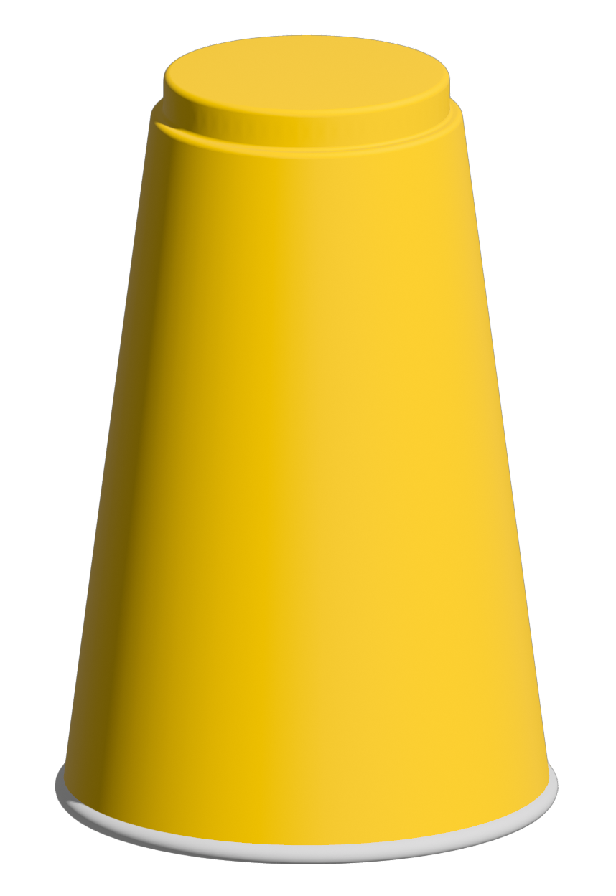

A Quick Check-In
You should have received an email inviting your GitHub account to join the Stat184-Spring2026 organization. This would have gone to the email you used for your GitHub account.
Have you accepted the invite?
Yes.
Not yet, but will do so as soon as possible/now.
No, as I didn't get an invite. (Talk to your instructor ASAP.)

Slide 30
Version Control & Git
Unit 4

Slide 31
What is Version Control & Git?
How many of you use version control in your regular lives?
How many of you use any of the following: Time Machine or another back up system (iCloud, Dropbox, etc.), Google's Suite of Office Applications, Microsoft Office Online?
Each of these technologies come with version control capabilities.
Version control is a method of tracking changes to a set of files over time so that if needed, users can recover/restore older versions.
Git is an open-source, distributed version control system, originally created for Linux kernel development.
Distributed here means that each person working on a Git-powered project has the complete codebase and history on their local computers.
This approach has the benefit that programmers can work non-linearly and on different OS's without running into many problems.

Slide 32
Two Approaches to VC
There are two general approaches to version control (VC).
Delta-Based VC
After initializing the VC, the system tracks the changes (deltas) to the files in the repository. Thus, subsequent versions are the sum of the initial files and all of the changes made up to that version.
Snapshot Based VC
After initializing the VC, the system takes a snapshot of the whole repository with each version. Changed files get updated and unchanged files are linked for efficiency.
Git is a snapshot based VC system that we'll work with.

Slide 33
Using Git
Each circle/dot is a snapshot of the codebase.
Programmer A's Branch
Initialize Repo
Main Code
Programmer B's Branch
Programmer C's Branch

Slide 34
Working with GitHub
Unit 4

Slide 35
General Workflow in Git
The process to using Git is fairly straightforward; you just need to practice and get used to the vocabulary.
Step 0: Create an account on a Git server (e.g., GitHub); install any needed tools on your machine (e.g., GitHub Desktop).
HW #4.2
Step 1: Create a repository ("repo") that will act as the central directory/folder structure for some project.
Step 2: Clone this repo to your local machine.
Step 3: Edit, add/delete files as needed. Making commits (snapshots) along the way.

Slide 36
General Workflow in Git
Step 3: Edit, add/delete files as needed. Making commits (snapshots) along the way.
Step 3A: Make and save your changes, add/delete files in your local copy of the repo.
Step 3B: Stage which of those changes you want to be part of your next commit.
Step 3C: You create a commit of the changes you staged, adding this snapshot to your Git directory.
Suggestion: make a commit at the end of each step of your plan.
Step 4: Push your commits to the appropriate branch of the repo on the server at least once per day.
Step 5: Pull changes that either you (or someone else) made on a different machine AND/OR Pull-Merge changes from another branch into your own.

Slide 37
Let's Practice
Go to GitHub.com and log in.
We're going to work together to create a practice repo together.

Slide 38
Homework
Assignments
HW #4.3: Reproducible Data Analysis
Due by 11:59pm, Monday, April 13, 2026
Be sure to review the rubrics and the info questions
There is a separate submission portal for uploading your rendered PDF.

