Slide 1
Plan for the Day
Goals
Students will develop ways of thinking that make use of R's computing power to solve problems. (CT.1)
Students will develop their skills in programming with statistical software. (Prog.4, Prog.5, Prog.6)
Students will develop their skills in creating reproducible code and data analyses. (Repro.1, Repro.2, Repro.4)
Needs: signal cups, notes, GitHub Desktop, your practice repo
Steps
Git Branches
Meaningful Commit Messages
Pull Requests
Suggested GitHub Work Flows

Slide 2
More with GitHub
In our last class, we started working with Git by creating a repo (from a template) and cloning it to our local machines.
We could then make changes, commit them, and push them back to the repo on the GitHub server.
We're going to cover a couple more key elements of working with GitHub that are important for helping us fully capitalize on this technology.
Writing Commit Messages
Branches and Work Flows
Bringing Branches Together (Pull Requests)

Slide 3
Git Branches
Unit 4

Slide 4
Branches
Repos support creating multiple production lines for the same project.
A branch is a version of the repo that allows a person to work without fear of accidentally messing up the project's main body of work. Branches are part of the repo, not a separate repo.
The central branch (i.e., the default branch) of any project is main.
While there are many approaches to working with branches, here's one we suggest for data analysis projects and small team work.
The team works together to establish the main branch and get the essential elements set up.
Once the main branch and essential elements are in place, everyone stops working on main. Each person creates their own development branch (such as dev-neil or dev-veronica).
Each person works and pushes commits to their dev branch.
Periodically, the team checks in on each other and merges copies of their branches into each others (to pass critical elements) or bring changes to the main branch.

Slide 5
Let's Practice
Bring up your practice repo from our last class in GitHub Desktop.
In GitHub Desktop, make sure that you're in your practice repo.
Using either the Branch menu or the Current Branch button, we are going to make a new branch.
Give your branch a name and then click Create Branch.
If prompted, you'll need to decide whether your current changes should stay on the old branch or come to the new branch.
Generally, you'll want to bring your changes to the new branch.
We will then need to Publish our Branch; this is a type of Push that will create the branch on the server.

Slide 6
Writing Meaningful Commit Messages
Stat 184

Slide 7
Writing Commit Messages
If the commit involves multiple changes and/or complicated ones, you'll want to include and additional message.
A commit message is a larger description of the change(s) that make up this particular snapshot. The message should cover the What and Why of the changes, not the How of your changes.
You can even reference issues (bugs, new features) that have been logged in the repo in your commit messages to help flag important changes.
Suppose the issue #21 highlighted that cross-references were breaking and you managed to fix this issue. Your commit subject and message might look like:
Correct broken cross-references
All instances of cross-references were not rendering due spaces appearing in multiple label names.
Fixes #21

Slide 8
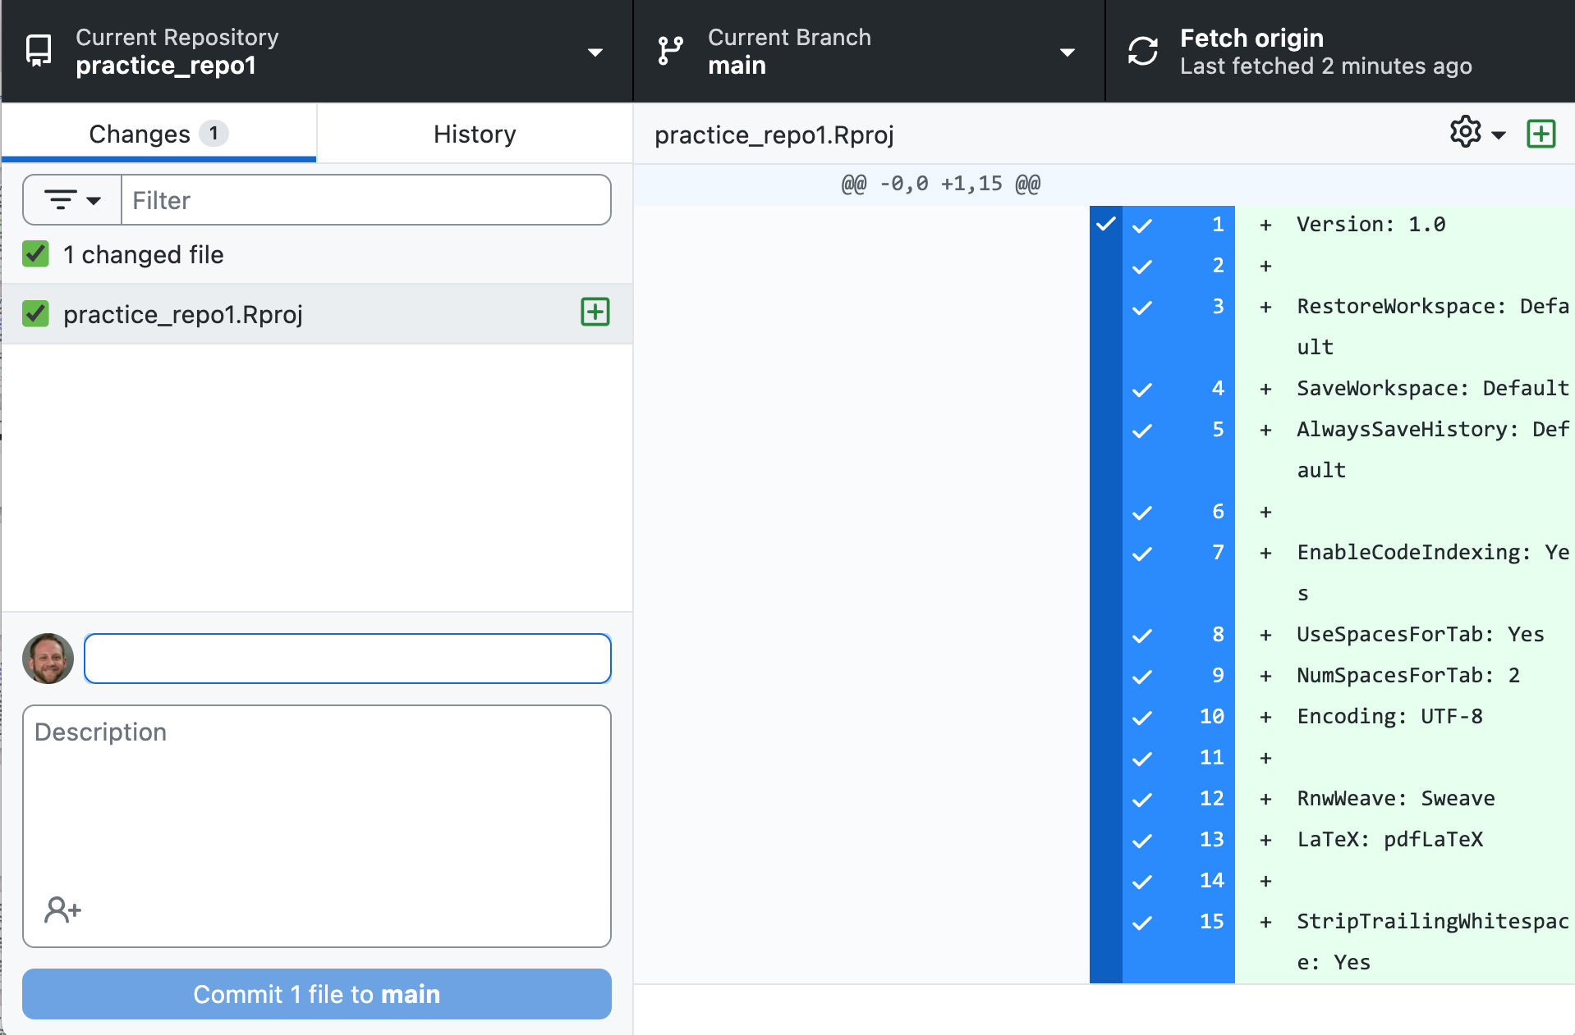
Let's Practice
Create a commit message based on the following GitHub Desktop info.
Notes:
Subject only needed: Add a RStudio Project to the repo

Slide 9
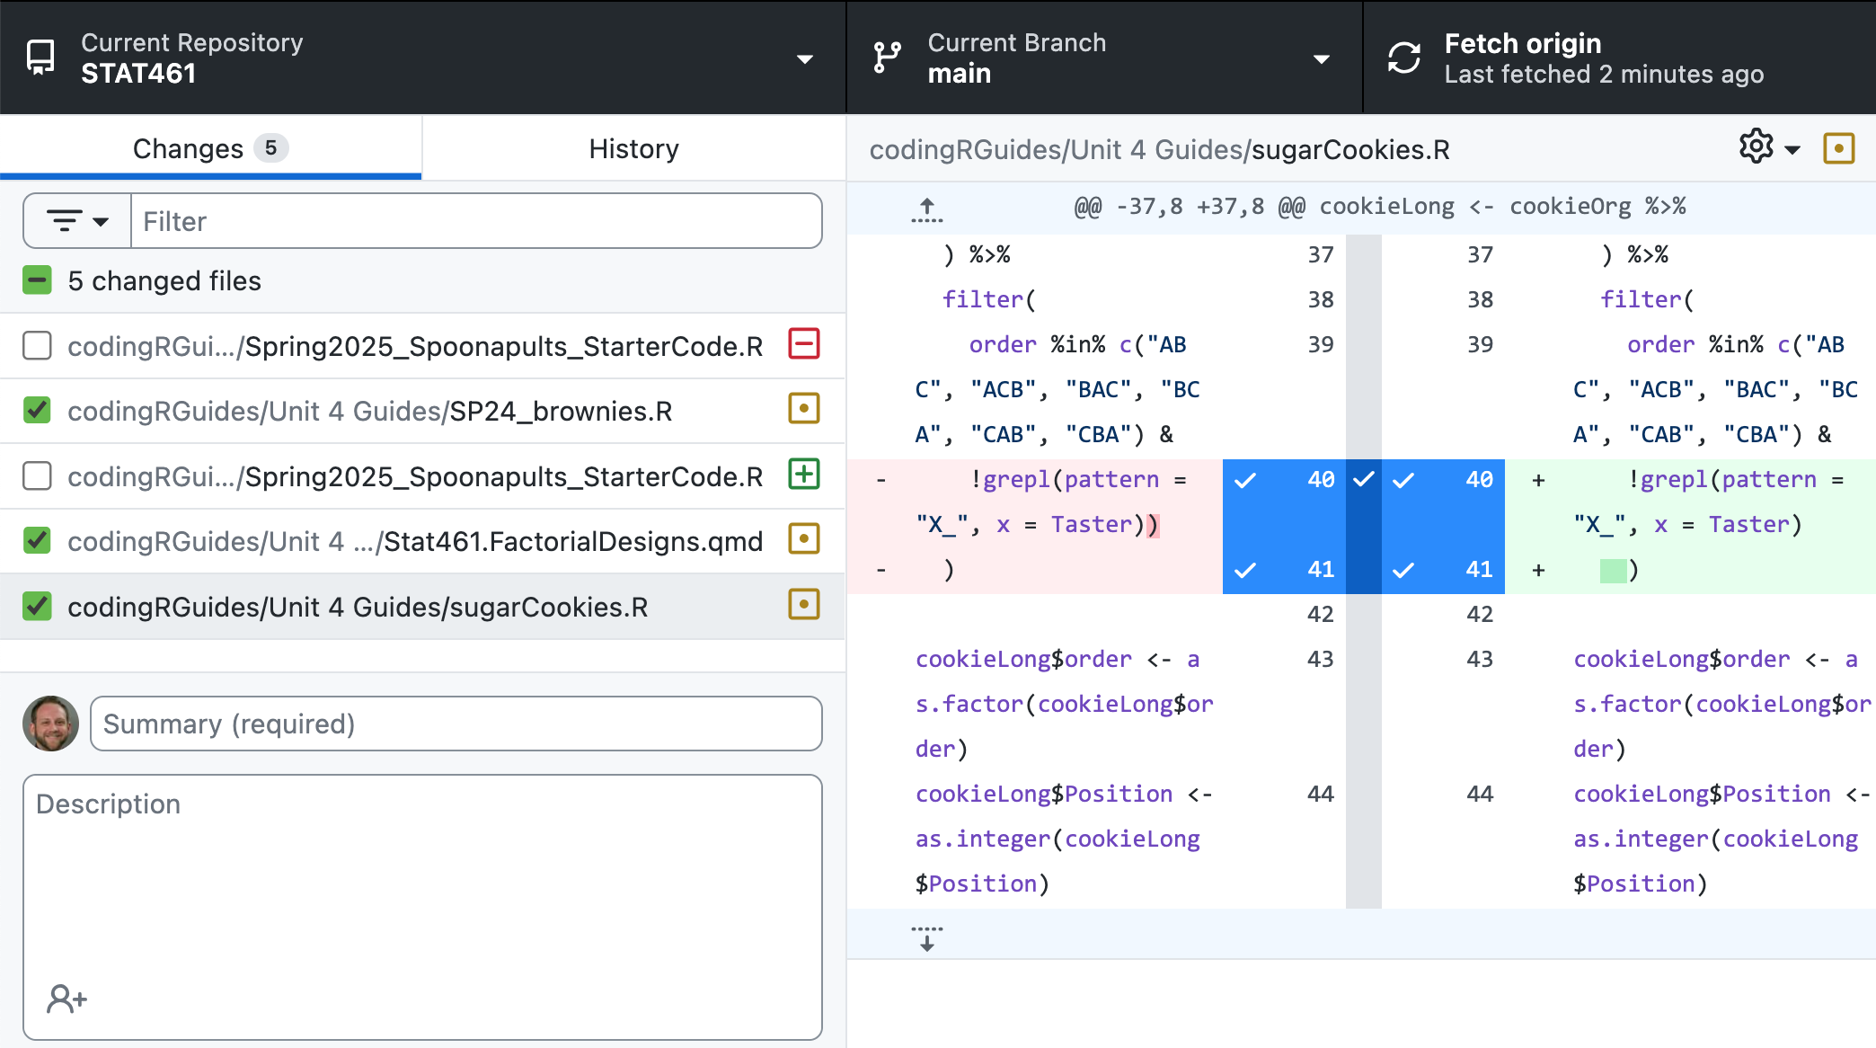
Let's Practice
Create a commit message based on the following GitHub Desktop info.
Notes:
Subject and Message Required--Note what is staged (checked)
Subject: Change files related to factorial designs and baking contexts.
Message (limited since they don't know the why): Changes two R scripts to address problems inconsistent formatting and updates a quarto file.

Slide 10
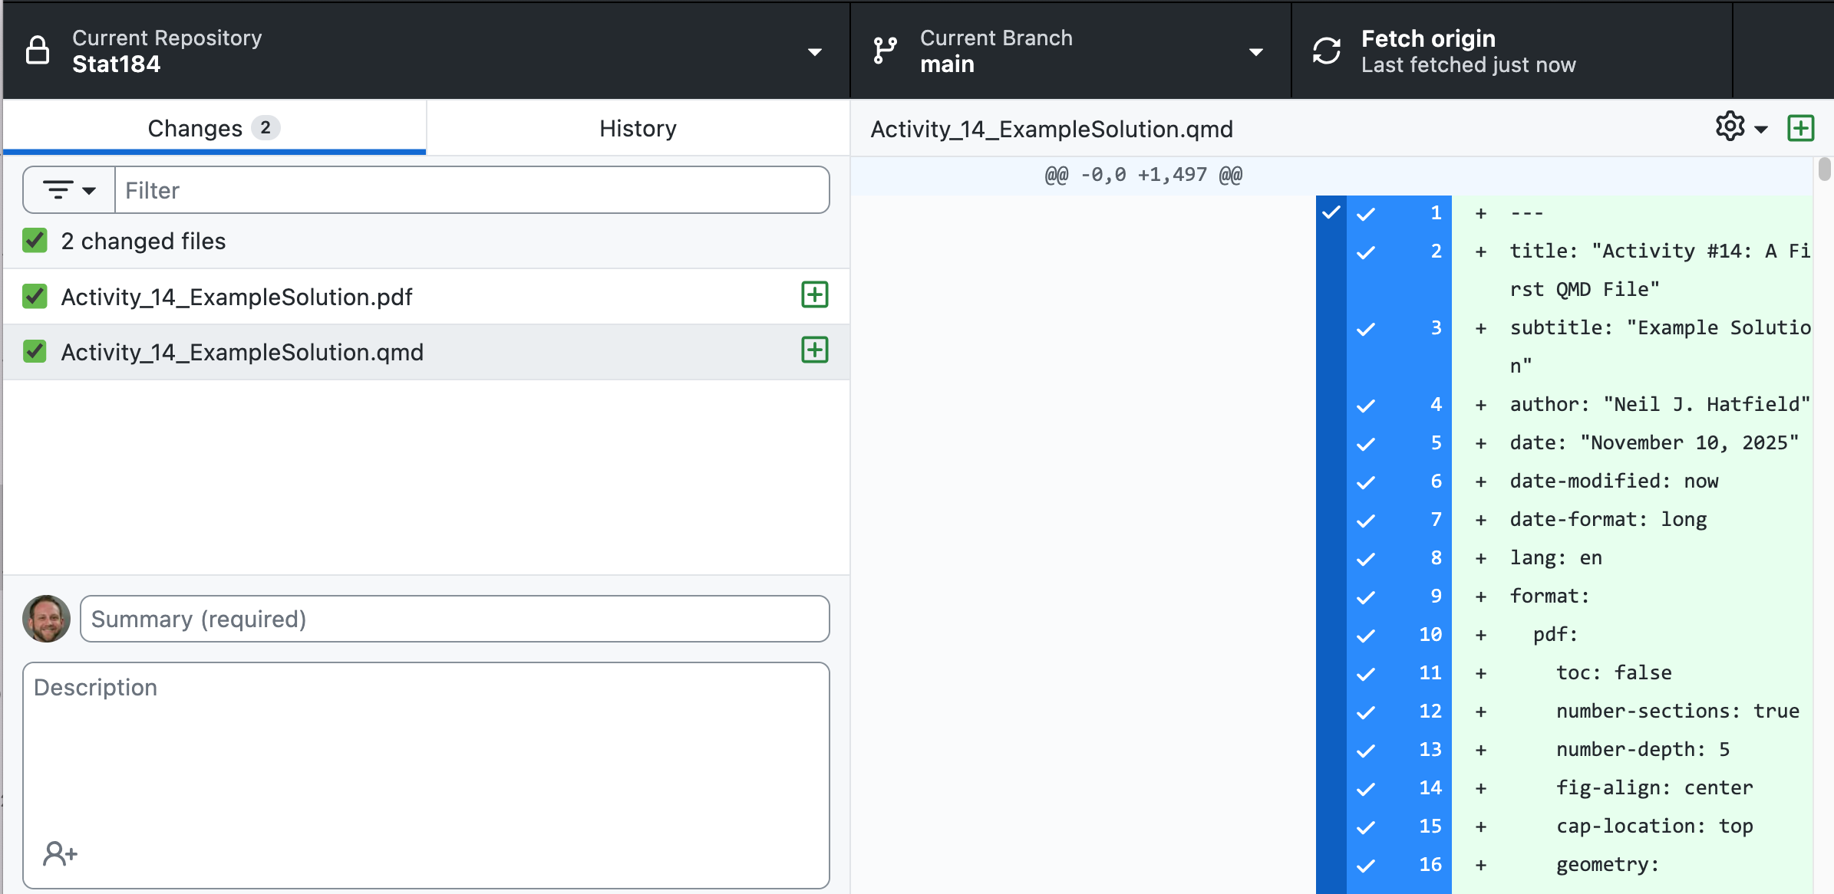
Let's Practice
Create a commit message based on the following GitHub Desktop info.
Notes:
Subject and Message Required
Subject: Add Example Solutions for Activity 14
Message: Adds the original quarto document that functions as an example solution for Activity 14 as well as the rendered PDF output.

Slide 11



Self-Check
Locate at least two files you've made for Stat 184 and place copies of them into your current practice repo.
Make a commit to your current branch of your repo with a meaningful commit subject and message.
I've made my commit.
I'm working on my commit.
Something has gone wrong; help!

Slide 12
Pull Requests
Unit 4

Slide 13
Pull Requests
When you are working with multiple branches, you will need to periodically bring your developments either into other branches or to the main branch.
Bringing elements to the main branch is important as that is the branch that people coming to your repo are going to reference and use.
To merge two branches together, you have to first create a Pull Request.
A Pull Request sets up a space in the repo for people to compare the cumulative set of commits on a (dev) branch to the current state of a target branch while providing them with a space to discuss whether merging should move forward.
Once reviewed and approved, the team can merge the (dev) branch into the target branch. The (dev) branch's commit history gets added to the target branch and they are then identical.

Slide 14
Pull Requests
When working in a team, you should approach Pull Requests as a team.
That is to say, that you shouldn't make a Pull Request, approve your own pull request, and then finalize the pull request by merging the branches.
Ideally, one person should propose the Pull Request; other people should review and approve the request, and then a designated individual will then complete the merge.
In the Shiny App Program, we require a student to get two approving reviews by other students before the code director (Neil) completes the merge and deploys the new version of the app for the world to use.

Slide 15
Updating Branches from Main
As people work on their separate dev branches, the main branch may periodically get updates.
A good practice to adopt is that when a Pull Request to the main branch is finalized and merged, to let the team know.
They can then use the Update command from the Branch menu in GitHub Desktop to update the code base of their dev branch.
When dealing with Pull Requests and Updates, you can encounter Merge Conflicts. These happen when Git sees two different sets of changes for the same line and wants you to manually resolve them.
If and when these happen for you in this course, we will work with your team to explore how to address these issues.

Slide 16
Homework
Assignments
HW #4.3: Reproducible Data Analysis
Due by 11:59pm, Monday, April 13, 2026
Be sure to review the rubrics and the info questions
There is a separate submission portal for uploading your rendered PDF.

Slide 17
Plan for the Day
Goals
Students will develop ways of thinking that make use of R's computing power to solve problems. (CT.1)
Students will develop their skills in programming with statistical software. (Prog.4, Prog.5, Prog.6)
Students will develop their skills in creating reproducible code and data analyses. (Repro.1, Repro.2, Repro.4)
Students will develop their professional identity through self-reflection and working with others. (Prof.2, Prof.4)
Needs: signal cups, notes
Steps
The README for your Repos
Issues in GitHub
Coming Full Circle
GitHub Practice

Slide 18
The README
Unit 4

Slide 19
README
The README file is a special file in every repo.
When you (or someone else) visits your repo on Web, GitHub will display the contents of the README file. Thus, you can think of the README as your front/cover page of your repo/project.
Ideally, your README should be lightweight (i.e., not full reports) and easy to digest. They should allow a visitor to quickly learn...
What the repo/project is about
Where the data come from
What's the current plan
How is the repo organized
Contact information
The README.md file should live at the top level of your repo and can be open/edited with any plain text editor (including RStudio). They are Markdown files so you can use that syntax for formatting the text.

Slide 20
Create a README
Let's return to our practice repo and create a README.
Here's the bullet list.
What the repo/project is about
Where the data come from
What's the current plan
How is the repo organized
Contact information
When you're done editing, make a commit and push your updated README to the server.

Slide 21
Issues in GitHub
Unit 4

Slide 22
GitHub Issues
One of the most powerful elements of GitHub is the Issues page that exists for every repo.
Issues allow you to plan, discuss, and track work across the project and all contributors.
When you create an Issue on the repo, you must give the issue a title and a description.
However, you can also add the following:
Assignees
Labels (e.g., bug, documentation, help wanted, question, etc.)
Type (e.g., Bug, Feature, Task)

Slide 23
Create an Issue
Let's return to our practice repo and create an Issue.
Our issue is that we are going to need to add our code for doing the Monte Carlo Simulation for Numerical Integration.
Be sure to assign this issue to yourself.

Slide 24
Resolving Issues
After creating an issue, we can go about resolving it.
For our practice issue, the fix is relatively simple: we need to add the appropriate R script file to our repo.
Let's make this change BUT don't yet commit this change.
We can link a commit to an issue by adding a reference to the issue in our commit message by including the issue's number.
If we use particular keywords, we can actually close the issue when a Pull Request to the main branch involving that commit runs.
close
closes
closed
fix
fixes
fixed
resolve
resolves
resolved
Let's write a commit message that addresses the issue that we made.

Slide 25
Additional GitHub Options
There are many more features to GitHub that you should explore.
You can create an entire Wiki page for each repo.
You can create Project tables to help manage project oversight.
You can create automated workflows (Actions) that run when certain triggers are activated.
With your GitHub account, you can even create a website with GitHubPages that can function as a professional portfolio.
You should continue to explore what is possible with GitHub.

Slide 26
Coming Full Circle:
PCIP and Version Control
Unit 4

Slide 27
Plan-Code-Improve-Polish
Throughout the semester, we have encouraged you to apply the PCIP system to your data work.
We have routinely asked you to engaging in Planning your functions, wrangling, and analysis by writing down your Goals, Needs and Steps.
We ask you then to begin Coding by enacting your plan by writing code in R, thereby leveraging R as a tool.
As you work on writing, we've also asked your to think about Improving your work by engaging in iterative debugging, testing, and updating of your plans.
Finally, we have you Polish your work by making sure that your code and product are attractive and informative to others (including your future self).
Version Control, Reproducibility, and the ideals of Open Science all fit within PCIP.

Slide 28
PCIP and Open Science
Open Science, including reproducibility, are at the heart of PCIP.
The whole process of PCIP is about documenting your work from the very beginning so that someone else can follow what you've done.
We've routinely stressed the PCIP applies to more than coding and data visualizations/analysis...it applies to all science.
Version control, especially through the use of GitHub, provides you with an additional tool to implement three of the core principles of Open Science:
Open Methodology
Open Source
Open Data

Slide 29
Adding Version Control to Your Plans
Adding VC to your plans is actually easier than you might think.
Goal(s)
Add a goal statement to use VC to any plan you have. This could be through any system, including creating a GitHub repo.
Needs
Be sure to think about what you might need to implement VC. If you are using GitHub, almost all of your needs are already met (account, technology); you just need to make a repo and clone it to your computer.
Steps
Add an initial step your plans to A) create a repo, B) clone it to your computer, and C) set up an R project for that repo as a first step (even before loading packages).
Add steps at the end of each sub-section of your plan to make commits and push them to the server on the appropriate branch.
Add steps to check in on the Issues tab to help you refine/update your plan and to track your progress.

Slide 30
GitHub Practice
Unit 4

Slide 31
HW #4.4
HW #4.4 asks you to put into practice what we've been discussing this week around version control and GitHub.
To complete this activity, you're going to need to create a repo for your HW #4.3 work. Your repo should include:
Using the branching capabilities of Git (Main & at least one more).
Using the Issues feature of the repo (at least two).
Properly set commits and pull requests.
A README file.
A plan that covers both the creating/maintain the repo AND your HW #4.3 work.
The PDF you submitted as part of HW #4.3.
The QMD file you used in HW #4.3.

Slide 32
Homework
Assignments
HW #4.4: GitHub Practice
Due by 11:59pm, Friday, April 17, 2026
Be sure to enter the URL to your repo in the first question of the assignment.

Slide 33
Plan for the Day
Goals
Students will develop ways of thinking that make use of R's computing power to solve problems. (CT.1)
Students will develop their skills in programming with statistical software. (Prog.4, Prog.5, Prog.6)
Students will develop their skills in creating reproducible code and data analyses. (Repro.1, Repro.2, Repro.4)
Students will develop their professional identity through self-reflection and working with others. (Prof.2, Prof.3, Prof.4, Prof.5)
Needs: signal cups, notes
Steps
Creating Production Ready Code
Linting
Strategies for Working in Teams
Introduction to the Course Project

Slide 34
Making Your Code Production Ready
Unit 4

Slide 35
PCIP and Production Ready Code
If you've been drawing upon the PCIP system, then your code is going to be in a much stronger position than if you didn't.
In particular, your code will be closer to being truly Production Ready.
For our purposes, Production Ready R code is
Readable
Maintainable
Reproducible
Documented
These elements support each other, making your work stronger when you make sure to progress on each.
We've provided your with tools and ways of thinking that will support you in making production ready R code throughout the semester.

Slide 36
Key Tools
We've provided your with tools and ways of thinking that will support you in making production ready R code throughout the semester.
Here are some of the approaches that we've provided you:
Using the Plan-Code-Improve-Polish System
Creating Transition Documents
the Function Transition Document
the Wrangling Template
general transition documents
Flow of code using {ggplot2}
Using a Coding Style
Using Quarto
Using GitHub
We're going to introduce you to two more tools: the concept of linting and strategies for working in teams for coding/data analysis.

Slide 37
Linting
Unit 4

Slide 38
Linting
Who has heard of linting before?
Linting is a form of static code analysis that looks through code to find and flag potential issues that could be bugs or errors in programming as well as inconsistent styling.
The name comes from doing laundry: a dryer's lint trap captures small fibers and the like that come off the clothes.
While there are many different programs that conduct linting, the best one for our purposes comes from the {lintr} package.
install.packages("lintr")
We will issue a general caution that no linter is perfect and just because you ran linters on your code does not mean that your code is error/issue free. You should always do a human-check of your code.

Slide 39
Linting
Using the {lintr} package is fairly straightforward.
IMPORTANT!
Linting a file should be done from outside the file(s) you want to check. That is, the lint command should not be inside the file you want to check but be done as a call from a separate file or from the console.
Save the file(s) (*.R, *.qmd) that you want to check.
In a new R script, load the {lintr} package (library(lintr)).
Run the appropriate command
Single File lint(filename = "/path/to/file.R")
Whole Directory lint_dir(path = ".")
Review the results and make the necessary changes to your file(s).
Linting is best done inside the RStudio Project environment so you can use relative file paths. This also lets lint_dir more easily check all of the files by default.

Slide 40
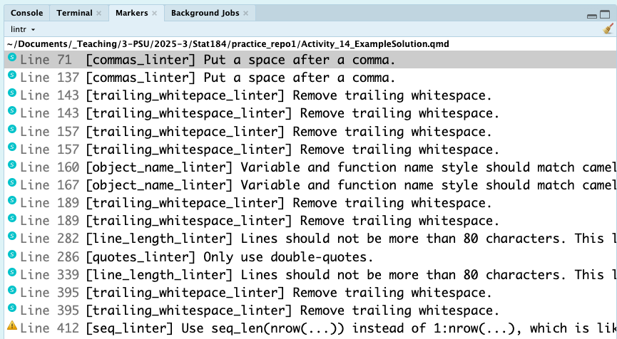
Linting Example
lint(
filename = "Activity_14_ExampleSolution.qmd",
)
RStudio will also open up the file you check (if not already open) so that when you click on each of these markers, you'll jump to the appropriate section of the file.

Slide 41
Linting Defaults
The lint function in {lintr} is highly customizable.
The defaults to lint match the {tidyverse} coding style, which is sufficient for a vast majority of situations.
However, you can customize which linters run in two ways.
Use the linters argument of lint to list out which linters you want to run and change their parameters.
Use a .lintr file in the folder to specify which linters you want to run and how you want them to check your code.
Using a .lintr file is highly recommended, especially when working in teams, as this will ensure consistent linting throughout the project team.
We will give a caution that customizing your linter can take time and several iterations to hone. We will provide a .lintr file for your course project.

Slide 42
Strategies for Working in Teams
Unit 4

Slide 43
Coding/Data Analysis in Teams
In many situations, you'll end up working in teams on some coding or data analysis project.
As such, having at least one strategy you can use for such situations is highly beneficial.
Here is one strategy that we recommend.
Form/get the team together and agree on the terms of a group work contract (define goals, expectations, policies, consequences, etc.).
Generate the team's initial plan together.
Create a GitHub repo together.
Execute plan with explicit check-ins and updates to the plan.
Debrief as a team.

Slide 44
Pair Programming
Pair Programming is an approach where two people take turns writing/developing code.
In essence, pair programming allows for one person to focus on the Coding while the other focuses on Improving/Planing at the same time.
One member acts as the driver/writer who actually types up their code.
The other member acts as the navigator/editor who keeps an eye on the big picture and looks out for potential issues with the written code.
The pairs swap roles every 15-30 minutes and even swap partners when working in larger teams.

Slide 45
Code Headers
Part of Open Science includes transparency and acknowledgement of who did what in the project.
This extends to team members taking responsibility for different blocks of code as both the main author and as the reviewer.
Code Headers are an easy approach you can take to provide this information.
In essence, a code header is a simple code comment at the top of a block of code that gives the general goal of the block and who were the key team members involved.
If the section is for creating a function, this information should be included in the @description portion.

Slide 46
Code Headers Example
```{r}
#| label: docSetup
#| include: false
# Main Author: Neil Hatfield
# Reviewer: Veronica Bubb
# This document will use the BOAST Style Guide.
# Load Packages ----
library(googlesheets4) # For loading Armed Forces Data
library(rvest) # For scraping Armed Forces Ranks
library(dcData) # For loading Baby Names Data
library(tidyverse) # For data wrangling and visualizing
library(janitor) # For making two-way table
library(knitr) # For creating professional tables
library(kableExtra) # For styling professional tables
# Define global elements ----
psuPalette <- c("#1E407C", "#BC204B", "#3EA39E", "#E98300",
"#999999", "#AC8DCE", "#F2665E", "#99CC00")
```

Slide 47
Giving Credit
Code Headers are one way to give credit for people's contributions that works well for code.
For larger projects and reports, we also want to give credit to each contributor. We can do this in two key ways.
First, we need to make sure that list all of the authors in the author line at the top of our document. For a Quarto document, we can set up the YAML header like this:
authors:
- name: Neil J. Hatfield
orcid: 0000-0003-1807-6946
corresponding: true
roles: [conceptualization, data curation, formal analysis, writing]
- name: Veronica Bubb
roles: [formal analysis, editing]

Slide 48
Giving Credit
Second, at the end of our document, we will want to create a section titled Author Contributions.
In this section of narrative text, we list out each author and list what they contributed to the project.
To help standardize this section, we can turn to the Contributor Role Taxonomy (CRediT) to give us key terms.
Conceptualization
Data curation
Formal analysis
Funding acquisition*
Investigation
Methodology
Project administration†
Resources
Software
Supervision†
Validation
Visualization
Writing-original draft
Writing-review & editing
* Not applicable for your course project.
† Generally restricted to a single individual and/or senior personnel.

Slide 49
Course Project
Unit 4
🛑 TO BE UPDATED 🛑

Slide 50
Congratulations!
You've each gone through several phases of a hiring process at Big Data, Inc.--one of the top data analysis firms in the world.
We are looking for the best statisticians, data scientists, and data analysts to join our firm.
We've hired you all as Probationary Data Scientists and want to see how you each work as part of a team and what you can produce.
To this end, you will form teams of 2-3 people and prepare a reproducible analysis of data of your choosing.

Slide 51
Project Elements
To this end, you will form teams of 2-3 people and prepare a reproducible analysis of data of your choosing.
Your team's project must include
A team/group work contract (Checkpoint #1)
A detailed plan
A GitHub repo showing a README, proper use of commits, Issues, branches, and pull requests
Evidence of appropriate data wrangling
A reproducible, exploratory data analysis
Completion of all checkpoints
A Work-in-Progress presentation the week of 4/27/26
A final report that is your reproducible data analysis document (Quarto) plus the rendered output file (PDF)
The use of a consistent coding style
Peer- & self-evaluations
Adherence to the elements and principles of Open Science, including appropriate citations

Slide 52
Project Data
Your team will be able to choose what data you work with, provided certain conditions are met.
The data may not be any of the collections we have used in class (examples, homework, activities, etc.).
The data should be real; no fake or synthetic data. You may not use genAI tools to create or find data.
The data should be rich; that is, more than a couple of attributes. (Look for data sets that you can use to complement/supplement each other.)
You must be able to report the data provenance as fully as possible.
You must be able to explain how the data meet (or not) the FAIR and CARE principles.
Your data may not come from or be found on Kaggle.
Your data may not come from another project you are or have done for a grade in another course, without prior permission.
You may use data you acquire from labs/researchers on campus, provided they have granted your permission to do so.

Slide 53
Additional Guidelines
All details of the project are available in the course_project_template repo in the Stat184-Spring2026 GitHub Organization.
Use this repo as a template to create your team's repo and make sure that Stat184-Spring2026 is the owner.
You may not re-use any project, in whole or in part, from any other course (past or current) for this project.
The use of genAI tools is limited to the generation of initial alt text, long descriptions, spelling/grammar checks, and the possibility of linting. All usages should be fully documented as an appendix.

Slide 54
Key Dates
Date | Element
4/20/26 (Sec. 1 & 4) 4/21/26 (Sec. 2 & 5) | Checkpoint #1: Form Teams and make your team contract (on paper, during class) Begin planning and finding your data
4/22/26 (Sec. 1 & 4) | Checkpoint #2: Initial Data and Plan Approval (in MOM, during class)
4/24/26 (Sec. 1 & 4) 4/23/26 (Sec. 2 & 5) | Checkpoint #3: GitHub Repo Check (in MOM, during class)
4/24/26 (Sec. 1 & 4) 4/23/26 (Sec. 2 & 5) | Checkpoint #4: Sign up for Work-In-Progress Presentation Slot (during class)
4/27/26-5/1/26 | Checkpoint #5: Work-In-Progress Presentations and Peer Feedback (during class)
5/6/26 | Checkpoint #6: Submission of final report (PDF) and link to repo
5/7/26 | Checkpoint #7: Submission of Self- & Peer-Evaluations

Slide 55
Homework
Assignments
HW #4.4: GitHub Practice
Due by 11:59pm, Friday, April 17, 2026
Be sure to enter the URL to your repo in the first question of the assignment.
Talk with people to form your groups first thing Monday; you MUST be present in order to join a group.

