Slide 1

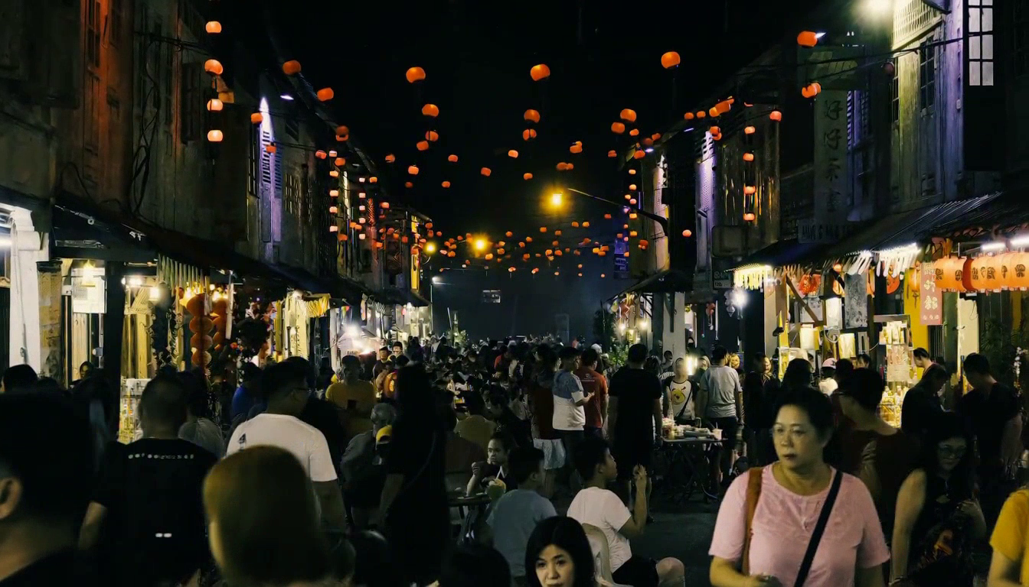
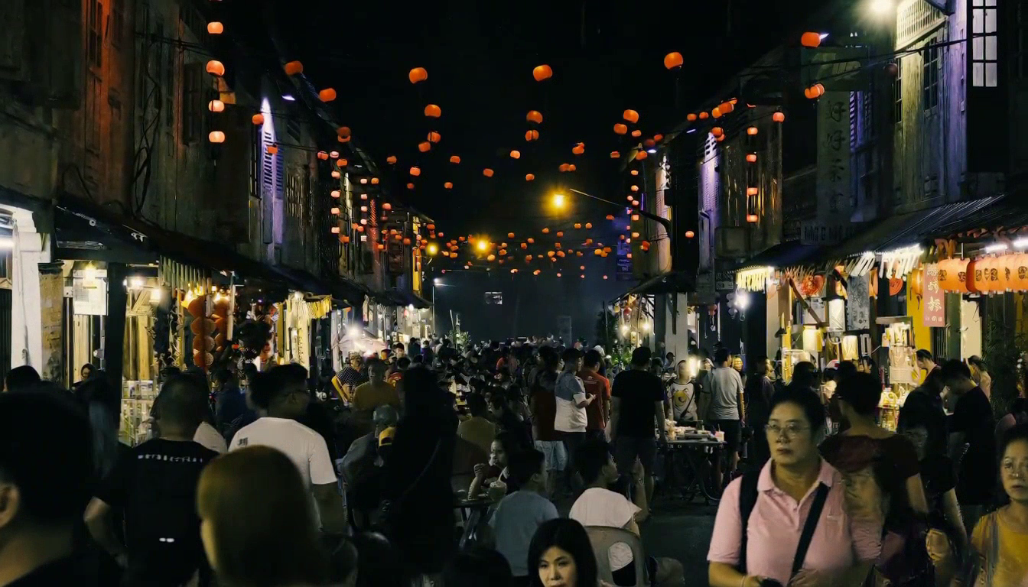
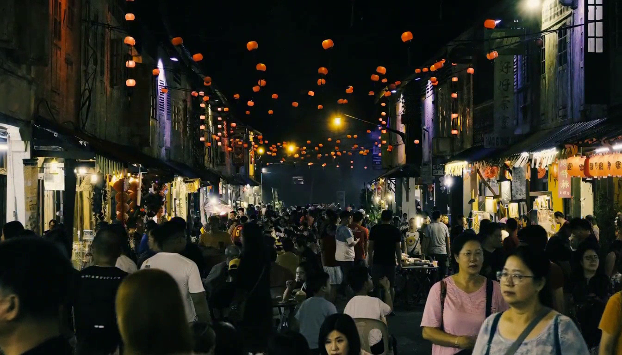
Quantization: Crowded Night Market
Add SageAttention to QAD and inspect crowd detail, shop textures and occlusions
BF16 Reference
Online NVFP4
QAD NVFP4
QAD + SageAttention
BF16 weights
cuDNN BF16 attention
Direct NVFP4; no calibration
cuDNN BF16 attention
Published QAD DiT
cuDNN BF16 attention
Same QAD DiT
Sage: INT8 Q/K, FP8 V
Request: 152.58 s*
Request: 103.14 s*
Request: 102.06 s*
Request: 85.05 s*
LPIPS 0.0000 | SSIM 1.0000
LPIPS 0.2029 | SSIM 0.5856
LPIPS 0.1864 | SSIM 0.6438
LPIPS 0.1982 | SSIM 0.6264
QAD + Sage retains the same VSA tile128 routing and 90% target sparsity.
1344 × 768 · 124 frames at 24 FPS · 8 steps · Seed 1234 · Same BF16 encoder and VAE
*First request with CPU offload. QAD pair on GPU 3; BF16 / Online retained from GPU 0.
Notes:
Four side-by-side clips of the user-selected James Lo crowded night-market reference. Same prompt, image, seed 1234, 1344x768, 124 frames at 24fps, eight evaluations, original BF16 encoder and original video/audio VAE. BF16 and Online NVFP4 clips retained unchanged from v1.31 on GPU 0. QAD cuDNN and QAD + Sage newly generated sequentially on GPU 3 with identical checkpoint and software except attention selection. Layerwise CPU offload, one resident DiT block. Direct Online NVFP4 uses untouched BF16 weights, round-to-nearest NVFP4, per-input activation amax and per-16 E4M3 scales; no calibration table or QAD products.
QAD + Sage uses the same published QAD NVFP4 DiT weights. Fine attention uses CAKE Sage via FlashInfer, INT8 Q/K and FP8 V, BF16 output. Logical tile128 sparse selection is unchanged: each selected tile is represented by both 64-token halves in the same attention reduction. Pooling, top-k, dense prefix and learned coarse correction are retained. The token refiner keeps its common BF16 SDPA path. An isolated two-guard runtime patch enables the existing tile128 adapter for Sage. The installed FlashInfer wheel lacks the required ragged/per-row-count specialization, so both new QAD arms use the previously verified FlashInfer source checkout. No quality tuning or new calibration.
Request times include first generation, CPU offload, possible first-use JIT, encoding and complete MP4 receipt; exclude model loading and offline weight packing. The shared GEMM/Sage JIT cache was populated before the displayed QAD timings. The initial QAD cold-compilation request is recorded separately and excluded from the displayed timing. No full-model warmup or steady-state repeats. These times are illustrative, not a production speedup benchmark.
All four embedded videos start together and are muted. PDF uses frame 60 for every poster. Full-resolution LPIPS AlexNet v0.1 and RGB Gaussian SSIM average all 124 same-index decoded frames against BF16. Motion can diverge despite identical seed; scores do not isolate texture preservation, action correctness, temporal stability or general quality. Audio is not scored.
Reference: James Lo / Unsplash, https://unsplash.com/photos/crowded-street-market-at-night-with-lanterns-prZR_BQiZzU. Prompt requests a bag handoff and slow camera motion; these requested actions are not asserted as completed.
Visual review: {"scope": "Visual contact-sheet review at frames 0,24,48,72,96,120; full-video similarity measured separately.", "retained_BF16_Online_review": {"method": "Visual inspection of decoded frames 0, 24, 48, 72, 96 and 120 for all three outputs.", "observed": "All three retain a densely populated night-market wide composition, shopfronts and overhead lanterns. Foreground pedestrians move through and occlude the crowd; positions and appearances diverge between variants.", "not_verified": "The prompt requested a shopping-bag handoff and a one-metre camera glide; neither is asserted as successfully realized.", "files": ["bf16-contact.png", "online-contact.png", "qad-contact.png"]}, "new_QAD_and_Sage": ["Dense crowd, shops, lantern strings and the wide night-market composition persist in both clips.", "Foreground pedestrians change position and occlude others; the two clips differ in individual appearance and motion.", "No whole-frame corruption or blank frames was apparent in the sampled frames.", "Small-face and text fidelity, action correctness and temporal stability are not established by this sampled visual check."], "requested_actions_not_verified": ["Specific shopping-bag handoff", "Exact one-meter camera travel"]}
Measured results: {"online_nvfp4": {"lpips_alex_v0_1": {"mean": 0.20293374329565034, "std_population": 0.025967516105094113, "min": 0.10791829973459244, "max": 0.24780380725860596, "frames": 124}, "ssim_rgb": {"mean": 0.5856079840882614, "std_population": 0.06557552277576059, "min": 0.4950069698834845, "max": 0.7241507284598728, "frames": 124}}, "qad_nvfp4": {"lpips_alex_v0_1": {"mean": 0.1864361187983905, "std_population": 0.03237268742291045, "min": 0.0830867737531662, "max": 0.26430436968803406, "frames": 124}, "ssim_rgb": {"mean": 0.6437654416671673, "std_population": 0.05560447690054216, "min": 0.5207953646026361, "max": 0.8245423213251488, "frames": 124}}, "qad_nvfp4_sage": {"lpips_alex_v0_1": {"mean": 0.19817851513864532, "std_population": 0.02879523384700233, "min": 0.09071141481399536, "max": 0.2357463389635086, "frames": 124}, "ssim_rgb": {"mean": 0.6264287235545855, "std_population": 0.05985428408962352, "min": 0.548336103427627, "max": 0.8068987751583977, "frames": 124}}}

