Slide 1

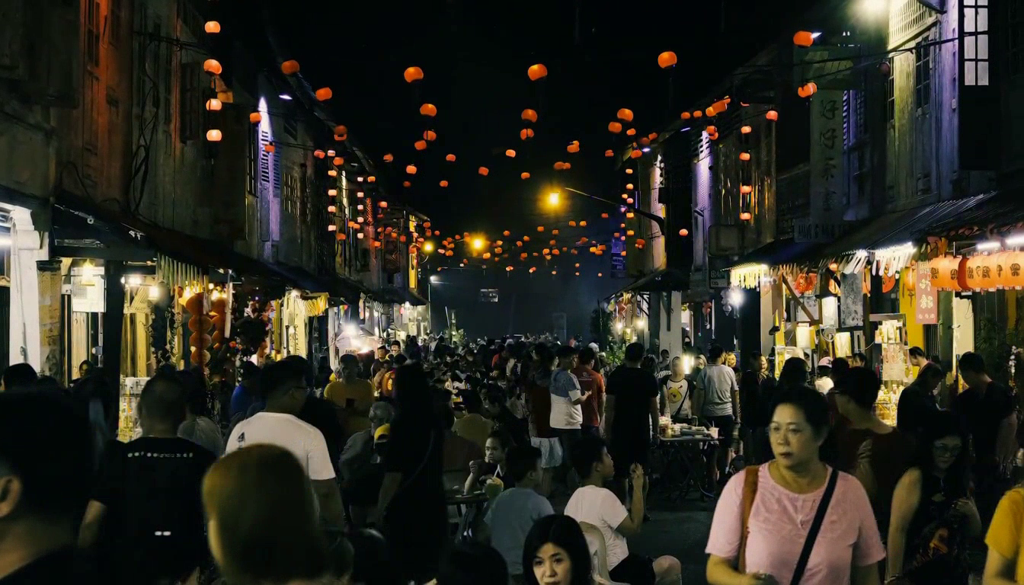
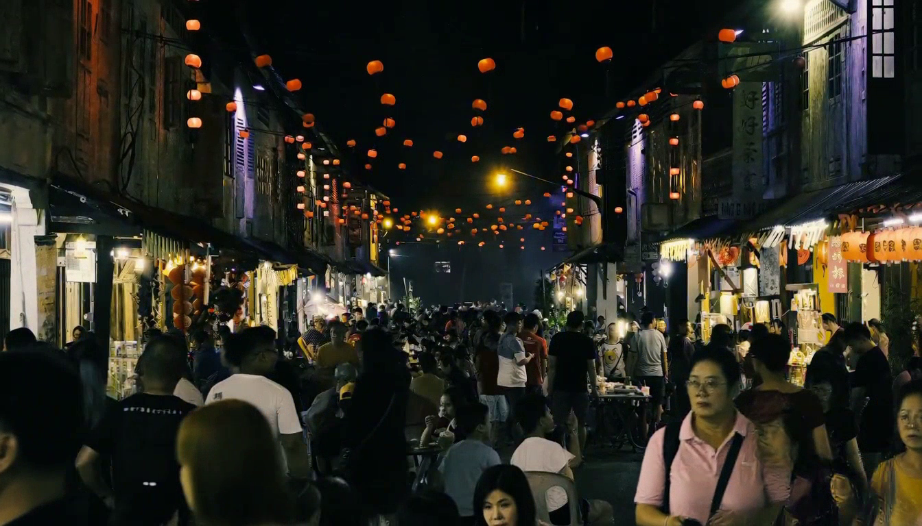
Quantization: Crowded Night Market
Compare crowd detail, shop textures and occlusions in one densely populated scene
BF16 Reference
Online NVFP4
QAD NVFP4
Original BF16 weights
Direct algorithm · No calibration / QAD
Published QAD DiT weights
Request: 152.58 s*
Request: 103.14 s*
Request: 102.53 s*
LPIPS 0.0000 | SSIM 1.0000
LPIPS 0.2029 | SSIM 0.5856
LPIPS 0.1864 | SSIM 0.6438
Inspect small figures, merchandise, lanterns and detail through occlusions.
1344 × 768 · 124 frames at 24 FPS · 8 steps · Seed 1234 · Same BF16 encoder and VAE
*Single-GPU CPU offload; first request. LPIPS lower and SSIM higher mean closer to BF16.
Notes:
Three newly generated matching crowded-night-market clips. The user selected the James Lo night-market reference before any outputs were generated. Prompt requests a five-second uninterrupted wide shot with many pedestrians, shops and lanterns, slow forward camera movement, independent crowd motion and a small shopping-bag handoff. These are requested actions, not a claim that every action is realized. Inspect the generated outputs separately. Same single reference image, prompt, seed 1234, 1344x768, 124 frames at 24fps and eight evaluations. Single idle GPU 0, identical layerwise CPU-offload configuration, original BF16 encoder, original video/audio VAE and cuDNN BF16 VSA. QAD DiT revision 0087718b2c8fe4b7e2d0a97463dc38da13f7703f; BF16 source 88d512c5e7cc38dda499fbb65688ce58611f9c80. QAD encoder replaced by the common original BF16 encoder for this controlled comparison. Online NVFP4 uses direct RTN of untouched BF16 weights with current-input tensor amax and per-16 E4M3 scales; no calibration table, QAD weights or learned QAD scales. Weight prepacking is cached before loading; activations are quantized dynamically each forward.
All three videos are embedded side by side, started together and muted. PDF uses frame 60 for all posters. Request time includes the first generation after startup, CPU offload, possible first-use JIT, encoding and complete MP4 receipt; excludes loading and prepacking. It is not a production speed benchmark. LPIPS AlexNet v0.1 and RGB Gaussian SSIM use all 124 original-resolution decoded frames. Audio is not scored. Crowd motion can diverge even with the same seed; framewise differences do not isolate detail preservation, action correctness or temporal stability. This single sample does not establish general QAD superiority.
Reference photograph: James Lo, Unsplash, https://unsplash.com/photos/crowded-street-market-at-night-with-lanterns-prZR_BQiZzU . Downloaded from the author's public Unsplash image at width 2400, quality 95, without editing. The source file and SHA256 are in video-provenance.json.
Visual review: sampled frames 0, 24, 48, 72, 96 and 120 retain dense crowds, shops and lanterns in all three outputs. Foreground pedestrians move and occlude one another. A specific bag handoff and camera travel distance were not verified.
Measured values: {"online_nvfp4": {"lpips_alex_v0_1": {"mean": 0.20293374329565034, "std_population": 0.025967516105094113, "min": 0.10791829973459244, "max": 0.24780380725860596, "frames": 124}, "ssim_rgb": {"mean": 0.5856079840882614, "std_population": 0.06557552277576059, "min": 0.4950069698834845, "max": 0.7241507284598728, "frames": 124}}, "qad_nvfp4": {"lpips_alex_v0_1": {"mean": 0.1864361187983905, "std_population": 0.03237268742291045, "min": 0.0830867737531662, "max": 0.26430436968803406, "frames": 124}, "ssim_rgb": {"mean": 0.6437654416671673, "std_population": 0.05560447690054216, "min": 0.5207953646026361, "max": 0.8245423213251488, "frames": 124}}}

