Slide 1
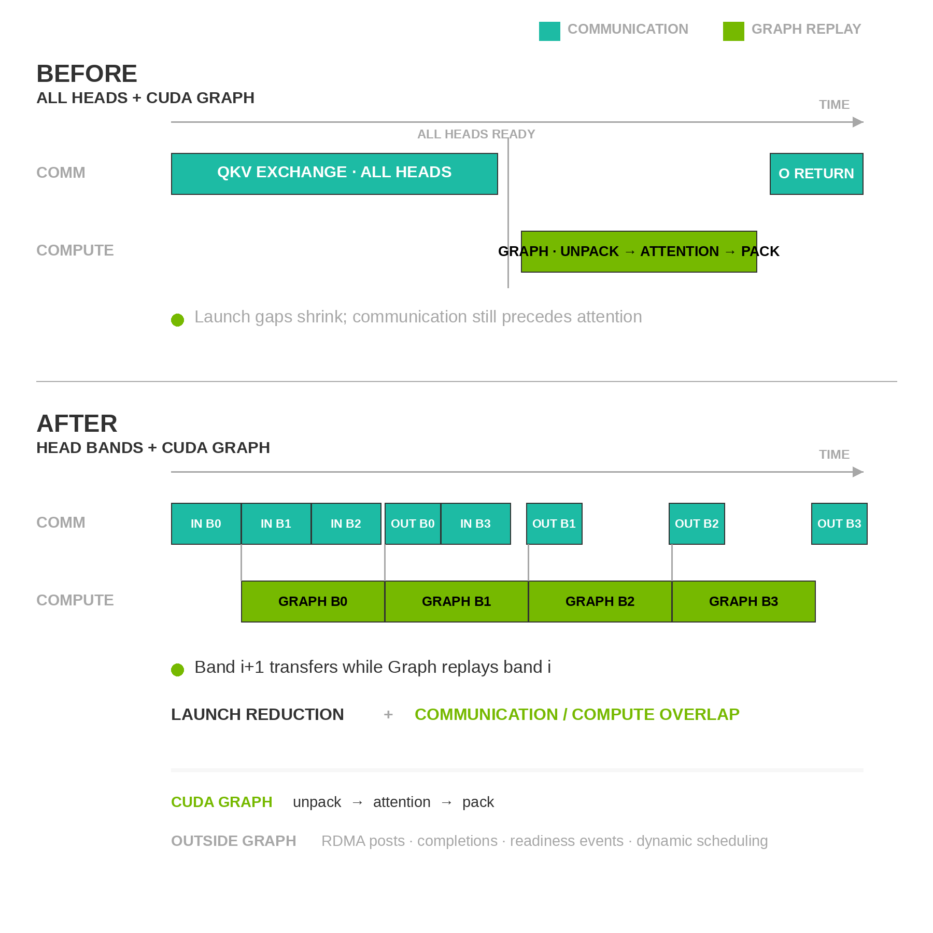
CUDA Graph for Head Pipelining
All-head replay cuts launch gaps; head bands expose overlap
Request-stable shape
  One video keeps the same H/W/T and reference layout through denoising
All heads + Graph
  Cuts launch overhead, but attention still waits for the full exchange
Head bands + Graph
  Starts attention as each fixed band arrives and pipelines later bands
Capture boundary
  Graph: unpack → attention → pack; RDMA and readiness events stay outside
Same Graph Benefit · Different Overlap
Head batching exposes overlap; CUDA Graph keeps the finer pipeline from becoming launch-bound
Notes:
CUDA Graph does not depend on head batching. An all-head Ulysses exchange can still replay a captured unpack, attention and pack compute island when resolution, frame count, tensor geometry, strides and registered buffer addresses remain fixed. Sequence length can change when H, W, T or the packed reference slots change, so arbitrary video requests have less cross-request reuse than LLM decode. The current captured island contains no block-specific weights, and its key uses implementation configuration rather than the DiT block instance. When configuration and metadata match, one GraphExec per band/profile can replay across all 50 blocks and all denoising steps: 400 times under PDD8 or 2,500 times under Base50. The (1, 2, 3, 1) band plan uses four such GraphExecs. Fixed live-stream profiles also reuse their Graphs across continuation windows, which can amortize warmup and capture far better than arbitrary generation. The upper timeline shows the remaining limitation: attention still waits for the complete QKV exchange, so Graph replay only removes CPU launch and scheduling gaps. The lower timeline divides the seven local heads into fixed bands. Once band zero arrives, its captured compute island can run while the communication stream moves the next band. Graph replay keeps the smaller per-band unpack, attention and pack operations from becoming launch-bound. RDMA work requests, completion polling, readiness events and dynamic band scheduling remain outside CUDA Graph. CUDA Graph does not increase RDMA bandwidth and does not make arbitrary dynamic sequence lengths static. Cross-request variation still requires a bounded shape cache, padding and masking, or eager fallback on a cache miss.

