Slide 1
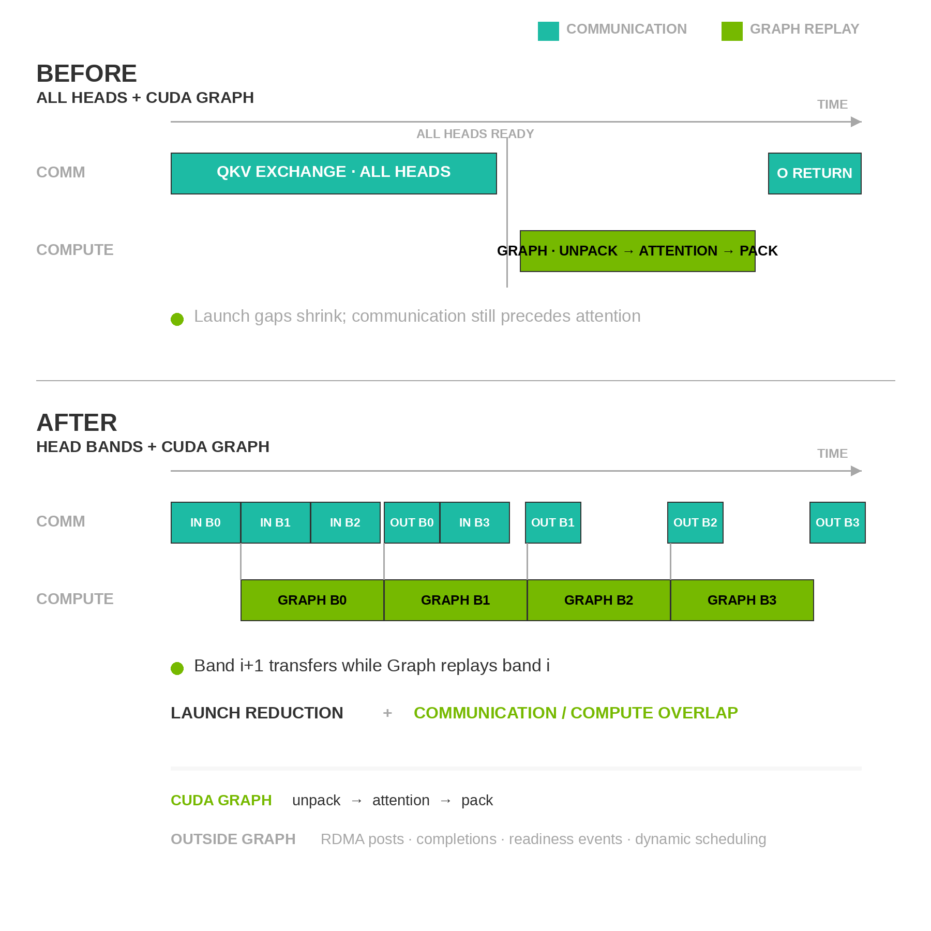
CUDA Graph for Head Pipelining
All-head replay cuts launch gaps; head bands expose overlap
Request-stable shape
  One video keeps the same H/W/T and reference layout through denoising
All heads + Graph
  Cuts launch overhead, but attention still waits for the full exchange
Head bands + Graph
  Starts attention as each fixed band arrives and pipelines later bands
Capture boundary
  Graph: unpack → attention → pack; RDMA and readiness events stay outside
Same Graph Benefit · Different Overlap
Head batching exposes overlap; CUDA Graph keeps the finer pipeline from becoming launch-bound
Notes:
CUDA Graph does not depend on head batching. An all-head Ulysses exchange can still replay a captured unpack, attention and pack compute island when resolution, frame count, tensor geometry, strides and registered buffer addresses remain fixed. Sequence length can change when H, W, T or the packed reference slots change, so arbitrary video requests have less cross-request reuse than LLM decode. The current captured island contains no block-specific weights, and its key uses implementation configuration rather than the DiT block instance. When configuration and metadata match, one GraphExec per band/profile can replay across all 50 blocks and all denoising steps: 400 times under PDD8 or 2,500 times under Base50. The (1, 2, 3, 1) band plan uses four such GraphExecs. Fixed live-stream profiles also reuse their Graphs across continuation windows, which can amortize warmup and capture far better than arbitrary generation. The upper timeline shows the remaining limitation: attention still waits for the complete QKV exchange, so Graph replay only removes CPU launch and scheduling gaps. The lower timeline divides the seven local heads into fixed bands. Once band zero arrives, its captured compute island can run while the communication stream moves the next band. Graph replay keeps the smaller per-band unpack, attention and pack operations from becoming launch-bound. RDMA work requests, completion polling, readiness events and dynamic band scheduling remain outside CUDA Graph. CUDA Graph does not increase RDMA bandwidth and does not make arbitrary dynamic sequence lengths static. Cross-request variation still requires a bounded shape cache, padding and masking, or eager fallback on a cache miss.

Slide 2
CUDA Graph Reuse Depends on the Video Profile
Arbitrary video requests have lower Graph reuse than LLM decode; fixed live streams reuse across continuation windows
Question | LLM Decode | H3 Video | Serving Policy
Shape key | Batch bucket q_len = 1 | H/W/T · reference slots head band | Cache a small set of hot profiles
Replay window | Many token steps and requests | Across blocks + steps PDD8: 400 · Base50: 2,500* | Reuse persistent slots across continuation windows
VSA Top-K | — | Count fixed per profile indices and values change | Content changes replay the same Graph
New geometry | Select another batch bucket | Bucket hit or eager path | Capture only after the profile becomes hot
Buffer addresses | Static or pooled decode buffers | Registered QKV/O staging buffers | Use a persistent buffer pool
Notes:
LLM decode commonly captures a small set of batch-size buckets with query length one, then reuses those graphs across many token steps and requests. Video generation has a higher-dimensional shape key. Output height, width and frame count change the latent sequence length; packed reference slots or conditioning length can add another dimension; head-band width and stable registered-buffer addresses also participate in the current prototype key. Therefore arbitrary video requests have lower cross-request Graph hit rate. The captured island contains no block-specific weights, and its key does not include the DiT block instance. When configuration and metadata match, one GraphExec per band/profile can replay across all 50 blocks and all denoising steps: 400 times under PDD8 or 2,500 times under Base50. The (1, 2, 3, 1) plan uses four GraphExecs. A fixed live-avatar profile can recover even more reuse because resolution, frame window, reference slots, band plan and persistent buffers repeat across continuation requests. For fixed-sparsity or fixed-Top-K VSA, the selected count is fixed for one profile. Top-K indices, scores and Q/K/V values change, but their tensor shapes do not, so those content changes do not require recapture. If a ratio-based K is derived from sequence length, K can still change when a new request changes H, W or T. The serving policy is to pre-capture a bounded set of hot profiles, use persistent registered buffer pools, run uncommon shapes eagerly, and capture only after a reuse threshold. Report Graph hit rate, cold capture cost, private-pool memory and eager fallback rate.

