Slide 1
Real-Time Video Generation
With MiniMax H3
8× RTX PRO 5000 · vLLM-Omni
Shunyang Li | Public technical brief | October 2026
Notes:
This talk has two parts: taking MiniMax H3 toward real-time generation on eight RTX PRO 5000 GPUs, then using vLLM-Omni as the multi-GPU backend for ComfyUI applications.

Slide 2
01 Toward Real-Time H3 Generation
02 vLLM-Omni and ComfyUI Applications
Notes:
Part one covers the real-time target, platform constraints, bottleneck analysis, distributed optimization, and validation. Part two uses the public ComfyUI integration and PR #9194 workflows as the application story.

Slide 3
01 · Real-Time H3
Generation
Notes:
Part one moves from the real-time definition to the eight-GPU baseline, bottleneck analysis, optimization, and validation.

Slide 4

Real-Time Ref2VA Raises the Systems Bar
A 124-frame clip at 24 FPS is real time only when end-to-end latency stays below 5.167 s (RTF < 1)
Generative Backbone · Full Parameters (B)
Model Capability · Native 768P · 33B Dense
RTF = latency ÷ media duration; the 124-frame deadline is 5.167 s. H3 has the largest dense backbone in this peer set; Wan2.2 has 27B total and 14B active parameters
A 32B encoder feeds the 33B Omni Transformer and visual/audio VAEs. Fifty blocks × 50 steps dominate compute; about 13B AdaLN parameters can be cached
Notes:
Real time is RTF = end-to-end generation latency divided by finished-media duration, with RTF <= 1.0. The baseline is MiniMax H3 Base Ref2VA at 960x544: 124 frames / 24 FPS = 5.167 s. It uses 50 denoising steps, BF16, eight GPUs with USP8, local NCCL, and no RDMA. MiniMax H3 uses a 33B dense Omni Transformer with 50 Transformer blocks; the reference workload runs 50 denoising steps. These are distinct dimensions. Wan2.2 A14B is 27B total / 14B active, LTX-2.5 uses its official 22B designation, and HunyuanVideo-1.5 is 8.3B. The comparison excludes text encoders. Open H3-Base targets native 768p; the H3-Regenerate-2K module is not part of the open release and is excluded. The 130 GB figure is the raw BF16 size of the 32B encoder plus 33B generator, before VAE, activations, attention workspace, and CUDA Graph pools. Sources: https://huggingface.co/MiniMaxAI/MiniMax-H3 ; https://github.com/Wan-Video/Wan2.2 ; https://huggingface.co/Lightricks/LTX-2.5 ; https://github.com/Tencent-Hunyuan/HunyuanVideo-1.5

Slide 5
SM120 Brings FP4 Compute; PCIe Limits Scale
All discrete SM120 cards pair fifth-generation Tensor Cores with GDDR7 and PCIe Gen5; none provides GPU-to-GPU NVLink
SKU | Compute | Memory | GPU I/O / Fabric
RTX PRO 5000 ×8 Blackwell | SM120 · 110 SMs 5th-gen Tensor · FP4 | 72 GB GDDR7 ECC 48 GB variant | PCIe Gen5 ×16 Planned: RDMA via NIC*
RTX PRO 6000 WS / Server | SM120 · 188 SMs 5th-gen Tensor · FP4 | 96 GB GDDR7 ECC | PCIe Gen5 ×16 No GPU NVLink
GeForce RTX 5090 | SM120 · 170 SMs 5th-gen Tensor · FP4 | 32 GB GDDR7 | PCIe Gen5 ×16 No NVLink
DGX Spark · GB10 | SM121 · 48 SMs 5th-gen Tensor · FP4 | 128 GB unified LPDDR5X | NVLink-C2C in SoC 200 Gb/s ConnectX-7
Notes:
The template's native Table Example is reused at its original coordinates with its native table style and typography. RTX PRO 5000, RTX PRO 6000 and GeForce RTX 5090 use compute capability 12.0 / SM120; each has fifth-generation Tensor Cores with FP4 support. DGX Spark's GB10 uses compute capability 12.1 / SM121 and fifth-generation Tensor Cores with FP4 support. The planned RTX PRO 5000 scale-out path is GPU memory to PCIe Gen5 to a compatible NIC and then the RDMA fabric. This path is a deployment plan, not a measured result; GPUDirect RDMA requires compatible software and PCIe topology. The first row marks the selected eight-GPU RTX PRO 5000 baseline. Sources: https://developer.nvidia.com/cuda/gpus ; https://www.nvidia.com/en-gb/products/workstations/professional-desktop-gpus/rtx-pro-5000/ ; https://docs.nvidia.com/cuda/gpudirect-rdma/

Slide 6
Latency Breakdown
NCCL occupies 49.2% of the average GPU timeline
Stage | Average GPU Time* | Share
Mean GPU timeline* | 250.0 s | 100.0%
NCCL communication | 123.0 s | 49.2%
Included: DiT collectives | 116.1 s | 46.4%
Included: Encoder, VAE, and other collectives | 7.0 s | 2.8%
Tensor compute | 84.5 s | 33.8%
Included: Attention | 45.3 s | 18.1%
Included: GEMM / MLP | 39.2 s | 15.7%
AdaLN weight staging + device layout | 38.5 s | 15.4%
Encoder, VAE, and other GPU work | 4.0 s | 1.6%
  Of the 38.5 s average, 36.9 s is AdaLN projection weight staging from CPU; layout is 1.5 s
  This run uses the default runtime cache, not a complete precomputed schedule sidecar
Notes:
The measured baseline is MiniMax H3 Base Ref2VA at 960x544, 124 frames, 24 FPS, 50 denoising steps, BF16, and eight RTX PRO 5000 GPUs with USP8. Communication uses local NCCL; RDMA is disabled. The media duration is exactly 124 / 24 = 5.1667 seconds, shown as 5.167 seconds. The four top-level rows are mutually exclusive accounting buckets. The locked endpoint cohort contains three steady requests at 247.956, 246.201 and 248.298 seconds; its median is 247.956 seconds and RTF 47.992. The separately rerun matched Nsight request took 252.773 seconds, or RTF 48.924, after a 253.075-second warmup. Its warmup and measured outputs share one SHA-256 and fully decode. The matched trace reaches 60,827 MiB during the measured request and 61,299 MiB across the sampled run. The table is a hierarchy. NCCL communication includes DiT collectives and collectives in encoder, VAE and other work. It is reported separately from tensor compute and AdaLN host-to-device weight staging/layout. The four top-level cost centers are mutually exclusive and sum to 100 percent. The matched request passed the eight-device, kernel-count, attribution, transport and exclusive-accounting gates, and its CUDA kernel and memory totals match independent nsys stats exactly. The share denominator is kernel, memcpy and memset duration summed across all eight GPUs. The time column divides each category by eight and reports mean operation time per GPU. An interval-union check found no same-GPU overlap among the classified kernel/copy activities, and per-rank activity totals are 247.86 to 248.69 seconds, close to the measured E2E. NCCL kernel duration includes synchronization and peer waiting, so the DiT collective share of 46.4 percent is serialized collective residency rather than pure transfer time or an achieved-bandwidth measurement. The repeated loop issues 10,000 SendRecv kernels per rank: four per DiT block across 50 steps and 50 blocks. DiT host-to-device copies contribute 295.3 aggregate GPU-seconds and 8.94 TB of CUPTI logical bytes. More than 99.998 percent of that H-to-D time comes from staging AdaLN projection BF16 weight and bias on exact-cache misses. The run uses the default 256 MiB runtime output cache and does not configure a complete offline schedule sidecar. Ordinary Attention, MLP and QKV weights remain resident after initialization. This page stops at measured Base50 evidence. Optimization methods begin on the following slides.

Slide 7

How Denoising Works
H3 follows a learned velocity field from noise toward clean video and audio latents
State and direction
  x(t) is the current latent; the DiT predicts a data-ward velocity
Solver update
  Euler advances x(t) by a small interval along that velocity
  The next DiT call needs the new latent, so conventional steps run in sequence
Network function evaluation (NFE)
  One NFE is one complete DiT forward
Base H3
  50 NFE × 50 main blocks = 2,500 main-block passes
Classical Flow-Matching Sampling
A chain of dependent solver updates turns noise into clean latents
Notes:
This page defines the sampling terms used by the rest of the deck. A latent state x(t) is the current compressed video and audio representation. The DiT reads that state, its time coordinate and the prompt or reference conditioning, then predicts a data-ward velocity. The Euler solver uses that velocity to construct the next latent. Conventional sampling is sequential because the next DiT call requires the state produced by the previous update. NFE means network function evaluation; one NFE is one complete DiT forward, not one Transformer block. Base H3 uses 50 sequential NFEs. Each NFE traverses the 50-block main Transformer trunk, so the repeated trunk workload is 50 times 50, or 2,500 main-block passes. Under USP8, each of eight ranks executes its local shard, which is why a system trace can show 20,000 rank-local attention launches. Prompt and reference encoding happen before the repeated loop, and VAE decoding happens after it. H3 uses separate shifted Euler schedules for video and audio; x(t) and delta-t on this page deliberately abstract those two modality-specific updates, which share one joint DiT forward. Sources: https://research.nvidia.com/labs/genair/pdd/ ; https://github.com/MiniMax-AI/MiniMax-H3/blob/main/transformer/config.json

Slide 8

Few-Step Distillation
PDD predicts four intervals per call, reducing 50 calls to eight
  Base H3 calls the full DiT 50 times. Each call predicts one short interval, updates the latent, and provides the starting point for the next call
  PDD uses Base H3 as the teacher and trains a student on groups of four adjacent denoising intervals
  One student call predicts four consecutive directions from the same noisy latent
  The solver combines those directions, advances the latent, and invokes the student again
  The released H3 schedule covers 32 fine intervals in eight student calls
  DiT calls fall from 50 to 8; block passes fall from 2,500 to 400 (−84%)
N = fine intervals · L = intervals predicted in parallel
Paper example: N = 12, L = 4 · H3 PDD8: N = 32, L = 4
Notes:
Video generation starts from noise. Base H3 runs the full DiT once for each denoising update, so the model runs 50 times. Parallel Decoding Distillation uses Base H3 as the teacher and trains a student to predict several fine-interval updates in one DiT evaluation. The released H3 Ref2VA PDD adapter uses a new 32-interval schedule and predicts four interval velocities per evaluation, so 32 divided by 4 equals eight DiT evaluations. This is not the same as selecting eight of the original 50 solver steps. Each H3 evaluation still crosses 50 DiT blocks, so repeated block executions fall from 50 times 50, or 2,500, to 8 times 50, or 400. That is 84 percent fewer repeated block calls, reducing repeated attention, GEMM/MLP, and USP communication together. The 84 percent figure is workload arithmetic, not measured end-to-end speedup; encoders, VAE, data movement, memory, and matched quality still require end-to-end validation. NVIDIA Figure 2 shows the generic N=12, L=4 mechanism; the H3 N=32, L=4 schedule is labeled outside the paper figure.

Slide 9

Sparse Attention
Coarse attention finds relevant cubes; fine attention resolves token-level detail
Predict important regions cheaply
  Pool spatiotemporal cubes and run global attention on the shorter sequence
Select content-dependent blocks
  Per-query Top-K cube scores choose which K/V regions to visit
Spend fine attention on selected detail
  Compute token attention inside the chosen blocks; skip the rest
Keep global context and local detail
  Learned gates combine coarse and fine outputs
O = O_c ⊙ G_c + O_f ⊙ G_f
Global coarse context + selected fine detail · FastH3 adaptation: G_f = 1
Notes:
Architecture paraphrased from VSA Figure 1 and Section 3: https://arxiv.org/html/2505.13389v4 . H3 uses logical tiles of 128; do not substitute the paper default block geometry. The displayed figure is the cited VSA figure. H3 adaptation fixes the fine gate at one.

Slide 10


FastH3 Omni: Quantization-Aware Distillation
An eight-forward student learns to compensate for quantization error before deployment
Few-step + four-bit inference
Train through quantization
Deploy the student only
Eight model evaluations reduce sampling work. NVFP4 linears reduce numerical precision.
FP32 master weights update through STE gradients while the forward executes NVFP4.
Teacher supervision and reconstruction losses recover quality during training; inference omits them.
Notes:
This diagram describes the public OmniRef QAD training recipe, not training performed by this project. PR #1989 was open at inspection. The frozen teacher is the same eight-forward OmniRef checkpoint without student quantization. Student trainable master weights must be FP32: the code rejects BF16 masters because small updates would round away. The NVFP4 linear forward casts current master weights to BF16, quantizes weights and activations, and executes FlashInfer mm_fp4. The backward uses straight-through dense linear gradients. FP4 fine attention is modeled by a differentiable emulator. Teacher and loss computation are removed for inference. Few-step distillation and QAD address separate costs: fewer model evaluations versus quantized numerical error. https://github.com/hao-ai-lab/FastVideo/blob/ea3275dfd1ce48cbb01f9fc7f28e918e857a0536/fastvideo/train/models/minimax_h3/omniref_pdd.py
https://github.com/hao-ai-lab/FastVideo/blob/ea3275dfd1ce48cbb01f9fc7f28e918e857a0536/fastvideo/layers/quantization/nvfp4_qad.py
Precision map merged from the former standalone What Runs in Four Bits slide. Only attention and FFN projection parameters train; the VSA gates remain frozen while executing NVFP4. The public QAD recipe calibrates selected FFN activation global scales; this differs from the direct Online NVFP4 comparison, which has no calibration table. Designated boundary modules remain FP32.

Slide 11
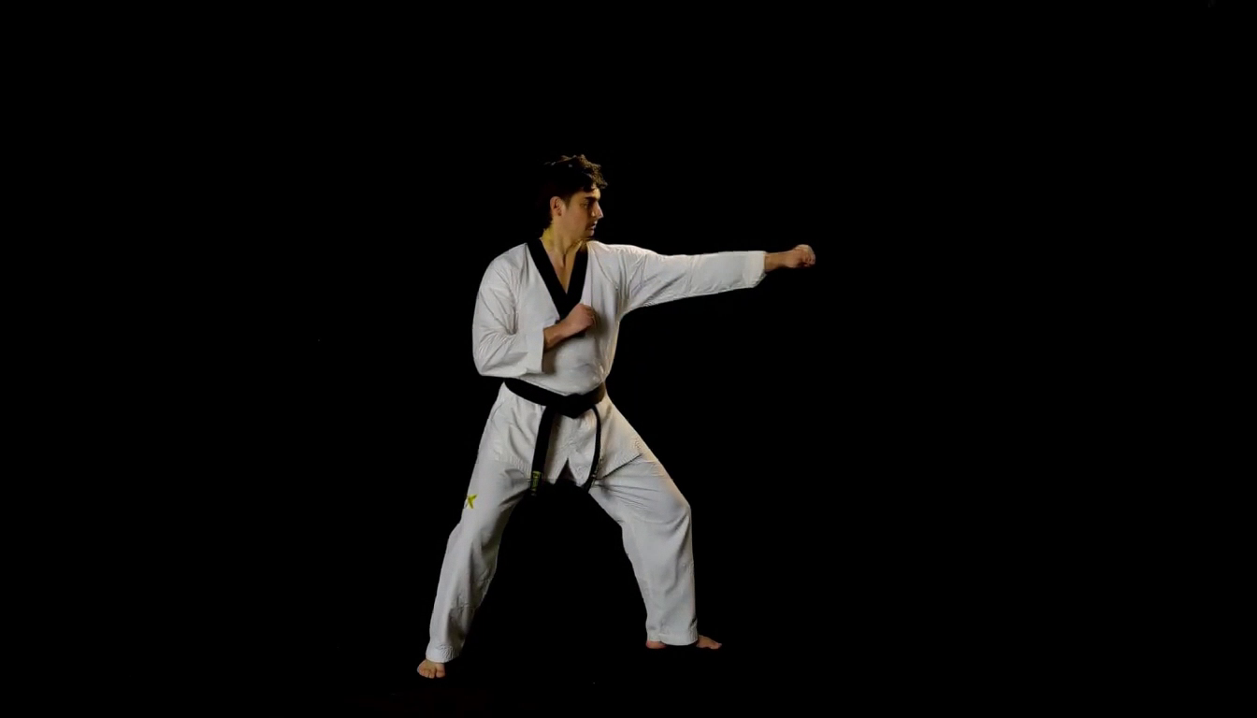
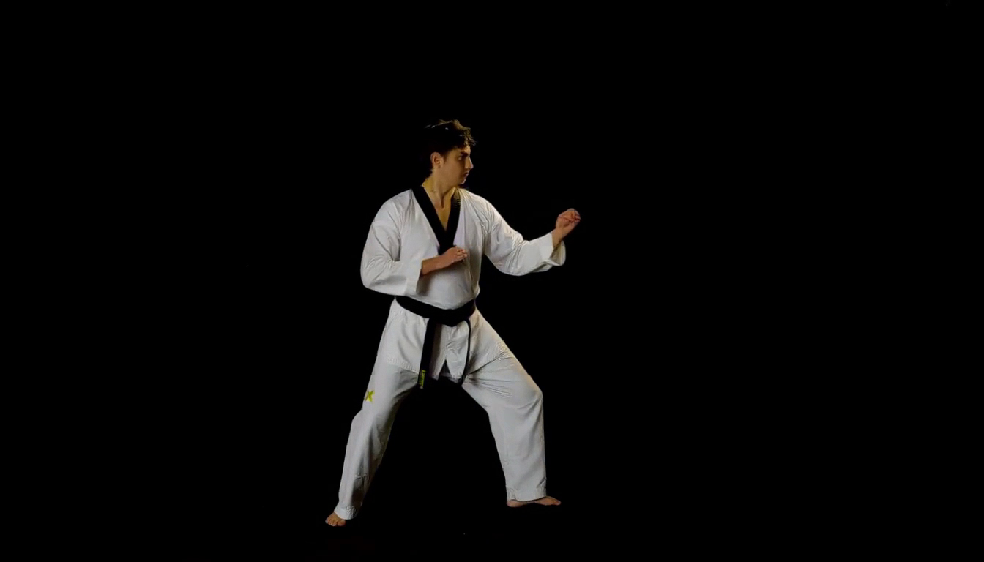
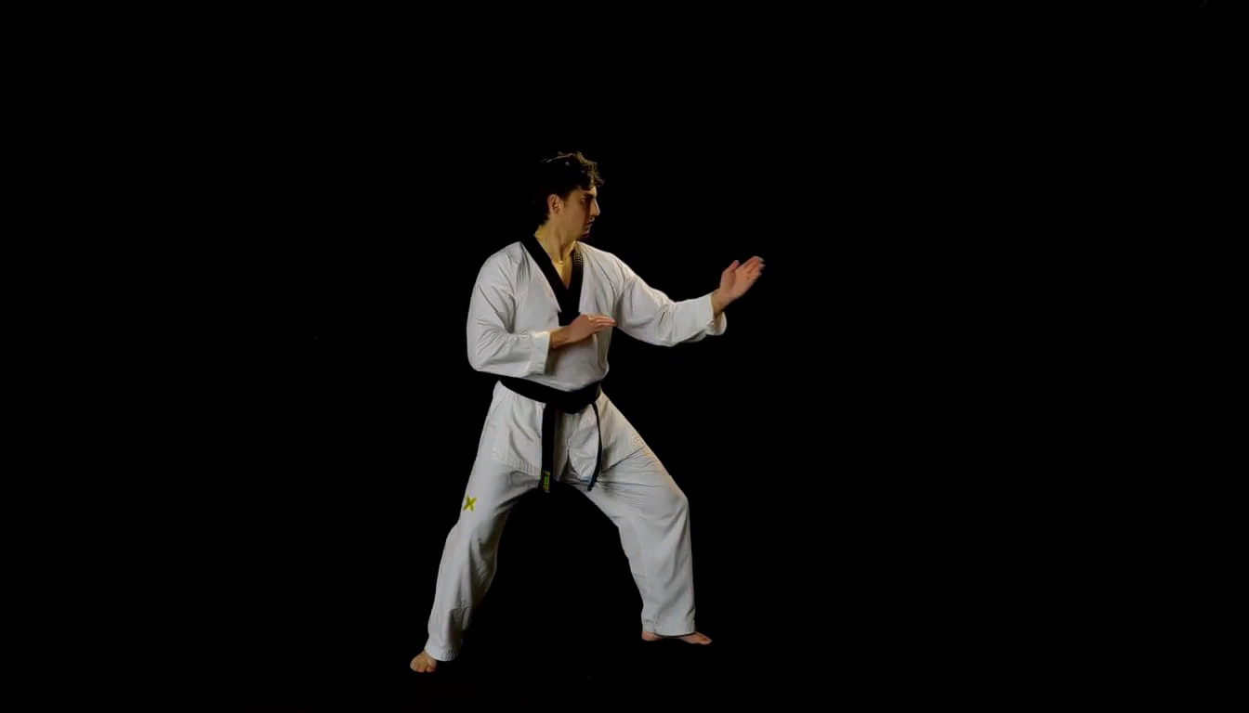
Quantization: Dynamic Motion Comparison
Compare limb contours, pose transitions and cloth detail in the same martial-arts action sequence
BF16 Reference
Online NVFP4
QAD NVFP4
Original BF16 weights
Direct algorithm · No calibration / QAD
Published QAD DiT weights
Request: 123.49 s*
Request: 79.79 s*
Request: 77.84 s*
LPIPS 0.0000 | SSIM 1.0000
LPIPS 0.0419 | SSIM 0.9454
LPIPS 0.0369 | SSIM 0.9497
Inspect hand and foot contours, pose transitions and moving cloth folds.
1344 × 768 · 124 frames at 24 FPS · 8 steps · Seed 1234 · Same BF16 encoder and VAE
*Single-GPU CPU offload; first request. LPIPS lower and SSIM higher mean closer to BF16.
Notes:
Three newly generated matching dynamic-action clips. Prompt: two straight punches, pivot, waist-height side kick, recovery to guard, cloth and belt dynamics, slow lateral camera arc. Selected for articulated motion before seeing outputs. Same two reference images, prompt, seed 1234, 1344x768, 124 frames at 24fps and eight evaluations. Single idle GPU 0, identical layerwise CPU-offload configuration, identical original BF16 encoder and original video/audio VAE, identical cuDNN BF16 VSA. Published QAD DiT is revision 0087718b2c8fe4b7e2d0a97463dc38da13f7703f; source BF16 is 88d512c5e7cc38dda499fbb65688ce58611f9c80. The QAD encoder is explicitly replaced by the common original BF16 encoder for this comparison. Online NVFP4 remains direct RTN of untouched BF16 weights with current-input tensor amax and per-16 E4M3 scales; no calibration table, QAD weights or learned QAD scales are used in that arm. Weight prepacking is cached before loading, activations are quantized dynamically on every forward.
All three videos are embedded side by side, started together and muted. PDF uses the same frame index 60 for all posters. Request times include the first generation after startup, encoding and complete MP4 transfer, excluding model loading and prepacking. They include CPU-offload costs and possible first-use JIT, and are not representative of the previous four-GPU production timings. Full-frame LPIPS AlexNet v0.1 and RGB Gaussian SSIM are recomputed on all124 decoded original-resolution frames. Audio is not scored. A static dark background can dominate full-frame scores; these are checkpoint similarity metrics and do not by themselves measure temporal stability, physical action correctness or general perceptual quality. Motion trajectories can diverge even for the same seed. No outcome was assumed from the prompt.
Measured values: {"online_nvfp4": {"lpips_alex_v0_1": {"mean": 0.04186826251867798, "std_population": 0.025374898582460087, "min": 0.008706730790436268, "max": 0.10916323214769363, "frames": 124}, "ssim_rgb": {"mean": 0.9454475520047675, "std_population": 0.016676196513861805, "min": 0.9092317327232791, "max": 0.9800593967178822, "frames": 124}}, "qad_nvfp4": {"lpips_alex_v0_1": {"mean": 0.03694349149572513, "std_population": 0.02413766988705653, "min": 0.008445855230093002, "max": 0.10601461678743362, "frames": 124}, "ssim_rgb": {"mean": 0.9497315785220294, "std_population": 0.018061974326140488, "min": 0.911523032934331, "max": 0.9796215969945749, "frames": 124}}}

Slide 12



Ulysses
Each GPU swaps a token shard for seven full-sequence heads
Start with token shards
  Eight GPUs split 56,960 tokens; each rank keeps 7,120 tokens and all 56 heads
Swap the sharding axis
  Q/K/V/G all-to-all changes [S/8, 56] into [S, 7]
Do the expensive part locally
  Each GPU sees the full sequence for its own seven heads
Switch back for the block
  The O all-to-all restores token shards for projection, residual, and MLP
Shard by heads, then restore token shards
Original website illustration: P = 4
Measured H3 configuration at left: P = 8
Notes:
Sequence parallelism starts with a token shard on every GPU. For this measured 362-frame profile, the aligned sequence has 56,960 tokens, so USP8 gives each rank 7,120 tokens and all 56 attention heads. After the local Q, K, V and learned VSA gate projections, Ulysses runs an all-to-all that gathers the full sequence while scattering heads. The local tensor changes from [B, S/8, 56, 128] to [B, S, 7, 128]. Each rank can now compute full-sequence attention locally for its own seven heads. A reverse all-to-all on O restores [B, S/8, 56, 128], and output projection, residual and MLP continue on the local token shard. The element count is preserved: (S/8) times 56 equals S times 7. USP reduces the per-rank activation and head workload; it does not reduce the global attention math. New Q, K, V and gate tensors are produced in every attention block, so this exchange repeats block by block. The 56,960-token shape belongs to the measured 960 by 544, 362-frame communication study; it is not the 124-frame Base50 shape.
v1.21: Title changed to Ulysses. The original website SVG and PNG are embedded without artwork edits. The schematic is the website P=4, S=15104 Q/K/V/O example, not the P=8, S=56960 measured H3 configuration described at left. The illustration does not include the extra learned VSA gate slot in the measured H3 profile. Retained website source: https://grateful-requirements-dictionaries-impacts.trycloudflare.com/scaling/ulysses.svg. The old tunnel is currently unavailable; original local website files were recovered.

Slide 13
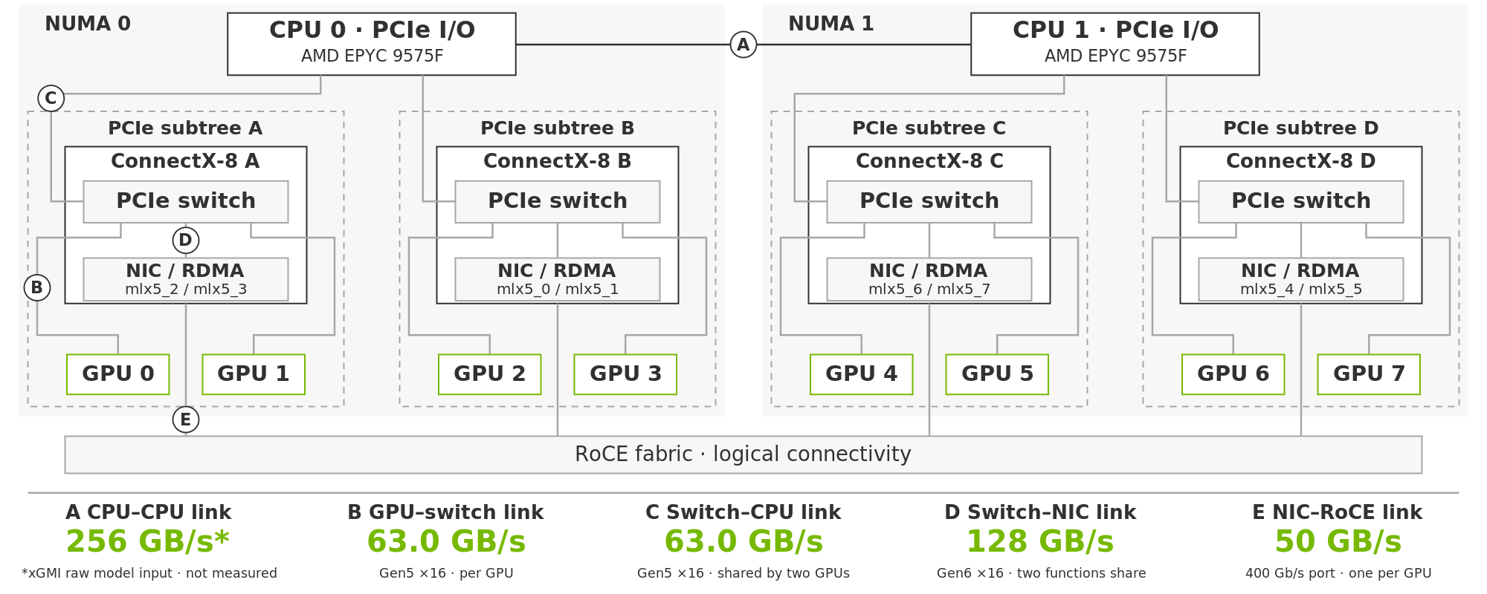




Eight-GPU Topology
Two CPU sockets · four ConnectX-8 cards · two GPUs per PCIe subtree
One-way link capacities · network ports support simultaneous TX and RX
Notes:
Static functional topology, no payload overlays. Four CX8 devices each serve two GPUs. GPU-to-switch and shared switch-to-CPU links are PCIe Gen5 x16: 63.015 GB/s per direction after line encoding and before packet overhead. Switch-to-NIC is Gen6 x16: 128 GB/s nominal per direction shared by two NIC functions. Each GPU is mapped to a 400 Gb/s RoCE port: 50 GB/s nominal one-way. Each CX8 has 800 Gb/s aggregate network capacity for its two GPUs, or 100 GB/s send and independently 100 GB/s receive. The eight ports total 400 GB/s nominal send, not guaranteed effective throughput. Protocol, fabric and receiver constraints remain. The former 256 GB/s xGMI platform maximum is removed: it was not this host's verified configured capacity. A new CPU sequential remote-memory-read experiment measured 113.02-135.71 GB/s medians across 8/16/32/56 threads and both directions. This workload includes DRAM, fabric and CPU limitations; it is not GPU-path capacity or an xGMI counter measurement. Kernel 5.15 lacks an exposed HSMP interface on this host, and privileged configuration access is unavailable. Sources: https://developer.nvidia.com/blog/nvidia-connectx-8-supernics-advance-ai-platform-architecture-with-pcie-gen6-connectivity/ https://docs.amd.com/v/u/en-US/58462_amd-epyc-9005-tg-architecture-overview
CPU-to-CPU capacity uses C=256 GB/s as the raw one-way aggregate model input (4 links x 16 lanes x 32 Gb/s / 8). Installed link configuration and effective payload rate are not established. https://docs.amd.com/v/u/en-US/58462_amd-epyc-9005-tg-architecture-overview

Slide 14


Local NCCL to RDMA
Matched eight-GPU Q/K/V/O exchanges · FI RDMA is 2.33–2.47× faster across three sequence lengths
Local NCCL: one P2P peer, six SHM peers
  Cross-subtree payload uses host memory
  Two GPUs share one 63.0 GB/s uplink
  2 × B × 6/7 ≤ 63.0, so B ≤ 36.8 GB/s
Cross-NUMA: C = 256 GB/s (raw model)
  4 × B × 4/7 ≤ 256, so B ≤ 112 GB/s
  Local ceiling: min(36.8, 112) = 36.8
FI RDMA: one nearest 400G port per GPU
  Bypasses host buffers and CPU-facing uplinks
  B ≤ min(63.0, 128/2, 50) = 50 GB/s
Shared PCIe uplink is the tighter raw bound
SHM, layout and scheduling add further cost.
Next: hide waits with 2 / 3 / 2 head bands,
then reduce compute launch cost with graphs.
B: off-rank TX per GPU · C: raw xGMI model input
Necessary link bounds; effective capacity can be lower
Measured: communication + layout + scheduling; not E2E.
Separate Q/K-first candidate: 96/96 rank checks exact
on four GPUs; full eight-GPU H3 validation pending.
Notes:
The gray bars now use original vLLM-Omni all_to_all_4D, AST-extracted without modifications from clean checkout 63487a7f22db603adefcdac378cfe2a26f6bcb7c, matching the recorded Base50 source HEAD. The original function is replayed eagerly; this is not a full-model torch.compile or E2E run. PyTorch 2.13.0+cu132, NCCL 2.29.7, 8 GPUs, B1 H56 D128 BF16. Q/K/V scatter heads and O gathers heads. The comparison explicitly adds NCCL_NET_DISABLE_INTRA=1 with NCCL_IB_DISABLE=1, NCCL_P2P_DISABLE=0, NCCL_SHM_DISABLE=0. This additional local-only control was NOT recorded in the historical Base50 launch. Fresh original-source audit finds all 56 directed pairs: eight within-subtree P2P/CUMEM, 16 within-NUMA cross-subtree SHM/direct/direct, 32 cross-NUMA SHM/direct/direct. All eight physical mlx5_0..7 TX/RX counters remained unchanged during 20 Q/K/V/O repeats. The separate IB-disable-only replay selected NET/Socket for cross-NUMA; it must not be called a pure P2P/SHM run. Historical Base50 per-pair routes remain unrecorded. Connection logs establish routes, not channel byte/time fractions. Each local two-GPU subtree must carry six of seven peer payloads over its CPU uplink; 2*B*6/7 <=63.015 gives B<=36.759. The socket cut requires 4*B*4/7<=C, so B<=7*C/16. C is unmeasured; raw xGMI platform maximum is not usable C. SHM staging can add further memory/protocol overhead. All-RDMA uses nearest GPU-affine ports and bypasses the CPU-facing payload route. The necessary RDMA bound is min(63.015,128/2,50)=50 GB/s/GPU, with no network oversubscription assumed; all values are one-way. These capacity bounds do not explain or predict the entire measured improvement. Original NCCL includes its eager output allocations and relayouts; FI uses reusable registered outputs and ordinary-input staging. Both include synchronization and CPU-to-GPU-completion timing. No GEMM/attention, no graphs, unlocked clocks, resident services preserved. The timing is rank maximum per sample, then pooled median across three rounds with alternating route order. Original-source and route audit: local-nccl-20261026/source-evidence.json, route-audits.json. [{"sequence": 15104, "route": "nccl", "samples": 90, "median_ms": 5.5599215, "p10_ms": 5.464282000000001, "p90_ms": 5.776382, "round_medians_ms": [5.5446314999999995, 5.5613515, 5.569026], "TX_bytes_per_GPU": 94732288, "effective_TX_GBps_per_GPU": 17.038421855416484}, {"sequence": 15104, "route": "rdma", "samples": 90, "median_ms": 2.3746525, "p10_ms": 2.3610830000000003, "p90_ms": 2.387686, "round_medians_ms": [2.3754575, 2.3743675, 2.3743375], "TX_bytes_per_GPU": 94732288, "effective_TX_GBps_per_GPU": 39.893116150678885}, {"sequence": 32768, "route": "nccl", "samples": 90, "median_ms": 12.123344, "p10_ms": 11.8987111, "p90_ms": 12.4382989, "round_medians_ms": [12.0223615, 12.136538999999999, 12.241837499999999], "TX_bytes_per_GPU": 205520896, "effective_TX_GBps_per_GPU": 16.952492315651526}, {"sequence": 32768, "route": "rdma", "samples": 90, "median_ms": 4.9158825, "p10_ms": 4.904389, "p90_ms": 4.929872, "round_medians_ms": [4.916513, 4.918573, 4.9130175000000005], "TX_bytes_per_GPU": 205520896, "effective_TX_GBps_per_GPU": 41.80752814982864}, {"sequence": 65536, "route": "nccl", "samples": 90, "median_ms": 22.4714855, "p10_ms": 21.618092100000002, "p90_ms": 23.0818239, "round_medians_ms": [22.239369500000002, 22.4875045, 22.560588000000003], "TX_bytes_per_GPU": 411041792, "effective_TX_GBps_per_GPU": 18.2917053703459}, {"sequence": 65536, "route": "rdma", "samples": 90, "median_ms": 9.6350585, "p10_ms": 9.622725099999998, "p90_ms": 9.661646, "round_medians_ms": [9.634298000000001, 9.639059, 9.631359], "TX_bytes_per_GPU": 411041792, "effective_TX_GBps_per_GPU": 42.661058259272636}]
Conclusion update: The local-NCCL to FI-RDMA speedups are 2.341361, 2.466158 and 2.332262 for S=15104/32768/65536. The comparison validates the complete tested communication implementations, not a pure link substitution. To support B=36.759, the socket cut needs C=84.0205 GB/s. CPU remote-read results above this value do not establish the GPU/SHM path capacity, especially with simultaneous bidirectional traffic. Neither PCIe saturation nor xGMI saturation is isolated. Do not claim xGMI saturation is the cause of the observed improvement.
C=256 GB/s is a one-way raw aggregate capacity assumption, not the installed measured payload bandwidth. Uniform all-to-all yields B<=7C/16=112 GB/s, so the shared Gen5 x16 uplink bound (36.8 GB/s) is tighter in this model. Real SHM, memory and interconnect costs can reduce observed throughput. The curves remain the retained communication microbenchmarks, not E2E.
Merged prior p17 validation:
The transport precheck used four physical ranks and the real RDMA route with synthetic, rank-distinct BF16 inputs. Its 96 passing rank-cases are 24 distributed configurations observed on four ranks: two row counts, three head widths, two stream priorities and two phases. It retained the production eight-slot layout, transported physical peer slots zero through three and zero-filled the other receive slots. Q and K were exchanged while V contained NaNs; only after that exchange did a producer stream publish V and record a CUDA event, which the communication stream waited on before reading V. This proves ordering and synchronization, not concurrent V projection or overlap gain. The captured graph contains only fixed-address split-QKV unpack, which remained byte-exact after inputs changed and the graph replayed. The all-RDMA collective stays outside CUDA Graph capture and explicitly refuses capture because it posts mlx5 work requests and polls completion queues from the host. Whole output return and two row-chunk returns, including the repeated coarse tail, matched independent references byte for byte. These are transport and layout exactness results; full attention, W_O, end-to-end latency, peak memory and candidate overlap were not measured. The complete eight-GPU H3 candidate therefore remains pending. Evidence bundle: real-rdma-four-gpu-20261024-v2/summary.json.
Merged prior p18 interpretation:
Recommended presentation closing: On this eight-GPU PCIe platform, use the tested GPU-affine FI RDMA path for Ulysses. Against the controlled local NCCL replay of the original Ulysses code, the complete FI implementation improves communication throughput from 17.0-18.3 to 39.9-42.7 GB/s/GPU and reduces Q/K/V/O time by a factor of 2.33-2.47. The local-only environment adds NCCL_NET_DISABLE_INTRA=1; it is not a rerun of historical Base50 E2E. Route logs establish P2P/SHM versus nearest-port RDMA selection. They do not establish per-link utilization or attribute percentages of performance. The optimistic PCIe shared-uplink bound is 36.76 GB/s/GPU. The xGMI cut would need at least 84.02 GB/s to support that bound, but the relevant GPU/SHM capacity is unmeasured. The CPU remote-memory experiment is supporting platform context only. Do not infer that CPU interconnect is harmless or saturated. Further tuning should reduce input staging via direct production into registered buffers, followed by full-H3 validation of correctness, E2E latency and compute/communication overlap. Previous isolated producer-direct communication experiments showed possible improvement, but those are not an E2E result. The immediately preceding validation slide concerns a separate overlap/graph/tiled-O candidate, whose full eight-GPU H3 acceptance remains pending. No claim is made that NCCL inherently cannot use RDMA or that the observed implementation speedup is solely due to network bandwidth.
Current model clarification: C=256 GB/s is only the raw one-way aggregate xGMI assumption; installed effective capacity is unknown. Under that assumption the 36.8 GB/s shared PCIe uplink bound is tighter. This does not exclude memory/SHM/xGMI implementation costs as contributors to the measured gap.

Slide 15
vLLM-Omni Ulysses: NCCL Implementation
Original source: head-shard exchange before attention; inverse exchange before output projection
Q / K / V branch · comm.py
Ulysses entry · Q / K / V
input_t = (
input.reshape(bs, shard_seqlen,
seq_world_size, shard_hc, hs)
.transpose(0, 2).contiguous()
)
output = torch.empty_like(input_t)
dist.all_to_all_single(
output, input_t, group=group
)
output = output.reshape(seqlen, bs, shard_hc, hs)
output = (
output.transpose(0, 1).contiguous()
.reshape(bs, seqlen, shard_hc, hs)
)
query = SeqAllToAll4D.apply(
self._ulysses_pg, query,
self._scatter_idx,
self._gather_idx, self._use_sync
)
Key and value use the same call.
Ulysses exit · reverse O
return SeqAllToAll4D.apply(
ctx.ulysses_pg, attn_output,
ctx.gather_idx, ctx.scatter_idx,
ctx.use_sync
)
Dense Base50: four exchanges
Layout work surrounds transport
NCCL selects the physical route
Q / K / V, then O. A VSA gate adds
another exchange when present.
Pack input, allocate output, restore layout.
At B = 1, Q/K/V output can be a view.
P2P / SHM / NET depend on
topology and runtime settings.
Notes:
The source checkout is clean and its HEAD equals the Base50 r4 launch.json head. Original source path: vllm_omni/diffusion/distributed/comm.py, lines 16-117. The slide shows the Q/K/V branch expressions from lines 44,46,51,57,60; line wrapping is adjusted and guards are omitted. This is an excerpt, not a standalone executable function. Copyright (c) Microsoft Corporation and Jiarui Fang, Apache-2.0. Q/K/V call sites: diffusion/attention/parallel/ulysses.py:538-544; optional VSA gate at 545-548 adds an exchange when present. The dense Base50 case uses four Q/K/V/O exchanges, not the gate-bearing QAD five-slot case. O reverse is ulysses.py:721. SeqAllToAll4D.forward delegates at comm.py:117. The inverse branch is comm.py:64-99. Factory picks Ulysses at factory.py:80-88. Attention defaults are scatter_idx=2,gather_idx=1,use_sync=False at layer.py:68-70. With --no-ulysses-a2a-permute, Base50 chooses this ordinary NCCL path. The baseline source contains no FlashInfer Ulysses adapter; the backend environment label alone is not the code-path proof. The group is created through torch.distributed.new_group, inheriting NCCL. all_to_all_single is a PyTorch API, not a specification of PCIe/RDMA. NCCL transport selection occurs below this code. For contiguous B1 inputs, QKV input packing copies, while its final singleton-dimension transpose is already contiguous. For tested H/P=7, O input packing and output reorder both copy. Eager Q/K/V/O therefore has five materializing relayouts; this does not measure their latency and full-model compilation may change the physical execution. NCCL 2.29.7 default P2P cutoff PATH_PXB is in src/graph/paths.cc:298; AMD <=2 GPUs is a separate exception at line304. Intra-host NET preference is controlled by NCCL_NET_DISABLE_INTRA at paths.cc:493-498. SHM/direct/direct at shm.cc:119 denotes mapped host buffers without the optional CE staging mode, not direct GPU-to-GPU P2P. Sources: https://github.com/NVIDIA/nccl/blob/v2.29.7-1/src/graph/paths.cc#L298 https://github.com/NVIDIA/nccl/blob/v2.29.7-1/src/transport/shm.cc#L119
v1.29 shows the original QKV branch and original query / output call sites directly on one coding-layout slide. Only line wrapping, outer parentheses and omitted guards differ from the source. Source snapshot: h3-nccl-rdma-20261026/source/{comm.py,ulysses.py}. The application code delegates to PyTorch/NCCL; it is not NCCL library internals. Bottom notes use separate boxes with explicit room for wrapped lines.

Slide 16
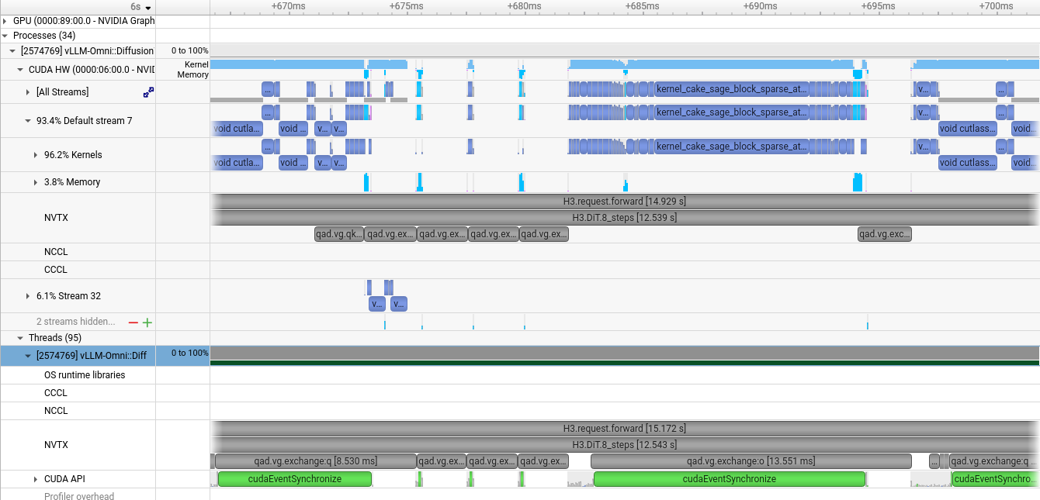
RDMA Still Leaves Ulysses Waiting
Whole-head dependencies expose communication waits before attention and output projection
1 · Input-readiness bubble
2 · O-return tail
1 · Inputs not ready
Attention needs the full
Q/K/V for its head group.
2 · O return pending
Output projection waits
for the returned O.
Next: pipeline heads
Compute one band while
transferring the next.
3.24 s / GPU
Exposed phase · full DiT
Mean across eight GPUs
Notes:
Actual Nsight Systems GUI screenshot of FastH3_QAD36L_8xPRO5000_960x544_PCIe_GPU_NIC.nsys-rep. This is the pre-head-pipeline RDMA baseline; it already overlaps V/g projection with the first exchange. Q/K/V/G and O are otherwise whole-head operands. Exposed transport is defined using event-sync return to closing barrier CPU launch, intersected with productive CUDA kernels, excluding pack/unpack/copy/barrier kernels. Mean over eight GPUs: phase 3.761780366 s, exposed 3.244157462 s, covered 13.760%. Includes host posting/CQ polling/flush; not exact NIC wire time or E2E attribution. Screenshot does not show the proposed 2/3/2 schedule. Nsight reported possible incomplete CUDA/NVTX/OSRT collection; expected windows reconcile.
v1.29 annotations are native transparent overlays; the embedded Nsight screenshot bytes remain unchanged. Region 1 covers source pixels x525..732,y74..248, spanning sparse transport/control activity with little productive compute before the main attention region. Region 2 covers x1118..1174,y74..248, the exposed tail around O return. These are visually selected illustrative regions, not independently measured duration brackets; neither implies all GPU activity is absent. Guide lines extend from external labels to GPU-lane boxes. The 3.24 s value remains the full-trace exposed transport aggregate and is not the duration of these two boxes. The baseline is FI RDMA, not an NCCL trace or a CUDA Graph before/after comparison.

Slide 17



Pipeline Ulysses by Head Bands
Use bands of 2, 3 and 2 heads per GPU to overlap communication with attention
Start earlier
Overlap across bands
Pipeline adds repeated submissions
Run the first two heads as soon as their full-sequence inputs arrive.
Transfer the next band while current-band attention executes.
Each band adds compute submissions.
Graph replay becomes more valuable.
Notes:
Each GPU owns seven attention heads after Ulysses redistribution. Selected band slices [0:2], [2:5], [5:7]. Each band receives Q/K/V for the complete global sequence before executing fine/coarse VSA. Stream events gate readiness and buffer reuse. Returned O bands restore all 56 heads for each token in the local token shard before full W_O; there is no independent full output projection per head band. Shared NIC direction capacity still applies; the communication lane here serializes operations and illustrates overlap with compute. The schedule is conceptual with illustrative durations, not a prediction of latency. 2/3/2 is selected for the updated presentation and has not been benchmarked here. Historical measurements used 1/2/3/1 and are labeled separately.
v1.27 visual revision: consistent blue input transfers, gray output transfers, green compute bands with visible separation, three readiness arrows and an explicit complete-output dependency. Timing coordinates and logical ordering are unchanged.
Pipeline changes dependency granularity to hide transfers behind productive work. It also repeats the compute submission sequence for every band. CUDA Graph is the following optimization: replay each qualified band compute island to reduce CPU/driver submission overhead. It neither changes link bandwidth nor replaces the head-pipeline readiness dependencies.
Head-band caveats: smaller bands can lose kernel efficiency and add launches, events and communication calls. Each band still needs full-sequence QKV; all O bands must restore the full 56-head local-token representation before W_O. Rank ordering, input readiness and buffer lifetime must remain correct. Compute and transfers can compete for HBM/PCIe/NIC resources. Overlap must repay the extra scheduling and split-kernel cost. CUDA Graph can already be used before banding; banding increases repeated submissions and strengthens its motivation. The displayed 2/3/2 remains a selected schematic, without a matched full-model benchmark in this release.

Slide 18



Head Bands Make CUDA Graph More Valuable
Graph replay works before banding; smaller bands increase repeated compute submission work
Banding strengthens the need
Each band repeats unpack, Top-K,
attention and pack submissions.
A stable workload fits replay
Fixed shapes and registered buffers;
tensor values may change.
400 calls amortize capture
Each band repeats over 50 blocks
and eight model evaluations.
Capture compute only. RDMA, readiness
events and full W_O stay outside.
Single-GPU compute experiment · historical 1 / 2 / 3 / 1 · no communication
Head layout | Eager ms | Graph ms | Reduction
All 7 heads | 11.703 | 11.658 | 0.39%
Bands 1 / 2 / 3 / 1 | 12.323 | 12.040 | 2.30%
Banding still adds compute cost.
End-to-end gains require enough
communication overlap to repay it.
Notes:
Stages group representative kernels rather than counting individual launches. The timeline is a conceptual launch-bound example on the same illustrative time scale. Matching kernel widths indicate unchanged work; the diagram is not an Nsight capture, and does not quantify the measured request gain. No retained paired Nsight screenshots isolate the graph-only change. RDMA and input/output readiness events are outside this prototype capture; graphs do not directly raise link bandwidth. Capture body: unpack QKV, original fine/coarse VSA, pack O_BUNDLE.
Historical selected-profile 8-GPU head pipeline 1/2/3/1: warmed local HTTP request to complete MP4 mean 13.249868 s without compute graph versus 11.993609333333334 s with graph, three measured requests per cohort, fixed 960x544 / 362 frames / 8 steps / one reference. Model load and one per-shape warmup excluded. This is retained cohort evidence, not a newly randomized run or a new 2/3/2 measurement.
Separate single-GPU four-arm component experiment on saved real layer-0 input: 12 counterbalanced rounds x 20 repeats, 5 warmup repeats. Seven-head eager 11.703171412150065 ms, graph 11.658073425292969 ms (0.385% reduction); bands 1/2/3/1 eager 12.323460133870443 ms, graph 12.040123176574706 ms (2.299% reduction). Excludes RDMA, gate, W_O, other DiT, encoder, VAE and HTTP. Bit-exact output checks passed before and after. Even banded graph compute remains 2.879% slower than unbanded eager compute; total pipeline gain depends on communication overlap. Evidence: cuda-graph-evidence.json.
https://docs.nvidia.com/cuda/cuda-programming-guide/04-special-topics/cuda-graphs.html
https://docs.pytorch.org/docs/stable/notes/cuda
Merged suitability and scope from v1.28 page 19:
Suitability follows from the inspected qad_head_compute_graph.py implementation, not a claim that every H3 or RDMA operation is graph-safe. The existing prototype is opt-in, inference-only, on a dedicated compute stream. It validates production SP8 geometry, tile128 multi-region metadata, mask-free non-joint attention, registered BF16 input/output views, and fixed addresses. A request runs 50 blocks x 8 model evaluations, giving 400 repeated attention calls per band when the profile, route plan, runtime and backend stay unchanged. Weights/GEMMs are outside this compute island, allowing reuse across blocks.
Sparse Top-K selection is input-dependent, but values/selected indices may change while tensor shapes and launch structure remain fixed. Input-ready wait is enqueued before replay and output-ready recorded afterward; correctness requires stable buffer lifetime and safe reuse. Tensor values are refreshed in registered storage before replay. Cached entries retain runtime, route plan, geometry and callable objects.
Actual cache identity includes runtime identity, compute stream, band position/start/head count, receive/send data pointers, shapes, strides, dtype/device, route-plan identity, complete reference/video/padding metadata, sparsity/keep rate, provider/precision/backend settings and callable identities. Two equal-sized bands A/C need not share GraphExec because their registered addresses differ. S and Kmax shorthand on slides denotes geometry encoded in buffers/plan and metadata.
The actual prototype warms exact shape/JIT, synchronizes, captures a private pool and explicitly first-replays on a miss; full cache raises an error. Eager fallback and qualifying recurring profiles in vLLM are proposed production policy, not behavior already implemented by this prototype. Different resolution/frame/reference/head profile must not replay an incompatible graph.
The same CUDA Graph mechanism is common in LLM inference; decode often dispatches batch/token-count profiles, while this H3 compute island dispatches video/reference geometry and head-band slots. This is a workload distinction, not a different graph algorithm. Kernel-dominated large bands may gain little. Capture/instantiate time and private-pool memory must amortize across replays. In the separate four-arm prototype, the 1/2/3/1 cold install after external JIT took 38.663 ms and added 1222 MiB reserved memory; these are experiment-specific costs, not a forecast for 2/3/2.
https://docs.nvidia.com/cuda/cuda-programming-guide/04-special-topics/cuda-graphs.html
https://docs.pytorch.org/docs/stable/notes/cuda
Key causal distinction: head pipelining exposes useful transfer/attention overlap; graph replay amortizes the extra per-band compute submissions. Illustrative timeline retains the same kernel-stage widths in both modes; it is not measured Nsight evidence and does not attribute the entire 9.48% request delta to GPU idle time. All detailed production scope, LLM comparison, cache-key requirements and cold-cost evidence remain in speaker notes.
v1.30 clarifies why combine these optimizations. Graph replay is possible before splitting heads. In the controlled four-arm experiment, Graph reduced all-seven-head compute by 0.385% and 1/2/3/1 banded compute by 2.299%. Splitting by itself added 5.30% compute time; split-plus-Graph remained 2.879% slower than all-head eager compute. Therefore these component results support a stronger Graph benefit after splitting, not a claim that the combined path always wins. End-to-end benefit relies on useful communication overlap. The retained 8-GPU 1/2/3/1 warmed request cohorts are 13.249868 seconds without compute Graph and 11.993609333 seconds with it, a 9.481% reduction (three requests each, not newly randomized). No matched full-model four-arm experiment establishes the combined path against all-head Graph.
Graph batches submission; it does not fuse the GPU kernels. QKV linear projection is outside this compute island. Capture includes unpack QKV, original fine/coarse VSA including routing/Top-K, and pack O_BUNDLE. Host mlx5 RDMA, readiness events, local gate/assembly and full W_O remain outside the current prototype. Do not generalize this scope to all RDMA APIs.
The CPU schedule submits each compute band before continuing host-driven RDMA, so reducing submission work can also allow earlier host progress. This is a mechanistic explanation, not measured attribution of the entire request delta. If CPU submission is already ahead of GPU execution, Graph can add little benefit.
Nsight timing semantics: enqueue occurs during the CPU launch API, so a GPU kernel may begin before that API returns. The conceptual drawing now marks enqueue points before each GPU start. CPU API return is not the dependency that gates GPU execution. Kernel widths are preserved across eager and graph diagrams; the diagram is not a measured before/after trace.
Suitability is conditional on a stable profile: request geometry, S, Kmax, reference/padding metadata, band slot, backend, dtype, shape, stride and registered buffer pointers. Different data and sparse indices can be supplied without changing launch structure. Equal-sized bands can still require distinct graphs because pointers differ. Fifty blocks times eight evaluations give 400 uses per band when runtime/route/backend/profile remain unchanged. H3 has a repeated geometry within a request, whereas continuously batched LLM decoding often varies batch size, KV length and active requests; both can use Graph after their profiles and buffers are qualified.
Caveats: capture/JIT/first-replay costs and private graph pools must be amortized. Historical four-band cold install after external geometry JIT cost 38.663 ms and increased reserved memory by 1222 MiB in this experiment. A shape/cache miss warms, synchronizes and captures; the retained 32-entry cache raises when full. An eager production fallback is proposed, not implemented. CPU work is not replayed. Correct readiness, collective order, stream joins and buffer lifetime remain necessary. The retained qualification is inference-only, tile 128, mask-free, nonjoint and SP8. The selected 2/3/2 schedule needs its own qualification and end-to-end measurements.
Official timing semantics: https://docs.nvidia.com/nsight-systems/AnalysisGuide/
Graph semantics: https://docs.pytorch.org/docs/stable/notes/cuda ; https://docs.nvidia.com/cuda/cuda-programming-guide/04-special-topics/cuda-graphs.html

Slide 19
Real-Time Demonstrated; Attribution Pending
Only Base50 uses the locked 960×544, 124-frame request; each optimized result uses a different workload
Status | Workload | System | Result / Limit
Measured baseline | 960×544 · 124f · 5.167 s | Base50 · BF16 · USP8 · NCCL | 247.956 s · RTF 47.992
15 s study | 960×544 · 362f · 15.083 s | PDD8 · QAD · VSA · RDMA | 14.974 s mean · RTF 0.993
10 s study | 960×544 · 243f · 10.125 s | 4-step Turbo · MXFP8 · Sage · RDMA | 6.958 s · RTF 0.687
Portrait study | 576×1024 · 119 new frames · 4.958 s | 4-step MXFP8 · Sage · FP4 VAE · RDMA | 4.459 s median · RTF 0.899
Required matched test | Lock image, audio, prompt, seed, shape, and request mode | PDD8, VSA, QAD/Sage and RDMA | At least 3 runs per stage
Notes:
Read this page as an evidence ledger, not as a performance ladder. Green means the exact locked benchmark. Blue means a result qualified inside its own study but not comparable with the green row. Orange is the acceptance work still required before we publish a cumulative optimization story.
Row A is the only current result on the locked MiniMax H3 Base Ref2VA request: 960 by 544, 124 frames at 24 FPS, 5.1667 seconds of media, the Miles reference image and voice, the locked prompt, seed 43, 50 denoising steps, BF16 dense attention, eight RTX PRO 5000 GPUs, TP1 and USP8, local NCCL, and no RDMA. After initialization and one warmup, three formal requests took 247.956, 246.201, and 248.298 seconds. The median is 247.956 seconds, or RTF 47.992. All three formal outputs and the warmup share the same MP4 SHA-256 and fully decode. The 70.84 GiB value is the maximum sampled whole-device reading across ranks over cold initialization and steady requests. It is not a PyTorch allocator high-water mark, and the ranks are materially imbalanced. Slide 6 reports the same run as 60,813 MiB steady and 72,539 MiB during cold initialization.
Row B is a different 15.083-second request: 960 by 544, 362 frames, one Zhiwei image, no external voice, an eight-forward NVFP4-QAD 36-layer decoder with VSA, and three samples per arm. Its original NCCL control averaged 17.681 seconds, while the final production arm averaged 14.974 seconds, changing RTF from 1.172 to 0.993. All three final requests met the 15.083-second media-duration budget. This is not sustained-stream evidence; the worst final request was 14.999848 seconds, only 0.152 milliseconds below a nominal 15.000-second threshold. The RDMA path also changes direct Ulysses layout handling, so its delta must not be described as isolated network transport.
Row C is internally paired but historical. Both arms use the same 960 by 544, 243-frame input and seed in that study. The original Base50 arm took 263.847 seconds; a distinct four-step Turbo, MXFP8, dense-Sage, NVFP4-VAE, TP1/SP8 and RDMA production stack took 6.958 seconds. RTF moves from 26.059 to 0.687. There is one formal sample per arm, and many material axes change together. This proves endpoint feasibility for that study, not a PDD8, VSA, QAD, Sage, or RDMA ablation.
Row D is the portrait live-avatar workload: 576 by 1024, a 124-frame request window with five-frame overlap, and therefore 119 new frames or 4.958 seconds of new media per continuation. It uses a four-step MXFP8 stack, BF16 Sage on the first sensitive attention path, NVFP4 video VAE, USP8 and RDMA. The initial request took 4.644 seconds. Five continuations have a 4.459-second median and RTF 0.899. The n label 1 + 5 means one initial request plus five continuation requests; it is not six steady samples. This is useful live-feasibility evidence, but it has no matched Base50 arm, no long-run P95, and no complete perceptual or lip-sync qualification.
The orange row is the publication gate. Keep the row-A image, audio, prompt, seed, geometry, frame count, request mode, hardware placement, timing boundary and memory method fixed. Measure Base50, PDD8, PDD8 plus VSA, the selected QAD or Sage path, and the RDMA plus overlap path with at least three steady requests per stage. Record end-to-end latency, RTF, peak GPU memory under one method, output exactness or a stated quality metric, and matched Nsight cost centers and overlap. Only then may these stages be connected as a cumulative waterfall.
The four-GPU real-RDMA precheck on the previous slide is correctness-only and is therefore absent from the performance rows. It did not run the full eight-GPU H3 model, measure end-to-end latency, or measure overlap. The 87.11 percent overlap value belongs to the separate 362-frame QAD trace and must not be attached to the Base50 row. A successful 1344 by 768 PDD8/VSA BF16 study is also component evidence only and does not fill a stage in the locked 544P chain.
Visible footer note: the 70.84 GiB value is the whole-device nvidia-smi maximum across cold and steady execution, not allocator high-water. Rows B through D are independent evidence, not a staged sequence.

Slide 20
02 · ComfyUI Apps
With vLLM-Omni
Notes:
Part two focuses on ComfyUI workflows backed by vLLM-Omni multi-GPU serving, beginning with the public MiniMax H3 character-replacement work in PR #9194.

Slide 21


vLLM-Omni Brings Multi-GPU H3 to ComfyUI
Open PR #9194 adds character replacement, continuation-aware references, and chainable LoRA controls
Official vLLM-Omni Architecture
ComfyUI Workflow · PR #9194
ComfyUI authors the workflow; vLLM-Omni runs scheduling, model execution, and multi-GPU deployment
The workflow supports single- and multi-character replacement, source-derived duration, long-video continuation, and LoRA controls
Notes:
This slide opens part two. It uses the official vLLM-Omni architecture and the public PR #9194 ComfyUI character-replacement workflow. The pull request is open as of October 24, 2026.

Slide 22
Notes:
Required closing slide from NVIDIA Corporate PPT Template Starter Guide v1, page 22.

