Slide 1
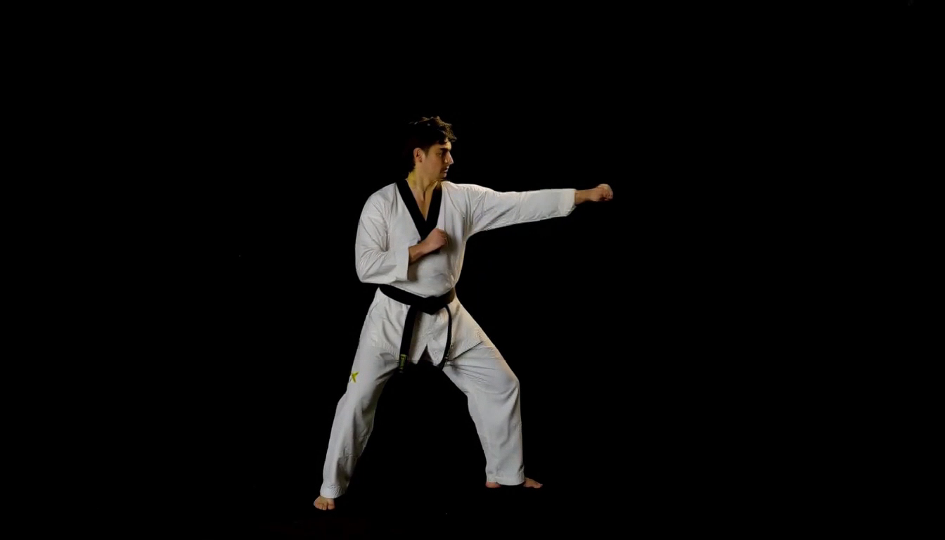
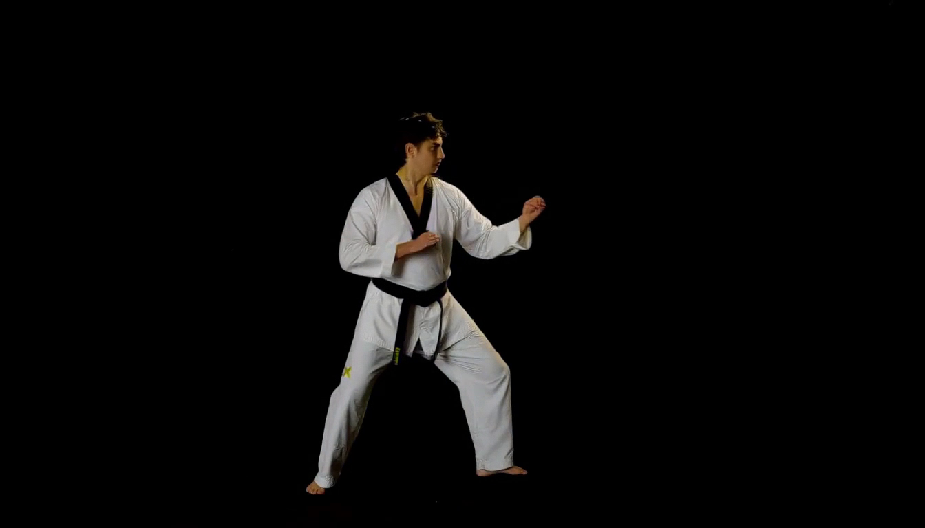
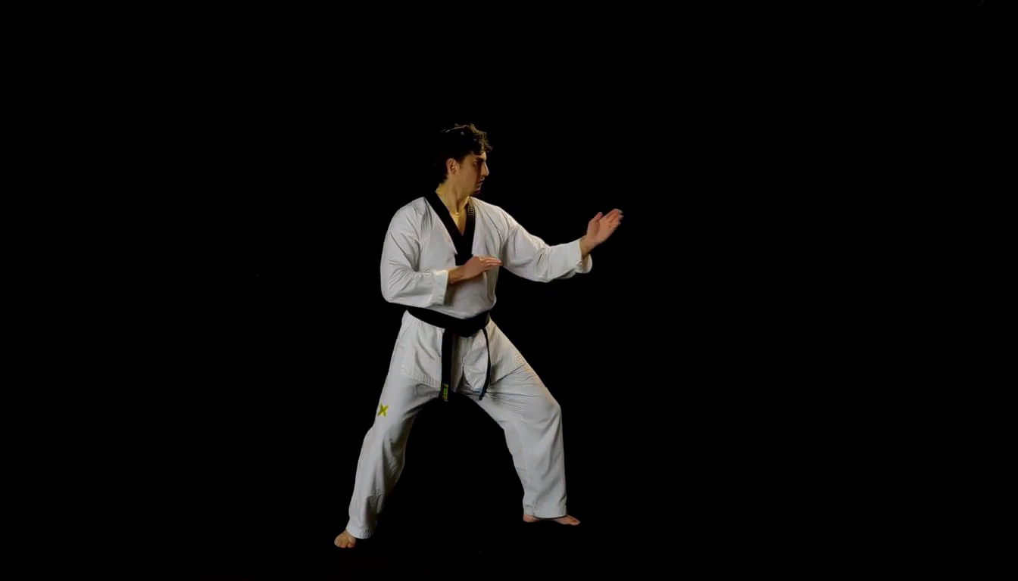
Quantization: Dynamic Motion Comparison
Compare limb contours, pose transitions and cloth detail in the same martial-arts action sequence
BF16 Reference
Online NVFP4
QAD NVFP4
Original BF16 weights
Direct algorithm · No calibration / QAD
Published QAD DiT weights
Request: 123.49 s*
Request: 79.79 s*
Request: 77.84 s*
LPIPS 0.0000 | SSIM 1.0000
LPIPS 0.0419 | SSIM 0.9454
LPIPS 0.0369 | SSIM 0.9497
Inspect hand and foot contours, pose transitions and moving cloth folds.
1344 × 768 · 124 frames at 24 FPS · 8 steps · Seed 1234 · Same BF16 encoder and VAE
*Single-GPU CPU offload; first request. LPIPS lower and SSIM higher mean closer to BF16.
Notes:
Three newly generated matching dynamic-action clips. Prompt: two straight punches, pivot, waist-height side kick, recovery to guard, cloth and belt dynamics, slow lateral camera arc. Selected for articulated motion before seeing outputs. Same two reference images, prompt, seed 1234, 1344x768, 124 frames at 24fps and eight evaluations. Single idle GPU 0, identical layerwise CPU-offload configuration, identical original BF16 encoder and original video/audio VAE, identical cuDNN BF16 VSA. Published QAD DiT is revision 0087718b2c8fe4b7e2d0a97463dc38da13f7703f; source BF16 is 88d512c5e7cc38dda499fbb65688ce58611f9c80. The QAD encoder is explicitly replaced by the common original BF16 encoder for this comparison. Online NVFP4 remains direct RTN of untouched BF16 weights with current-input tensor amax and per-16 E4M3 scales; no calibration table, QAD weights or learned QAD scales are used in that arm. Weight prepacking is cached before loading, activations are quantized dynamically on every forward.
All three videos are embedded side by side, started together and muted. PDF uses the same frame index 60 for all posters. Request times include the first generation after startup, encoding and complete MP4 transfer, excluding model loading and prepacking. They include CPU-offload costs and possible first-use JIT, and are not representative of the previous four-GPU production timings. Full-frame LPIPS AlexNet v0.1 and RGB Gaussian SSIM are recomputed on all124 decoded original-resolution frames. Audio is not scored. A static dark background can dominate full-frame scores; these are checkpoint similarity metrics and do not by themselves measure temporal stability, physical action correctness or general perceptual quality. Motion trajectories can diverge even for the same seed. No outcome was assumed from the prompt.
Measured values: {"online_nvfp4": {"lpips_alex_v0_1": {"mean": 0.04186826251867798, "std_population": 0.025374898582460087, "min": 0.008706730790436268, "max": 0.10916323214769363, "frames": 124}, "ssim_rgb": {"mean": 0.9454475520047675, "std_population": 0.016676196513861805, "min": 0.9092317327232791, "max": 0.9800593967178822, "frames": 124}}, "qad_nvfp4": {"lpips_alex_v0_1": {"mean": 0.03694349149572513, "std_population": 0.02413766988705653, "min": 0.008445855230093002, "max": 0.10601461678743362, "frames": 124}, "ssim_rgb": {"mean": 0.9497315785220294, "std_population": 0.018061974326140488, "min": 0.911523032934331, "max": 0.9796215969945749, "frames": 124}}}

