Slide 1
Real-Time Video Generation
With MiniMax H3
8× RTX PRO 5000 · vLLM-Omni
Shunyang Li | Public technical brief | October 2026
Notes:
This talk has two parts: taking MiniMax H3 toward real-time generation on eight RTX PRO 5000 GPUs, then using vLLM-Omni as the multi-GPU backend for ComfyUI applications.

Slide 2
01 Toward Real-Time H3 Generation
02 vLLM-Omni and ComfyUI Applications
Notes:
Part one covers the real-time target, platform constraints, bottleneck analysis, distributed optimization, and validation. Part two uses the public ComfyUI integration and PR #9194 workflows as the application story.

Slide 3
01 · Real-Time H3
Generation
Notes:
Part one moves from the real-time definition to the eight-GPU baseline, bottleneck analysis, optimization, and validation.

Slide 4

Real-Time Ref2VA Raises the Systems Bar
A 124-frame clip at 24 FPS is real time only when end-to-end latency stays below 5.167 s (RTF < 1)
Generative Backbone · Full Parameters (B)
Model Capability · Native 768P · 33B Dense
RTF = latency ÷ media duration; the 124-frame deadline is 5.167 s. H3 has the largest dense backbone in this peer set; Wan2.2 has 27B total and 14B active parameters
32B encoder → 33B dense Omni Transformer → visual/audio VAE. Fifty blocks × 50 steps keep compute and memory pressure high; about 13B AdaLN parameters can be cached
Notes:
Real time is RTF = end-to-end generation latency divided by finished-media duration, with RTF <= 1.0. The baseline is MiniMax H3 Base Ref2VA at 960x544: 124 frames / 24 FPS = 5.167 s. It uses 50 denoising steps, BF16, eight GPUs with USP8, local NCCL, and no RDMA. MiniMax H3 uses a 33B dense Omni Transformer with 50 Transformer blocks; the reference workload runs 50 denoising steps. These are distinct dimensions. Wan2.2 A14B is 27B total / 14B active, LTX-2.5 uses its official 22B designation, and HunyuanVideo-1.5 is 8.3B. The comparison excludes text encoders. Open H3-Base targets native 768p; the H3-Regenerate-2K module is not part of the open release and is excluded. The 130 GB figure is the raw BF16 size of the 32B encoder plus 33B generator, before VAE, activations, attention workspace, and CUDA Graph pools. Sources: https://huggingface.co/MiniMaxAI/MiniMax-H3 ; https://github.com/Wan-Video/Wan2.2 ; https://huggingface.co/Lightricks/LTX-2.5 ; https://github.com/Tencent-Hunyuan/HunyuanVideo-1.5

Slide 5
SM120 Brings FP4 Compute; PCIe Limits Scale
All discrete SM120 cards pair fifth-generation Tensor Cores with GDDR7 and PCIe Gen5; none provides GPU-to-GPU NVLink
SKU | Compute | Memory | GPU I/O / Fabric
RTX PRO 5000 ×8 Blackwell | SM120 · 110 SMs 5th-gen Tensor · FP4 | 72 GB GDDR7 ECC 48 GB variant | PCIe Gen5 ×16 Planned: NIC → RDMA*
RTX PRO 6000 WS / Server | SM120 · 188 SMs 5th-gen Tensor · FP4 | 96 GB GDDR7 ECC | PCIe Gen5 ×16 No GPU NVLink
GeForce RTX 5090 | SM120 · 170 SMs 5th-gen Tensor · FP4 | 32 GB GDDR7 | PCIe Gen5 ×16 No NVLink
DGX Spark · GB10 | SM121 · 48 SMs 5th-gen Tensor · FP4 | 128 GB unified LPDDR5X | NVLink-C2C in SoC 200 Gb/s ConnectX-7
Notes:
The template's native Table Example is reused at its original coordinates with its native table style and typography. RTX PRO 5000, RTX PRO 6000 and GeForce RTX 5090 use compute capability 12.0 / SM120; each has fifth-generation Tensor Cores with FP4 support. DGX Spark's GB10 uses compute capability 12.1 / SM121 and fifth-generation Tensor Cores with FP4 support. The planned RTX PRO 5000 scale-out path is GPU memory to PCIe Gen5 to a compatible NIC and then the RDMA fabric. This path is a deployment plan, not a measured result; GPUDirect RDMA requires compatible software and PCIe topology. The first row marks the selected eight-GPU RTX PRO 5000 baseline. Sources: https://developer.nvidia.com/cuda/gpus ; https://www.nvidia.com/en-gb/products/workstations/professional-desktop-gpus/rtx-pro-5000/ ; https://docs.nvidia.com/cuda/gpudirect-rdma/

Slide 6
Latency Breakdown
NCCL occupies 49.2% of the average GPU timeline
Stage | Average GPU Time* | Share
Mean GPU timeline* | 250.0 s | 100.0%
NCCL communication | 123.0 s | 49.2%
↳ DiT collectives | 116.1 s | 46.4%
↳ Encoder, VAE, and other collectives | 7.0 s | 2.8%
Tensor compute | 84.5 s | 33.8%
↳ Attention | 45.3 s | 18.1%
↳ GEMM / MLP | 39.2 s | 15.7%
AdaLN weight staging + device layout | 38.5 s | 15.4%
Encoder, VAE, and other GPU work | 4.0 s | 1.6%
  Of the 38.5 s average, 36.9 s is AdaLN projection weight staging from CPU; layout is 1.5 s
  This run uses the default runtime cache, not a complete precomputed schedule sidecar
Notes:
The measured baseline is MiniMax H3 Base Ref2VA at 960x544, 124 frames, 24 FPS, 50 denoising steps, BF16, and eight RTX PRO 5000 GPUs with USP8. Communication uses local NCCL; RDMA is disabled. The media duration is exactly 124 / 24 = 5.1667 seconds, shown as 5.167 seconds. The four top-level rows are mutually exclusive accounting buckets. The locked endpoint cohort contains three steady requests at 247.956, 246.201 and 248.298 seconds; its median is 247.956 seconds and RTF 47.992. The separately rerun matched Nsight request took 252.773 seconds, or RTF 48.924, after a 253.075-second warmup. Its warmup and measured outputs share one SHA-256 and fully decode. The matched trace reaches 60,827 MiB during the measured request and 61,299 MiB across the sampled run. The table is a hierarchy. NCCL communication includes DiT collectives and collectives in encoder, VAE and other work. It is reported separately from tensor compute and AdaLN host-to-device weight staging/layout. The four top-level cost centers are mutually exclusive and sum to 100 percent. The matched request passed the eight-device, kernel-count, attribution, transport and exclusive-accounting gates, and its CUDA kernel and memory totals match independent nsys stats exactly. The share denominator is kernel, memcpy and memset duration summed across all eight GPUs. The time column divides each category by eight and reports mean operation time per GPU. An interval-union check found no same-GPU overlap among the classified kernel/copy activities, and per-rank activity totals are 247.86 to 248.69 seconds, close to the measured E2E. NCCL kernel duration includes synchronization and peer waiting, so the DiT collective share of 46.4 percent is serialized collective residency rather than pure transfer time or an achieved-bandwidth measurement. The repeated loop issues 10,000 SendRecv kernels per rank: four per DiT block across 50 steps and 50 blocks. DiT host-to-device copies contribute 295.3 aggregate GPU-seconds and 8.94 TB of CUPTI logical bytes. More than 99.998 percent of that H-to-D time comes from staging AdaLN projection BF16 weight and bias on exact-cache misses. The run uses the default 256 MiB runtime output cache and does not configure a complete offline schedule sidecar. Ordinary Attention, MLP and QKV weights remain resident after initialization. This page stops at measured Base50 evidence. Optimization methods begin on the following slides.

Slide 7

How Denoising Works
H3 follows a learned velocity field from noise toward clean video and audio latents
State and direction
  x(t) is the current latent; the DiT predicts a data-ward velocity
Solver update
  Euler advances x(t) by a small interval along that velocity
  The next DiT call needs the new latent, so conventional steps run in sequence
Network function evaluation (NFE)
  One NFE is one complete DiT forward
Base H3
  50 NFE × 50 main blocks = 2,500 main-block passes
Classical Flow-Matching Sampling
A chain of dependent solver updates turns noise into clean latents
Notes:
This page defines the sampling terms used by the rest of the deck. A latent state x(t) is the current compressed video and audio representation. The DiT reads that state, its time coordinate and the prompt or reference conditioning, then predicts a data-ward velocity. The Euler solver uses that velocity to construct the next latent. Conventional sampling is sequential because the next DiT call requires the state produced by the previous update. NFE means network function evaluation; one NFE is one complete DiT forward, not one Transformer block. Base H3 uses 50 sequential NFEs. Each NFE traverses the 50-block main Transformer trunk, so the repeated trunk workload is 50 times 50, or 2,500 main-block passes. Under USP8, each of eight ranks executes its local shard, which is why a system trace can show 20,000 rank-local attention launches. Prompt and reference encoding happen before the repeated loop, and VAE decoding happens after it. H3 uses separate shifted Euler schedules for video and audio; x(t) and delta-t on this page deliberately abstract those two modality-specific updates, which share one joint DiT forward. Sources: https://research.nvidia.com/labs/genair/pdd/ ; https://github.com/MiniMax-AI/MiniMax-H3/blob/main/transformer/config.json

Slide 8

Few-Step Distillation
PDD predicts four denoising intervals per DiT call: 50 calls → 8
  Base H3 calls the full DiT 50 times. Each call predicts one short interval, updates the latent, and provides the starting point for the next call
  PDD uses Base H3 as the teacher and trains a student on groups of four adjacent denoising intervals
  One student call predicts four consecutive directions from the same noisy latent
  The solver combines those directions, advances the latent, and invokes the student again
  The released H3 schedule covers 32 fine intervals in eight student calls
  50 → 8 DiT calls; 2,500 → 400 repeated block passes (−84%)
N = fine intervals · L = intervals predicted in parallel
Paper example: N = 12, L = 4 · H3 PDD8: N = 32, L = 4
Notes:
Video generation starts from noise. Base H3 runs the full DiT once for each denoising update, so the model runs 50 times. Parallel Decoding Distillation uses Base H3 as the teacher and trains a student to predict several fine-interval updates in one DiT evaluation. The released H3 Ref2VA PDD adapter uses a new 32-interval schedule and predicts four interval velocities per evaluation, so 32 divided by 4 equals eight DiT evaluations. This is not the same as selecting eight of the original 50 solver steps. Each H3 evaluation still crosses 50 DiT blocks, so repeated block executions fall from 50 times 50, or 2,500, to 8 times 50, or 400. That is 84 percent fewer repeated block calls, reducing repeated attention, GEMM/MLP, and USP communication together. The 84 percent figure is workload arithmetic, not measured end-to-end speedup; encoders, VAE, data movement, memory, and matched quality still require end-to-end validation. NVIDIA Figure 2 shows the generic N=12, L=4 mechanism; the H3 N=32, L=4 schedule is labeled outside the paper figure.

Slide 9

Sparse Attention
VSA scans globally, then spends fine attention only where it matters
Why dense attention hurts
  34,373 tokens create 1.181B candidate pairs per head and block
Look broadly, then zoom in
  Coarse attention scans all cubes; Top-K picks where fine attention should work
Bring both views together
  A learned gate mixes global context with selected fine detail
What stays dense
  USP8 still exchanges full-length Q/K/V/O between GPUs
O = O_c ⊙ G_c + O_f ⊙ G_f
Global coarse context + selected fine detail · FastH3 adaptation: G_f = 1
Notes:
After PDD removes denoiser calls, dense attention still compares every valid token with every other valid token. For the locked 544P request, 34,373 valid packed rows imply 1,181,503,129 candidate pairs for each head in each DiT block. Video Sparse Attention first partitions the video latent into spatiotemporal cubes. In the paper default, a 4 by 4 by 4 cube represents 64 tokens. Coarse global attention scores the cubes, Top-K selection chooses the relevant regions, and fine sparse attention gathers the original K and V tokens only from selected cubes; a learned gate combines coarse and fine outputs. The paper default selects 32 KV cubes for each query cube. Keep three implementation granularities separate: the paper cube contains 64 tokens, the current H3 logical routing tile is 128 rows, and the fine kernel tile is 64 rows. VSA reduces attended token pairs and attention compute. In the current strict Ulysses route, Q, K and V are exchanged before attention and O is exchanged on the return path, so VSA alone does not automatically reduce collective payload; the learned gate adds a Q-sized forward exchange when present. VSA routing and gate weights are learned, so switching a dense checkpoint to a sparse kernel is not equivalent to a quality-qualified VSA model. The public Ref2VA PDD8 adapter and public FastH3 VSA student are separate artifacts, so this slide describes the optimization sequence rather than claiming a released combined checkpoint. The communication result is source-derived, not a measured bandwidth claim.

Slide 10
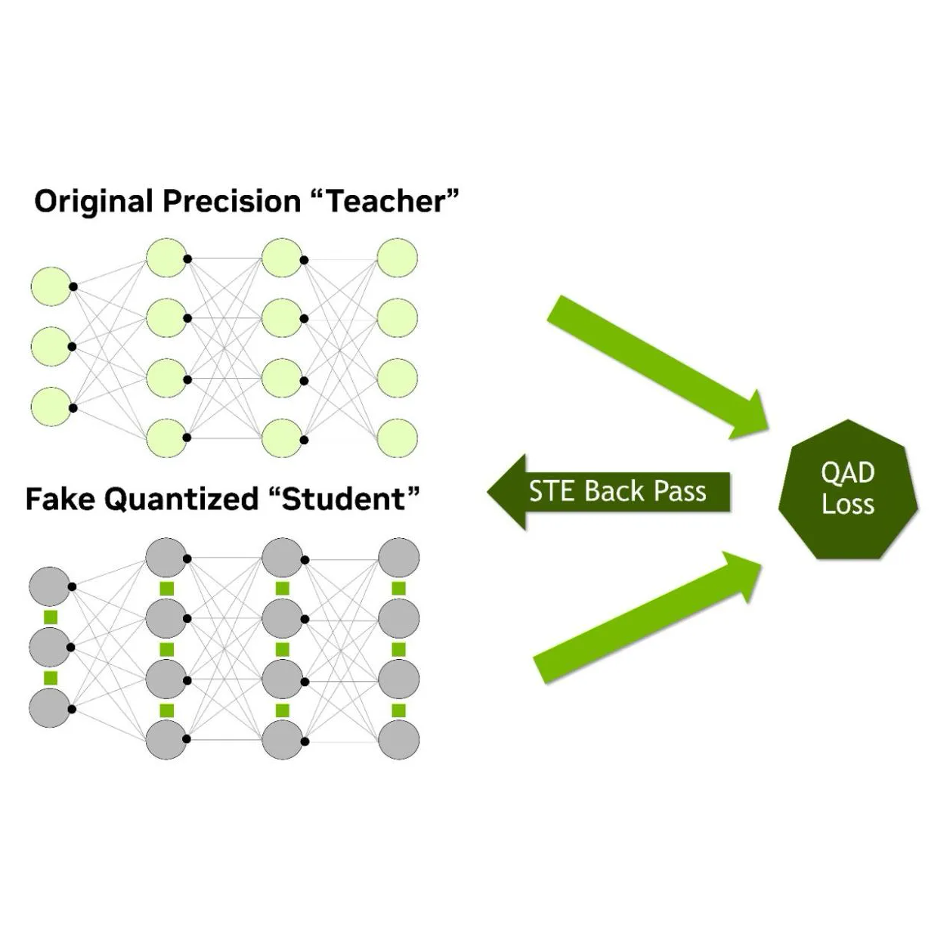
Quantization
QAD trains the deployed NVFP4 path against a frozen BF16 teacher
Why PTQ is not enough
  Four-bit rounding can move the model away from its BF16 output
Same sample, two paths
  The teacher stays frozen; the student sees deployment quantization noise
Only the student learns
  Distillation + STE update the student; the teacher disappears at inference
Mixed precision by design
  High-throughput linears use NVFP4; sensitive surrounding math stays BF16
Teacher Guides; NVFP4 Student Learns
Concept: L_QAD = D(y_BF16, y_NVFP4) · the teacher disappears at inference
Notes:
Start with the trained BF16 model. Apply the quantization recipe to create a student whose forward pass simulates the rounding and clipping it will see at inference. The same training sample also goes through the frozen BF16 teacher. A distillation loss measures the difference between teacher and student outputs, and gradients update only the student through the straight-through estimator. QAD is therefore a quality-recovery training method; it does not add work to the deployed inference graph. The public FastH3 Omni NVFP4-QAD checkpoint uses eight transformer forwards and packed NVFP4 transformer linears, while calibrated sensitive modules remain in BF16. The separate local Sage-VSA path quantizes selected fine-attention math to Q/K INT8 and V FP8, but the current Ulysses exchange still carries BF16 tensors. Do not combine the public checkpoint and the separate Sage path into one measured speedup until they pass a matched run. Figure source: https://developer.nvidia.com/blog/how-quantization-aware-training-enables-low-precision-accuracy-recovery/

Slide 11
Communication
USP8 turns every attention block into four synchronized all-to-all exchanges
Scope | Tensor / Execution | A2A Rounds | Minimum Off-Rank Payload* | Rate at 5.167 s*
One DiT Block | Q / K / V forward + O reverse | 4 | 1.728 GB | 61.7 MB/rank/A2A
Base50 | 50 steps × 50 blocks = 2,500 | 10,000 | 4.319 TB | 836.0 GB/s
PDD8 | 8 steps × 50 blocks = 400 | 1,600 | 691.1 GB | 133.8 GB/s
Boundary | Current VSA / Sage keeps dense BF16 exchange | — | Logical bytes | Not achieved bandwidth
Notes:
Strict Ulysses runs three forward Q, K and V all-to-alls and one reverse O all-to-all in each of 50 DiT blocks. At 50 denoiser evaluations that is 10,000 synchronized collective rounds. The 4.319 TB figure counts remote logical payload once at the sender. It excludes protocol and topology amplification and is not a wire-byte measurement. Dividing by the 5.167-second media duration gives a lower-bound payload rate, not an observed link rate. PDD8 removes the global step multiplier, but VSA and SageAttention do not automatically shrink BF16 Q, K, V and O exchange; overlap, exchanged dtype and layout, and topology-qualified RDMA must be measured separately.

Slide 12
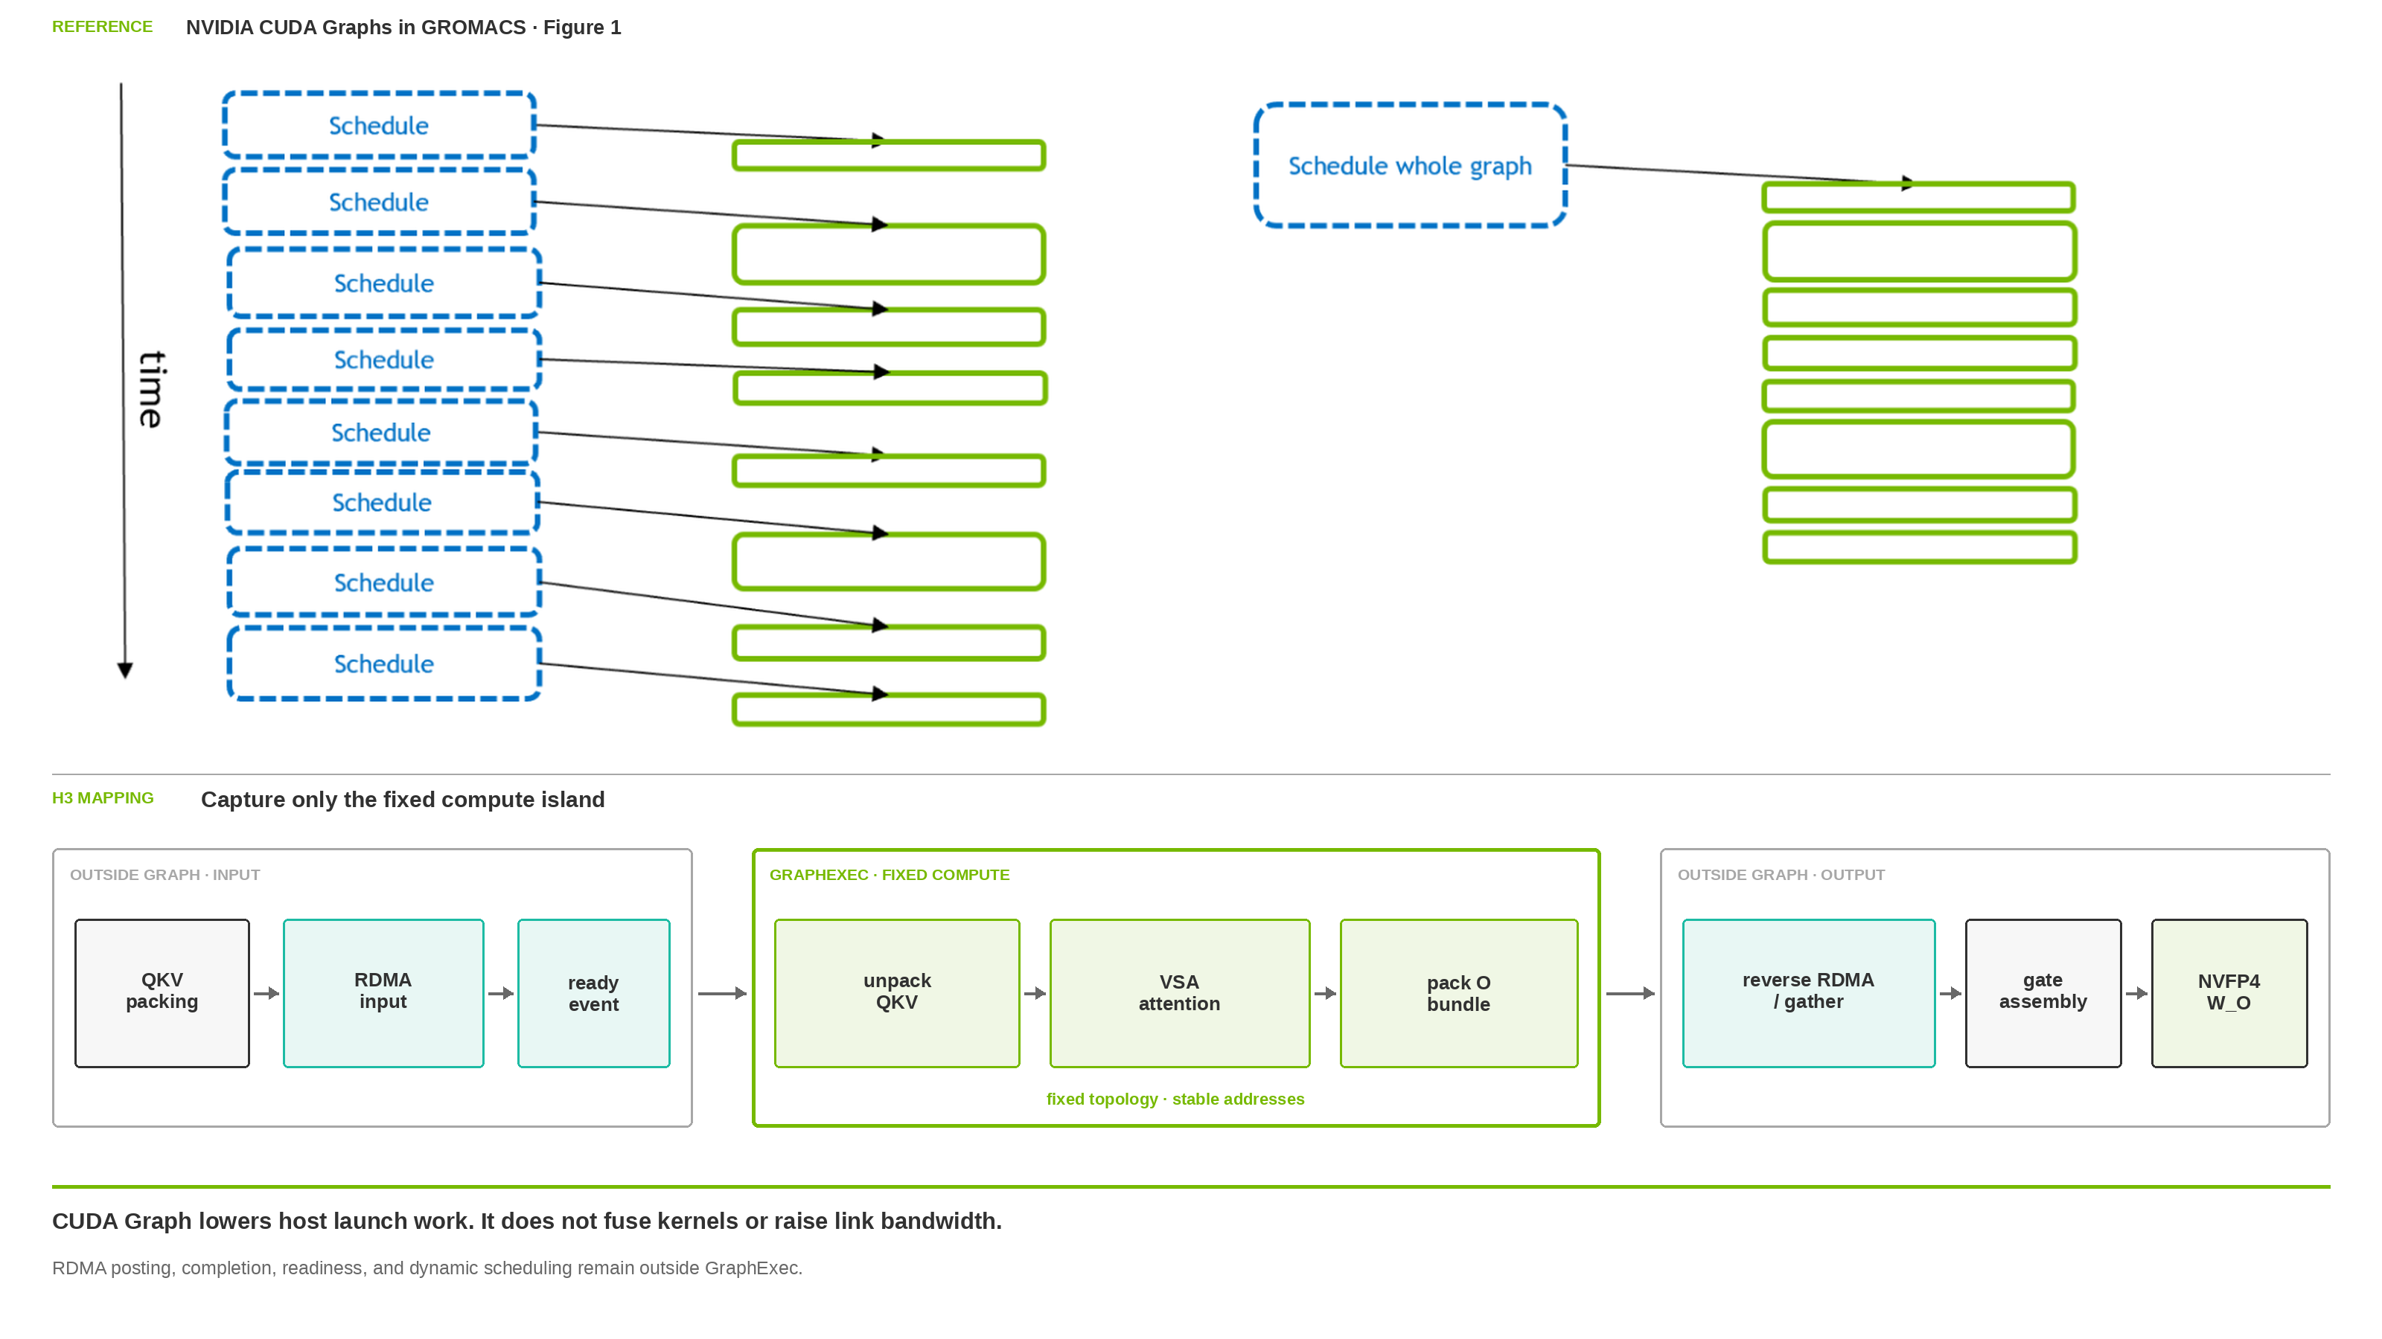
CUDA Graph
One host launch schedules the fixed compute island; RDMA stays outside
NVIDIA Reference · H3 Capture Boundary
Fixed-profile 8-GPU head pipeline: 13.250 s → 11.994 s (−9.48%)
Notes:
CUDA Graph records a fixed launch topology and replays it with one host launch. It reduces CPU, runtime and driver submission gaps; the GPU kernels remain separate and still perform the same memory traffic. The H3 prototype captures only unpack QKV, VSA attention and O-bundle packing. QKV packing and input RDMA, readiness events, reverse RDMA and gather, local gate assembly, complete NVFP4 W_O and dynamic scheduling remain outside the current Graph. CUDA Graph therefore does not increase link bandwidth.
A saved real layer-0 input was tested on one GPU with 12 counterbalanced rounds and 20 repeats per arm; all outputs were bit-exact. The all-head compute island changed from 11.703171 to 11.658073 ms, a 0.3853 percent reduction. Four fixed head bands changed from 12.323460 to 12.040123 ms, a 2.2992 percent reduction. This component test contains no collective, RDMA or overlap. Banding is still 2.879 percent slower than all-head eager in compute-only time; its intended gain comes from communication-compute overlap. Graph keeps the smaller per-band kernels from becoming launch-bound but does not create the overlap by itself.
In the qualified fixed 8-GPU profile, the head pipeline changed from 13.249868 seconds to 11.993609 seconds with compute CUDA Graph, a 9.481 percent reduction. The profile is 960 by 544, 362 frames, one reference and PDD8. This is a fixed-profile pipeline result, not qualification for arbitrary shapes or concurrent requests.
Official references: https://docs.nvidia.com/cuda/cuda-programming-guide/04-special-topics/cuda-graphs.html ; https://developer.nvidia.com/blog/a-guide-to-cuda-graphs-in-gromacs-2023/

Slide 13
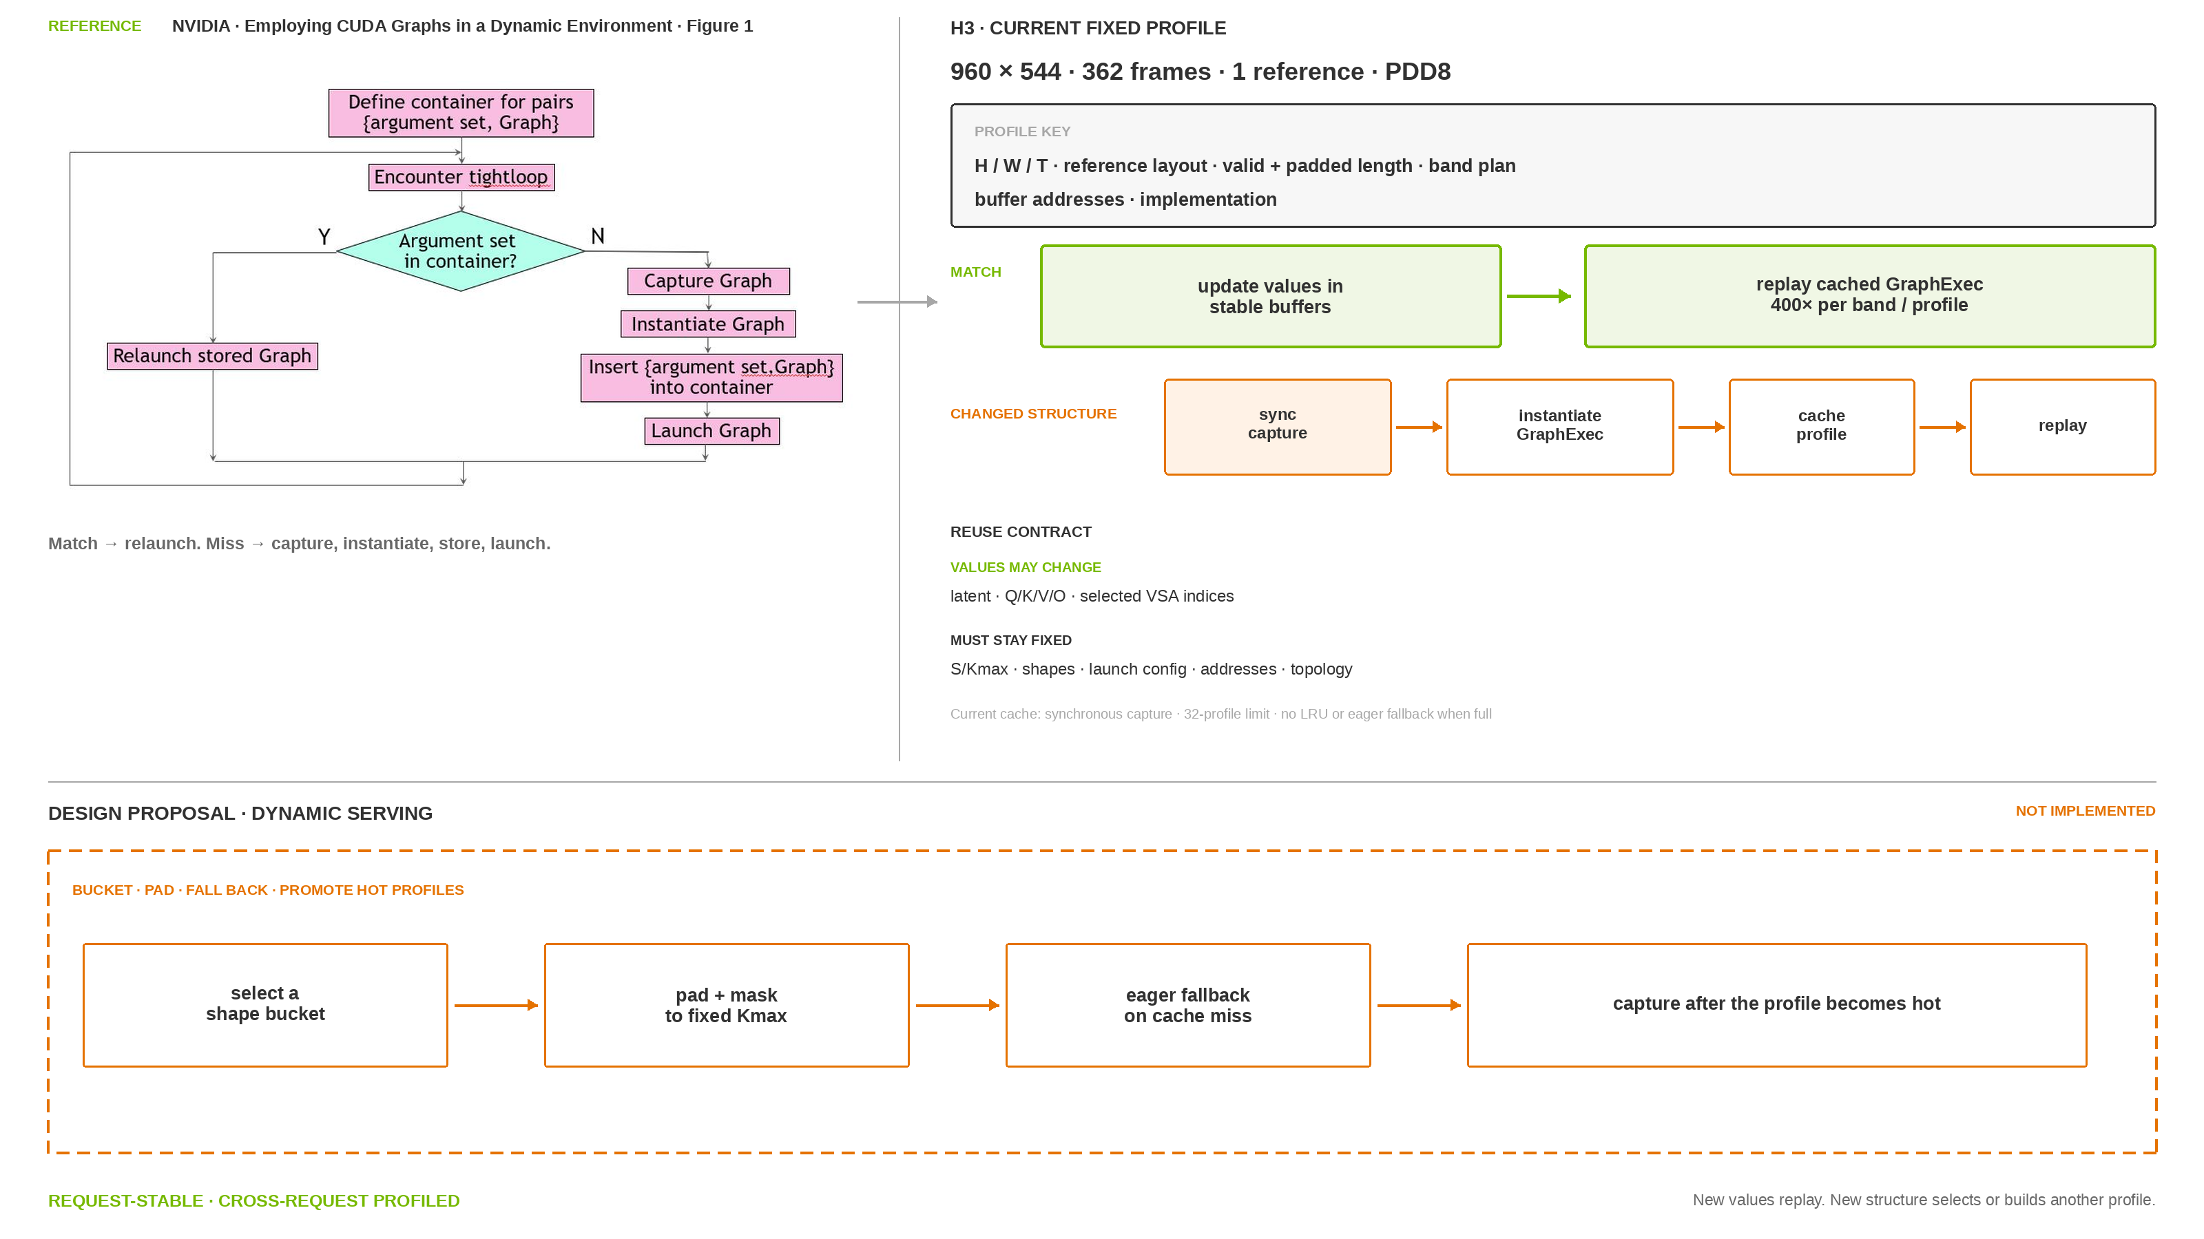
CUDA Graph Reuse
The same profile replays 400 times; a new video shape needs another GraphExec
NVIDIA Reference · H3 Profile Mapping
Qualified today: one fixed 960×544 profile · hot-bucket serving policy: proposed
Notes:
The current qualified profile is 960 by 544, 362 frames, one reference and PDD8. Its resolution, frame count, reference layout, valid and padded sequence lengths, Kmax, band plan, tensor geometry, implementation path and registered buffer addresses remain fixed. One GraphExec per fixed band/profile can replay across 50 blocks and eight denoising steps, or 400 calls per band/profile. Base50 would imply 2,500 calls, but that count is arithmetic only and has not been qualified. The (1, 2, 3, 1) plan uses four GraphExecs.
Tensor values may change between replays. VSA can select different token indices and Q/K/V can contain new values as long as S, Kmax, tensor shapes, strides and stable virtual addresses still match the profile. A new resolution, frame count, reference layout, band plan, route metadata or buffer address can force another capture. cudaGraphExecUpdate supports some parameter changes when topology remains compatible; it does not make arbitrary topology or kernel-path changes reusable.
The present prototype captures synchronously on a miss, keeps tensors and geometry in a private pool, limits the cache to 32 entries and raises if the cache is full. It does not yet implement a general serving bucket manager, LRU eviction or eager fallback. Hot shape buckets, padding and masking, eager fallback and capture after a reuse threshold are the proposed serving policy. They must be labeled as design, then validated with Graph hit rate, cold capture cost, private-pool memory and eager fallback rate.
Official references: https://docs.nvidia.com/dl-cuda-graph/cuda-graph-basics/constraints.html ; https://docs.pytorch.org/docs/stable/notes/cuda.html ; https://developer.nvidia.com/blog/employing-cuda-graphs-in-a-dynamic-environment/

Slide 14

USP
Each GPU swaps a token shard for seven full-sequence heads
Start with token shards
  Eight GPUs split 56,960 tokens; each rank keeps 7,120 tokens and all 56 heads
Swap the sharding axis
  Q/K/V/G all-to-all changes [S/8, 56] into [S, 7]
Do the expensive part locally
  Each GPU sees the full sequence for its own seven heads
Switch back for the block
  The O all-to-all restores token shards for projection, residual, and MLP
Same Tensor, Different Ownership
7,120 × 56 → 56,960 × 7 → 7,120 × 56 · repeated in every attention block
Notes:
Sequence parallelism starts with a token shard on every GPU. For this measured 362-frame profile, the aligned sequence has 56,960 tokens, so USP8 gives each rank 7,120 tokens and all 56 attention heads. After the local Q, K, V and learned VSA gate projections, Ulysses runs an all-to-all that gathers the full sequence while scattering heads. The local tensor changes from [B, S/8, 56, 128] to [B, S, 7, 128]. Each rank can now compute full-sequence attention locally for its own seven heads. A reverse all-to-all on O restores [B, S/8, 56, 128], and output projection, residual and MLP continue on the local token shard. The element count is preserved: (S/8) times 56 equals S times 7. USP reduces the per-rank activation and head workload; it does not reduce the global attention math. New Q, K, V and gate tensors are produced in every attention block, so this exchange repeats block by block. The 56,960-token shape belongs to the measured 960 by 544, 362-frame communication study; it is not the 124-frame Base50 shape.

Slide 15
USP Communication
NUMA 0 · CPU 0
PCIe P0
PCIe P1
GPU 0
GPU 1
GPU 2
GPU 3
CX-8 · mlx5_2
CX-8 · mlx5_3
CX-8 · mlx5_0
CX-8 · mlx5_1
The exchange is balanced in bytes; the host paths are not
Four PCIe islands
  Each island holds two GPUs and two nearest 400-Gb/s CX-8 ports
Three kinds of peer path
  From one rank: 1 PXB, 2 NODE, and 4 SYS peers
Most peers cross sockets
  Four of seven off-rank peers use the SYS path
Why the baseline is uneven
  IB is disabled, so local NCCL follows these host paths
NUMA 1 · CPU 1
PCIe P2
PCIe P3
GPU 4
GPU 5
GPU 6
GPU 7
CX-8 · mlx5_6
CX-8 · mlx5_7
CX-8 · mlx5_4
CX-8 · mlx5_5
PXB · 1/7 peer
NODE · 2/7 peers
SYS · 4/7 peers · 57.1%
Nearest-NIC GPUDirect RDMA · assigned 400-Gb/s CX-8 port per GPU
Eight GPUs · Four PCIe Islands
The math is balanced. The roads are not.
Notes:
The previous page explains the Ulysses tensor transform; this page shows the physical roads underneath it. The five Q, K, V, gate and output slots cross the topology in each measured VSA-enabled DiT block. The retained host has two NUMA sockets and four two-GPU PCIe islands. P0 contains GPUs 0 and 1, P1 contains GPUs 2 and 3, P2 contains GPUs 4 and 5, and P3 contains GPUs 6 and 7. From any GPU, one remote peer shares its PCIe subtree and is classified PXB, two peers sit behind the other subtree on the same NUMA socket and are classified NODE, and four peers sit across the CPU-to-CPU path and are classified SYS. Ulysses uses equal peer chunks, so the logical off-rank split is 1/7 PXB, 2/7 NODE and 4/7 SYS. Therefore 57.1 percent of minimum one-way off-rank logical payload is cross-socket. This is a topology and logical-payload statement; it is not a captured split of NCCL wire bytes, route residency, or elapsed time. The nearest-NIC mapping is GPU0 to mlx5_2, GPU1 to mlx5_3, GPU2 to mlx5_0, GPU3 to mlx5_1, GPU4 to mlx5_6, GPU5 to mlx5_7, GPU6 to mlx5_4 and GPU7 to mlx5_5. Each retained ConnectX-8 port was active at 400 Gb/s. The editable diagram shows hardware containment and path classes; it does not assert that the local NCCL control transported every byte over a single physical route family. Code anchors: pipeline_minimax_h3.py lines 648 and 886-887; pipeline_minimax_h3.py line 3539; denoise_loop.py lines 3-7 and the single model call beginning at line 404.

Slide 16
RDMA
The nearest-NIC path moves the same payload in less than half the measured communication + layout time
Route | Logical Off-Rank Volume | Rank-Max / Block | Effective BW / Rank | Serialized PDD8*
NCCL local | 446.6 MB / rank / block 1.429 TB / all ranks / PDD8 request | 24.87 ms | 17.95 GB/s | 9.95 s
Nearest-NIC GDR | 446.6 MB / rank / block 1.429 TB / all ranks / PDD8 request | 10.86 ms | 41.14 GB/s | 4.34 s
RDMA delta | Same five-slot bytes | −56.4% | 2.29× | −5.61 s
Measured scope | Communication + path-required layout | Exact vs independent all_gather | No attention or GEMM | No overlap *serial × 400; not E2E
Notes:
This exact-shape benchmark isolates the five Ulysses Q, K, V, gate and output slots for the current MiniMax H3 Ref2VA avatar profile: 960 by 544, 362 frames at 24 FPS, BF16, DP1, TP1, USP8, Ring1, global aligned sequence 56,960, local sequence 7,120, 56 heads and head dimension 128. It is one request on one eight-GPU replica, not DP8. Each route moves 446,566,400 off-rank logical bytes per rank and DiT block. Across all eight ranks and 400 PDD8 block calls, the minimum one-way off-rank logical volume is 1,429,012,480,000 bytes, or 1.42901248 decimal terabytes. Five warmups preceded eight paired trials with four block calls per trial. Each trial records the slowest rank; the slide reports the mean of those rank maxima. NCCL local measured 24.874763 milliseconds per block and 17.952589 decimal gigabytes per second of effective off-rank send bandwidth per rank. Nearest-NIC GPUDirect RDMA measured 10.855998 milliseconds and 41.135455 gigabytes per second. Multiplying the unrounded block means by 400 gives 9.949905 and 4.342399 seconds of serialized PDD8 communication plus path-required layout, a 5.607506-second reduction. The RDMA path is 2.291338 times faster and uses 56.3574 percent less measured communication-plus-layout time. Outputs match an independent all_gather reference exactly. This test contains no attention, GEMM or communication-compute overlap. Its serialized values are not end-to-end request predictions. The NCCL and RDMA adapters also use different path-required layout operations, so the delta is a measured deployment-path result rather than isolated wire time. Raw source: /tmp/h3-qad-realtime-20261023/ulysses-362f-paths-20261025.json.

Slide 17

RDMA Validation
Four-GPU transport is byte-exact; eight-GPU H3 validation is still pending
Q/K first
  V waits for an explicit CUDA event
Graph replay
  Fixed-address unpack remains exact after the input changes
Tiled O return
  Whole and row-chunk returns match byte for byte
Eight-GPU acceptance gate
  Full attention + W_O, end-to-end latency, memory, and Nsight overlap
Four-GPU Real RDMA · 96 of 96 Rank Cases Exact
24 configs × 4 ranks · 8-GPU H3 candidate pending
Notes:
The transport precheck used four physical ranks and the real RDMA route with synthetic, rank-distinct BF16 inputs. Its 96 passing rank-cases are 24 distributed configurations observed on four ranks: two row counts, three head widths, two stream priorities and two phases. It retained the production eight-slot layout, transported physical peer slots zero through three and zero-filled the other receive slots. Q and K were exchanged while V contained NaNs; only after that exchange did a producer stream publish V and record a CUDA event, which the communication stream waited on before reading V. This proves ordering and synchronization, not concurrent V projection or overlap gain. The captured graph contains only fixed-address split-QKV unpack, which remained byte-exact after inputs changed and the graph replayed. The all-RDMA collective stays outside CUDA Graph capture and explicitly refuses capture because it posts mlx5 work requests and polls completion queues from the host. Whole output return and two row-chunk returns, including the repeated coarse tail, matched independent references byte for byte. These are transport and layout exactness results; full attention, W_O, end-to-end latency, peak memory and candidate overlap were not measured. The complete eight-GPU H3 candidate therefore remains pending. Evidence bundle: real-rdma-four-gpu-20261024-v2/summary.json.

Slide 18
Real-Time Demonstrated; Attribution Pending
Only Base50 uses the locked 960×544, 124-frame request; each optimized result uses a different workload
Status | Workload | System | Result / Limit
Measured baseline | 960×544 · 124f · 5.167 s | Base50 · BF16 · USP8 · NCCL | 247.956 s · RTF 47.992
15 s study | 960×544 · 362f · 15.083 s | PDD8 · QAD · VSA · RDMA | 14.974 s mean · RTF 0.993
10 s study | 960×544 · 243f · 10.125 s | 4-step Turbo · MXFP8 · Sage · RDMA | 6.958 s · RTF 0.687
Portrait study | 576×1024 · 119 new frames · 4.958 s | 4-step MXFP8 · Sage · FP4 VAE · RDMA | 4.459 s median · RTF 0.899
Required matched test | Lock image, audio, prompt, seed, shape, and request mode | PDD8 → VSA → QAD/Sage → RDMA | At least 3 runs per stage
Notes:
Read this page as an evidence ledger, not as a performance ladder. Green means the exact locked benchmark. Blue means a result qualified inside its own study but not comparable with the green row. Orange is the acceptance work still required before we publish a cumulative optimization story.
Row A is the only current result on the locked MiniMax H3 Base Ref2VA request: 960 by 544, 124 frames at 24 FPS, 5.1667 seconds of media, the Miles reference image and voice, the locked prompt, seed 43, 50 denoising steps, BF16 dense attention, eight RTX PRO 5000 GPUs, TP1 and USP8, local NCCL, and no RDMA. After initialization and one warmup, three formal requests took 247.956, 246.201, and 248.298 seconds. The median is 247.956 seconds, or RTF 47.992. All three formal outputs and the warmup share the same MP4 SHA-256 and fully decode. The 70.84 GiB value is the maximum sampled whole-device reading across ranks over cold initialization and steady requests. It is not a PyTorch allocator high-water mark, and the ranks are materially imbalanced. Slide 6 reports the same run as 60,813 MiB steady and 72,539 MiB during cold initialization.
Row B is a different 15.083-second request: 960 by 544, 362 frames, one Zhiwei image, no external voice, an eight-forward NVFP4-QAD 36-layer decoder with VSA, and three samples per arm. Its original NCCL control averaged 17.681 seconds, while the final production arm averaged 14.974 seconds, changing RTF from 1.172 to 0.993. All three final requests met the 15.083-second media-duration budget. This is not sustained-stream evidence; the worst final request was 14.999848 seconds, only 0.152 milliseconds below a nominal 15.000-second threshold. The RDMA path also changes direct Ulysses layout handling, so its delta must not be described as isolated network transport.
Row C is internally paired but historical. Both arms use the same 960 by 544, 243-frame input and seed in that study. The original Base50 arm took 263.847 seconds; a distinct four-step Turbo, MXFP8, dense-Sage, NVFP4-VAE, TP1/SP8 and RDMA production stack took 6.958 seconds. RTF moves from 26.059 to 0.687. There is one formal sample per arm, and many material axes change together. This proves endpoint feasibility for that study, not a PDD8, VSA, QAD, Sage, or RDMA ablation.
Row D is the portrait live-avatar workload: 576 by 1024, a 124-frame request window with five-frame overlap, and therefore 119 new frames or 4.958 seconds of new media per continuation. It uses a four-step MXFP8 stack, BF16 Sage on the first sensitive attention path, NVFP4 video VAE, USP8 and RDMA. The initial request took 4.644 seconds. Five continuations have a 4.459-second median and RTF 0.899. The n label 1 + 5 means one initial request plus five continuation requests; it is not six steady samples. This is useful live-feasibility evidence, but it has no matched Base50 arm, no long-run P95, and no complete perceptual or lip-sync qualification.
The orange row is the publication gate. Keep the row-A image, audio, prompt, seed, geometry, frame count, request mode, hardware placement, timing boundary and memory method fixed. Measure Base50, PDD8, PDD8 plus VSA, the selected QAD or Sage path, and the RDMA plus overlap path with at least three steady requests per stage. Record end-to-end latency, RTF, peak GPU memory under one method, output exactness or a stated quality metric, and matched Nsight cost centers and overlap. Only then may these stages be connected as a cumulative waterfall.
The four-GPU real-RDMA precheck on the previous slide is correctness-only and is therefore absent from the performance rows. It did not run the full eight-GPU H3 model, measure end-to-end latency, or measure overlap. The 87.11 percent overlap value belongs to the separate 362-frame QAD trace and must not be attached to the Base50 row. A successful 1344 by 768 PDD8/VSA BF16 study is also component evidence only and does not fill a stage in the locked 544P chain.
Visible footer note: the 70.84 GiB value is the whole-device nvidia-smi maximum across cold and steady execution, not allocator high-water. Rows B through D are independent evidence, not a staged sequence.

Slide 19
02 · ComfyUI Apps
With vLLM-Omni
Notes:
Part two focuses on ComfyUI workflows backed by vLLM-Omni multi-GPU serving, beginning with the public MiniMax H3 character-replacement work in PR #9194.

Slide 20


vLLM-Omni Brings Multi-GPU H3 to ComfyUI
Open PR #9194 adds character replacement, continuation-aware references, and chainable LoRA controls
Official vLLM-Omni Architecture
ComfyUI Workflow · PR #9194
ComfyUI authors the workflow; vLLM-Omni runs scheduling, model execution, and multi-GPU deployment
The workflow supports single- and multi-character replacement, source-derived duration, long-video continuation, and LoRA controls
Notes:
This slide opens part two. It uses the official vLLM-Omni architecture and the public PR #9194 ComfyUI character-replacement workflow. The pull request is open as of October 24, 2026.

Slide 21
Notes:
Required closing slide from NVIDIA Corporate PPT Template Starter Guide v1, page 22.

