Slide 1
Real-Time Video Generation
with MiniMax H3
8× RTX PRO 5000 · vLLM-Omni + ComfyUI
Shunyang Li | Public Technical Brief | October 2026
Notes:
This talk has two parts: taking MiniMax H3 toward real-time generation on eight RTX PRO 5000 GPUs, then using vLLM-Omni as the multi-GPU backend for ComfyUI applications.

Slide 2
01 Toward Real-Time H3 Generation
02 vLLM-Omni + ComfyUI Applications
Notes:
Part one covers the real-time target, platform constraints, bottleneck analysis, distributed optimization, and validation. Part two uses the public ComfyUI integration and PR #9194 workflows as the application story.

Slide 3
01 · Real-Time H3
Generation
Notes:
Part one moves from the real-time definition to the eight-GPU baseline, bottleneck analysis, optimization, and validation.

Slide 4

Real-Time Ref2VA Raises the Systems Bar
For 124 frames at 24 FPS, real time requires end-to-end latency < 5.167 s (RTF < 1.0)
GENERATIVE BACKBONE · FULL PARAMETERS (B)
MODEL CAPABILITY · NATIVE 768P · 33B DENSE
RTF = latency / media duration. The real-time deadline here is 5.167 s. H3 is the largest dense backbone in this peer set; Wan2.2 = 27B total / 14B active.
32B encoder → 33B dense Omni Transformer → Visual/Audio VAE. 50 blocks × 50 denoising steps; full attention. ≈130 GB raw BF16; ~13B AdaLN cacheable.
Notes:
Real time is RTF = end-to-end generation latency divided by finished-media duration, with RTF <= 1.0. The baseline is MiniMax H3 Base Ref2VA at 960x544: 124 frames / 24 FPS = 5.167 s. It uses 50 denoising steps, BF16, eight GPUs with USP8, local NCCL, and no RDMA. MiniMax H3 uses a 33B dense Omni Transformer with 50 Transformer blocks; the reference workload runs 50 denoising steps. These are distinct dimensions. Wan2.2 A14B is 27B total / 14B active, LTX-2.5 uses its official 22B designation, and HunyuanVideo-1.5 is 8.3B. The comparison excludes text encoders. Open H3-Base targets native 768p; the H3-Regenerate-2K module is not part of the open release and is excluded. The 130 GB figure is the raw BF16 size of the 32B encoder plus 33B generator, before VAE, activations, attention workspace, and CUDA Graph pools. Sources: https://huggingface.co/MiniMaxAI/MiniMax-H3 ; https://github.com/Wan-Video/Wan2.2 ; https://huggingface.co/Lightricks/LTX-2.5 ; https://github.com/Tencent-Hunyuan/HunyuanVideo-1.5

Slide 5
Frontier Models · The Cards
Every discrete SM120 card combines fifth-generation Tensor Cores with FP4 and GDDR7; memory capacity and PCIe-to-fabric bandwidth define the deployment envelope
SKU | Compute | Memory | GPU I/O / Fabric
RTX PRO 5000 Blackwell | SM120 · 110 SMs 5th-gen Tensor · FP4 | 72 GB GDDR7 ECC 48 GB variant | PCIe Gen5 ×16 Planned: NIC → RDMA*
RTX PRO 6000 WS / Server | SM120 · 188 SMs 5th-gen Tensor · FP4 | 96 GB GDDR7 ECC | PCIe Gen5 ×16 No GPU NVLink
GeForce RTX 5090 | SM120 · 170 SMs 5th-gen Tensor · FP4 | 32 GB GDDR7 | PCIe Gen5 ×16 No NVLink
DGX Spark · GB10 | SM121 · 48 SMs 5th-gen Tensor · FP4 | 128 GB unified LPDDR5X | NVLink-C2C in SoC 200 Gb/s ConnectX-7
×8
Notes:
The template's native Table Example is reused at its original coordinates with its native table style and typography. RTX PRO 5000, RTX PRO 6000 and GeForce RTX 5090 use compute capability 12.0 / SM120; each has fifth-generation Tensor Cores with FP4 support. DGX Spark's GB10 uses compute capability 12.1 / SM121 and fifth-generation Tensor Cores with FP4 support. The planned RTX PRO 5000 scale-out path is GPU memory to PCIe Gen5 to a compatible NIC and then the RDMA fabric. This path is a deployment plan, not a measured result; GPUDirect RDMA requires compatible software and PCIe topology. On click, the slide reveals the selected RTX PRO 5000 row and the eight-GPU baseline. Sources: https://developer.nvidia.com/cuda/gpus ; https://www.nvidia.com/en-gb/products/workstations/professional-desktop-gpus/rtx-pro-5000/ ; https://docs.nvidia.com/cuda/gpudirect-rdma/

Slide 6
Latency Breakdown
Base50 · 248 s latency for 5.17 s output · RTF 48.0
Cost center | Avg. time / GPU* | Share
Mean GPU timeline* | 248.3 s | 100.0%
Repeated DiT loop | 237.7 s | 95.7%
Communication + movement | 153.2 s | 61.7%
DiT USP8 all-to-all (NCCL) | 114.7 s | 46.2%
AdaLN cache misses + layout | 38.5 s | 15.5%
Tensor compute | 84.5 s | 34.0%
Attention | 45.3 s | 18.3%
GEMM / MLP | 39.2 s | 15.8%
Encoders + VAE + other | 10.6 s | 4.3%
  Current trace uses a partial AdaLN cache; full schedule precompute requires a matched rerun.
  Text, reference and audio encoders are included in Encoders + VAE + other.
Notes:
The measured baseline is MiniMax H3 Base Ref2VA at 960x544, 124 frames, 24 FPS, 50 denoising steps, BF16, and eight RTX PRO 5000 GPUs with USP8. Communication uses local NCCL; RDMA is disabled. The media duration is exactly 124 / 24 = 5.1667 seconds, shown as 5.167 seconds. The five rows are mutually exclusive accounting buckets. Three steady measured requests took 247.956, 246.201 and 248.298 seconds; the median is 247.956 seconds and RTF 47.992. All three measured outputs share one SHA-256 and fully decode. The maximum sampled steady-state memory is 60,813 MiB on one GPU; cold initialize reaches 72,539 MiB, leaving 876 MiB of the 73,415 MiB visible capacity. The table is a hierarchy: the profiled mean GPU timeline contains the repeated DiT loop and VAE/other work; the DiT loop contains communication/movement and tensor compute; those branches contain the five exclusive measured cost centers. The matched Nsight request passed the eight-device, kernel-count, attribution, transport and exclusive-accounting gates, and its CUDA kernel and memory totals match independent nsys stats exactly. The share denominator is kernel, memcpy and memset duration summed across all eight GPUs. The time column divides each category by eight and reports mean operation time per GPU. An interval-union check found no same-GPU overlap among the classified kernel/copy activities, and per-rank activity totals are 247.86 to 248.69 seconds, close to the measured E2E. NCCL kernel duration includes synchronization and peer waiting, so its 46.2 percent share is serialized collective residency rather than pure transfer time or an achieved-bandwidth measurement. The repeated loop issues 10,000 SendRecv kernels per rank: four per DiT block across 50 steps and 50 blocks. DiT host-to-device copies contribute 295.5 aggregate GPU-seconds and 8.94 TB of CUPTI logical bytes; the launch configuration identifies this as the default SM120 weight-offload path. This page stops at measured Base50 evidence. Optimization methods begin on the following slides.

Slide 7

PDD Removes 84% of Repeated DiT Work
H3 Ref2VA · 50 NFE → PDD · 8 NFE
BASE REF2VA
  50 NFE × 50 blocks = 2,500
    Every attention, MLP and USP exchange repeats
REF2VA PDD8
  8 NFE × 50 blocks = 400
    N = 32, L = 4 → 8 evaluations
−84% repeated DiT block calls
  Matched E2E, memory and quality remain pending
NVIDIA PDD · PARALLEL DECODER
Generic Figure 2 illustration: N = 12 intervals, grouped L = 4 per Transformer evaluation
Notes:
The locked Base workload uses 50 denoising evaluations and 50 DiT blocks, for 2,500 repeated block executions. The released task-specific H3 Ref2VA PDD adapter is the eight-NFE lane. Its public loader uses 32 fine intervals with a block size of four, so one transformer evaluation predicts four interval means and the complete schedule takes eight evaluations. It therefore executes 8 times 50, or 400, DiT blocks: 84 percent fewer than Base50. This removes attention, GEMM/MLP and USP communication together. PDD does not retain eight of the original 50 solver steps, and 2,500 to 400 is workload arithmetic, not a measured end-to-end speedup. NVIDIA Figure 2 is the generic N=12, L=4 mechanism illustration; the H3 N=32, L=4 schedule is stated separately. Matched 960x544 latency, peak memory and quality remain pending.

Slide 8
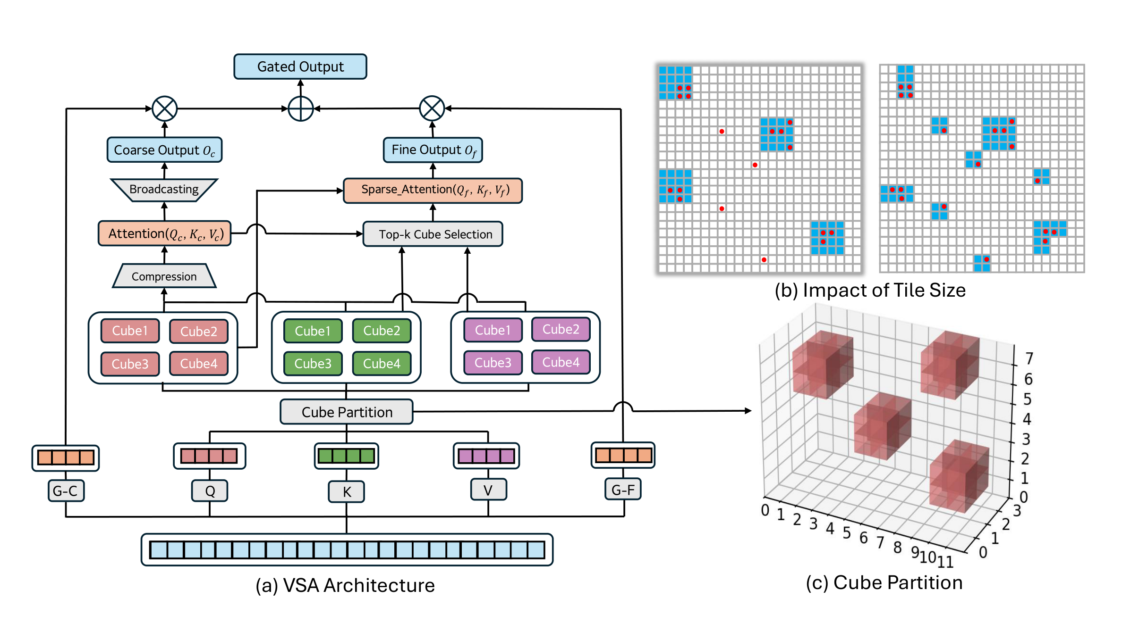
After PDD, Attention Still Scores Every Pair
Video Sparse Attention (VSA) = trainable, content-aware block sparsity over 3-D video cubes
DENSE Θ(S²) → VSA O((S/B)² + S·K·B)
Locked 544P: Svalid = 34,373 → 1.181B candidate pairs/head/block. Current USP8 still exchanges full Q/K/V/O (+ gate).
Notes:
After PDD removes denoiser calls, dense attention still compares every valid token with every other valid token. For the locked 544P request, 34,373 valid packed rows imply 1,181,503,129 candidate pairs for each head in each DiT block. Video Sparse Attention first partitions the video latent into spatiotemporal cubes. In the paper default, a 4 by 4 by 4 cube represents 64 tokens. Coarse global attention scores the cubes, top-k selection chooses the relevant regions, and fine sparse attention gathers the original K and V tokens only from selected cubes; a learned gate combines coarse and fine outputs. The paper default uses Kc=32. Keep three implementation granularities separate: the paper cube contains 64 tokens, the current H3 logical routing tile is 128 rows, and the fine kernel tile is 64 rows. VSA reduces attended token pairs and attention compute. In the current strict Ulysses route, Q, K and V are exchanged before attention and O is exchanged on the return path, so VSA alone does not automatically reduce collective payload; the learned gate adds a Q-sized forward exchange when present. The public Ref2VA PDD8 adapter and public FastH3 VSA student are separate artifacts, so this slide describes the optimization sequence rather than claiming a released combined checkpoint. The communication result is source-derived, not a measured bandwidth claim.

Slide 9
QAD Trains NVFP4; Sage Quantizes VSA
The two paths target different SM120 kernels and remain separately qualified in current public evidence
PATH | NUMERICAL ROUTE | WHAT IT CHANGES | VALIDATED SCOPE
QAD CHECKPOINT · PUBLIC | Packed NVFP4 linears; calibrated BF16 exceptions remain | A quantized student learns from a frozen BF16 teacher to recover quantization error | 8 forwards · PDD grid 32 VSA 90% · tile128 · Ref2VA artifact
SAGE VSA · LOCAL BRANCH | BF16 in → Q,K INT8 V FP8 E4M3 → BF16 out | Low precision only inside tile64 fine attention after top-k routing | SM120 · head dim 128 explicit opt-in · pure Ulysses
HIGH-PRECISION ISLAND | Token refiner → TORCH_SDPA VSA default → BF16 | Keeps the short, sensitive path outside approximate Sage math | Same-seed BF16 quality comparison required
INTER-GPU TRANSPORT | Q/K/V A2A before Sage O A2A after Sage | Arithmetic changes locally; collective tensors remain BF16 | No payload-byte reduction from QAD or Sage alone
Notes:
QAD is an accuracy-recovery training method: a quantized student learns under a frozen BF16 teacher. The public FastH3 Omni NVFP4-QAD artifact is an eight-forward Ref2VA checkpoint with its own PDD grid 32, 90 percent VSA and tile128 contract. The local vLLM-Omni Sage-VSA route is a separate tile64 SM120 path. It accepts BF16 tensors, quantizes Q and mean-centered K to INT8 and V to FP8 E4M3 inside the sparse fine attention kernel, and returns BF16. The token refiner stays on Torch SDPA. Ulysses exchanges Q, K and V before this local quantization and exchanges O afterward, so the current collective payload remains BF16. Do not add the public QAD artifact, Alibaba Ref2VA PDD adapter, tile64 VSA and local Sage kernel into one cumulative speedup until the exact combined path passes matched latency and quality validation.

Slide 10
USP8 Issues Four All-to-Alls per DiT Block
Base50 · S = 34,432 · 2,500 blocks · BF16 · 8× RTX PRO 5000 · local NCCL · no RDMA · 5.167 s deadline
SCOPE | TENSOR / EXECUTION | A2A ROUNDS | MIN. OFF-RANK PAYLOAD* | RATE @ 5.167 s*
ONE DIT BLOCK | Q / K / V forward + O reverse | 4 | 1.727660 GB | 61.702 MB/rank/A2A
BASE50 | 50 steps × 50 blocks = 2,500 | 10,000 | 4.319150 TB | 835.96 GB/s
PDD8 | 8 steps × 50 blocks = 400 | 1,600 | 691.064 GB | 133.75 GB/s
BOUNDARY | Current VSA / Sage keeps dense BF16 exchange | — | logical bytes | not achieved BW
Notes:
Strict Ulysses runs three forward Q, K and V all-to-alls and one reverse O all-to-all in each of 50 DiT blocks. At 50 denoiser evaluations that is 10,000 synchronized collective rounds. The 4.319 TB figure counts remote logical payload once at the sender. It excludes protocol and topology amplification and is not a wire-byte measurement. Dividing by the 5.167-second media duration gives a lower-bound payload rate, not an observed link rate. PDD8 removes the global step multiplier, but VSA and SageAttention do not automatically shrink BF16 Q, K, V and O exchange; overlap, exchanged dtype and layout, and topology-qualified RDMA must be measured separately.

Slide 11
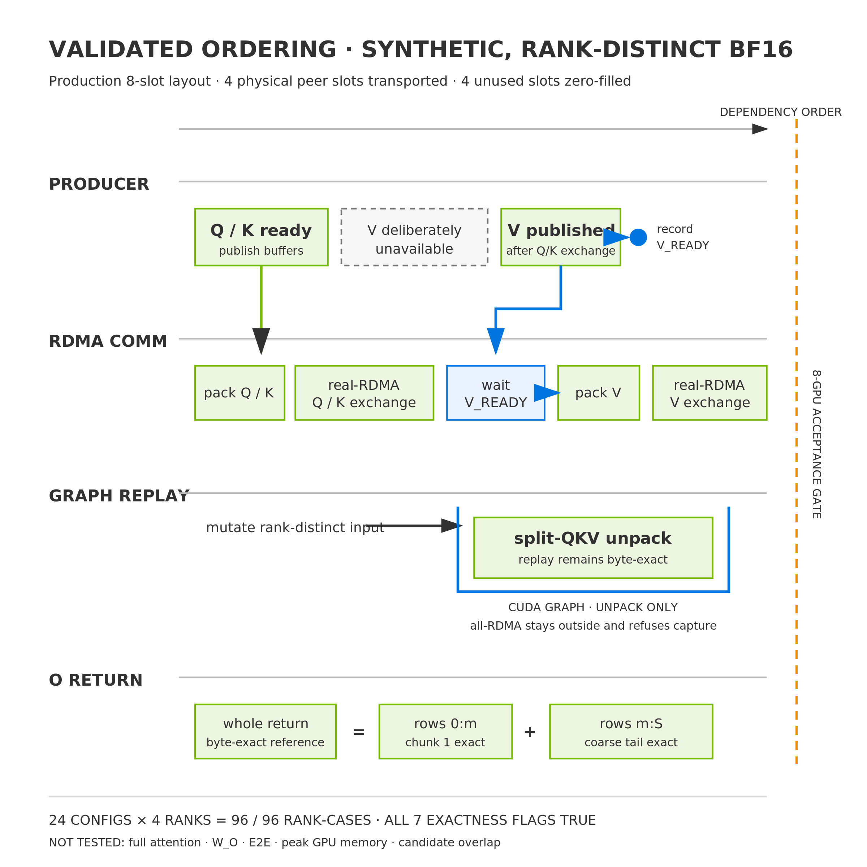
RDMA Precheck for the A2A Critical Path
4-GPU real-RDMA · 96/96 rank-cases exact · 8-GPU H3 candidate pending
Q / K FIRST
  V waits on an explicit CUDA event
GRAPH REPLAY
  Fixed-address unpack stays exact after input mutation
TILED O RETURN
  Whole and row-chunk returns match byte for byte
8-GPU ACCEPTANCE GATE
  Full attention + W_O · E2E · memory · Nsight overlap
4-GPU REAL-RDMA · 96 / 96 RANK-CASES EXACT
24 configs × 4 ranks · 8-GPU H3 candidate pending
Notes:
The transport precheck used four physical ranks and the real RDMA route with synthetic, rank-distinct BF16 inputs. Its 96 passing rank-cases are 24 distributed configurations observed on four ranks: two row counts, three head widths, two stream priorities and two phases. It retained the production eight-slot layout, transported physical peer slots zero through three and zero-filled the other receive slots. Q and K were exchanged while V contained NaNs; only after that exchange did a producer stream publish V and record a CUDA event, which the communication stream waited on before reading V. This proves ordering and synchronization, not concurrent V projection or overlap gain. The captured graph contains only fixed-address split-QKV unpack, which remained byte-exact after inputs changed and the graph replayed. The all-RDMA collective stays outside CUDA Graph capture and explicitly refuses capture because it posts mlx5 work requests and polls completion queues from the host. Whole output return and two row-chunk returns, including the repeated coarse tail, matched independent references byte for byte. These are transport and layout exactness results; full attention, W_O, end-to-end latency, peak memory and candidate overlap were not measured. The complete eight-GPU H3 candidate therefore remains pending. Evidence bundle: real-rdma-four-gpu-20261024-v2/summary.json.

Slide 12
Real-Time Demonstrated; Attribution Pending
Only Base50 is measured on the locked 960×544 / 124f request; optimized results retain their own workload contracts
STATUS | WORKLOAD CONTRACT | WITHIN-STUDY SYSTEM / COMPARISON | n | E2E · RTF | EVIDENCE BOUNDARY
MEASURED MATCHED | 960×544 · 124f @ 24 5.167 s · Miles image + voice seed 43 · independent request | Base50 · 50-step BF16 dense USP8 · local NCCL · no RDMA | 3 | 247.956 s median RTF 47.992 | Locked baseline only same MP4 hash across 3 formal runs 70.84 GiB max sampled device memory*
QUALIFIED SEPARATE · 15 s | 960×544 · 362f @ 24 15.083 s · Zhiwei image no voice reference | 8-step NVFP4-QAD + VSA NCCL control → RDMA / overlap / output pipeline | 3 / arm | 17.681 → 14.974 s mean RTF 1.172 → 0.993 | 3 / 3 final requests met the 15.083 s media budget not Base50 / 124f
QUALIFIED SEPARATE · 10 s | 960×544 · 243f @ 24 10.125 s · same input / seed within this study | Base50 BF16 TP8 → 4-step Turbo MXFP8 + dense Sage + RDMA stack | 1 / arm | 263.847 → 6.958 s RTF 26.059 → 0.687 | Paired endpoint proof many axes changed together; no stage attribution
QUALIFIED SEPARATE · PORTRAIT | 576×1024 · 124f window 119 new frames / 4.958 s Miles portrait + voice | 4-step MXFP8 BF16 Sage first-attn · NVFP4 VAE USP8 · RDMA · rolling continuation | 1 + 5 | 4.644 s initial 4.459 s continuation median RTF 0.899 | Portrait live feasibility no long-run P95 or matched Base50 arm
PENDING MATCHED GATE | Hold row-1 image · audio · prompt seed · shape · request mode fixed | PDD8 → VSA → QAD / Sage → RDMA + overlap | ≥3 / stage | E2E · RTF · peak GPU memory quality · Nsight | Publish a cumulative ladder only after every stage shares the same measurement contract
Notes:
Read this page as an evidence ledger, not as a performance ladder. Green means the exact locked benchmark. Blue means a result qualified inside its own study but not comparable with the green row. Orange is the acceptance work still required before we publish a cumulative optimization story.
Row A is the only current result on the locked MiniMax H3 Base Ref2VA request: 960 by 544, 124 frames at 24 FPS, 5.1667 seconds of media, the Miles reference image and voice, the locked prompt, seed 43, 50 denoising steps, BF16 dense attention, eight RTX PRO 5000 GPUs, TP1 and USP8, local NCCL, and no RDMA. After initialization and one warmup, three formal requests took 247.956, 246.201, and 248.298 seconds. The median is 247.956 seconds, or RTF 47.992. All three formal outputs and the warmup share the same MP4 SHA-256 and fully decode. The 70.84 GiB value is the maximum sampled whole-device reading across ranks over cold initialization and steady requests. It is not a PyTorch allocator high-water mark, and the ranks are materially imbalanced. Slide 6 reports the same run as 60,813 MiB steady and 72,539 MiB during cold initialization.
Row B is a different 15.083-second request: 960 by 544, 362 frames, one Zhiwei image, no external voice, an eight-forward NVFP4-QAD 36-layer decoder with VSA, and three samples per arm. Its original NCCL control averaged 17.681 seconds, while the final production arm averaged 14.974 seconds, changing RTF from 1.172 to 0.993. All three final requests met the 15.083-second media-duration budget. This is not sustained-stream evidence; the worst final request was 14.999848 seconds, only 0.152 milliseconds below a nominal 15.000-second threshold. The RDMA path also changes direct Ulysses layout handling, so its delta must not be described as isolated network transport.
Row C is internally paired but historical. Both arms use the same 960 by 544, 243-frame input and seed in that study. The original Base50 arm took 263.847 seconds; a distinct four-step Turbo, MXFP8, dense-Sage, NVFP4-VAE, TP1/SP8 and RDMA production stack took 6.958 seconds. RTF moves from 26.059 to 0.687. There is one formal sample per arm, and many material axes change together. This proves endpoint feasibility for that study, not a PDD8, VSA, QAD, Sage, or RDMA ablation.
Row D is the portrait live-avatar workload: 576 by 1024, a 124-frame request window with five-frame overlap, and therefore 119 new frames or 4.958 seconds of new media per continuation. It uses a four-step MXFP8 stack, BF16 Sage on the first sensitive attention path, NVFP4 video VAE, USP8 and RDMA. The initial request took 4.644 seconds. Five continuations have a 4.459-second median and RTF 0.899. The n label 1 + 5 means one initial request plus five continuation requests; it is not six steady samples. This is useful live-feasibility evidence, but it has no matched Base50 arm, no long-run P95, and no complete perceptual or lip-sync qualification.
The orange row is the publication gate. Keep the row-A image, audio, prompt, seed, geometry, frame count, request mode, hardware placement, timing boundary and memory method fixed. Measure Base50, PDD8, PDD8 plus VSA, the selected QAD or Sage path, and the RDMA plus overlap path with at least three steady requests per stage. Record end-to-end latency, RTF, peak GPU memory under one method, output exactness or a stated quality metric, and matched Nsight cost centers and overlap. Only then may these stages be connected as a cumulative waterfall.
The four-GPU real-RDMA precheck on the previous slide is correctness-only and is therefore absent from the performance rows. It did not run the full eight-GPU H3 model, measure end-to-end latency, or measure overlap. The 87.11 percent overlap value belongs to the separate 362-frame QAD trace and must not be attached to the Base50 row. A successful 1344 by 768 PDD8/VSA BF16 study is also component evidence only and does not fill a stage in the locked 544P chain.
Visible footer note: the 70.84 GiB value is the whole-device nvidia-smi maximum across cold and steady execution, not allocator high-water. Rows B through D are independent evidence, not a staged sequence.

Slide 13
02 · vLLM-Omni
ComfyUI Apps
Notes:
Part two focuses on ComfyUI workflows backed by vLLM-Omni multi-GPU serving, beginning with the public MiniMax H3 character-replacement work in PR #9194.

Slide 14


vLLM-Omni Connects ComfyUI to Multi-GPU H3 Serving
Open PR #9194: character replacement, continuation-aware references, and chainable LoRA controls
Official vLLM-Omni Architecture
ComfyUI Workflow · PR #9194
ComfyUI remains the visual frontend; vLLM-Omni owns model execution, scheduling, and multi-GPU deployment
Single- and multi-character replacement, source-derived duration, long-video continuation, and LoRA controls
Notes:
This slide opens part two. It uses the official vLLM-Omni architecture and the public PR #9194 ComfyUI character-replacement workflow. The pull request is open as of October 24, 2026.

