Slide 1

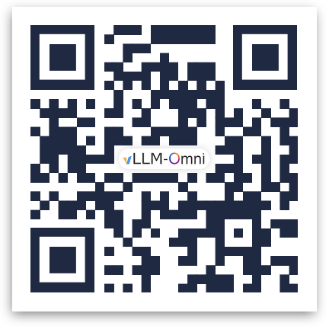


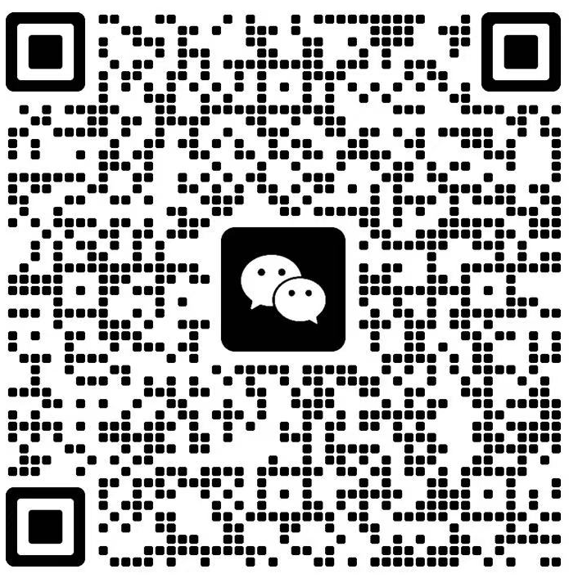

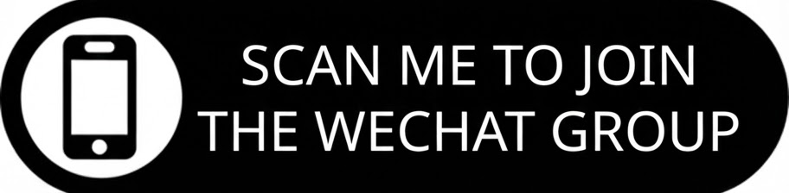
vLLM Networking Hour!
https://github.com/vllm-project/vllm-omni
https://blog.vllm.ai/2025/11/30/vllm-omni.html
https://communityinviter.com/apps/vllm-dev/join-vllm-developers-slack

