Slide 1
Real-Time Video
Inference on 8×
NVIDIA RTX PRO 5000
MiniMax H3 with vLLM-Omni
Shunyang Li | Public Technical Brief | October 2026
Notes:
Opening: this talk examines how an eight-GPU Blackwell workstation serves a long-sequence audiovisual generator in real time.

Slide 2

Real-Time 768p: The Full Pipeline Must Fit Within the Clip Duration
For 362 frames at 24 FPS, the encoder, eight DiT steps, communication, and VAE decode share one 15.08 s end-to-end budget.
REAL-TIME DEFINITION
MINIMAX H3-BASE · OFFICIAL ARCHITECTURE
RTF = end-to-end latency ÷ media duration ≤ 1.0
32B ENCODER
33B DENSE DiT × 50
VISUAL + AUDIO VAE
768p · 362 frames @ 24 FPS · 15.08 s media → ≤ 15.08 s end to end
PUBLISHED VIDEO DENOISER SCALE · BILLION PARAMETERS
0
10
20
30
MiniMax H3
33B dense
Wan2.2 A14B
27B total / 14B active
LTX-2.5
22B*
HunyuanVideo
13B
*LTX-2.5 uses the official 22B checkpoint designation. Parameter count is a scale proxy; architecture, active paths, sequence length, and denoising steps determine actual FLOPs.
Largest dense video transformer in this peer set: 33B
MODEL RESIDENCY
At native 768p, the dense generator operates over long audio-video sequences; the initial open release uses full attention, making tensor throughput and memory movement first-order serving constraints.
≈130 GB
raw BF16 weights for the 32B encoder + 33B generator—about 1.8× one 72 GB GPU—before Visual/Audio VAE, activations, attention workspace, and graph pools
Stage placement, precision, offload, and workspace reuse are therefore part of performance. About 13B H3 AdaLN parameters can be precomputed and cached for inference-only deployment.
2
Sources: official MiniMax H3, LTX-2.5, HunyuanVideo and Wan2.2 repositories · author 362-frame workload
Notes:
Real-time is defined as RTF = end-to-end generation latency divided by finished-media duration, with RTF <= 1.0. The 15.08 s example is 362 frames at 24 FPS. Parameter bars compare published video-generation transformer sizes, not full serving stacks or measured FLOPs. H3 is 33B dense with about 13B in AdaLN branches whose outputs can be precomputed and cached for inference-only deployment. Wan2.2 A14B is 27B total and 14B active per denoising step. LTX-2.5 uses its official 22B checkpoint designation. Sources: https://huggingface.co/MiniMaxAI/MiniMax-H3 ; https://huggingface.co/Lightricks/LTX-2.5 ; https://github.com/Wan-Video/Wan2.2 ; https://github.com/Tencent-Hunyuan/HunyuanVideo

Slide 3
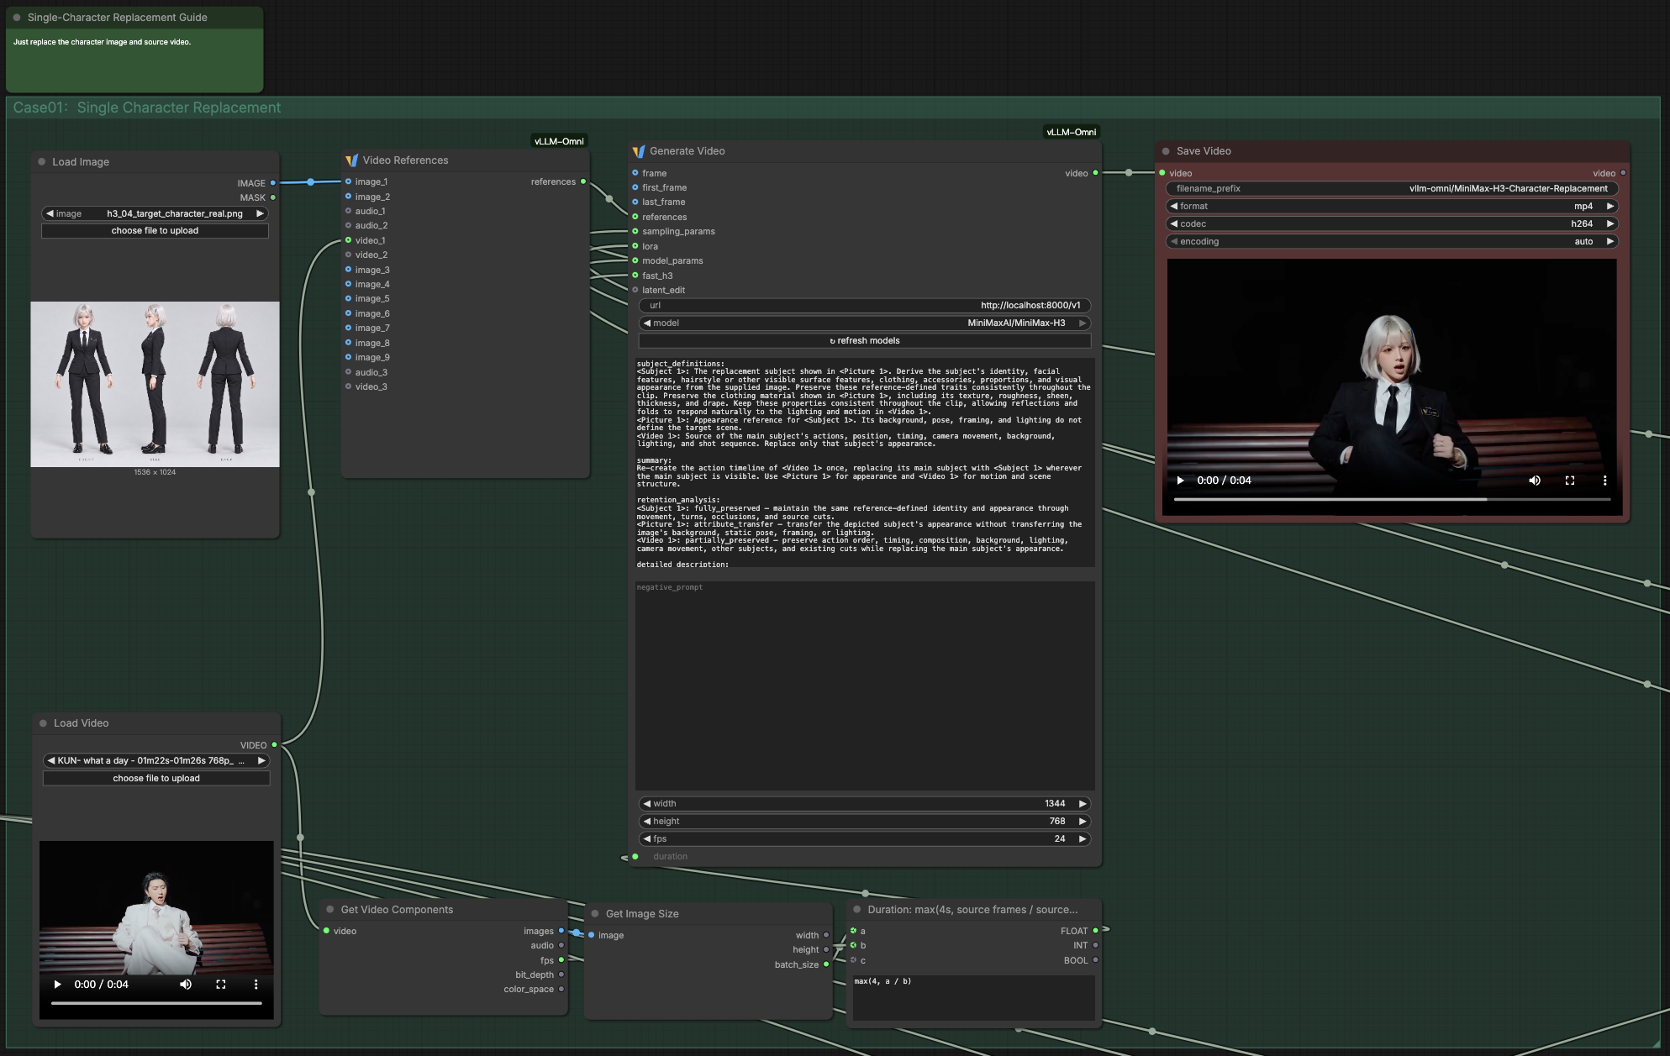
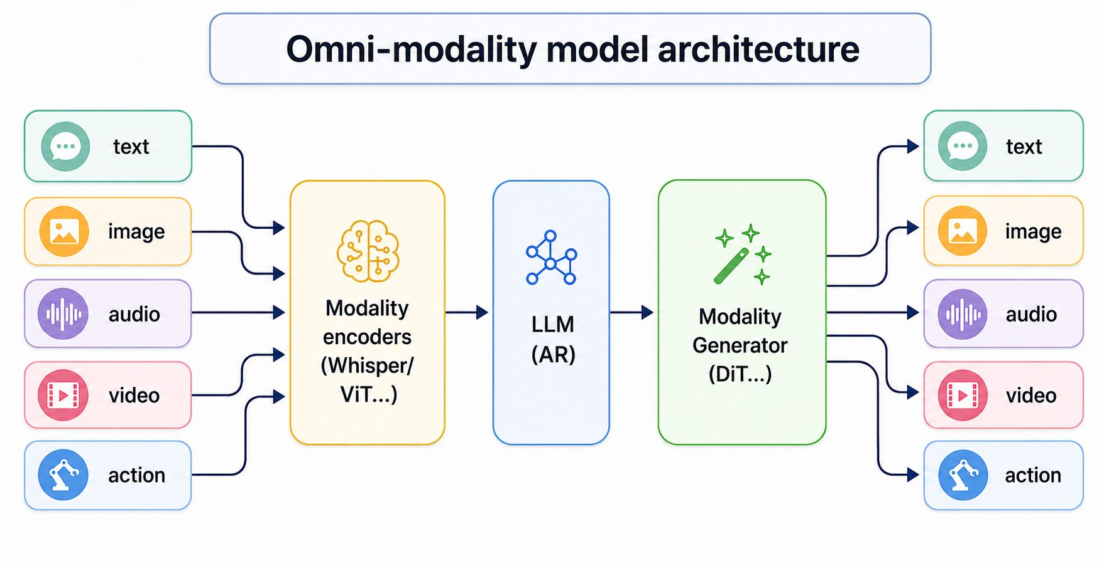
vLLM-Omni Connects Visual Workflows to Multi-GPU Serving
ComfyUI remains the authoring surface; vLLM-Omni owns serving, stage placement, batching, and multi-GPU execution
OFFICIAL vLLM-OMNI ARCHITECTURE
COMFYUI WORKFLOW · PR #9194
One serving layer spans omni-modal inputs, autoregressive reasoning, and DiT generation.
MiniMax-H3 character replacement calls the vLLM-Omni Generate Video endpoint; PR #9194 remains open.
3
Sources: vLLM-Omni v0.26 public deck, slide 22 · vLLM-Omni PR #9194 (open)
Notes:
This slide uses the template's standard 2-up Image 16:9 layout. Both visuals are copied directly from public vLLM-Omni materials: the official architecture figure and the PR #9194 ComfyUI workflow screenshot.

Slide 4
Frontier Models · The Cards
One Blackwell architecture (CC 12.0/12.1) spans several very different deployment envelopes
SKU | CC / SMs | Memory | Power | Interconnect
RTX PRO 5000 Blackwell 8-GPU baseline | 12.0 / 110 | 72 GB GDDR7 ECC 48 GB variant | 350 W configured* 300 W public TBP | PCIe Gen5 ×16 no GPU NVLink
RTX PRO 6000 Blackwell WS / Server | 12.0 / 188 | 96 GB GDDR7 ECC | 600 W | PCIe Gen5 ×16 no GPU NVLink
GeForce RTX 5090 | 12.0 / 170 | 32 GB GDDR7 | 575 W | PCIe Gen5 ×16 NVLink: no
DGX Spark · GB10 | 12.1 / 48 | 128 GB unified LPDDR5X | 140 W SoC 240 W system | NVLink-C2C in SoC 200 Gb/s ConnectX-7
SHARED BY DISCRETE CARDS · BLACKWELL FP4 · GDDR7 · PCIe GEN5 · NO GPU-TO-GPU NVLINK
Watch sustained clocks, not peak TOPS: controlled tensor-heavy tests reported SwPowerCap in 94.8–100% of valid samples; one rank stayed at 1.942 GHz and ran the same fine-attention input 6.78% slower. A 600 W-class design offers more headroom, but still requires a matched chassis A/B.
*350 W is the local configured/enforced limit; NVIDIA publicly specifies 300 W TBP for RTX PRO 5000.
4
Notes:
The template's native Table Example is reused directly. NVIDIA publicly specifies 300 W TBP for RTX PRO 5000; the local eight-GPU system reports a 350 W configured/enforced power limit, so both values are labeled rather than conflated. SwPowerCap is reported as the share of valid NVML samples, not exact time under cap.

