Slide 1
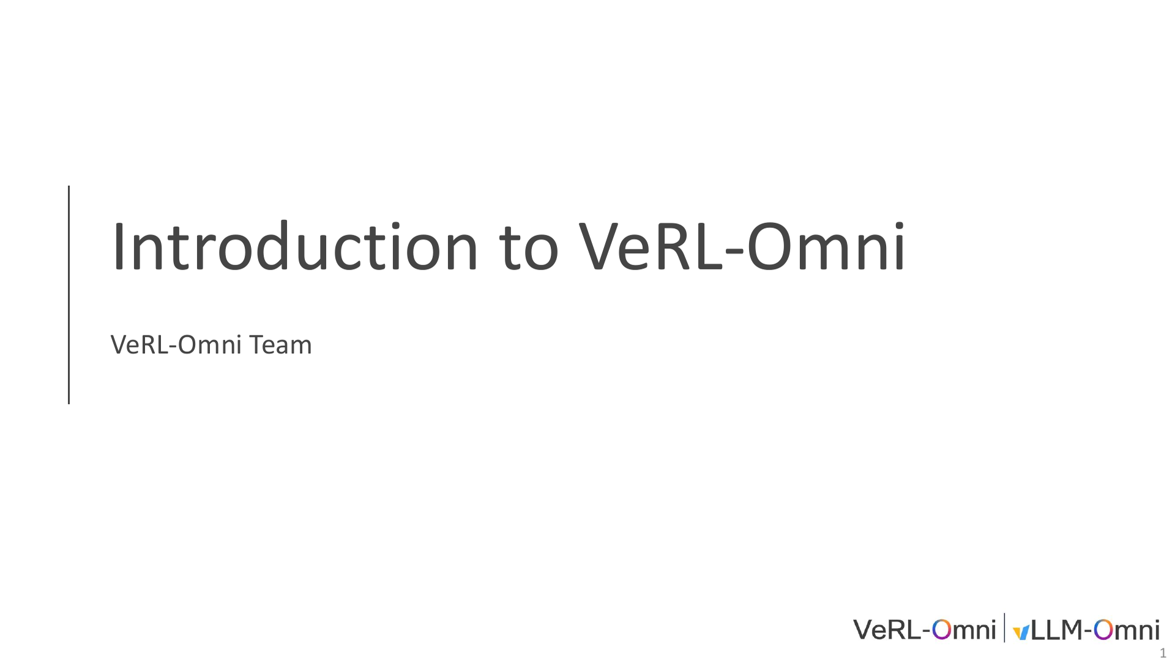
Notes:
1/34 · IntroductiontoVeRL-Omni

Slide 2
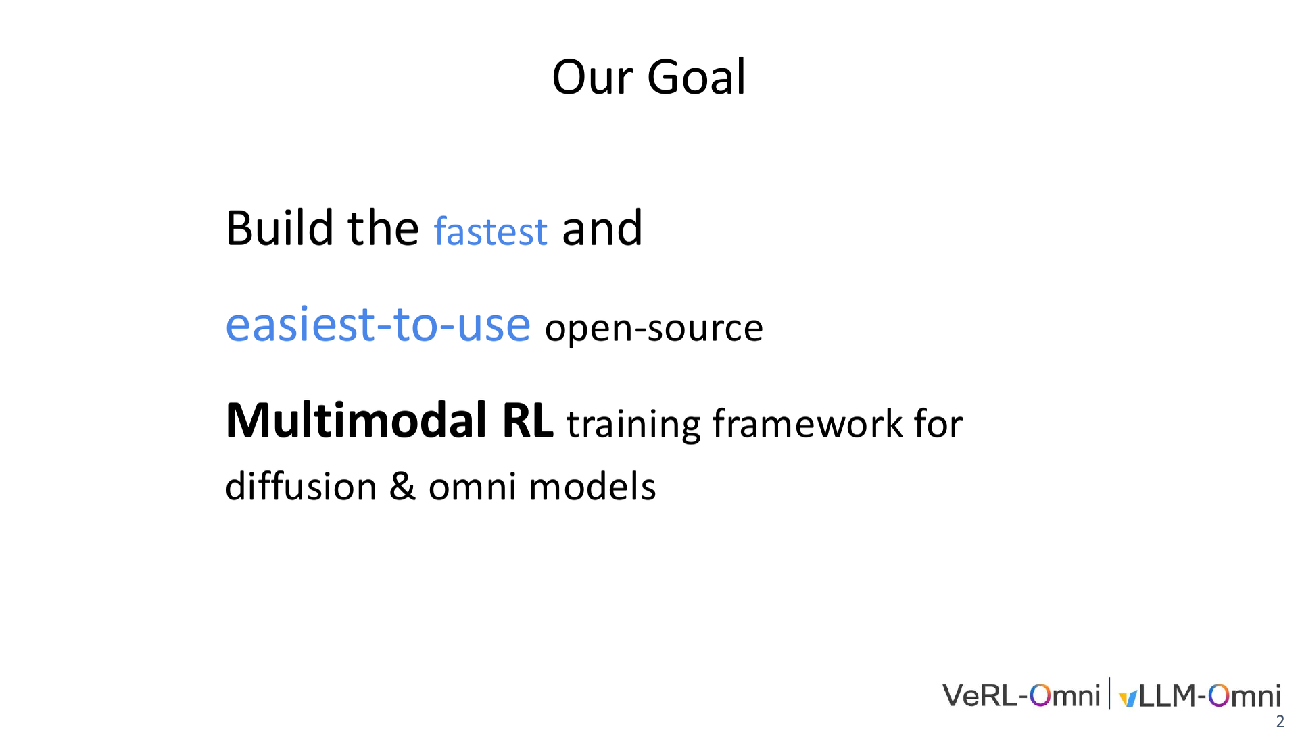
Notes:
2/34 · Our Goal

Slide 3
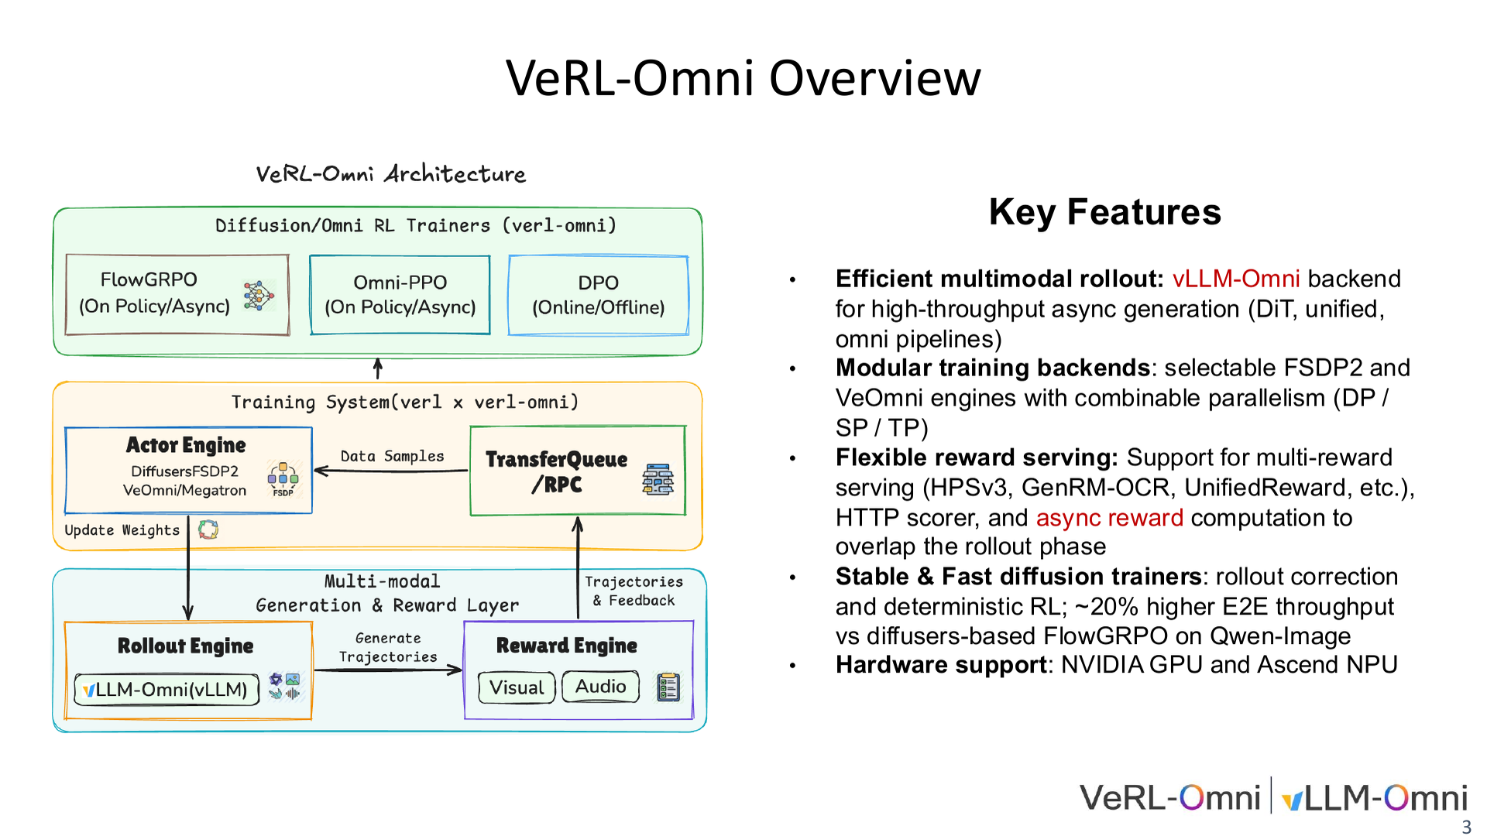
Notes:
3/34 · Key Features

Slide 4
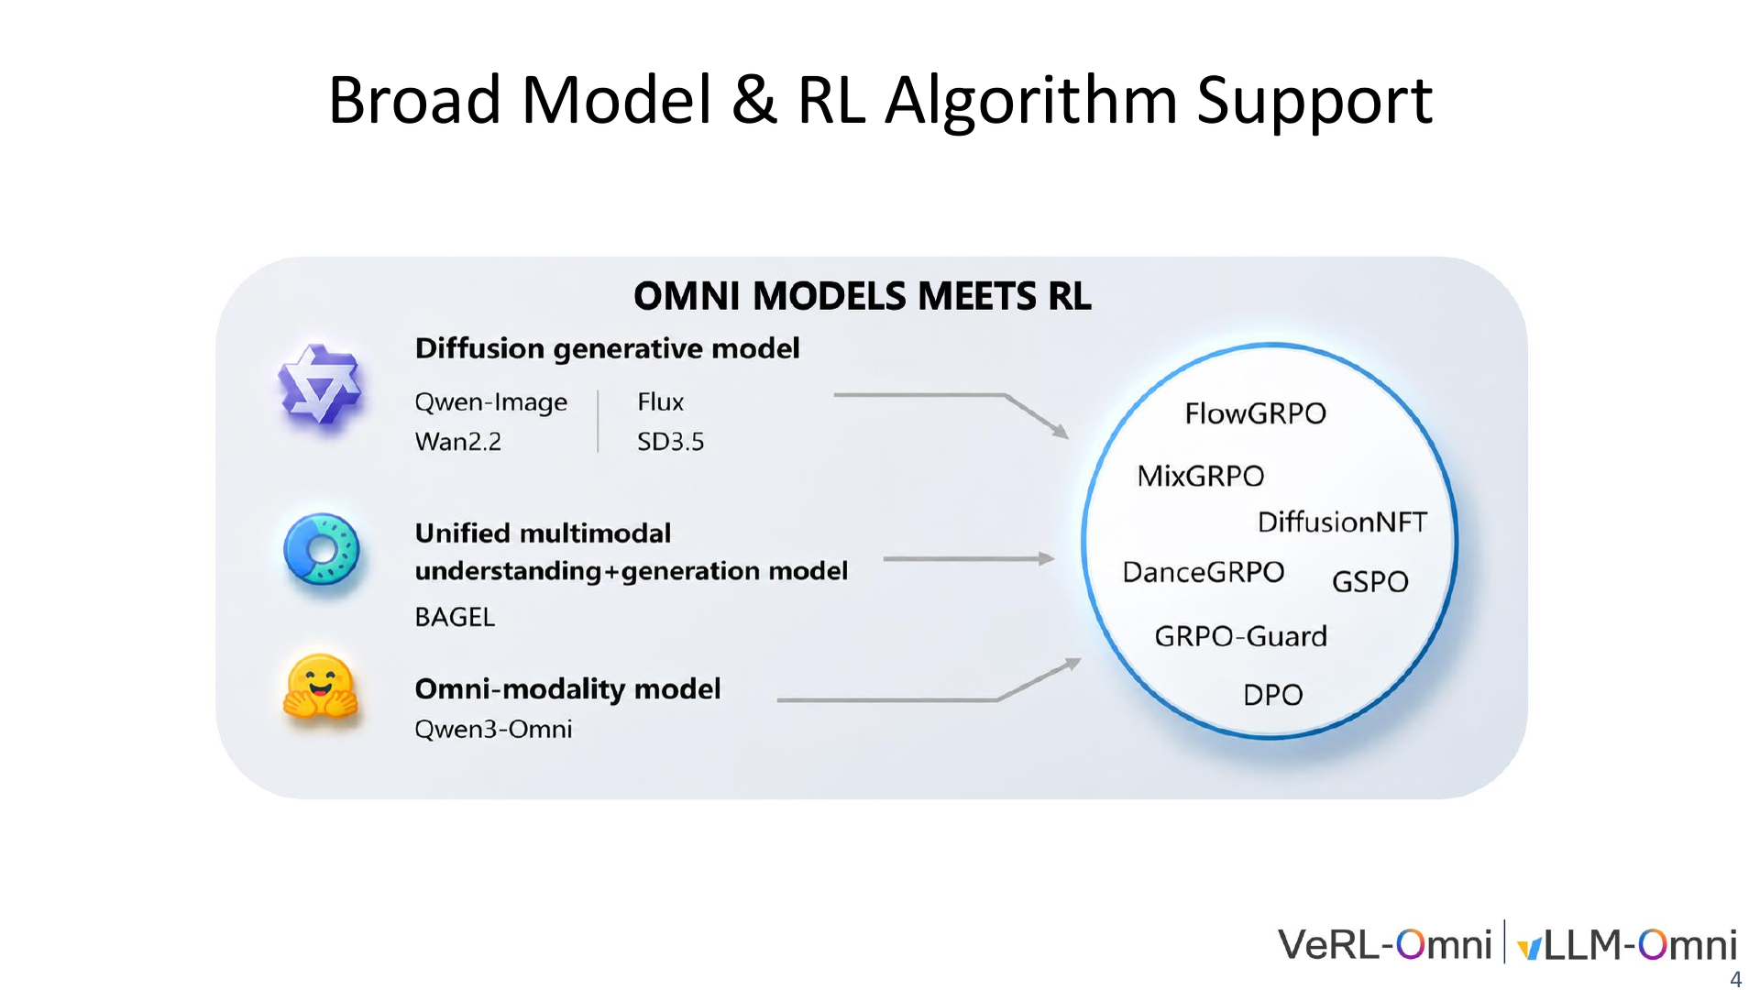
Notes:
4/34 · BroadModel&RLAlgorithmSupport

Slide 5
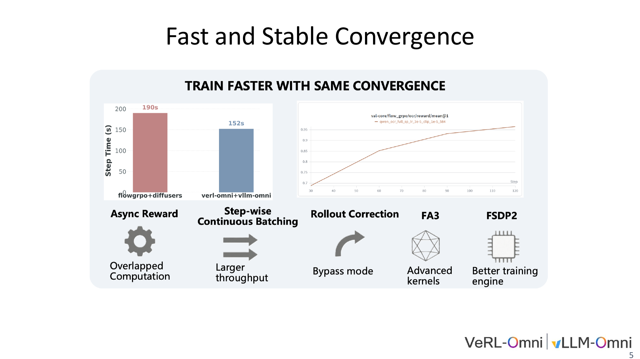
Notes:
5/34 · FastandStableConvergence

Slide 6
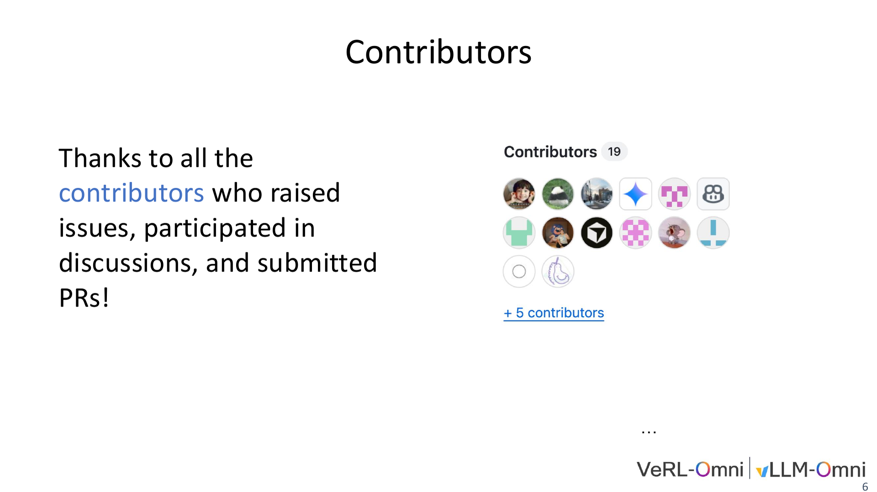
Notes:
6/34 · Contributors

Slide 7
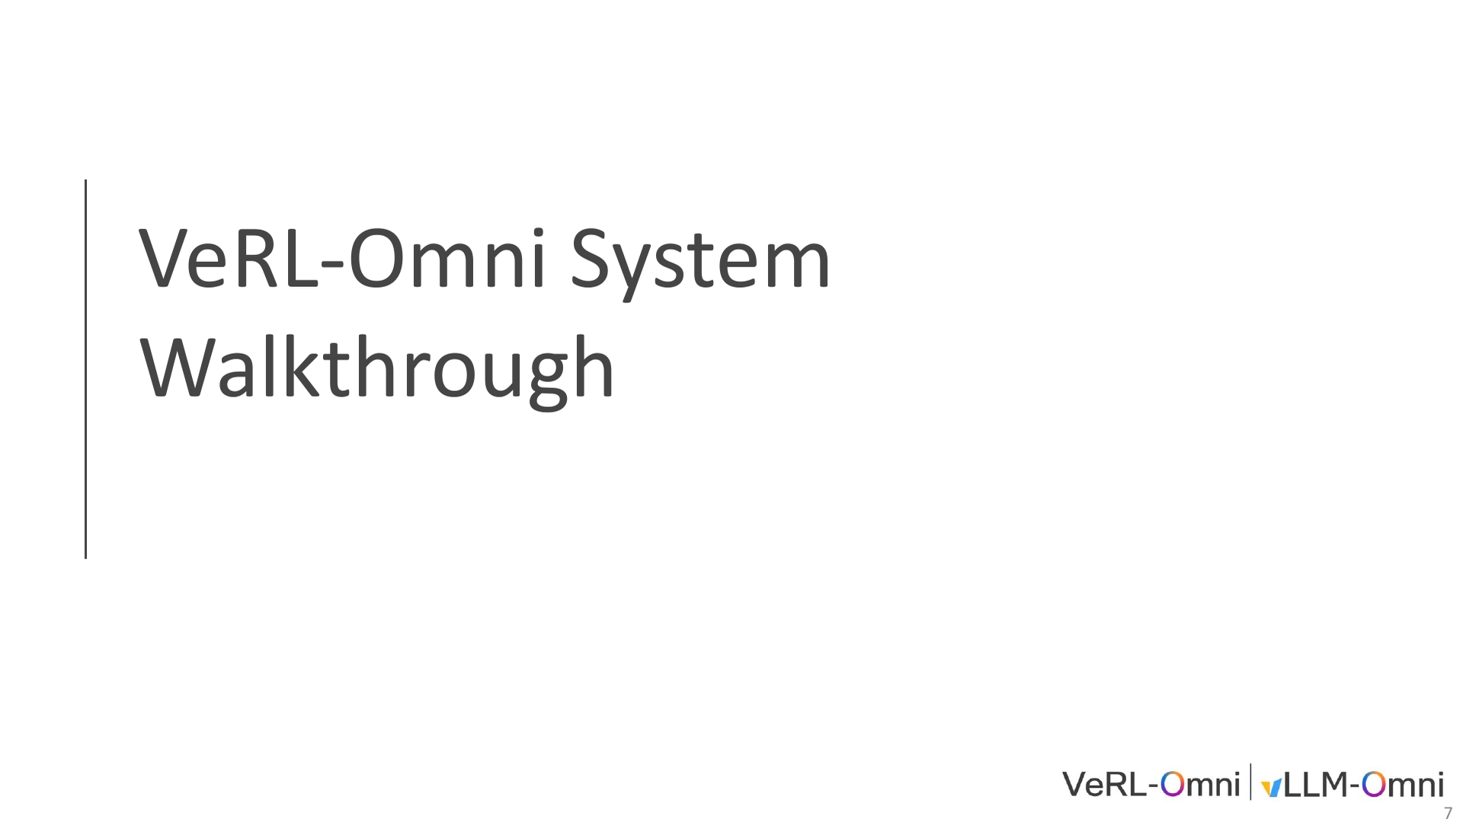
Notes:
7/34 · VeRL-Omni System

Slide 8
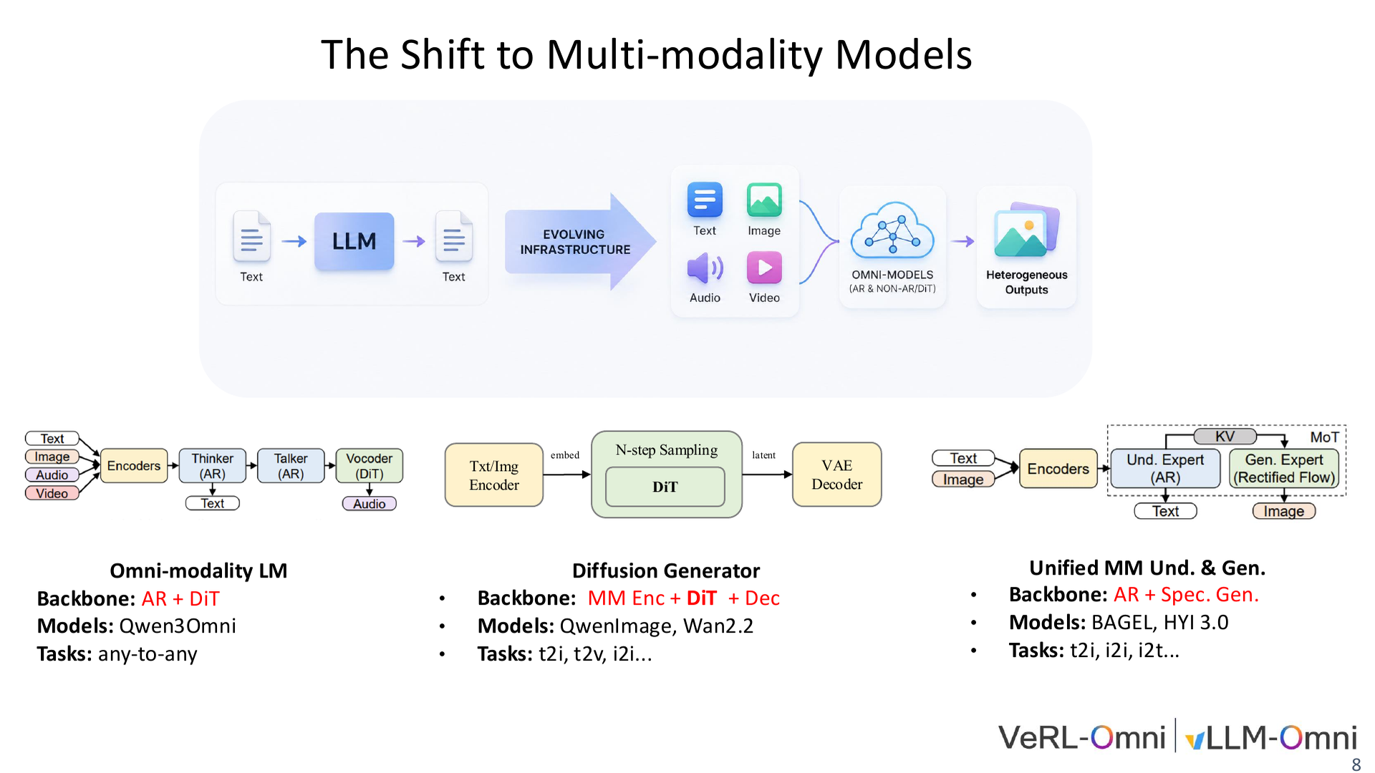
Notes:
8/34 · TheShifttoMulti-modalityModels

Slide 9
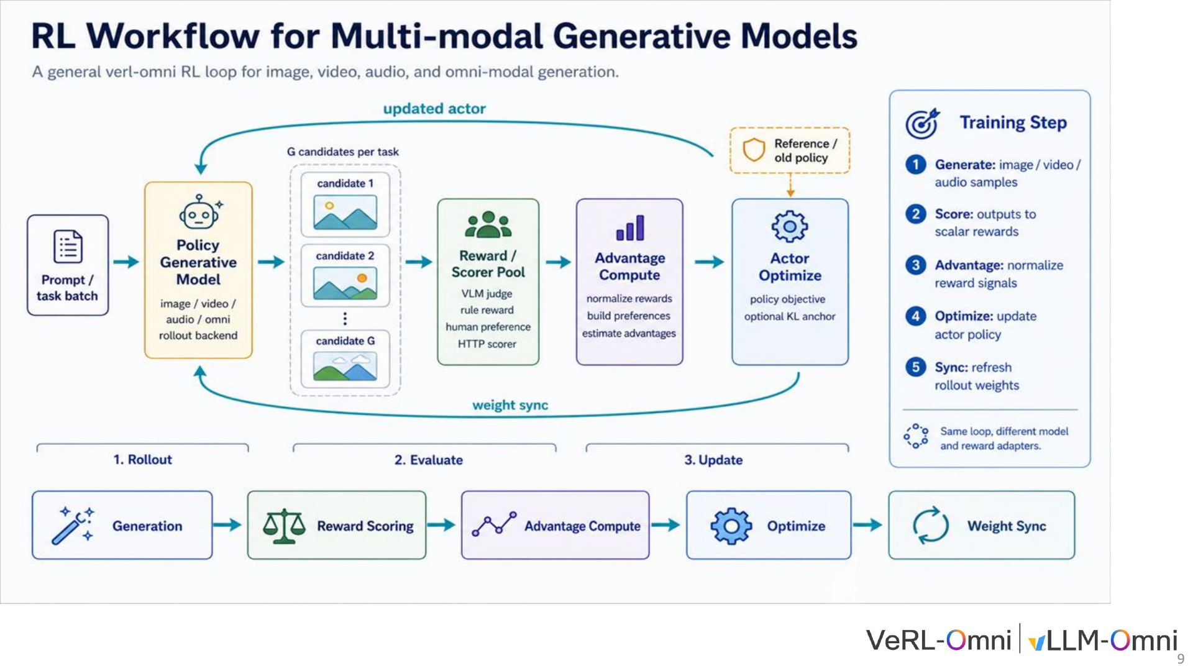
Notes:
9/34 · 9

Slide 10
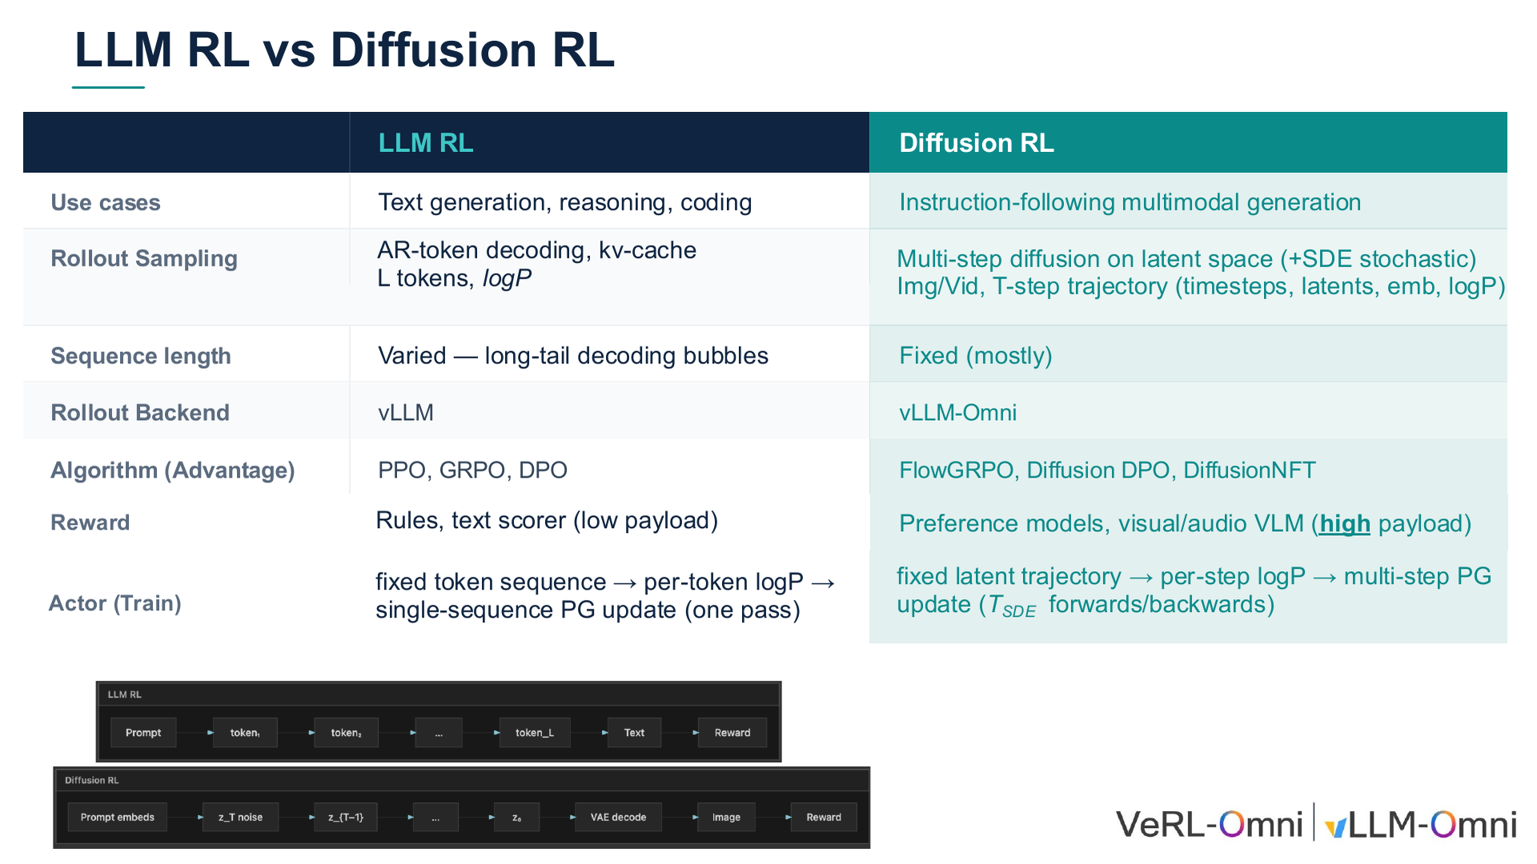
Notes:
10/34 · LLMRL vs DiffusionRL

Slide 11
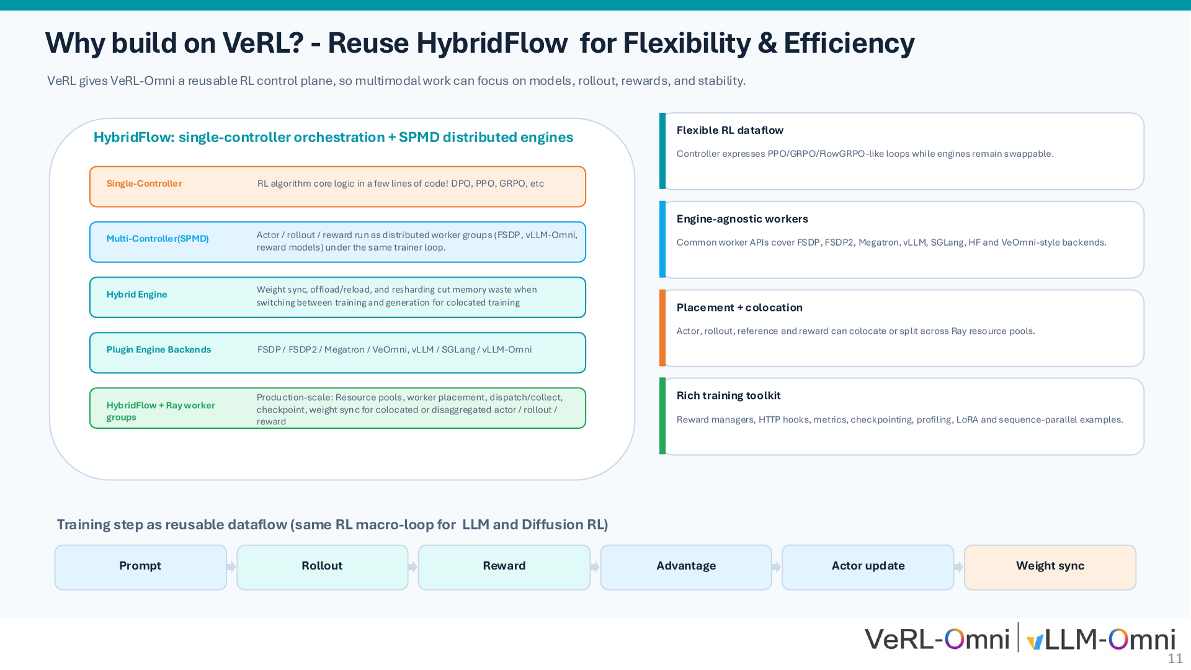
Notes:
11/34 · Why build on VeRL?-ReuseHybridFlow forFlexibility&Efficiency

Slide 12
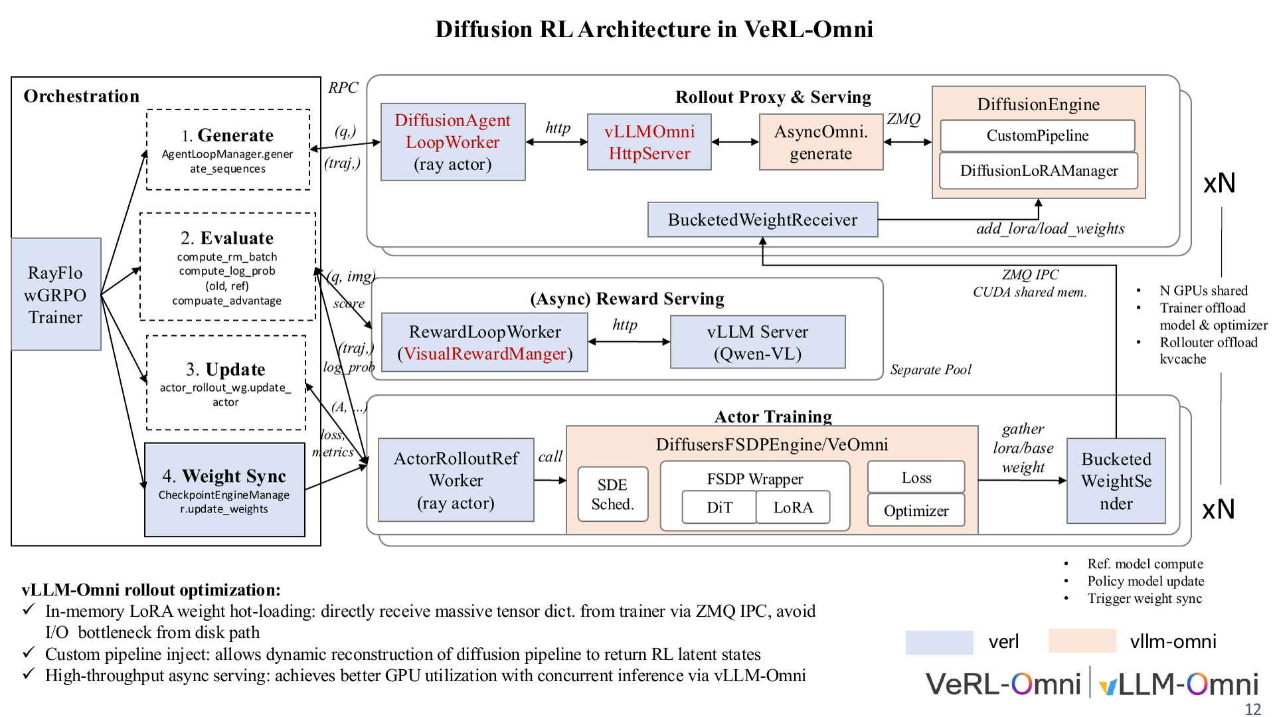
Notes:
12/34 · RolloutProxy&ServingActorTraining

Slide 13
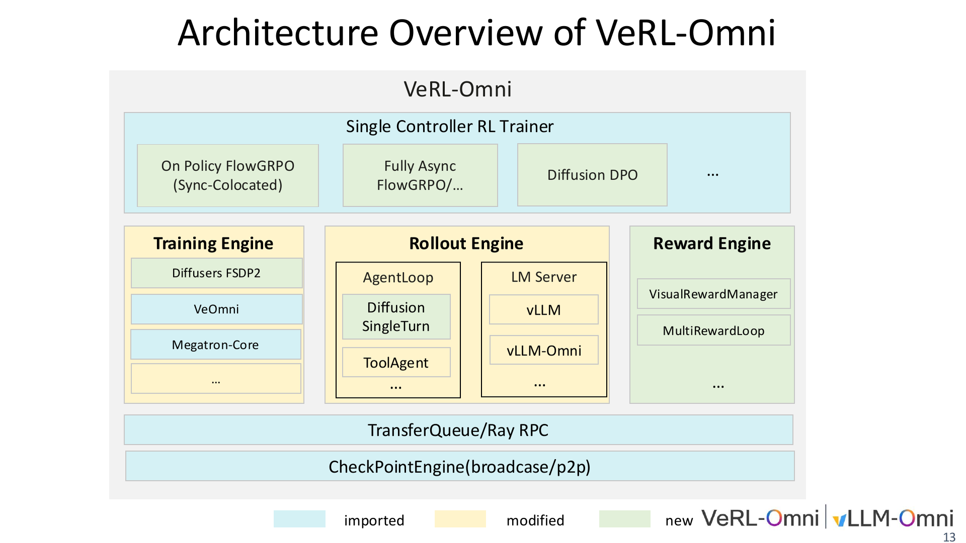
Notes:
13/34 · Architecture Overviewof VeRL-Omni

Slide 14
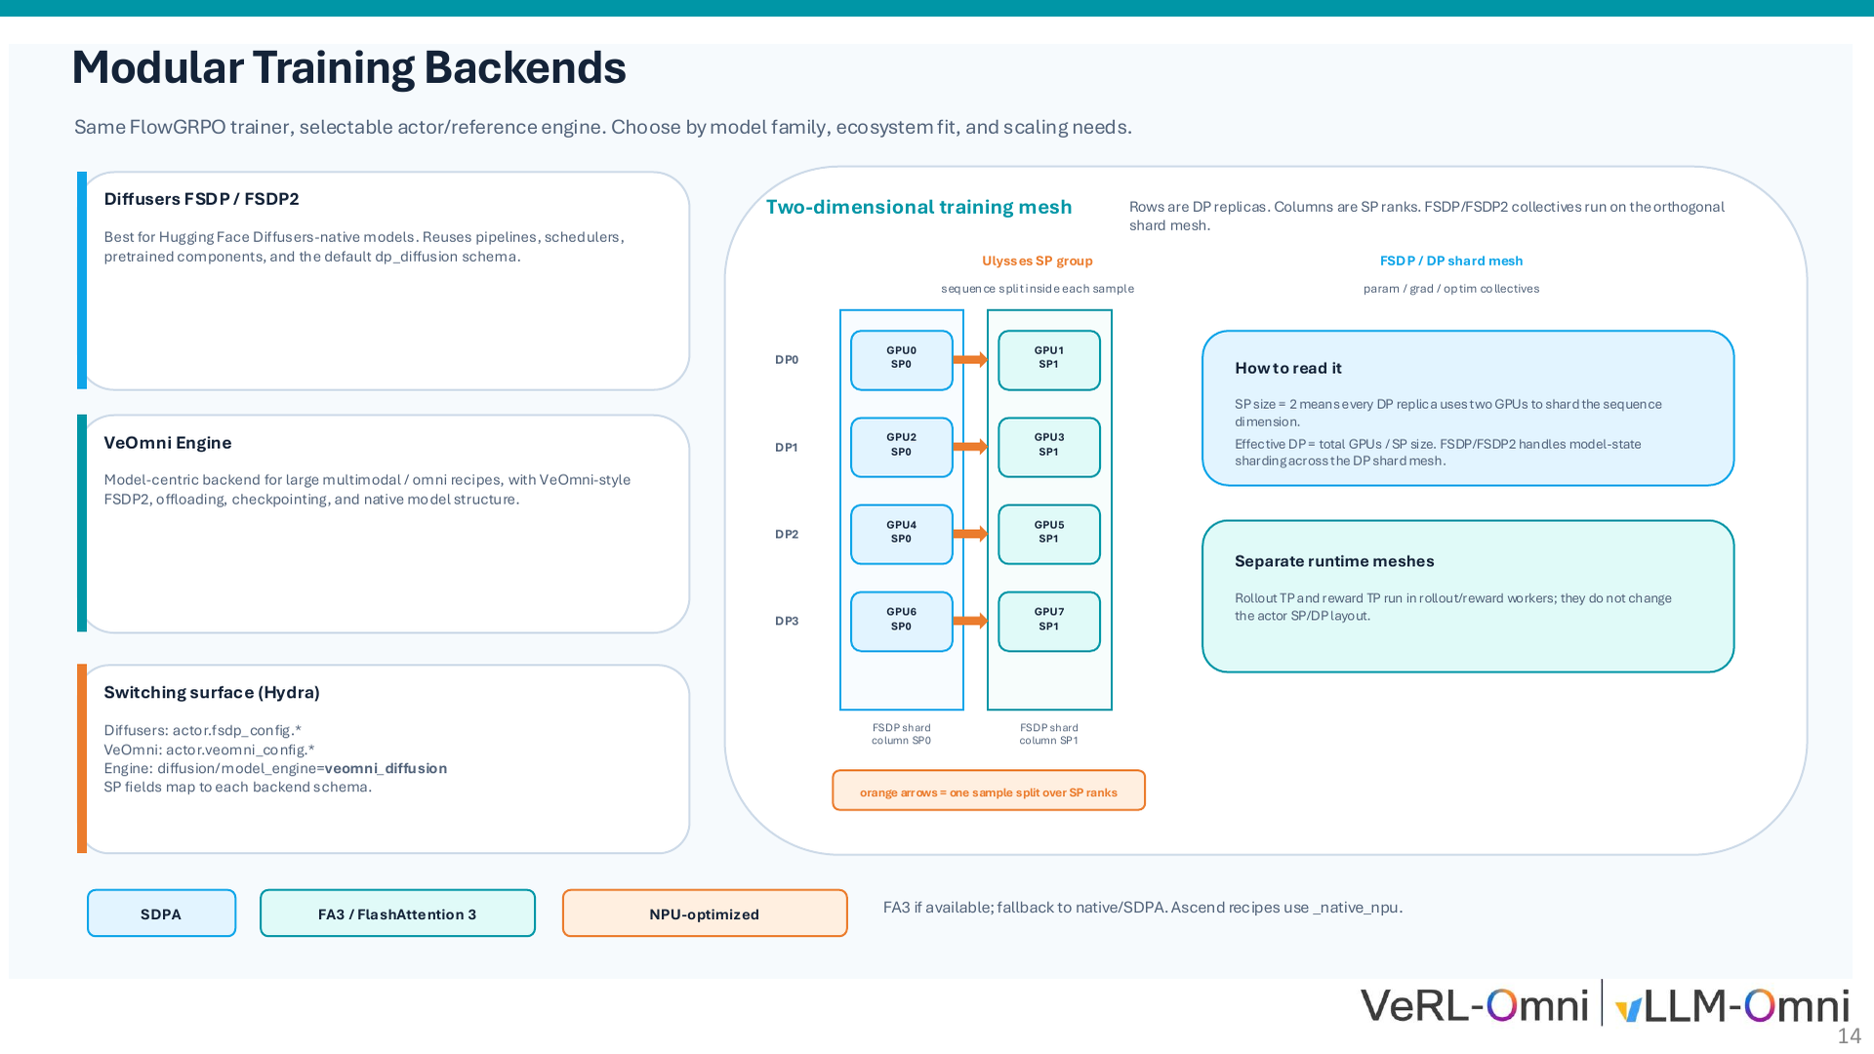
Notes:
14/34 · Modular Training Backends

Slide 15
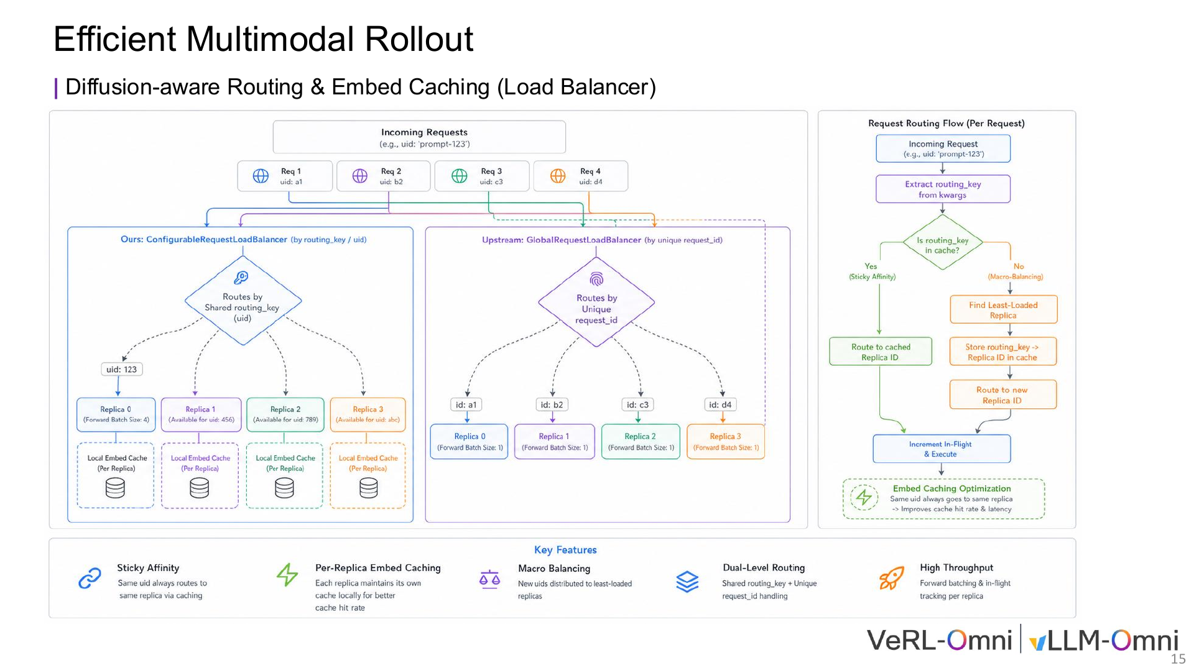
Notes:
15/34 · EfficientMultimodalRollout

Slide 16
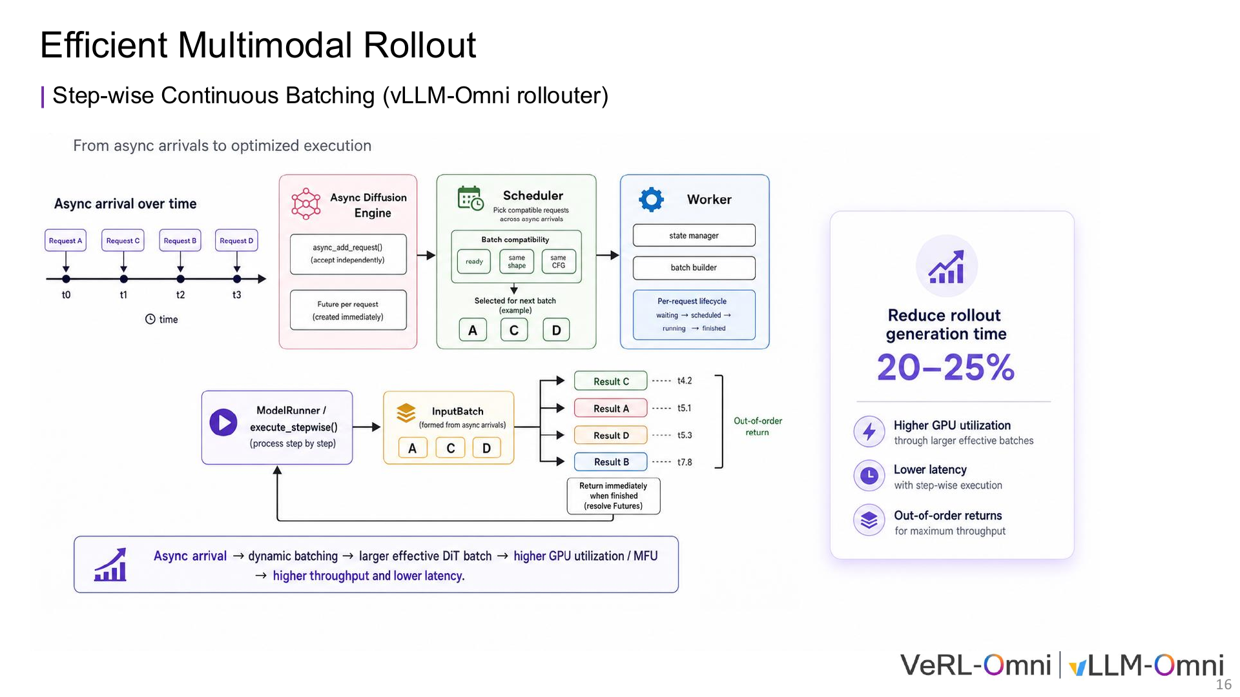
Notes:
16/34 · EfficientMultimodalRollout

Slide 17
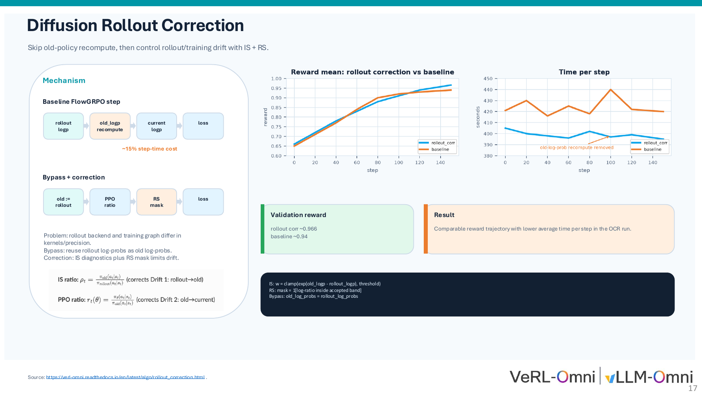
Notes:
17/34 · Diffusion Rollout Correction

Slide 18
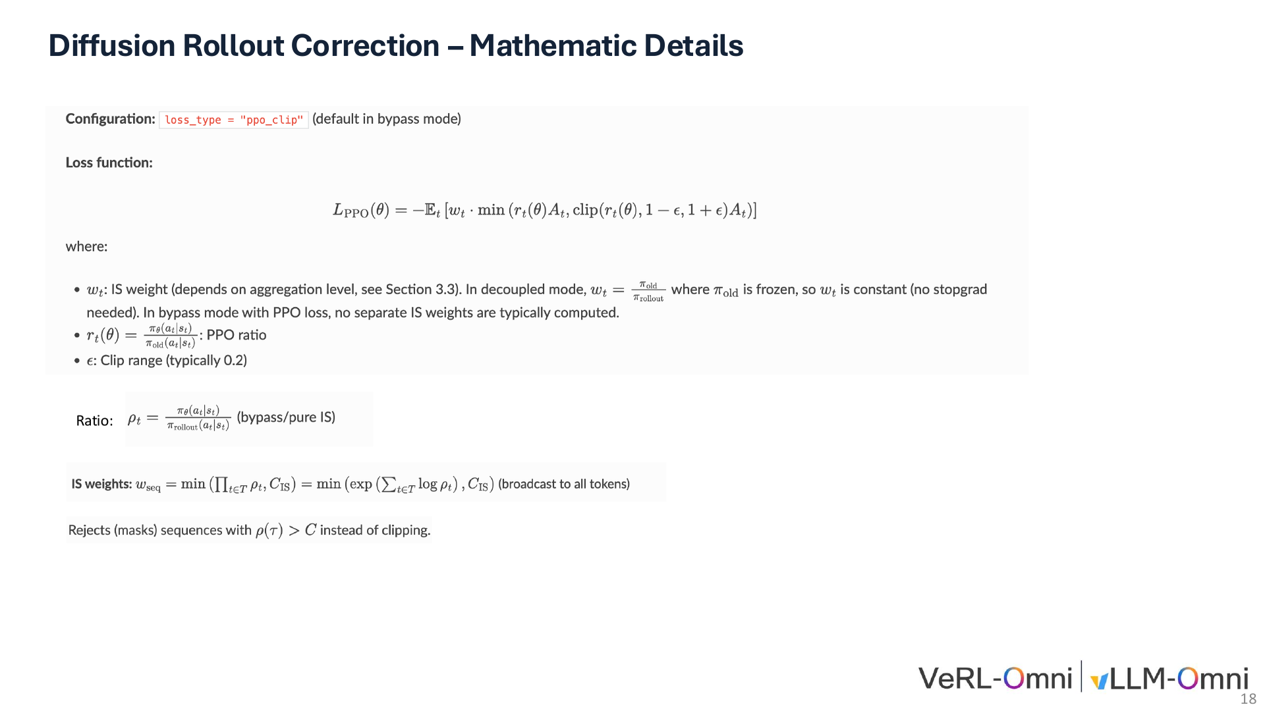
Notes:
18/34 · Diffusion Rollout Correction–MathematicDetails

Slide 19
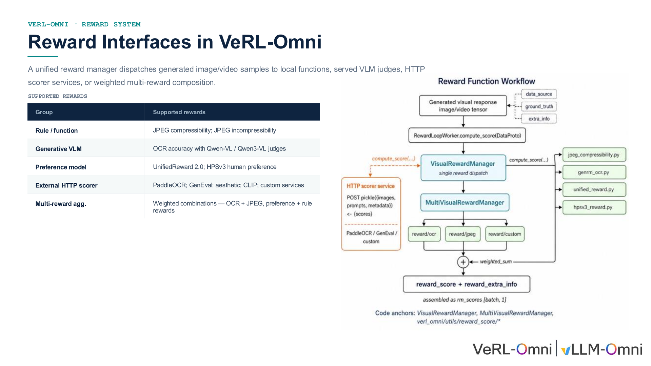
Notes:
19/34 · VERL-OMNI · REWARD SYSTEM

Slide 20
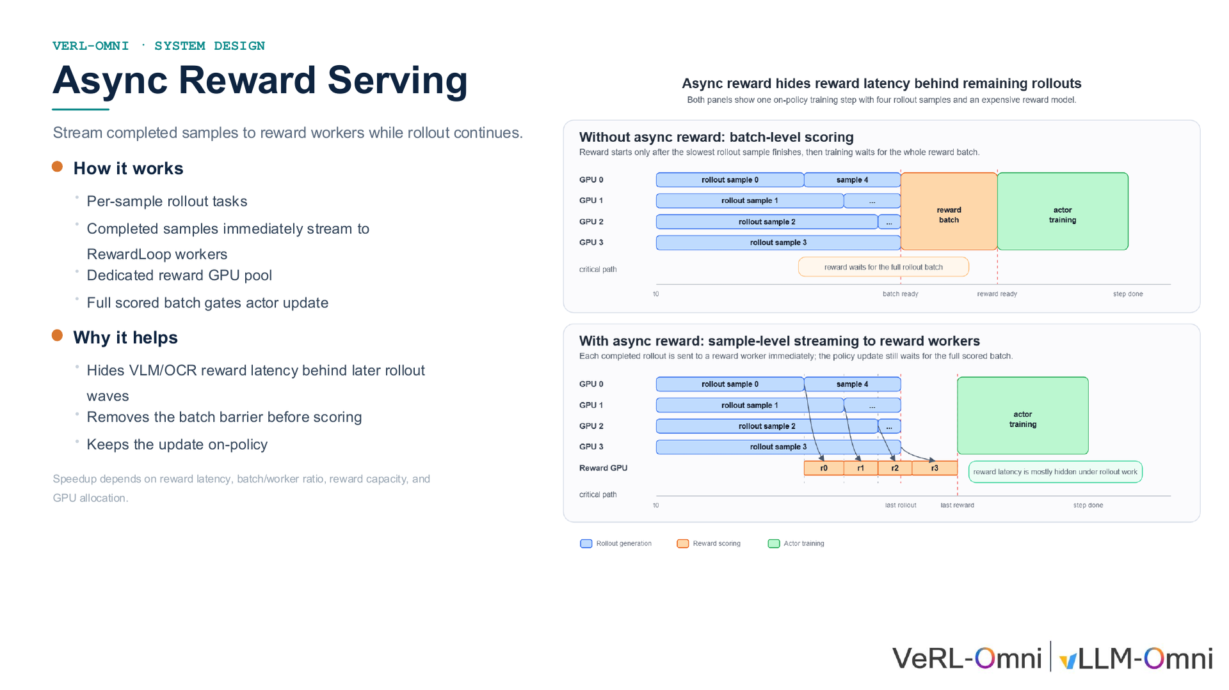
Notes:
20/34 · VERL-OMNI · SYSTEM DESIGN

Slide 21
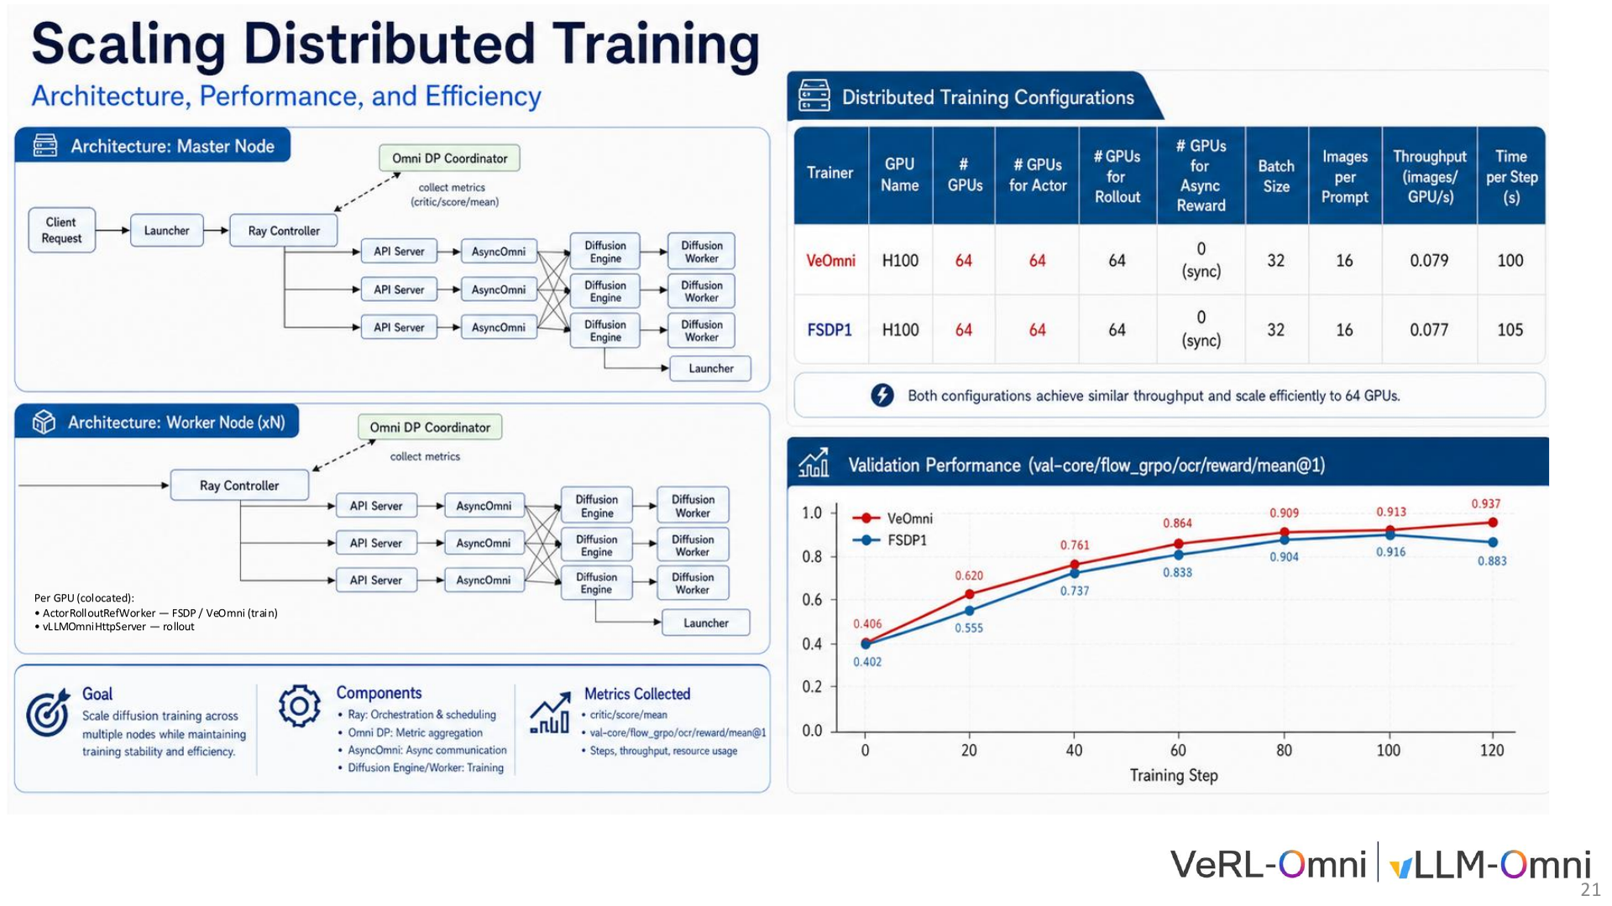
Notes:
21/34 · Per GPU (colocated):

Slide 22
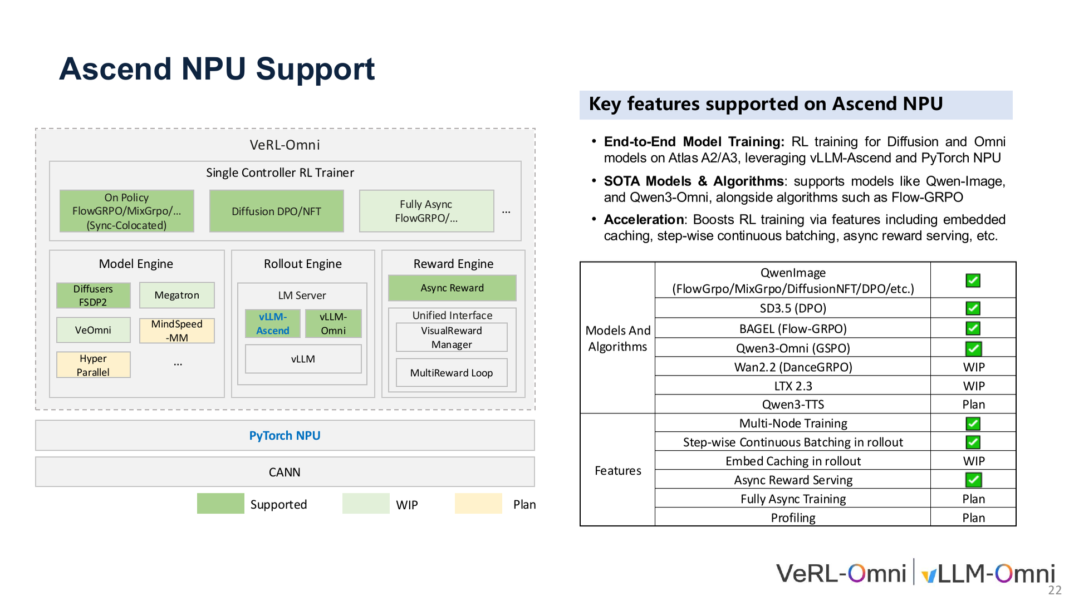
Notes:
22/34 · AscendNPUSupport

Slide 23
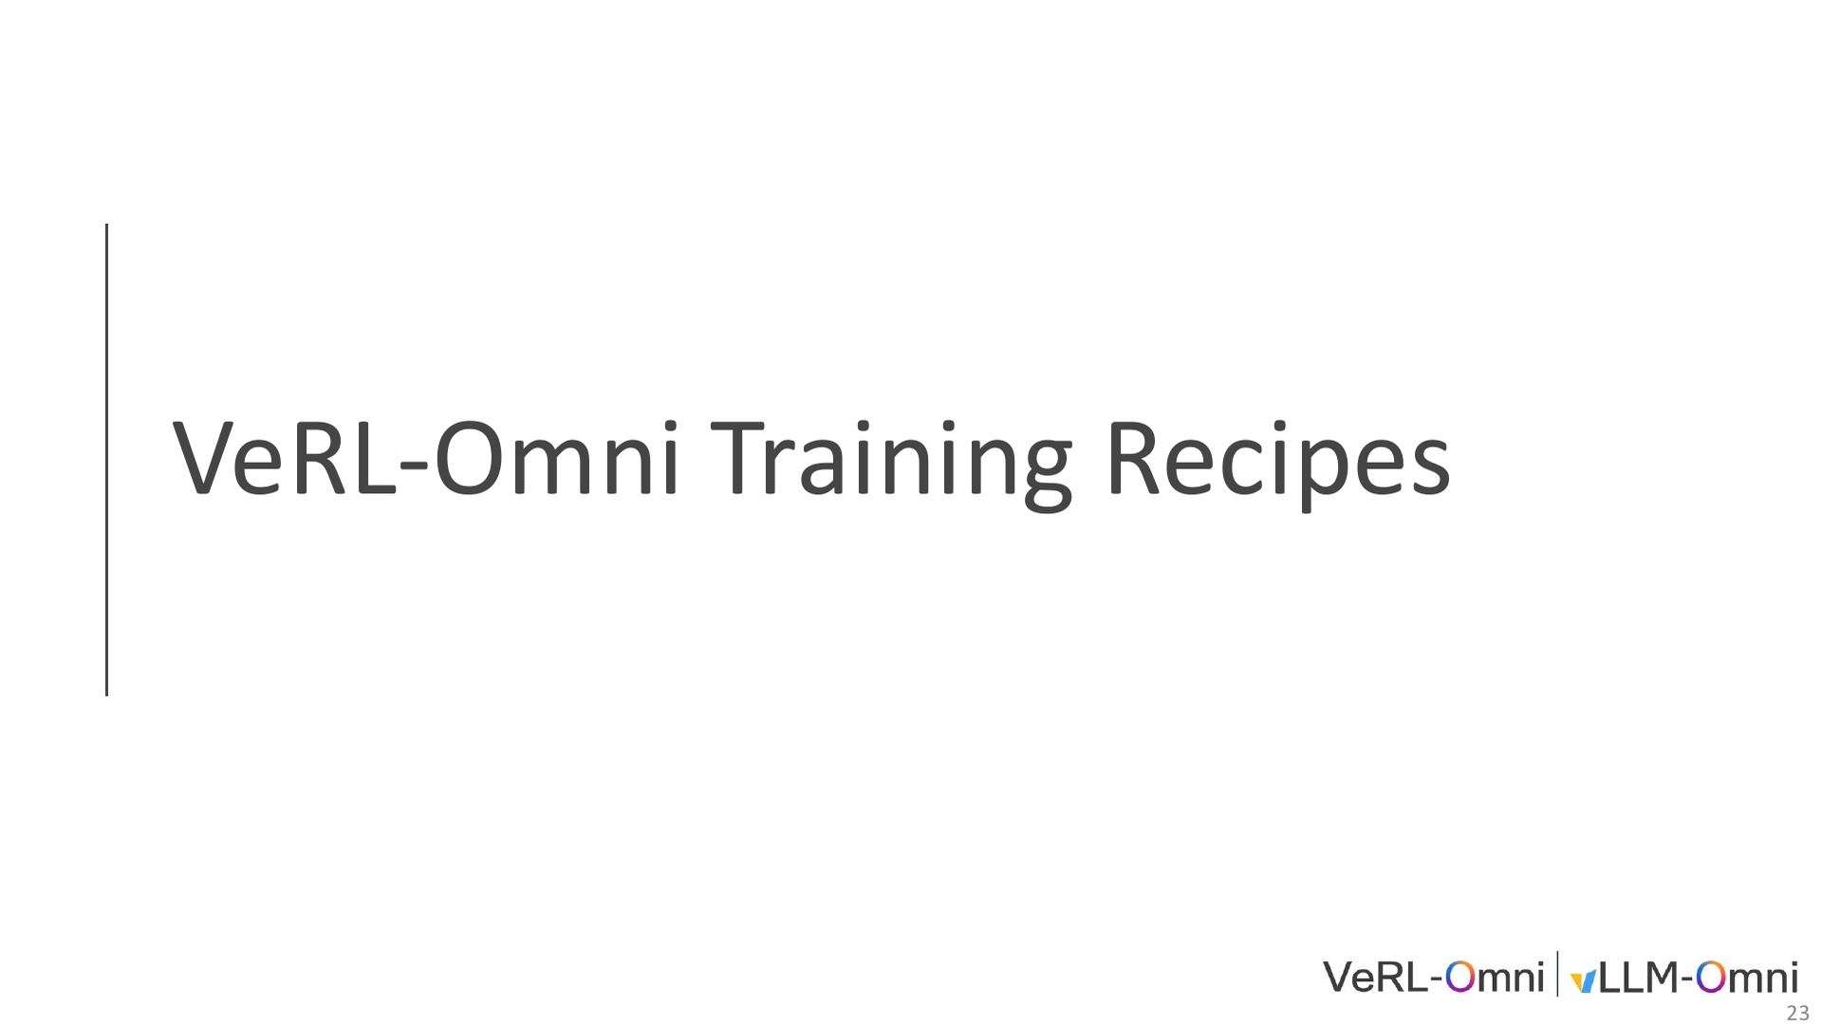
Notes:
23/34 · VeRL-Omni TrainingRecipes

Slide 24
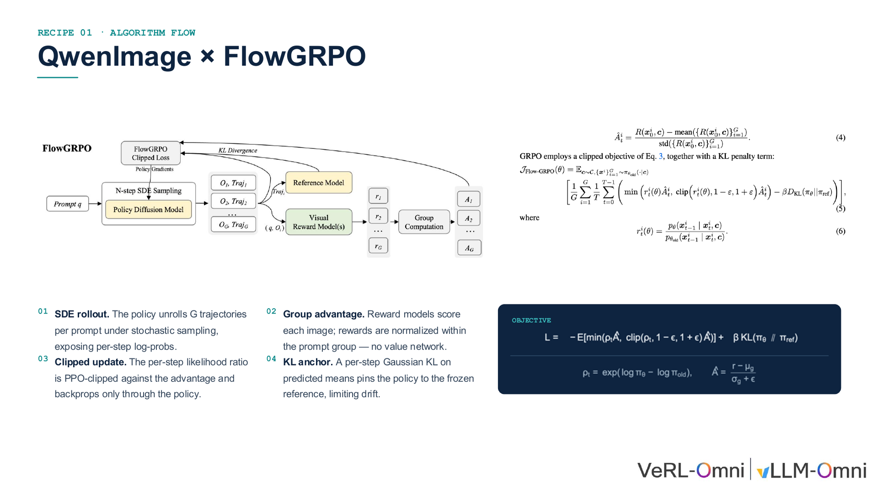
Notes:
24/34 · RECIPE 01 · ALGORITHM FLOW

Slide 25
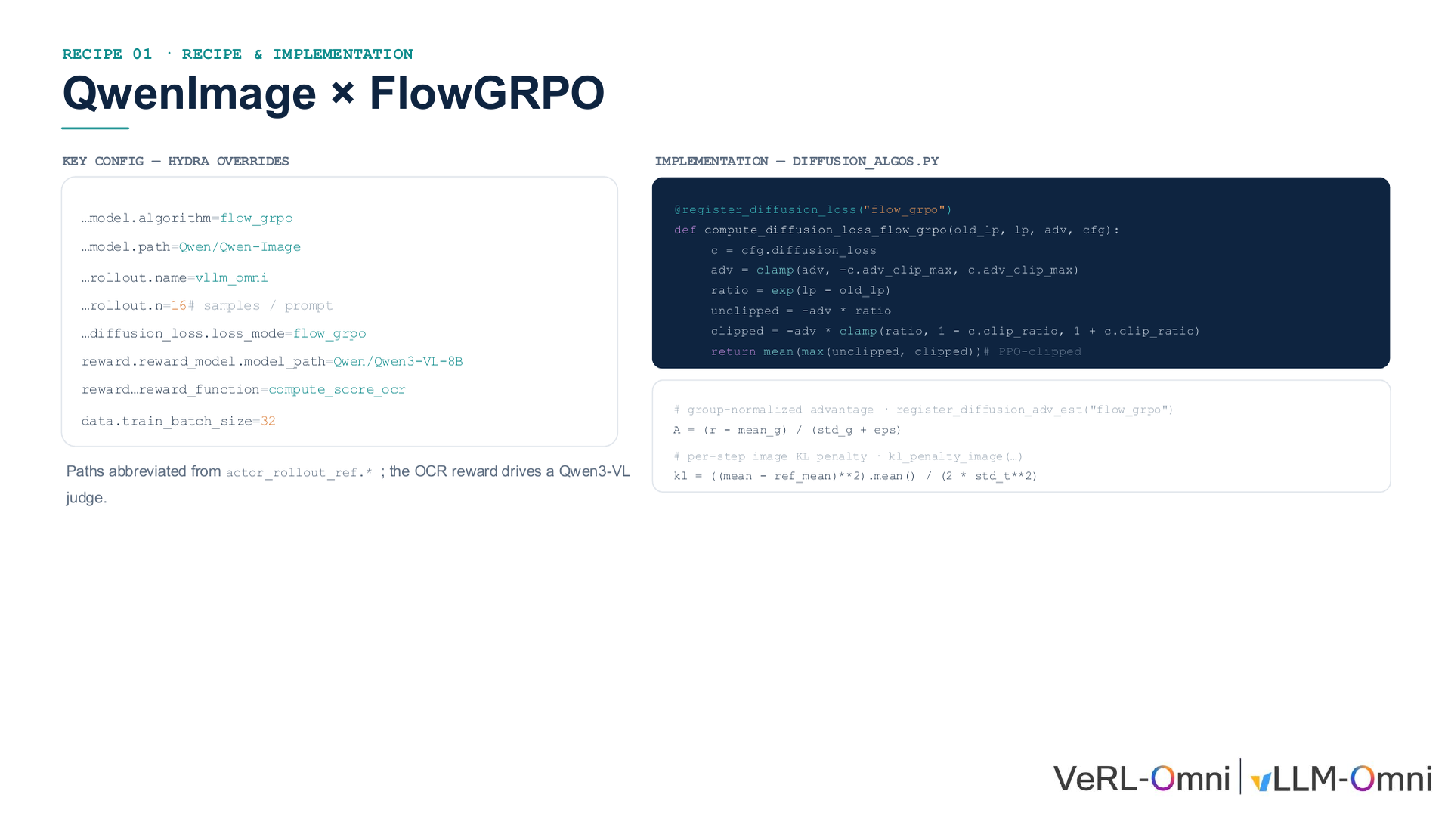
Notes:
25/34 · RECIPE 01 · RECIPE & IMPLEMENTATION

Slide 26
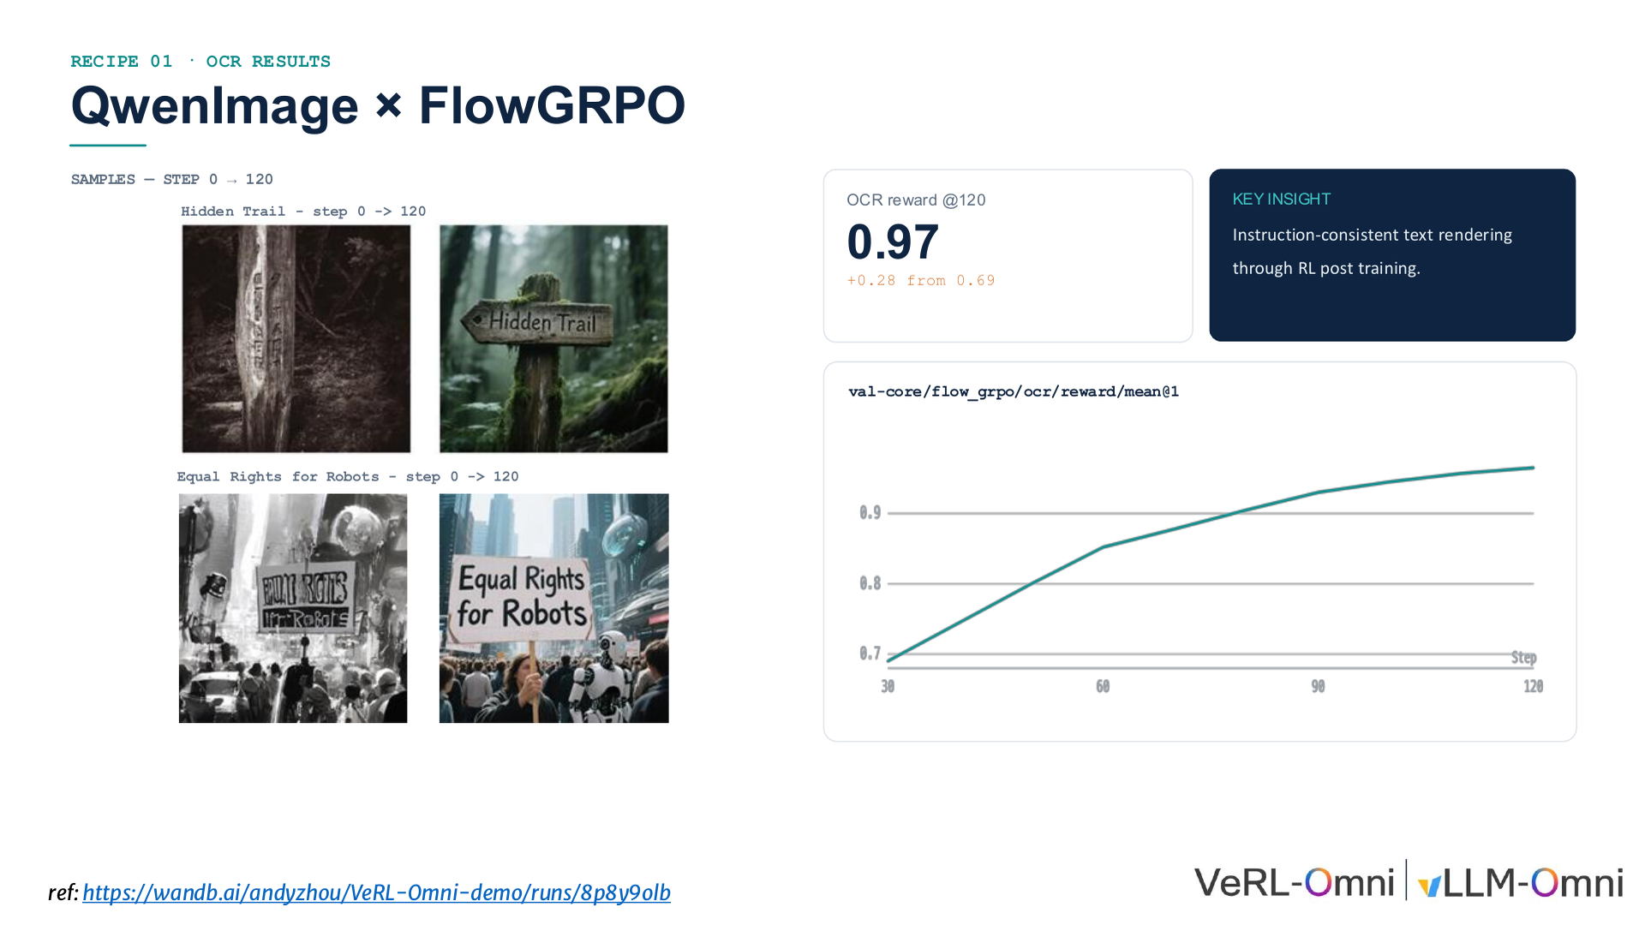
Notes:
26/34 · RECIPE 01 · OCR RESULTS

Slide 27
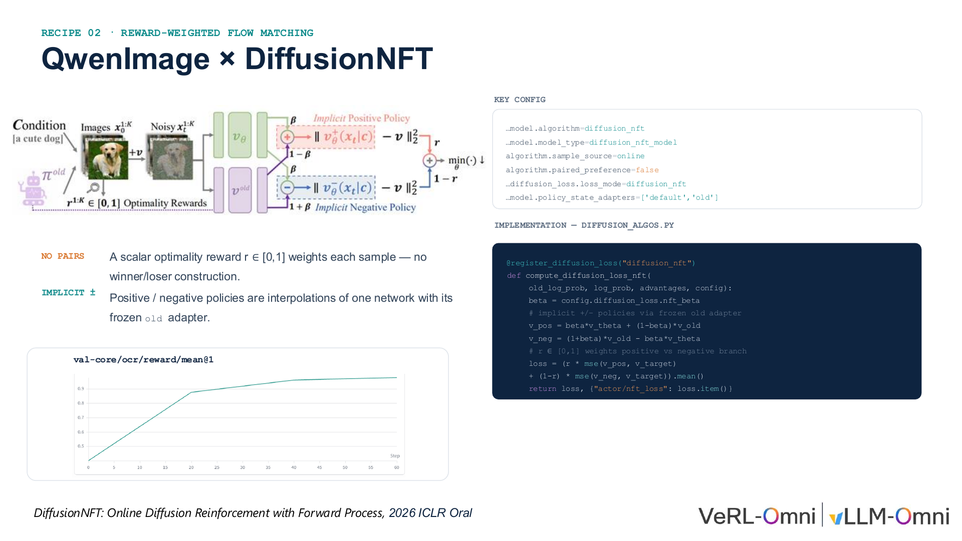
Notes:
27/34 · RECIPE 02 · REWARD-WEIGHTED FLOW MATCHING

Slide 28
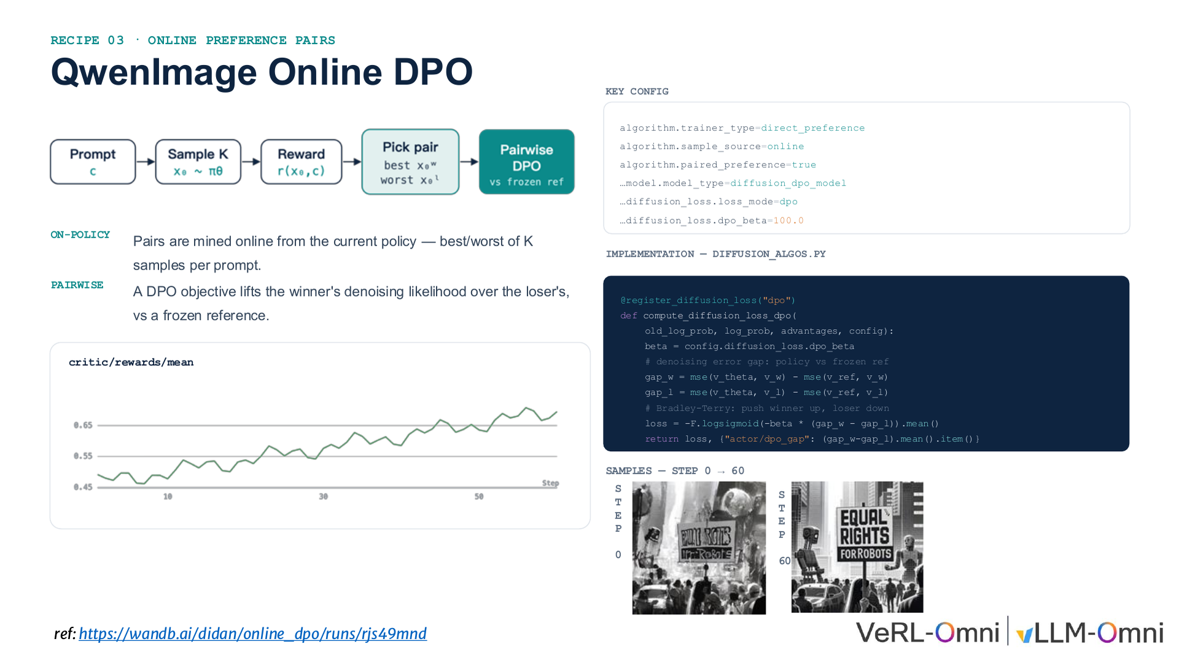
Notes:
28/34 · RECIPE 03 · ONLINE PREFERENCE PAIRS

Slide 29
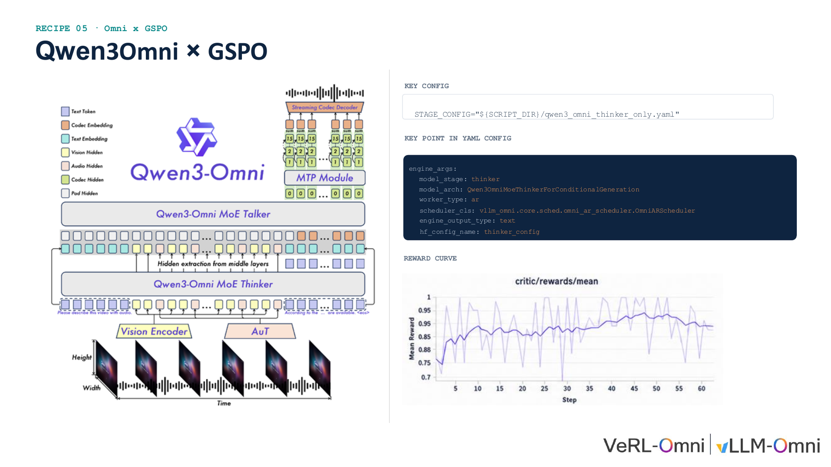
Notes:
29/34 · RECIPE 05 · Omni x GSPO

Slide 30
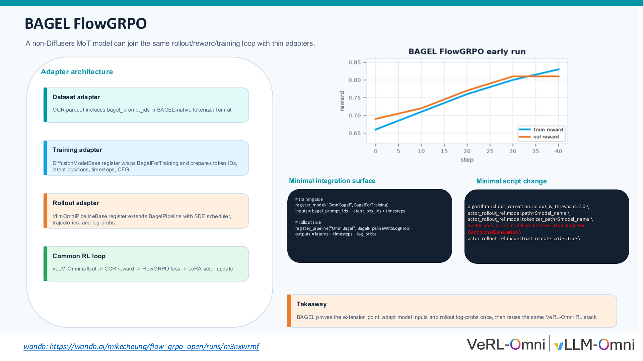
Notes:
30/34 · BAGEL FlowGRPO

Slide 31
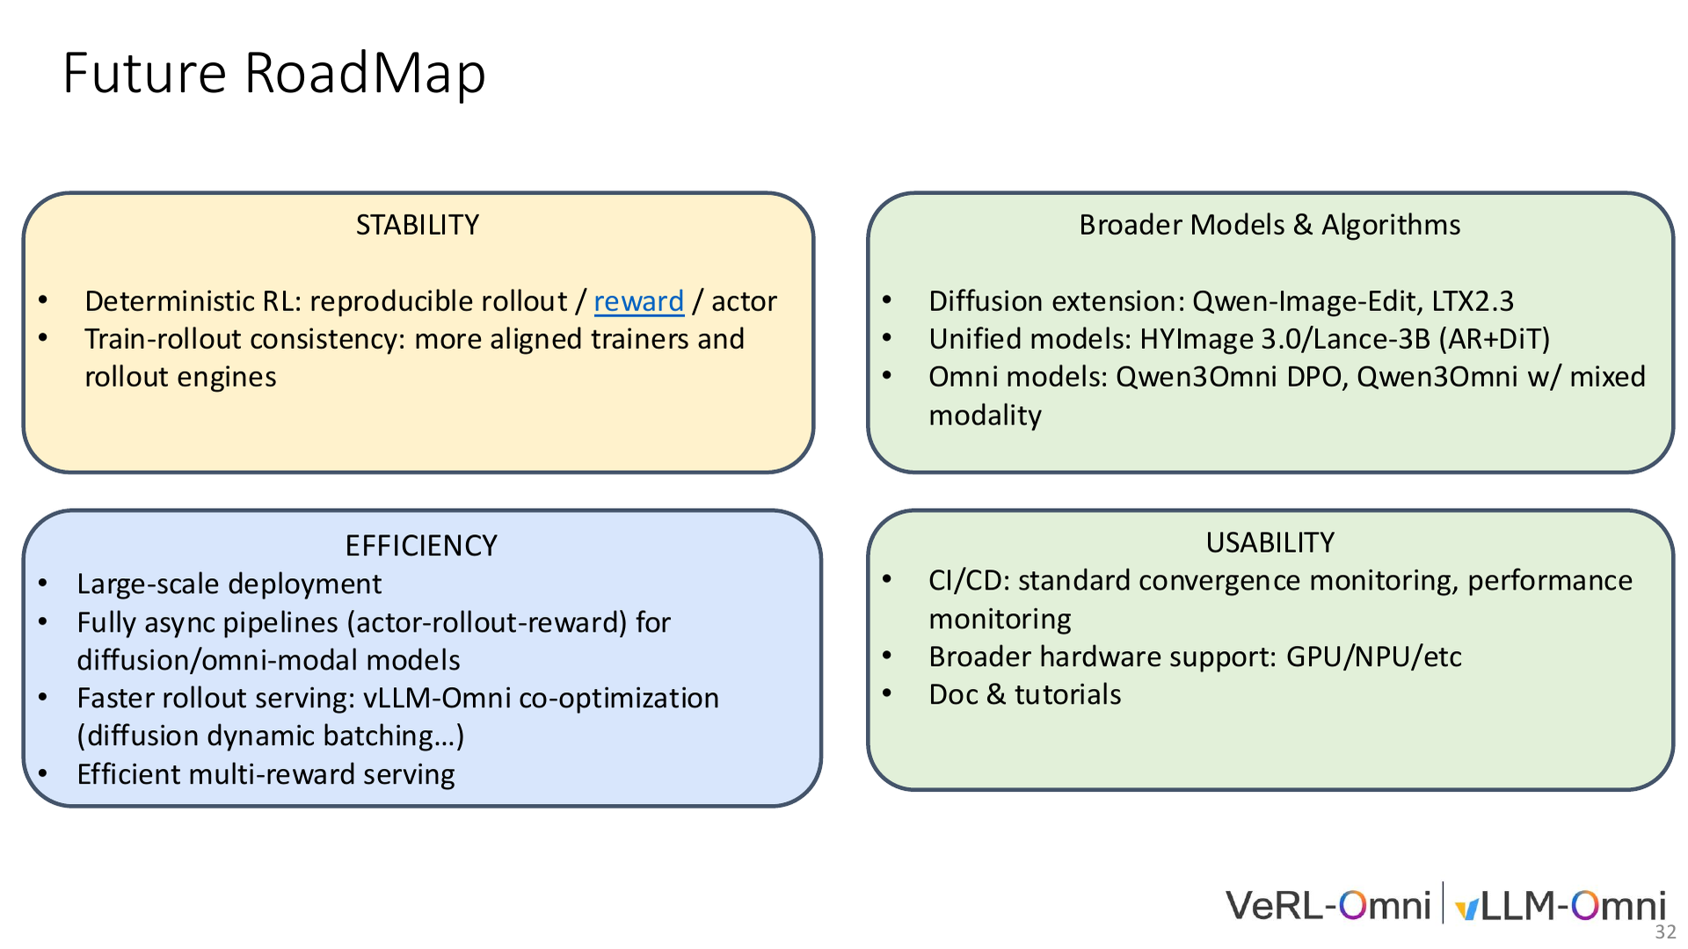
Notes:
31/34 · FutureRoadMap

Slide 32
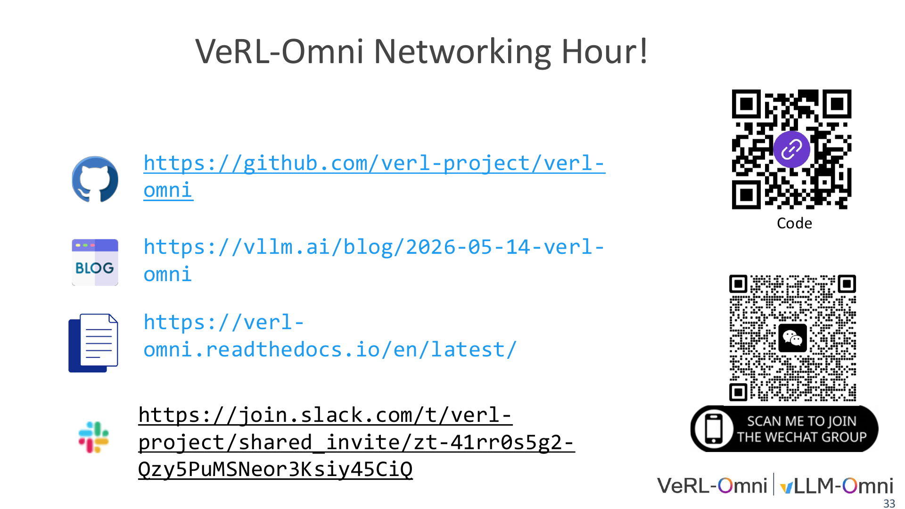
Notes:
32/34 · VeRL-OmniNetworking Hour!

Slide 33
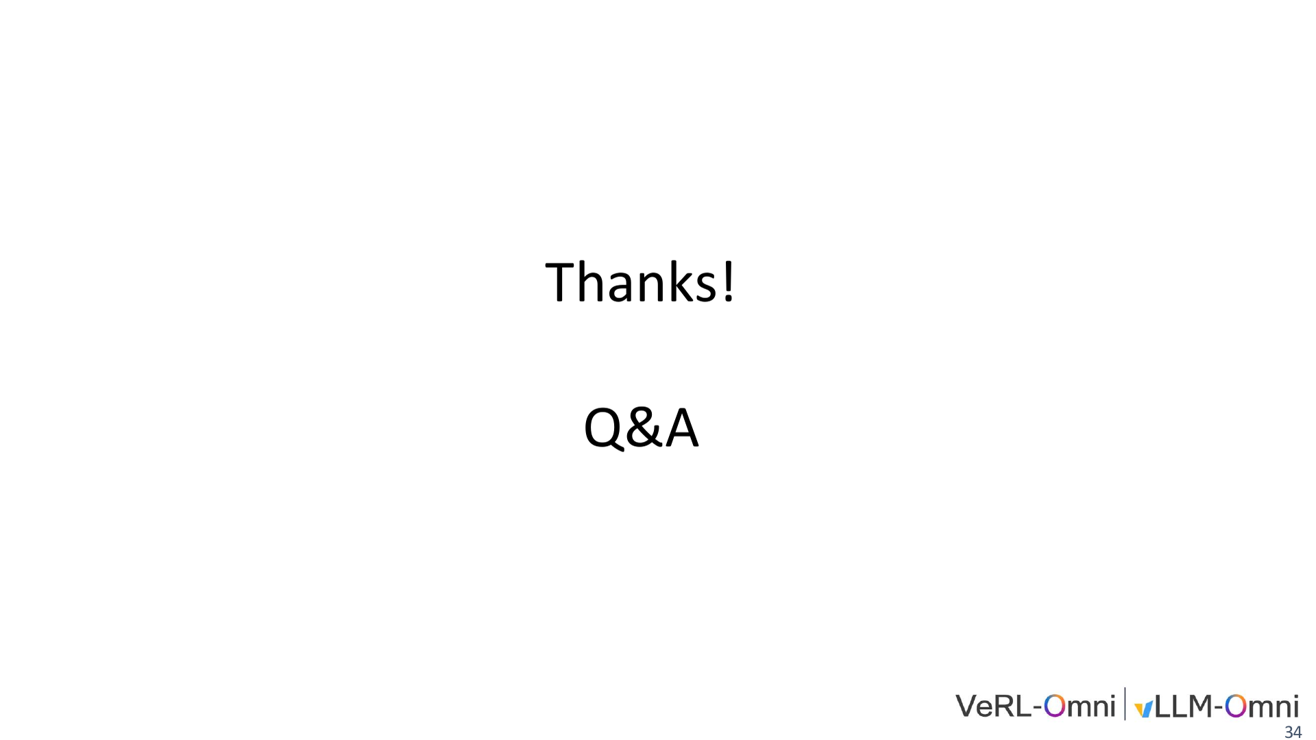
Notes:
33/34 · Thanks!

Slide 34
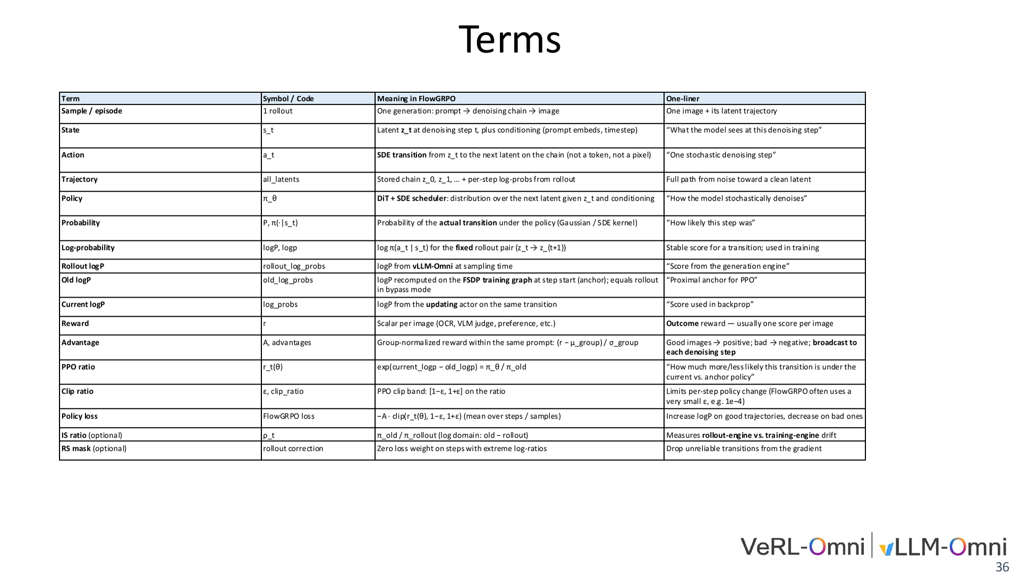
Notes:
34/34 · Terms

