Slide 1
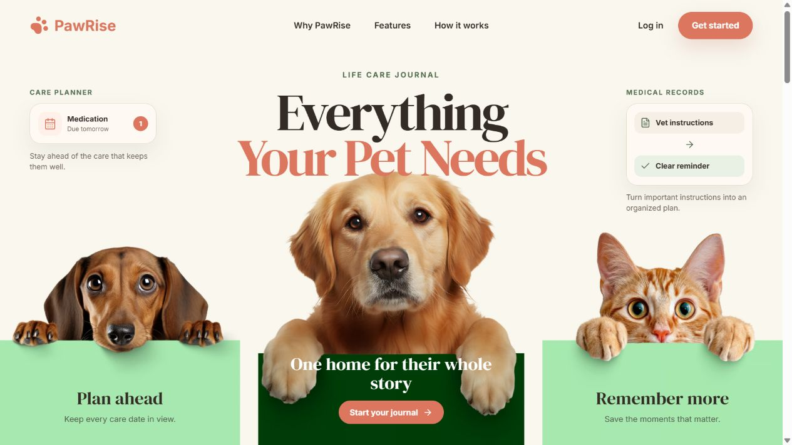
PAWRISE
One place for pet health, care, and memories
A full-stack pet care management platform
Notes:
Timing: 0:00–0:20. Hello everyone. Our project is PawRise, a full-stack web application for pet owners. It brings pet profiles, health records, care reminders, and memories into one organized place. In my part, I will briefly explain the problem, how our homepage communicates the solution, and the high-level architecture behind it.
[Sources]
- /Users/haochenlian/Documents/codexproject/pawrise/landing-desktop.png
- /Users/haochenlian/Documents/codexproject/pawrise/README.md
[/Sources]

Slide 2
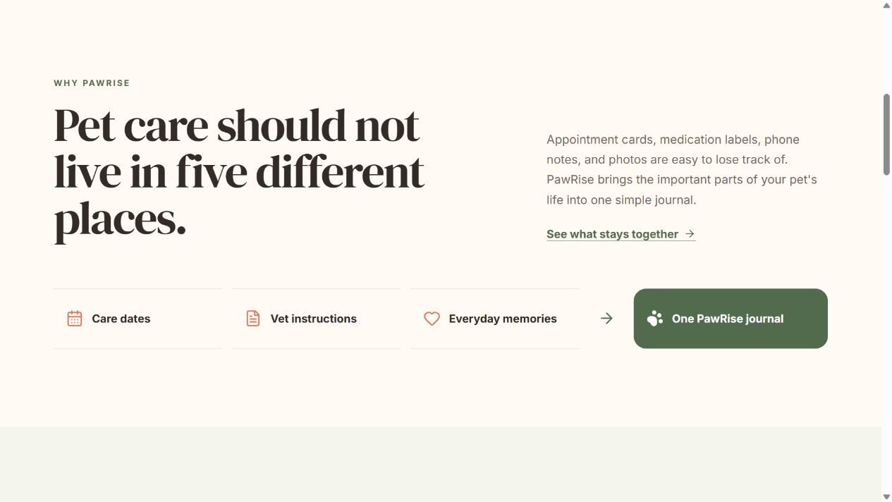
BUSINESS CHALLENGE
Pet care information is often scattered—and easy to miss
Veterinary instructions live in paper documents or messages.
Medication and follow-up dates can be forgotten.
Health information and memories are kept in different places.
Scattered information → one organized care plan
PAWRISE • MILESTONE 4
2
Notes:
Timing: 0:20–1:00. The main challenge is that pet-care information is often scattered. Veterinary instructions may be on paper or in a message, important medication and follow-up dates can be forgotten, and health information and memories may be stored in different places. PawRise brings these pieces together and turns them into one organized care plan. The value is not simply the website itself; it is helping owners move from scattered information to clear next steps.
[Sources]
- /Users/haochenlian/Documents/codexproject/pawrise/landing-why-section.png
- /Users/haochenlian/Documents/codexproject/pawrise/frontend/src/landing.jsx
[/Sources]

Slide 3
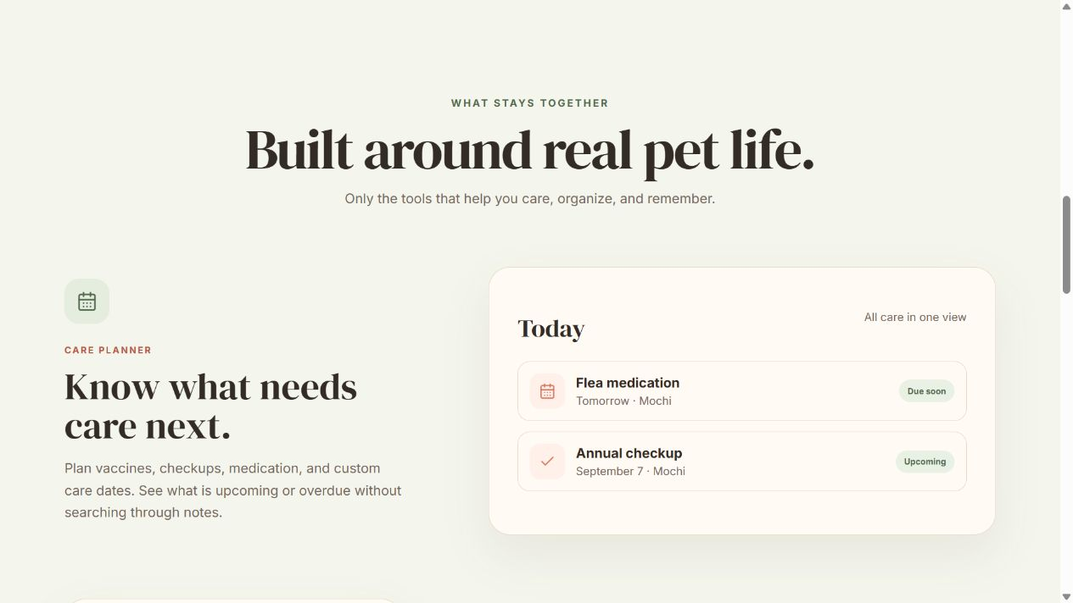
HOMEPAGE STRATEGY
The homepage explains the product before the user signs in
01
Clear promise
The hero states the outcome: plan care, organize records, and preserve memories.
02
Guided story
Why PawRise → Features → How it works gives visitors a simple reading path.
03
Action
Log in and Get started convert the story into the product experience.
PAWRISE • MILESTONE 4
3
Notes:
Timing: 1:00–1:50. The homepage is designed as a guided story. The hero gives a clear promise: plan ahead, organize medical records, and keep memories. The Why PawRise section explains the real problem. The feature sections then show how the product supports care planning, medical records, and memories, and the final call to action moves the visitor into the app. One important design decision is the connection between Medical Records and Care Reminders. PawRise can extract medication and follow-up information, but the owner must review and confirm it before any reminder is created.
[Sources]
- /Users/haochenlian/Documents/codexproject/pawrise/landing-features-section.png
- /Users/haochenlian/Documents/codexproject/pawrise/frontend/src/landing.jsx
- /Users/haochenlian/Documents/codexproject/pawrise/docs/MEDICAL_RECORDS_AND_REMINDERS.md
[/Sources]

Slide 4
HIGH-LEVEL ARCHITECTURE
React connects to a secure Flask API
REST API + JWT
SQLAlchemy
USER
FRONTEND
BACKEND
DATA
Browser
React + Vite
Flask REST API
SQLite
Homepage + app UI
Responsive interface
JWT + business rules
SQLAlchemy + files
Medical record service
OpenAI structured extraction • local fallback extractor
Draft returns to the owner for review before reminders are created.
PAWRISE • MILESTONE 4
4
Notes:
Timing: 1:50–2:50. At a high level, the user interacts with a React and Vite frontend. The frontend communicates with a Flask REST API, and JWT protects authenticated requests. The Flask backend contains the main business areas, including accounts, pet profiles, medical records, reminders, memories, settings, and the dashboard. SQLAlchemy connects the backend to SQLite, while authenticated file storage handles images and uploaded medical records. The medical-record service can use OpenAI structured extraction when it is available, with a local fallback. In both cases, the output is only a draft until the owner reviews it. That is the high-level structure behind PawRise. Now I’ll hand it over to my teammate, who will show the live demo and the main user workflow.
[Sources]
- /Users/haochenlian/Documents/codexproject/pawrise/README.md
- /Users/haochenlian/Documents/codexproject/pawrise/backend/app/__init__.py
- /Users/haochenlian/Documents/codexproject/pawrise/backend/app/services/ai_medical_extraction.py
- /Users/haochenlian/Documents/codexproject/pawrise/backend/app/services/medical_extraction.py
- /Users/haochenlian/Documents/codexproject/pawrise/frontend/package.json
[/Sources]

