Slide 1
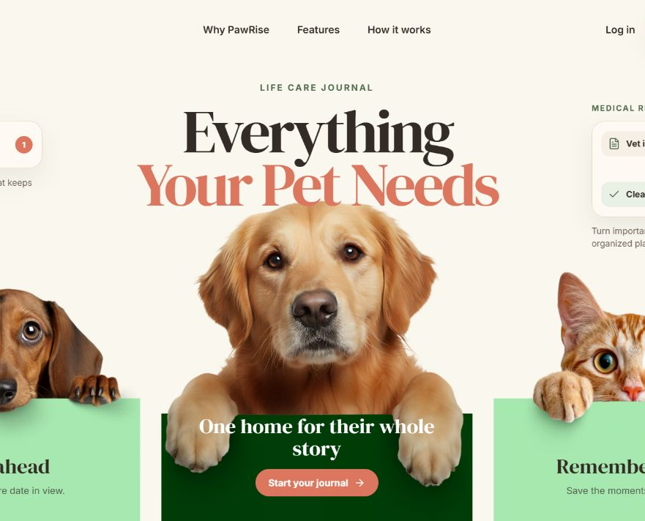
PAWRISE
One place for pet health, care, and memories
A full-stack pet care management platform
Notes:
Timing: 0:00–0:25. Hello everyone. Today I’m presenting PawRise, a full-stack web application that helps pet owners organize health records, care reminders, pet profiles, and memories in one place. The homepage introduces that value immediately: care today, memories for life.
[Sources]
- /Users/haochenlian/Documents/codexproject/pawrise/landing-desktop.png
- /Users/haochenlian/Documents/codexproject/pawrise/README.md
[/Sources]

Slide 2
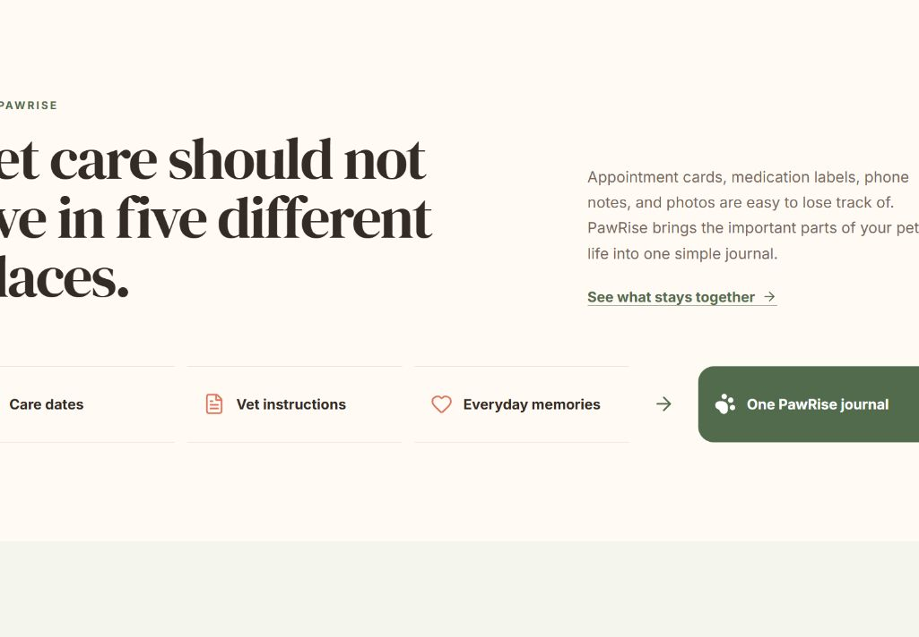
BUSINESS CHALLENGE
Pet care information is often scattered—and easy to miss
Veterinary instructions live in paper documents or messages.
Medication and follow-up dates can be forgotten.
Health information and memories are kept in different places.
Scattered information → one organized care plan
PAWRISE • MILESTONE 4
2
Notes:
Timing: 0:25–1:20. The business challenge is fragmentation. Owners may have appointment cards, medication labels, phone notes, and photos in different places. That creates missed dates and extra effort. PawRise brings those pieces together and turns veterinary instructions into a clear, actionable plan. The value is not simply that we built a website; it is the transition from scattered information to organized care.
[Sources]
- /Users/haochenlian/Documents/codexproject/pawrise/landing-why-section.png
- /Users/haochenlian/Documents/codexproject/pawrise/frontend/src/landing.jsx
[/Sources]

Slide 3
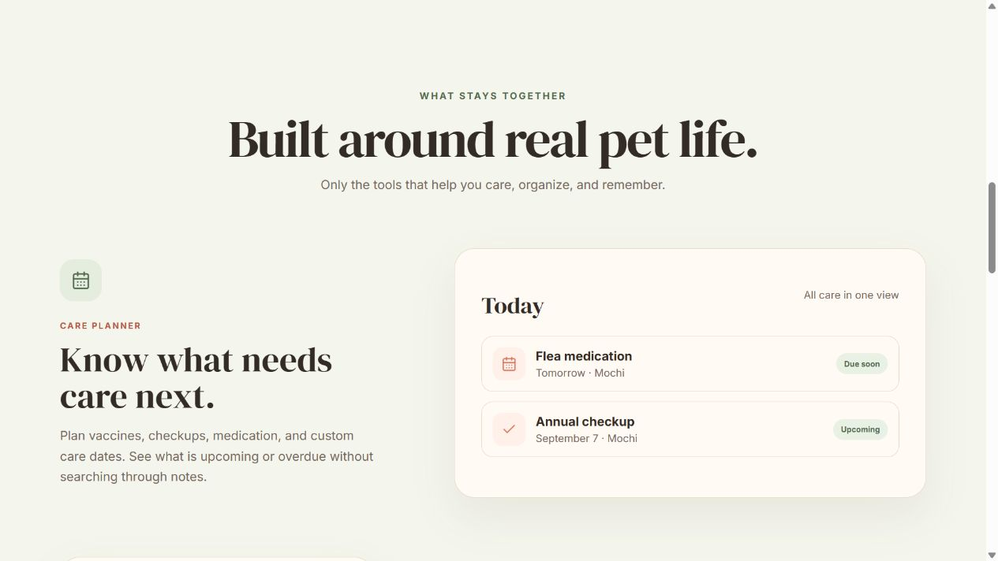
HOMEPAGE STRATEGY
The homepage explains the product before the user signs in
01
Clear promise
The hero states the outcome: plan care, organize records, and preserve memories.
02
Guided story
Why PawRise → Features → How it works gives visitors a simple reading path.
03
Action
Log in and Get started convert the story into the product experience.
PAWRISE • MILESTONE 4
3
Notes:
Timing: 1:20–2:25. The homepage is designed as a product story, not a feature inventory. First, the hero makes a clear promise. Next, the Why PawRise section explains the problem. Then the feature sections show real interface previews for care planning, medical records, and memories. Finally, How it works and the call to action move the visitor into the authenticated app. The most important workflow is the connection between Medical Records and Care Reminders: PawRise extracts medication and follow-up information, but the owner reviews and confirms each item before a reminder is created.
[Sources]
- /Users/haochenlian/Documents/codexproject/pawrise/landing-features-section.png
- /Users/haochenlian/Documents/codexproject/pawrise/frontend/src/landing.jsx
- /Users/haochenlian/Documents/codexproject/pawrise/docs/MEDICAL_RECORDS_AND_REMINDERS.md
[/Sources]

Slide 4
HIGH-LEVEL ARCHITECTURE
A React frontend connects to a secure Flask API
REST API + JWT
SQLAlchemy
USER
FRONTEND
BACKEND
DATA
Browser
React + Vite
Flask REST API
SQLite
Homepage + app UI
Responsive interface
JWT + business rules
SQLAlchemy + files
Medical record service
OpenAI structured extraction • local fallback extractor
Draft returns to the owner for review before reminders are created.
PAWRISE • MILESTONE 4
4
Notes:
Timing: 2:25–3:30. At a high level, the user interacts with a React and Vite frontend. The frontend calls a Flask REST API, and JWT protects authenticated operations. Flask contains the business areas for accounts, pet profiles, medical records, reminders, memories, settings, and the dashboard. SQLAlchemy stores relational data in SQLite, while authenticated file storage handles images and uploaded records. For medical records, the service can use OpenAI structured extraction when a key is available, with a local fallback. In both cases the result is a draft: the owner reviews it before reminders are created.
[Sources]
- /Users/haochenlian/Documents/codexproject/pawrise/README.md
- /Users/haochenlian/Documents/codexproject/pawrise/backend/app/__init__.py
- /Users/haochenlian/Documents/codexproject/pawrise/backend/app/services/ai_medical_extraction.py
- /Users/haochenlian/Documents/codexproject/pawrise/backend/app/services/medical_extraction.py
- /Users/haochenlian/Documents/codexproject/pawrise/frontend/package.json
[/Sources]

Slide 5
LIVE DEMO
Follow the story from homepage to care plan
01
02
03
04
Homepage
Enter the app
Medical record
Care plan
Hero → Why PawRise → Features
Log in with the prepared account
Paste instructions → review draft
Confirm reminders → dashboard/history
Keep the demo browser ready before presenting. Do not open the code unless asked in Q&A.
5
Notes:
Timing: 3:30–6:50. Switch to the browser. First, spend about 45 seconds on the homepage: point out the immediate promise, the Why PawRise section, feature previews, and the Get started path. Second, log in using a prepared account and pet. Third, open Medical Records, paste a short veterinary instruction, and show the extracted draft. Emphasize that nothing becomes a reminder automatically. Review the fields, confirm the selected medication or follow-up items, then open Care Reminders and the dashboard or care history to show the completed loop. Keep one backup screenshot ready in case the local server has a problem. Do not open the code unless a reviewer asks.
[Sources]
- /Users/haochenlian/Documents/codexproject/pawrise/frontend/src/landing.jsx
- /Users/haochenlian/Documents/codexproject/pawrise/frontend/src/App.jsx
- /Users/haochenlian/Documents/codexproject/pawrise/docs/MEDICAL_RECORDS_AND_REMINDERS.md
[/Sources]

Slide 6
READY FOR THE DRY RUN
The solution is integrated, tested, and ready to demonstrate
69 / 69
0
PASS
backend tests passed
test failures
frontend production build
PawRise turns scattered pet-care details into one clear, trusted workflow.
Questions?
PAWRISE • MILESTONE 4
6
Notes:
Timing: 6:50–7:30. To close, the current codebase passes all 69 backend tests, including authentication, ownership, reminders, uploads, medical records, and extraction behavior. The Vite production build also completes successfully. PawRise is ready for the dry run because the homepage communicates the value, the full stack supports the workflow, and the core behavior is verified. I’m happy to take questions.
[Sources]
- Local verification on 2026-08-10: pytest — 69 passed in 10.00s
- Local verification on 2026-08-10: pnpm run build — Vite production build completed successfully
- /Users/haochenlian/Documents/codexproject/pawrise/backend/tests
- /Users/haochenlian/Documents/codexproject/pawrise/frontend/package.json
[/Sources]

