Slide 1
MACHINE LEARNING
Statistical Foundations
of Machine Learning
Tree Models · Ensemble Methods · Gradient Boosting
Statistical Foundations for Graduate Students

Slide 2
Lecture Overview
Topic 1 — Supervised vs. Unsupervised Learning
Learning paradigms, examples, psychometric connections
Topic 2 — Tree-Based Regression & Random Forests
Decision trees, pruning, bagging, feature subsampling, OOB error
Topic 3 — Overfitting, Underfitting & Model Complexity
Bias-variance decomposition, complexity-error curves, remedies
Topic 4 — The Bias-Variance Tradeoff: Conceptual Framework
EPE decomposition, signal vs. noise, sample size effects
Topic 5 — Gradient Boosting
Stagewise additive models, gradient descent in function space, XGBoost/LightGBM
Topic 6 — Supervised vs Unsupervised Work Flows

Slide 3
SECTION1
Supervised vs.
Unsupervised Learning

Slide 4
The Epistemological Distinction
Supervised Learning
Unsupervised Learning
Learns from labeled training data {X, y}
Supervision = the outcome variable y
Goal: learn mapping f̂: X → y
Subtypes:
Regression: continuous y
Classification: categorical y
Provides: explicit loss function, unambiguous evaluation criterion
Epistemic status: Confirmatory
Access only to input features X — no outcome y
Goal: discover latent structure in X
Core tasks:
Clustering: group similar observations
Dimensionality reduction: compress X
Density estimation, anomaly detection
Evaluation requires domain judgment alongside statistical criteria
Epistemic status: Exploratory

Slide 5
Concrete Examples: One from Each Paradigm
Logistic Regression (Supervised)
K-Means Clustering (Unsupervised)
Predicting pass/fail (y ∈ {0,1}) from:
GPA, attendance, SES, formative scores
P(yᵢ = 1|xᵢ) = 1 / (1 + e^−(β₀ + βᵢxᵢ))
Training: maximize log-likelihood
Evaluation: AUC, accuracy, sensitivity on held-out test set
Supervision is explicit — every training student has a known outcome label that adjusts parameters.
Students measured on: reading fluency, math reasoning, executive function, engagement — no predefined groups
Minimize: Σₖ Σᵢ∈Cₖ ‖xᵢ − μₖ‖²
Cluster assignments emerge from geometric structure alone
K chosen by: silhouette, gap statistic, elbow method
Validation requires domain interpretation — do clusters map to meaningful student profiles?

Slide 6
Psychometric Analogs: Mapping the Distinction
Unsupervised Analogs
Supervised Analogs
Exploratory Factor Analysis
Discovers latent dimensions from covariance structure — no external criterion
Latent Class Analysis
Identifies unobserved categorical subpopulations — probabilistic K-means
Profile Cluster Analysis
Groups examinees by response pattern similarity
Predictive Validity Studies
Regressing criterion (GPA, job performance) on test scores
DIF Analysis with Known Groups
Conditioning on group membership provides supervision
G-Theory Decision Studies
Optimizing measurement decisions relative to a defined criterion

Slide 7
SECTION 2
Tree-Based Regression
& Random Forests

Slide 8
Decision Tree Regression: Core Mechanics
How It Works
Strengths & Weaknesses
Partitions feature space into rectangular regions via recursive binary splits
Greedy algorithm: each split minimizes RSS:
RSS = Σⱼ Σᵢ∈Rⱼ (yᵢ − ȳRⱼ)²
Prediction = mean of training obs in leaf
Pruning: cost-complexity (α|T|) controls overfitting
✓ Strengths
Highly interpretable — visual rules
Handles mixed variable types
Captures interactions implicitly
✗ Weaknesses
High variance — sensitive to sample
Low predictive accuracy alone
Instability undermines inference

Slide 9
Random Forests: Two Innovations
1. Bagging
2. Feature Subsampling
3. OOB & Importance
Draw B bootstrap samples → fit full tree to each → average:
f̂bag(x) = (1/B) Σ f̂*b(x)
Reduces variance toward σ²/B
At each split, consider only m < p predictors (≈ p/3).
Decorrelates trees → genuine ensemble diversity → further variance reduction
~37% of obs left out per bootstrap → free validation set.
Permutation-based variable importance: reliable, model-free

Slide 10
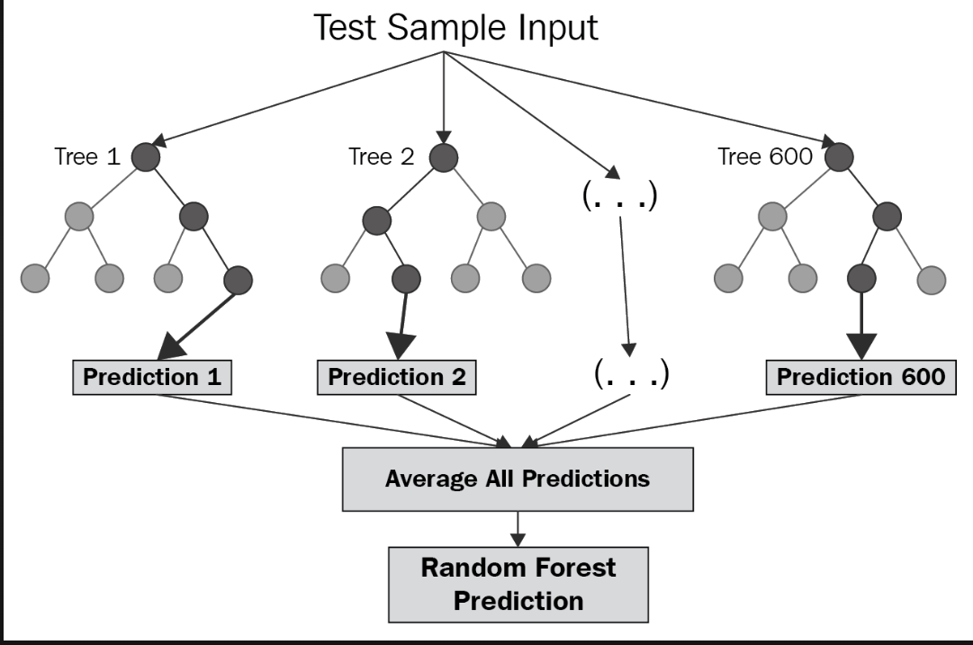
Tree Based Regression Model

Slide 11
Regression Tree vs. Random Forest: Head-to-Head
Dimension | Regression Tree | Random Forest
Interpretability | High — visual, explicit rules | Low — black box ensemble
Variance | High | Low (decorrelated averaging)
Bias | Low (deep trees) | Slightly higher
Predictive Accuracy | Moderate | Generally excellent
Overfitting Risk | High without pruning | Robust — OOB self-regulates
Variable Importance | Structural only | Permutation-based (reliable)
Computational Cost | Low | High (B × single tree)

Slide 12
SECTION 3
Overfitting &
Underfitting

Slide 13
Two Opposite Failure Modes in Model Fitting
⬇ Underfitting (High Bias)
⬆ Overfitting (High Variance)
Model too simple for true structure
Imposes constraints data does not satisfy
Statistical signature: High Bias, Low Variance
Diagnostics:
High training AND test error
Systematic residual patterns
Examples: linear fit to curved data; 1D IRT on multidimensional construct
Model too complex for sample size
Fits signal AND idiosyncratic noise
Statistical signature: Low Bias, High Variance
Diagnostics:
Large generalization gap (train ≪ test error)
Unstable coefficients across samples
Examples: unpruned tree; high-degree polynomial interpolation

Slide 14
The Complexity-Error Curve
Underfitting Zone
High train & test error
High Bias · Low Variance
Optimal Zone
Minimum test error
Bias-Variance balanced
Overfitting Zone
Low train, high test error
Low Bias · High Variance

Slide 15
Remedies for Overfitting & Underfitting
For Underfitting → Reduce Bias
For Overfitting → Reduce Variance
Add polynomial terms, interactions, or nonlinear transformations
Switch to flexible model class (GAMs, trees, mixed models)
Reconsider measurement model — allow multidimensionality
Regularization: Ridge, Lasso, Elastic Net
Pruning (trees); Dropout (neural nets)
Dimensionality reduction: PCA, factor analysis
Cross-validation for tuning parameter selection
Increase sample size
Bayesian priors: principled shrinkage

Slide 16
SECTION 4
The Bias-Variance
Tradeoff

Slide 17
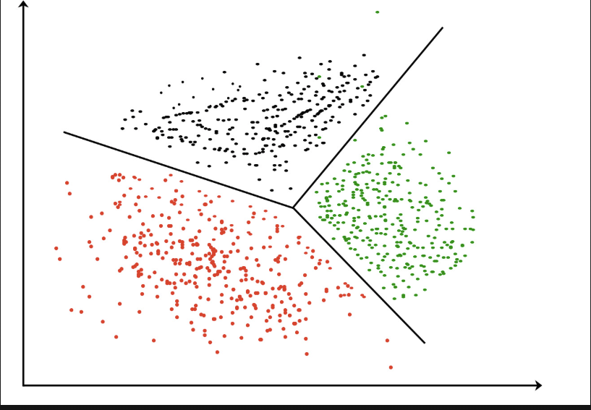
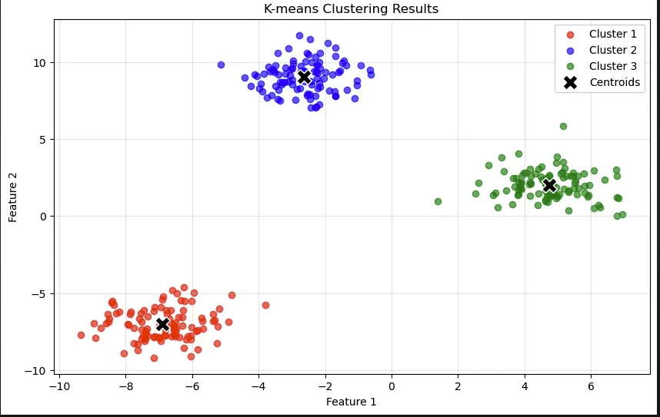
K-Means Clustering Models

Slide 18
Expected Prediction Error: The Fundamental Decomposition
EPE(x₀) = Bias²[f̂(x₀)] + Var[f̂(x₀)] + σ²ε
Bias²
Variance
σ²ε
Systematic Error
Estimation Instability
Irreducible Error
Property of the model CLASS, not the sample.
Reflects structural assumptions imposed on f(x): linearity, additivity, parametric form.
More data cannot fix bias — the model is structurally wrong.
Property of sensitivity to the specific training sample.
A high-variance model changes substantially across different samples — it fits noise alongside signal.
Noise does not replicate.
Genuine stochasticity in the phenomenon — measurement error, unmeasured causes, intrinsic randomness.
Sets a hard floor on achievable prediction error. No model, however perfect, can remove it.

Slide 19
The Tradeoff: Opposite Responses to Complexity
Key Insight
As complexity ↑: Bias² ↓ but Variance ↑
Total test error is U-shaped
Optimal = minimum of Bias² + Variance
No universally correct complexity level — depends on n and signal strength
Increasing n shifts the optimal point rightward (supports more complex models)

Slide 20
Practical Levers for Managing the Tradeoff
Strategy | Mechanism | Effect
Regularization (Ridge, Lasso) | Penalize coefficient magnitude | Introduces bias → reduces variance
Cross-Validation | Estimate test error directly | Locates optimal complexity empirically
Ensemble Methods | Average many fitted models | Reduces variance without increasing bias
Bayesian Informative Priors | Shrink estimates toward prior | Principled bias-variance regulation
Dimensionality Reduction | Reduce effective parameter count | Lowers variance; small bias cost
Increase Sample Size | Stabilizes estimation | Reduces variance; bias unchanged

Slide 21
SECTION 5
Gradient Boosting

Slide 22
Gradient Boosting: The Core Idea
Random Forest: many trees in PARALLEL → average predictions
Gradient Boosting: trees built SEQUENTIALLY — each corrects errors of all previous trees
The animating intuition:
Rather than fitting one complex model to the data, fit a sequence of simple models to the residuals of the residuals — iteratively steering the ensemble toward the truth by following the gradient of the loss function.
Stagewise Additive Model: F̂M(x) = Σₘ ν · hₘ(x)
where hₘ(x) = m-th weak learner (shallow tree) · ν = learning rate · M = total boosting rounds

Slide 23
The Algorithm: Step by Step
Init
1
2
3
4
Initialize
Compute Pseudo-Residuals
Fit Weak Learner
Compute Leaf Weights
Update Ensemble
F₀(x) = argmin Σ L(yᵢ, γ)
Grand mean (regression) or log-odds (classification)
rᵢₘ = −∂L(yᵢ, F(xᵢ))/∂F(xᵢ)
For squared error: rᵢₘ = yᵢ − F̂ₘ₋₁(xᵢ)
These are the targets for the next tree
Train shallow tree hₘ(x) (4–8 terminal nodes)
using pseudo-residuals {rᵢₘ} as response
For each leaf j: γⱼₘ = argmin Σ L(yᵢ, F̂ₘ₋₁(xᵢ) + γ)
Optimal step size per leaf
F̂ₘ(x) = F̂ₘ₋₁(x) + ν · hₘ(x)
Small learning rate ν prevents overfitting

Slide 24
The Gradient Descent Connection (Friedman, 2001)
Ordinary Gradient Descent
Boosting = Gradient Descent in Function Space
Minimize L(θ) over a parameter vector:
θ⁽ᵗ⁾ = θ⁽ᵗ⁻¹⁾ − η · ∇θ L(θ⁽ᵗ⁻¹⁾)
Update a finite vector of numbers.
The "parameters" are the function F(x) itself,
evaluated at every training point.
Negative gradient = pseudo-residuals:
rᵢₘ = −∂L(yᵢ, F(xᵢ))/∂F(xᵢ)
Each tree fits these residuals — a step in function space.
Parameters live in ℝᵖ — a finite-dimensional space
F lives in an infinite-dimensional function space

Slide 25
Regularization in Gradient Boosting
ν
d
s
Learning Rate (Shrinkage)
Tree Depth
Subsampling
Scales each tree's contribution.
Small ν → more trees needed but better generalization.
The pair (ν, M) jointly controls effective complexity.
Shallow trees → weak learners with high bias, low variance.
Depth-2: pairwise interactions.
Depth-3: three-way interactions (often sufficient).
Train each tree on a random subsample (without replacement).
Introduces randomness → reduces variance, speeds computation.
Connects gradient boosting to random forests.

Slide 26
Modern Implementations: XGBoost · LightGBM · CatBoost
Library | Key Innovation | Advantage
XGBoost | 2nd-order Taylor expansion of loss; explicit L1/L2 regularization; approximate split-finding | More precise leaf weight updates; handles large, sparse data
LightGBM | GOSS (gradient-based one-side sampling); EFB (exclusive feature bundling); leaf-wise tree growth | Dramatically faster training on high-dimensional data; comparable accuracy
CatBoost | Ordered boosting: statistics computed using only prior observations in a random permutation | Eliminates target leakage in categorical feature encoding

Slide 27
Gradient Boosting vs. Random Forests: Refined Comparison
Dimension | Random Forest | Gradient Boosting
Tree construction | Parallel, independent | Sequential, corrective
Bias reduction | Full-depth trees (inherently low bias) | Iterative residual fitting
Variance reduction | Averaging decorrelated trees | Shrinkage + subsampling
Weak learner | Deep trees | Shallow trees
Overfitting | Robust — plateaus with more trees | Can overfit — requires early stopping
Accuracy | Excellent | Often state-of-the-art on tabular data
Computation | Parallelizable | Inherently sequential

Slide 28
Statistical Connections & Educational Measurement Applications
Statistical Connections
Educational Measurement Applications
Stagewise Regression & LASSO
Incremental model building; each step reduces residual error
EM Algorithm
Iterative correction: fit → residuals → fit residuals → update
Functional Data Analysis
Treats functions as objects to optimize, not finite parameter vectors
Automated Essay Scoring
Captures complex linguistic/syntactic/semantic feature interactions
Process Data Analysis
Models high-dimensional log files from computer-based assessments
Dropout & Persistence Prediction
Tabular student data with mixed variable types; variable importance diagnostics

Slide 29
SECTION6
A step-by-step comparison of how each paradigm
operates from raw data to deployment
diet Boosting

Slide 30
The two learning paradigms at a glance
Supervised learning
Unsupervised learning
✓
Labeled training data — every observation has a known outcome y
◆
Feature matrix X only — no outcome labels exist
✓
Goal: learn a mapping f̂: X → y for prediction
◆
Goal: discover latent structure inherent in X
✓
Explicit loss function; unambiguous evaluation criterion
◆
Implicit objective; evaluation requires domain judgment
✓
Subtypes: regression (continuous y) and classification (categorical y)
◆
Tasks: clustering, dimensionality reduction, density estimation
✓
Epistemic status: Confirmatory — tests a pre-specified mapping
◆
Epistemic status: Exploratory — generates hypotheses
The fundamental divergence: supervised learning requires a known label y for every training observation; unsupervised learning operates without any labels.

Slide 31
Supervised learning — stages 1 through 3: data preparation
1
Raw data
Why labels matter
Observations with features X and a known outcome y for each row
The label y is the supervision signal. Every parameter update during training is driven by the discrepancy between ŷ and y. Without labels, there is no error signal.
2
Label every observation
Assign ground-truth outcome y — categorical or continuous
Critical rule
Train / validation / test split
3
Test set never seen until final evaluation
Partition data before any modeling; keep test set completely unseen
Stages 4–7 continue on the next slide →

Slide 32
Supervised learning — stages 4 through 7: training & evaluation
4
Feature engineering
Scale, encode, and transform predictors before fitting
Model training
Loss function options
5
Minimize loss L(y, ŷ) on the training set — the core learning step
· MSE — regression
Retrain
· Cross-entropy — classification
6
Validation & hyperparameter tuning
Adjust complexity; use cross-validation to prevent overfitting
· Log-likelihood — probabilistic
Test set evaluation
· Hinge loss — SVMs
7
Report accuracy, AUC, MSE — honest estimate of generalization error
← Stage 3 completed on previous slide

Slide 33
Supervised learning — stage 8: deployment & prediction
8
Deploy & predict
Map new, unlabeled inputs x → ŷ on production data
Input
Inference
Output
New observation arrives with features X but no label — the model has never seen this data point.
The fitted model f̂ maps x through its learned parameters to produce a predicted output ŷ.
ŷ is delivered: a class label (classification) or a continuous value (regression) with a confidence score.

Slide 34
Supervised learning — complete workflow at a glance
Retrain loop
1
2
3
4
5
6
7
8
Raw data
Label
Split
Features
Train
Validate
Evaluate
Deploy
X + y
Assign y
Train/Val/Test
Engineer
Minimize loss
Tune params
Test set
Predict ŷ
Central principle: supervision flows from label y through a loss function to drive every parameter update. The model learns by being shown what the correct answer is and minimizing the gap between its prediction ŷ and that answer.
Psychometric analog: predictive validity studies (regressing GPA or job performance on test scores) are supervised learning in classical form.

Slide 35
Unsupervised learning — stages 1 through 3: data & discovery
1
Raw data (features only)
Why scaling matters
The feature matrix X — no outcome labels exist or are required
K-means, PCA, and hierarchical clustering compute distances or covariances. A variable measured in thousands dominates over one measured in single digits. Without normalization, the geometry of the feature space is distorted before any learning occurs.
2
Preprocessing & feature scaling
Normalize; center; handle missing values — critical for distance-based algorithms
3
Structure discovery
Cluster, reduce dimensions, or model density — patterns emerge from X itself
4
Evaluate & validate structure
Internal metrics (silhouette, gap statistic) + domain interpretation

Slide 36
Unsupervised learning — core structure discovery algorithms
K-means clustering
Partitioning
Hierarchical clustering
Agglomerative
Assigns observations to K clusters by minimizing within-cluster sum of squares.
Objective: Σₖ Σᵢ∈Cₖ ‖xᵢ − μₖ‖²
Choose K via silhouette, gap statistic, or elbow method.
Builds a dendrogram by merging (or splitting) observations based on linkage criteria (single, complete, average, Ward).
No need to pre-specify K.
PCA
Dimensionality reduction
Density estimation
Generative modeling
Finds orthogonal linear combinations of variables that capture maximum variance.
Reduces p features to d components (d << p) for visualization and downstream modeling.
Learns the underlying probability distribution P(X).
Gaussian Mixture Models, kernel density estimation.
Anomaly detection: points in low-density regions.

Slide 37
Unsupervised learning — complete workflow at a glance
1
2
3
4
5
6
Raw data
Preprocess
Discover
Evaluate
Interpret
Validate
X only
Scale & clean
Cluster/reduce
Internal metrics
Domain judgment
External check
Key absence: no label y anywhere in this pipeline. There is no loss function comparing predictions to ground truth — the model finds patterns that are simply there in X.
Central principle: without a criterion variable, evaluation is inherently more judgment-dependent. Discovered structure must be externally validated by asking whether clusters or components correspond to meaningful, theoretically coherent groupings.
Psychometric analog: Exploratory Factor Analysis (EFA) and Latent Class Analysis (LCA) are classical unsupervised methods in psychometrics.

Slide 38
Workflow comparison — supervised vs. unsupervised, stage by stage
Stage | Supervised | Unsupervised
Data input | Features X + labeled outcomes y | Features X only — no labels
Labeling | Required — assigns y to every row | Not applicable
Data split | Train / validation / test partition | Often no formal split needed
Core operation | Minimize L(y, ŷ) — supervised loss | Minimize within-cluster variance or maximize explained variance
Evaluation | Prediction error on held-out test set | Internal metrics + domain interpretation
Feedback loop | Retrain until validation error stabilizes | Adjust K or components; re-run
Output | Prediction ŷ for new x | Cluster labels, embeddings, components
Epistemic role | Confirmatory — tests a mapping | Exploratory — generates structure

Slide 39
LECTURE SYNTHESIS
Key Unifying Themes
1
The Bias-Variance Tradeoff is the unifying framework across all topics — from single trees to gradient boosting.
2
Ensemble methods (bagging, random forests, boosting) are fundamentally variance-reduction strategies — each with a different mechanism.
3
The supervised/unsupervised distinction maps directly onto confirmatory/exploratory traditions in psychometrics.
4
Gradient boosting = gradient descent in function space — connecting optimization theory to statistical learning.
5
Every concept connects to design & measurement: model selection, latent class enumeration, predictive validity, process data analysis.

