Slide 1
Java Bootcamp

Slide 2
Agenda
Goal of the course
About this course
Preconditions
Result of the course

Slide 3
Goal of the course
Goal of the course is to give theoretical knowledge and practical experience in
Software Engineering Fundamentals using Java
as a programming language
Main topics covered in the course:
  Java programming language
  Object-oriented systems analysis, software design and programming
  Development environment and configuration management
  Collaboration using version control system
  Practice in teamwork by developing applications using Java frameworks for databases, web, GUI and/or Android
  Knowledge to define roles and assign tasks to team members
  Fundamentals of software engineering project life cycle and management approaches

Slide 4
About this course
This course based on globally performed "Java Bootcamp" in Accenture, developed by Massachusetts Institute of Technology (MIT)
Official language of the course is English
Course length is 160 astronomical hours
  It takes 4 weeks, 5 days in week, 8 hours in a day in regular "Nine-to-five" manner
  Lunch time is included
First two weeks (80 hours) are spent for theoretical lectures and practical exercises about different Java technologies
  During this part of course regular knowledge checks are performed
  Practical exercises have to be completed, including regular and extra tasks
Last two weeks (80 hours) students compete within separate teams to develop some Java-based solution
  At the end teams are rated each to other, and
  Contribution of team members inside teams

Slide 5
Preconditions
To pass this course, must have following prerequisite knowledge:
  Good conversational English
  Good skills of workstation usage (i.e. "power user")
  General understanding of operating systems and programming languages
Optional knowledge, which would help, is:
  General understanding of Object Oriented principles
  Practical experience in some kind of programming language
  General understanding of networking and databases
  Knowledge of some kind of Linux workstation

Slide 6
Result of the course
At the end of the course (successful) students:
Can develop new or extend existing Java projects:
  Can compile, debug and integrate them with external systems and libraries
  Can write and execute automated unit tests
  Can use Eclipse development environment, know about other Java IDEs
Understand version control principles
  Can get code changes into shared version control repository
Understand life cycle of software development project
  Understand different roles of software engineering and their responsibilities
Are prepared to make contribution to the Accenture Latvia
  Can help colleagues to solve problems
  Can work in different software engineering projects and switch to other programming languages

Slide 7
If you get disappointed...
The Bootcamp is quite technical as its graduates are expected to do mostly programming related tasks
There is wide range of less technical positions in Accenture:
  These are also needed in Accenture,
  These are also interesting and challenging
Contact Human Resources representative,
to get arranged different proposal

Slide 8
Speed of the course
Course is planned to be intensive, and tasks can be described as "Hard but doable"
It is planned, that most of students will complete most of the tasks
  That means, some students will not be able to complete some of tasks
All tasks have deadlines
  Tasks, which are completed after deadline, are not rated
Do as much as you can
  You can get fraction of credit for the task
  Most of tasks have some “easy credits”

Slide 9
Course schedule
All students have to work on the same schedule
  There are two lines of tasks — regular and extra
Do not rush ahead of planned schedule!
  But it doesn't mean you should be bored
If you have completed regular task, you can do extra task
  Completed extra tasks will be also rated
You can work overtime, if you like —
this is neither prohibited nor encouraged

Slide 10
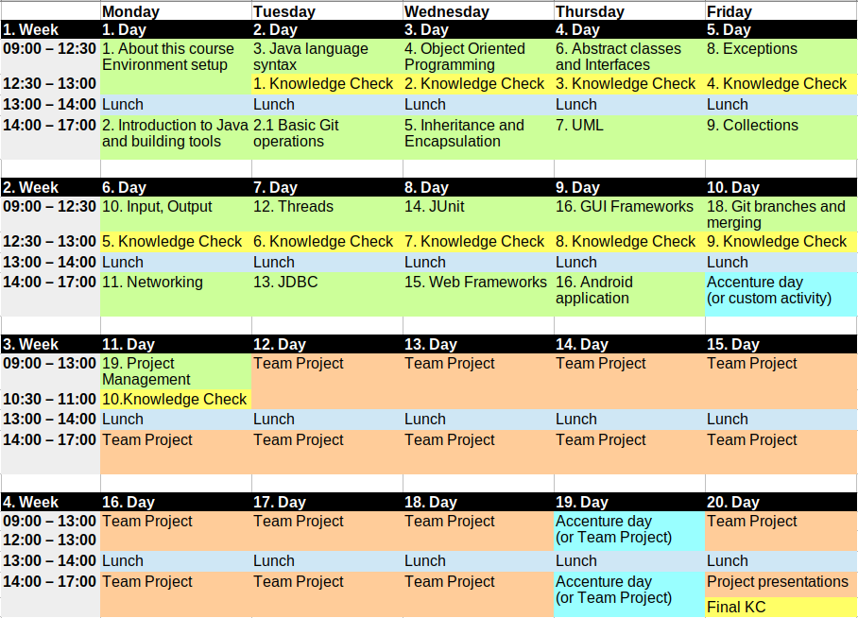
Course Map

Slide 11
Support levels
You are working in material rich environment and can use anything you can find
  In course materials and presentations
  In the sample project
  In the Internet
When dealing with problem use following approach:
  Help yourself looking at solutions on the web
  Ask your teammate close to you
  Ask competing team
  Ask teacher

Slide 12
Priority of information sources
As in any information rich course, different information sources can contradict
In this case priority of information in ascending order is:
  Internet (web particularly)
  Materials of the course
  What teacher says
It doesn't mean, you cannot oppose to teacher, but it means you need to convince him,
that other particular source is correct

Slide 13


Class resources
Other WiFis

Slide 14
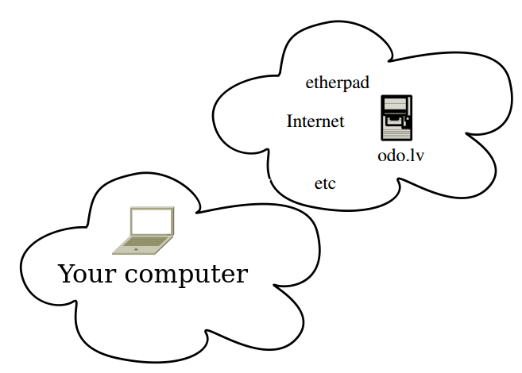
Class resources

Slide 15


Creation vs Consumption
How it is consumed and how it is prepared:
Users use proprietary Microsoft Windows and Office
Developers use Open Source e.g. Linux,
GNU tools, Java, MySQL, Tomcat, etc.

Slide 16

First task: prepare Linux workstation
In the course Linux workstations are used, because:
  Linux is the easiest operating system to develop in Java
  Linux has become the most popular operating system in cloud services
Open https://odo.lv/Training/Java and follow instructions in task:
  1. Preparation of workstation

Slide 17
Introduce yourself to the class
Please tell to the class:
  Your name and surname
  Where are you from
  Your relation to Accenture
  How did you get into course
  I have finished … course in … school
  Your self-assessed knowledge in programming:
    I'm (not) a programmer (if am, in which language, how long)
    I'm (not) familiar with Object-Oriented Programming (OOP)
    I (don't) have experience in Java and/or OOP (if have, how long)
Your expectations to this course
Tell something interesting about yourself
(what would enjoy us and could help to remember you)

Slide 18
Introduction Exercise
Please tell to the class:
  Your name and surname
  Where are you from
  Your relation to Accenture
  How did you get into course
  I have finished … course in … school
  Your self-assessed knowledge in programming
Your expectations to this course
Tell something interesting about yourself
(what would enjoy us and could help to remember you)
Use F9 to activate booting device menu, Select UEFI – UFD ...
  If there is OS installed already, choose:
  Erase disk and install Lubuntu
  Location: Riga, User: student,
  Password: Student007
  Computer name — first syllables of
  name and surname separated with dash, e.g., val-vit
  Language English or Latvian
Connect to wired network:
  Open on-line instructions:
  https://odo.lv/Training/Java
  Exercise: 1. Peparation of workstation

Slide 19
1. Exercise
Use F9 to activate booting device menu, Select UEFI – UFD ...
If there is OS installed already, choose:
Erase disk and install Lubuntu
Location: Riga, User: student,
Password: Student007
Computer name — first syllables of
name and surname separated with dash, e.g., val-vit
Language English or Latvian
Connect to wired network:
Open on-line instructions:
https://odo.lv/Training/Java
Exercise: 1. Peparation of workstation

Slide 20
Why wires and proxy server
archive.ubuntu.com
LTE 20Mb/s
proxy
WiFi router
Ethernet 1Gb/s
WiFi 50Mb/s

