Slide 1
Android Development

Slide 2
Agenda
Introduction to Android
Getting Started
Main Highligts of Programming

Slide 3

Why Android
The most popular mobile OS
https://www.statista.com/statistics/266136/global-market-share-held-by-smartphone-operating-systems/

Slide 4
What is Android
Android is an operating system for mobile devices such as smartphones and tablet computers.
It is developed by the Open Handset Alliance led by Google.
First release — 2008.
Currently supported versions (released):
  8.x Oreo (2017)
  9.x Pie (2018)
  10.x Android 10 (2019)

Slide 5

Android Architecture

Slide 6
Android Application Architecture
Android apps are written in Java
  Actually, a Java dialect (Apache Harmony)
  Everything we’ve learned still holds
  Recent Android Studio supports up to Java 8
Apps use four main components:
  Activity: A “single screen” that’s visible to user
  Service: Long-running background “part” of app (not separate process or thread)
  ContentProvider: Manages app data (usually stored in database) and data access for queries
  BroadcastReceiver: Component that listens for particular Android system “events”, e.g., “found wireless device”, and responds accordingly

Slide 7
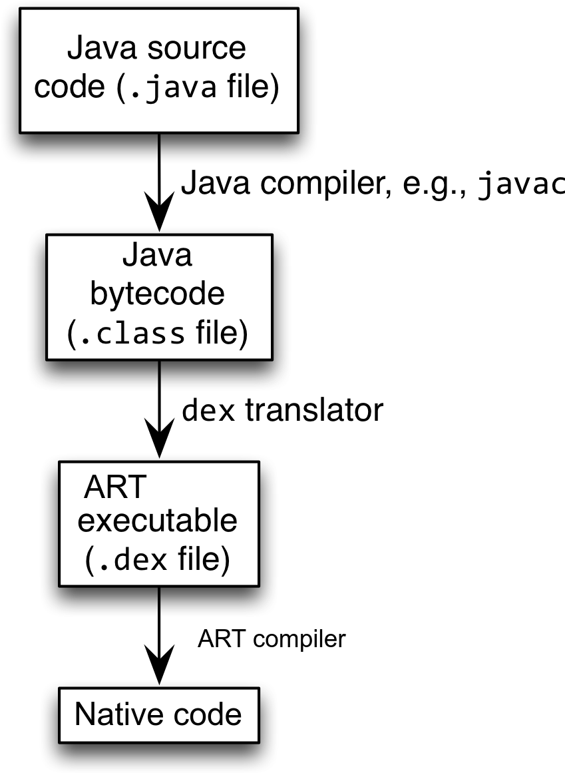
Android Execution Highligts
Android apps execute on ART (Android Runtime, previously Dalvik) VM, a “clean-room” implementation of JVM
  optimized for efficient execution
  Java source is compiled to .class file
  Java .class bytecode is translated to Dalvik EXecutable (DEX) bytecode
  Dex is translated to the native machine code and executed as native code
Compilation time
Runtime

Slide 8
App Manifest
Every Android app must include an AndroidManifest.xml file describing functionality
The manifest specifies:
  App’s Activities, Services, etc.
  Permissions requested by app
  Minimum API required
  Hardware features required, e.g., camera with autofocus
  External libraries to which app is linked, e.g., Google Maps library

Slide 9
The App Manifest
AndroidManifest.xml
<?xml version="1.0" encoding="utf-8"?>
<manifest xmlns:android="http://schemas.android.com/apk/res/android"
package="edu.osu.helloandroid"
android:versionCode="1"
android:versionName="1.0" >
<uses-sdk
android:minSdkVersion="8"
android:targetSdkVersion="17" />
<application
android:allowBackup="true"
android:icon="@drawable/ic_launcher"
android:label="@string/app_name"
android:theme="@style/AppTheme" >
<activity
android:name="edu.osu.helloandroid.MainActivity"
android:label="@string/app_name" >
<intent-filter>
<action android:name="android.intent.action.MAIN" />
<category android:name="android.intent.category.LAUNCHER" />
</intent-filter>
</activity>
</application>
</manifest>

Slide 10

Activity Lifecycle
Activity: key building block of Android apps
Extend Activity class, override onCreate(), onPause(), onResume() methods
Dalvik VM can stop any Activity without warning, so saving state is important!
Activities need to be “responsive”, otherwise Android shows user “App Not Responsive” warning:
  Place lengthy operations in Runnable Threads, AsyncTasks

Slide 11
Setting up tools
Download Android Studio from
  https://developer.android.com/studio/
General guide:
  https://developer.android.com/studio/install
Particularly on Ubuntu Linux
  Set up necessary libraries:
  sudo apt-get install openjdk-8-jdk
  sudo apt-get install gradle
  sudo apt-get install lib32z1 lib32ncurses5 libbz2-1.0 libstdc++6:i386
  Install recommended packages:
  sudo apt-get install android-tools-adb
  Extract files
  Run studio.sh file
On modern Linux, there is no need to install additional drivers or adjust hardware rules

Slide 12
App Creation Checklist
If you own an Android device:
  Ensure drivers are installed
  Enable developer options on device under Settings, specifically USB Debugging
    Go to Settings→About phone, tap on Build number 7 times to enable developer options
For Android Studio:
  Under File→Settings→Appearance, enable “Show tool window bars”; the Android view shows LogCat, devices
  Programs should log states via android.util.Log’s Log.d(APP_TAG_STR, “debug”), where APP_TAG_STR is a final String tag denoting your app
  Other commands: Log.e() (error); Log.i() (info); Log.w() (warning); Log.v() (verbose) – same parameters

Slide 13

Setting up VM
Strongly recommend testing with real Android device
  Android emulator: very slow
Bring up the Android SDK Manager
  Do not worry about Intel x86 Atom, MIPS system images
Settings
Now you’re ready for Android development!

Slide 14

Creating New App
Choose New Project… and complete setup wizard

Slide 15


Creating New App (1)
Creating Android app project in Android Studio:
  Go to File→New Project
  Enter app, project name
  Choose package name using “reverse URL” notation, e.g., edu.osu.myapp
  Select APIs for app, then click Next

Slide 16


Creating New App (2)
Determine what kind of Activity to create; then click Next
  We’ll choose a Blank Activity for simplicity
Enter information about your Activity, then click Finish
This creates a “Hello World” app

Slide 17

Deploying the App
Two choices for deployment:
  Real Android device
  Android virtual device
Plug in your real device; otherwise, create an Android virtual device
Emulator is slow. Try Intel accelerated version, or perhaps
http://www.genymotion.com/
Run the app: press “Run” button in toolbar

Slide 18
Underlying Source Code
src/…/MainActivity.java
package edu.osu.helloandroid;
import android.os.Bundle;
import android.app.Activity;
import android.view.Menu;
public class MainActivity extends Activity
{
@Override
protected void onCreate(Bundle savedInstanceState)
{
super.onCreate(savedInstanceState);
setContentView(R.layout.activity_main);
}
@Override
public boolean onCreateOptionsMenu(Menu menu)
{
// Inflate the menu; this adds items to the action bar if it is present.
getMenuInflater().inflate(R.menu.main, menu);
return true;
}
}

Slide 19
Underlying GUI Code
res/layout/activity_main.xml
<RelativeLayout xmlns:android="http://schemas.android.com/apk/res/android"
xmlns:tools="http://schemas.android.com/tools"
android:layout_width="match_parent"
android:layout_height="match_parent"
android:paddingBottom="@dimen/activity_vertical_margin"
android:paddingLeft="@dimen/activity_horizontal_margin"
android:paddingRight="@dimen/activity_horizontal_margin"
android:paddingTop="@dimen/activity_vertical_margin"
tools:context=".MainActivity" >
<TextView
android:layout_width="wrap_content"
android:layout_height="wrap_content"
android:text="@string/hello_world" />
</RelativeLayout>
– RelativeLayouts are quite complicated.

Slide 20

A Sampe WiFi App
We’ll now examine an app with more features: WiFi Tester
Press a button, scan for WiFi access points (APs), display them

Slide 21
Underlying Source Code (1)
@Override
public void onCreate(Bundle savedInstanceState)
{
super.onCreate(savedInstanceState);
setContentView(R.layout.activity_wi_fi);
// Set up WifiManager.
mWifiManager = (WifiManager) getSystemService(Context.WIFI_SERVICE);
// Create listener object for Button. When Button is pressed, scan for
// APs nearby.
Button button = (Button) findViewById(R.id.button);
button.setOnClickListener(new View.OnClickListener()
{
public void onClick(View v)
{
boolean scanStarted = mWifiManager.startScan();
// If the scan failed, log it.
if (!scanStarted) Log.e(TAG, "WiFi scan failed...");
}
});
// Set up IntentFilter for "WiFi scan results available" Intent.
mIntentFilter = new IntentFilter();
mIntentFilter.addAction(WifiManager.SCAN_RESULTS_AVAILABLE_ACTION);
}

Slide 22
Underlying Source Code (2)
Code much more complex
First get system WifiManager
Create listener Object for button that performs scans
We register Broadcast Receiver, mReceiver, to listen for WifiManager’s “finished scan” system event (expressed as Intent WifiManager.SCAN_RESULTS_
AVAILABLE_ACTION)
Unregister Broadcast Receiver when leaving Activity
@Override
protected void onResume()
{
super.onResume();
registerReceiver(mReceiver, mIntentFilter);
}
@Override
protected void onPause()
{
super.onPause();
unregisterReceiver(mReceiver);
}

Slide 23
The Broadcast Receiver
private final BroadcastReceiver mReceiver = new BroadcastReceiver()
{
@Override
public void onReceive(Context context, Intent intent)
{
String action = intent.getAction();
if (WifiManager.SCAN_RESULTS_AVAILABLE_ACTION.equals(action))
{
Log.e(TAG, "Scan results available");
List<ScanResult> scanResults = mWifiManager.getScanResults();
mApStr = "";
for (ScanResult result : scanResults)
{
mApStr = mApStr + result.SSID + "; ";
mApStr = mApStr + result.BSSID + "; ";
mApStr = mApStr + result.capabilities + "; ";
mApStr = mApStr + result.frequency + " MHz;";
mApStr = mApStr + result.level + " dBm\n\n";
}
// Update UI to show all this information.
setTextView(mApStr);
}
}
};

Slide 24
User Interface
Updating UI in code
UI Layout (XML)
private void setTextView(String str)
{
TextView tv = (TextView) findViewById(R.id.textview);
tv.setMovementMethod(new ScrollingMovementMethod());
tv.setText(str);
}
This code simply has the UI display all collected WiFi APs, makes the text information scrollable
<LinearLayout xmlns:android="http://schemas.android.com/apk/res/android"
xmlns:tools="http://schemas.android.com/tools"
android:layout_width="fill_parent"
android:layout_height="fill_parent"
android:orientation="vertical">
<Button
android:layout_width="fill_parent"
android:layout_height="wrap_content"
android:id="@+id/button"
android:text="@string/button_text"/>
<TextView
android:id="@+id/header"
android:layout_width="fill_parent"
android:layout_height="wrap_content"
android:text="@string/ap_list"
tools:context=".WiFiActivity"
android:textStyle="bold"
android:gravity="center">
</TextView>
<TextView
android:layout_width="fill_parent"
android:layout_height="fill_parent"
tools:context=".WiFiActivity"
android:id="@+id/textview"
android:scrollbars="vertical">
</TextView>
</LinearLayout>

Slide 25
Android Programming Notes
Android apps have multiple points of entry: no main() method
  Cannot “sleep” in Android
  During each entrance, certain Objects may be null
  Defensive programming is very useful to avoid crashes, e.g.,
  if (myObj != null) { // do something }
Java concurrency techniques are required
  Don’t block the “main” thread in Activities
  Implement long-running tasks such as network connections asynchronously, e.g., as AsyncTasks
Logging state via android.util.Log throughout app is essential when debugging (finding root causes)
Better to have “too many” permissions than too few
  Otherwise, app crashes due to security exceptions!
  Remove “unnecessary” permissions before releasing app to public
Event handling in Android GUIs entails many listener Objects

Slide 26
Concurrency: Threads (1)
Thread: program unit (within process) executing independently
Basic idea: create class that implements Runnable interface
  Runnable has one method, run(), that contains code to be executed
  Example:
  public class OurRunnable implements Runnable
  {
  public void run()
  {
  // run code
  }
  }
Create a Thread object from Runnable and start() Thread, e.g.,
Runnable r = new OurRunnable();
Thread t = new Thread(r);
t.start();
Problem: this is cumbersome unless Thread code is reused

Slide 27
Concurrency: Threads (2)
Easier approach: anonymous inner classes, e.g.,
Thread t = new Thread(new Runnable(
{
public void run()
{
// code to run
}
});
t.start();
Idiom essential for one-time network connections in Activities
However, Threads can be difficult to synchronize, especially with UI thread in Activity. AsyncTasks are better suited for this

Slide 28
Concurrency: AsyncTasks
AsyncTask encapsulates asynchronous task that interacts with UI thread in Activity:
public class AsyncTask<Params, Progress, Result>
{
protected Result doInBackground(ParamType param)
{
// code to run in background
publishProgress(ProgressType progress); // UI
…
return Result;
}
protected void onProgressUpdate(ProgressType progress)
{
// invoke method in Activity to update UI
}
}
Extend AsyncTask with your own class
Documentation at http://developer.android.com

