Slide 1



Tree Survival Prediction

Slide 2
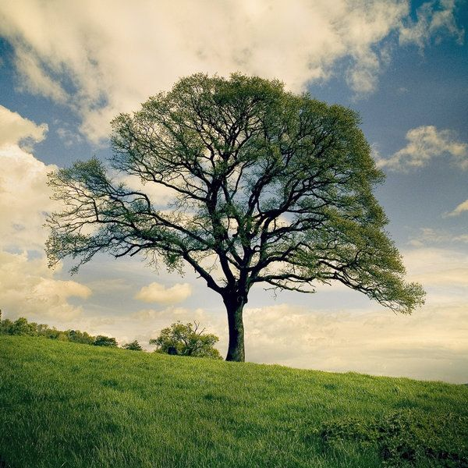
Introduction & The Dataset
Source: Kaggle
Project Goal: Survival Analysis in a real Use Case.
Defining the Core Variables:
Time (T): Duration (in days) the seedling survived
Event (E): Status of the seedling (1 = Dead, 0 = Censored/Harvested).

Slide 3
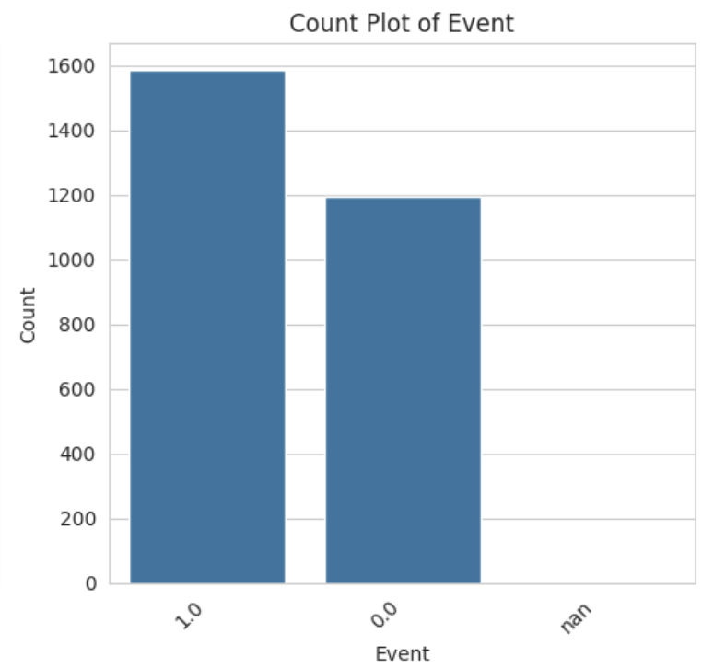
EDA & CLEANING
Initial dataset: 2783 seedling records
The Challenge: Severe missing data (EMF: 54% missing, Alive/Harvest: >75% missing)
The Solution:
Mean Imputation: Replaced missing EMF values with the column mean.
Leakage Prevention: Removed Census, Alive and Harvest columns, which were recorded at the end of the study

Slide 4
Baseline Survival & Group Comparisons
The Baseline
Testing Assumptions
The Surprise Finding
Kaplan-Meier curve shows the overall probability of seedling survival dropping over time.
Applied the Log-Rank test to compare survival across Light Categories (Low, Medium, High).
No statistically significant difference in survival distributions based solely on light (p > 0.05 for all comparisons).

Slide 5
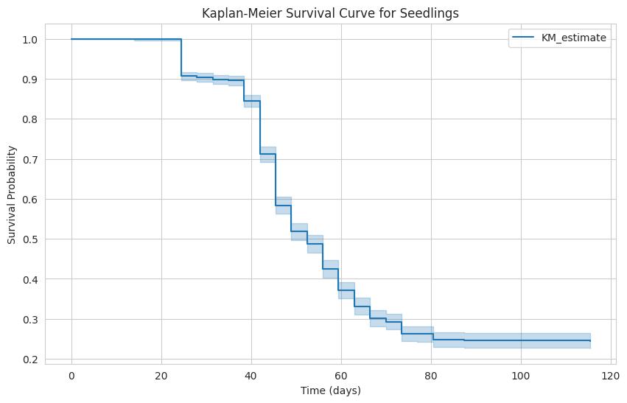

Slide 6
Quercus rubra (Red Oak) demonstrated a 51% lower
Multivariate Analysis: Cox Proportional Hazards
Approach: Evaluated all features simultaneously using a CoxPH model with regularization
Significant Protective Factors: Major Risk Factors:
Fungal Symbiosis: Mycorrhizal association (Myco_EMF) decreased the hazard of death by 57% (HR 0.43).
Species Resiliency: Quercus rubra (Red Oak) demonstrated a 51% lower mortality risk (HR 0.49).
Light Exposure: High light intensity (Light_ISF), drastically increased mortality risk with a HR 4.09.
Adult Proximity: Soil/proximity to Adult trees showed mixed effects (HRs fluctuating above and below 1), indicating complex local resource competition.

Slide 7
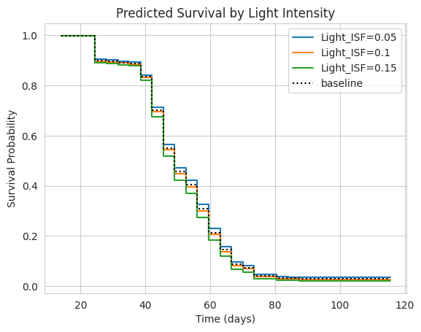

Slide 8
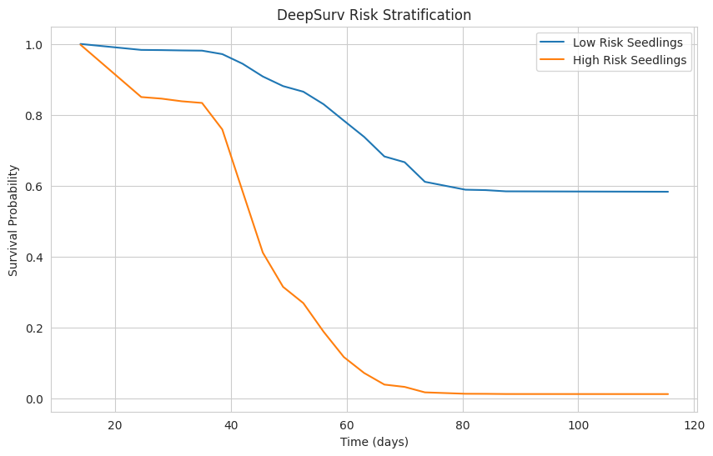
Deep Learning Approach: DeepSurv
The Architecture: Implemented a Multi-Layer Perceptron (MLP) using PyTorch and the pycox library
Model Performance: C-index of 0.7396
Risk Stratification: The model successfully bifurcates the test dataset into distinct risk profiles:
High Risk (Orange):Near-total mortality by day 70.
Low Risk (Blue): Stabilizes at a ~60% survival probability.

Slide 9
Key Insight: The similar performance indicates that environmental impacts on seedling survival are direct and linear. A complex 'black box' model is not required to understand these tree dynamics.
Baseline Performance: CoxPH achieved a Test C-Index of 0.7608
Modern Approach: DeepSurv achieved a Test C-Index of 0.7396
Model Evaluation & Final Insights
Advice for the Forestry Expert
Focus reforestation efforts on Quercus Rubra and other high-resiliency species identified by the model
Inoculate soil with EMF mycorrhizal fungi prior to planting.
Manage adult tree proximity and actively shield seedlings from extreme direct light (High ISF).

