Slide 1

Footbased Activity Recognition
Alphan Yilmaz
Alexey Nevezhin
Anastasia Kryzhanovskaya
Anna Sinitsyna

Slide 2
Subtasks
Design a foot-based movement recognition system for interacting with KPMG Dashboards
Come up with user-friendly foot movements
Interface with provided sensors (Gyroscope, Accelerometer, Magnetometer)
Sample data
Use machine learning on the data samples to differentiate between foot movements
Design a user interface

Slide 3
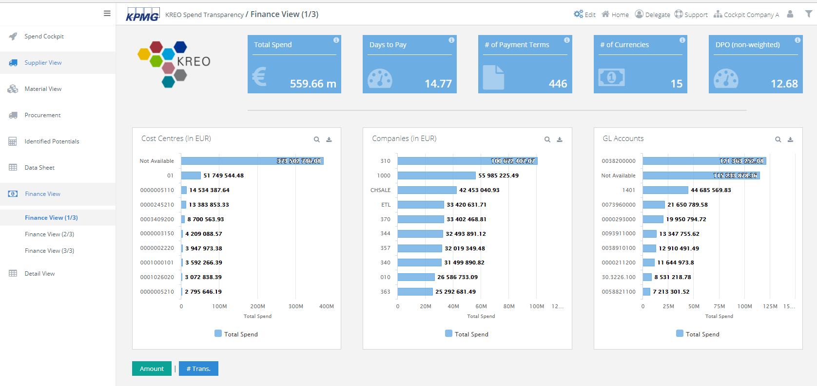
Dashboard

Slide 4
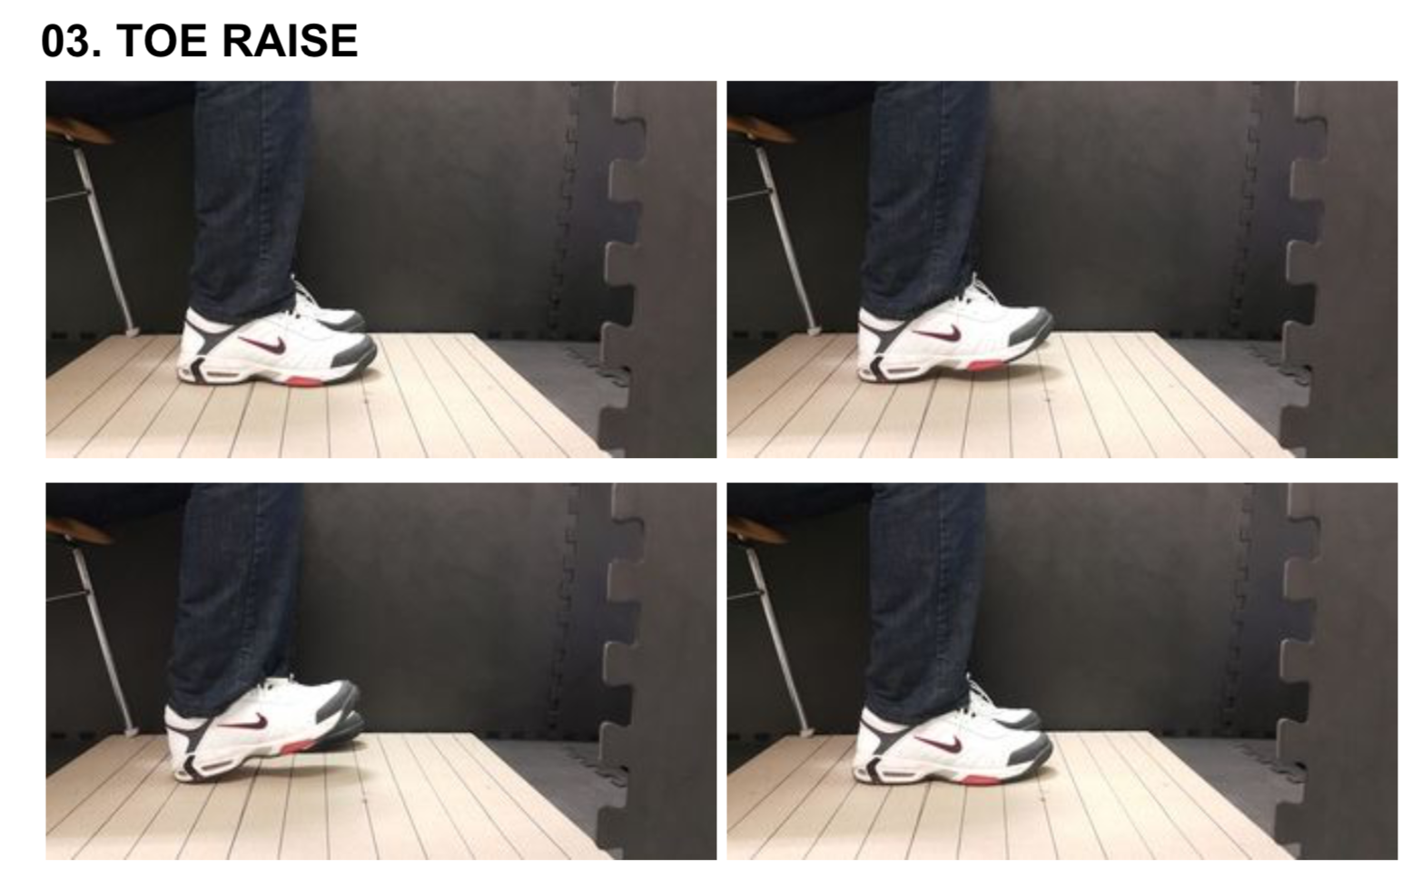
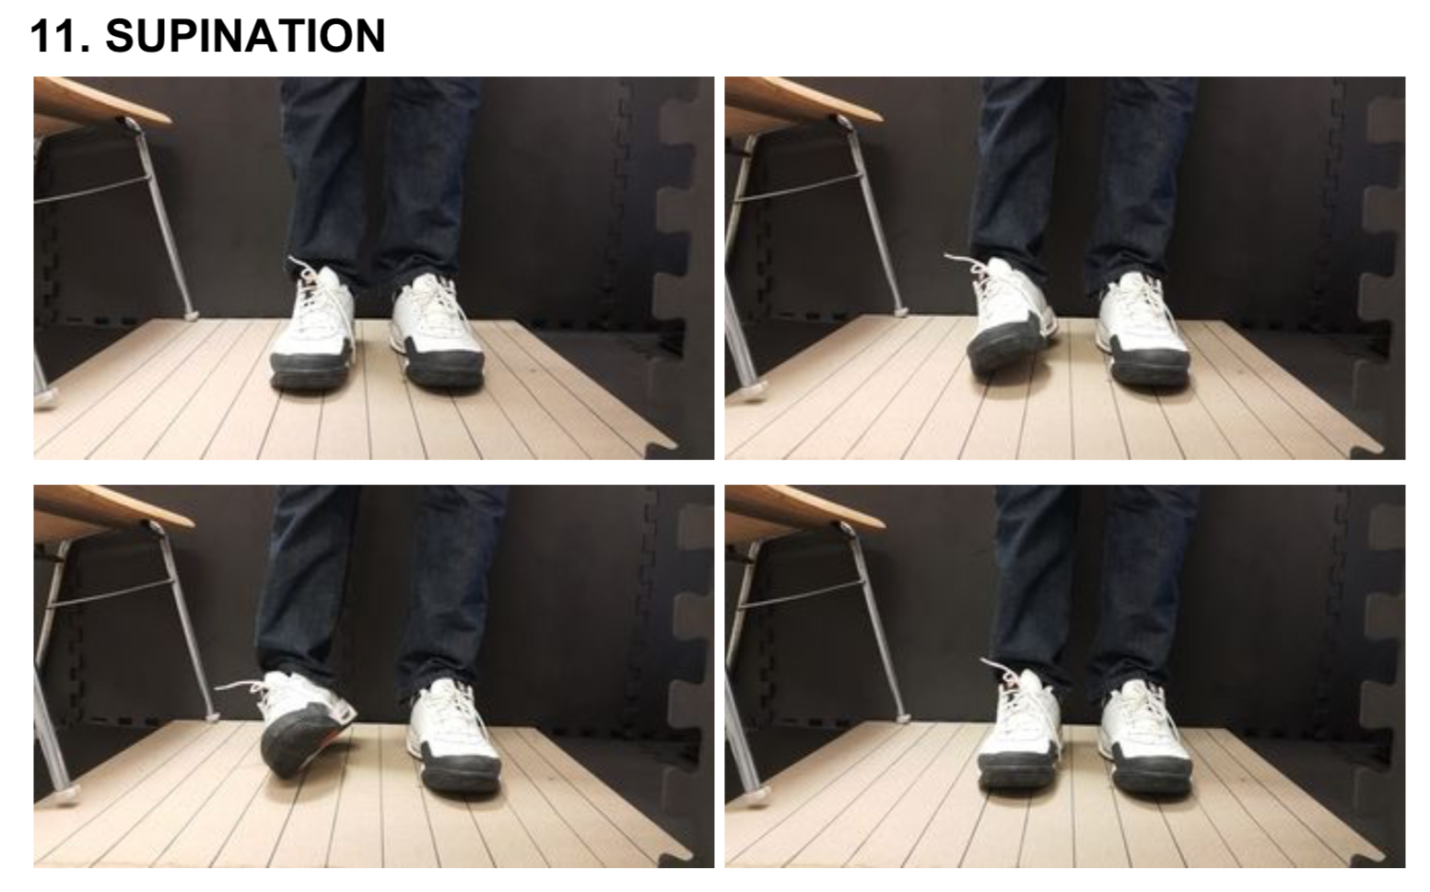
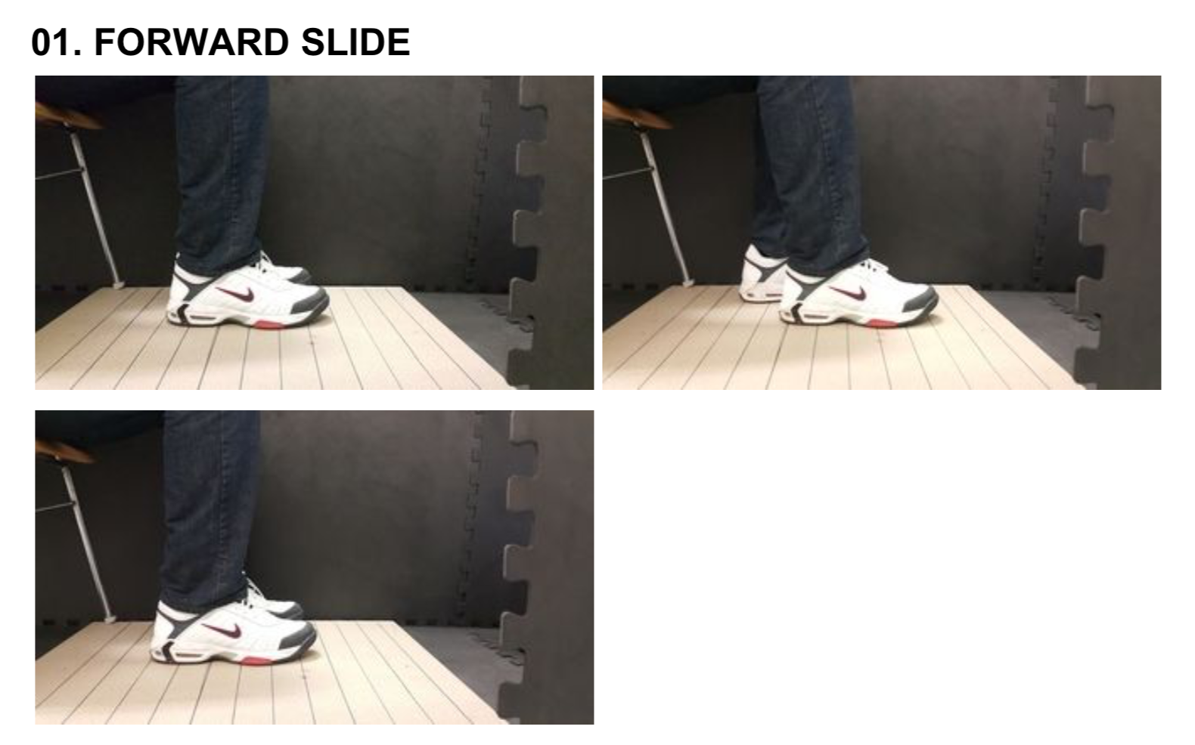
Movement examples

Slide 5
Hardware
Hier das Bild von den Sensoren?

Slide 6
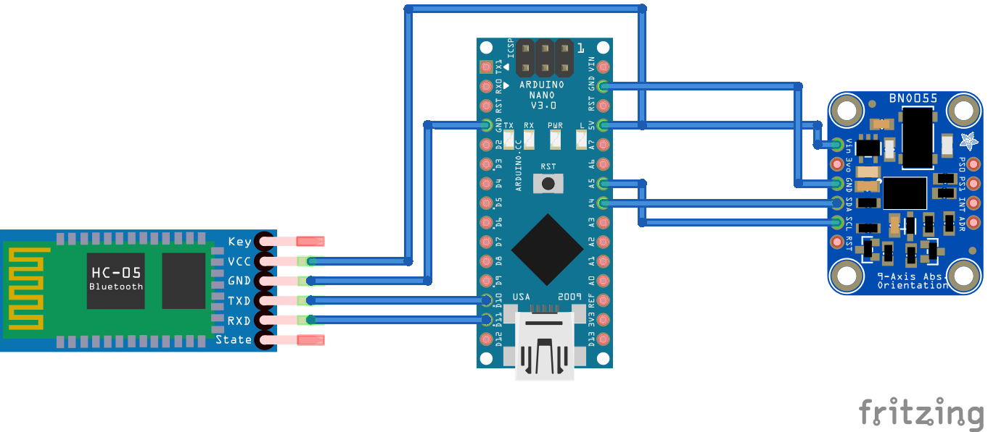
Hardware scheme

Slide 7
Software
Noch besprechen

Slide 8
Demo

